Slide 1
Team Two Improving 3Blueprints.com
CS 673
SPRING 2016

Slide 2
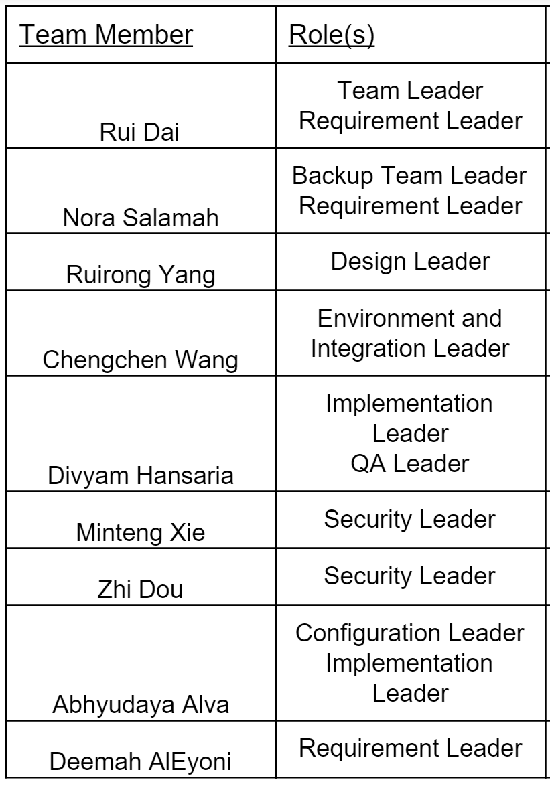
Team Overview
Weekly meetings.
Weekly reports.
Minutes of meetings report.
Slack communication.
Google Docs.

Slide 3
Project Overview
The objective of the project is to:
Redesign the Requirements Tracker Tool in 3blueprint.com.
Fix some existing bugs.
Extend some of the essential features.
Agile methodology.
The project will go through 3 iterations:
1st iteration is due by 3/2.
Training.
Testing
2nd iteration is due by 3/29.
Fix bugs.
3rd & final iteration is due by 4/27.

Slide 4
Project Tools
Communication:
Slack
GoogleDocs
Programming languages and tools:
Pycharm
Django
SQL
Version Control:
GitHub
Requirement & project status:
Pivotal Tracker

Slide 5
High Level Requirements
 | Functional Requirements | Non Functional Requirements
Essential | A new User should be able to sign up for an account. A user should be able to log in to the system if they have an account. An admin should be able to assign various roles for different users. Each story should have a status that updates depending on the break down of its tasks Improve the User interface . A user should be able to generate reports of the stories (as excel sheet). A user should be able to attach documents. | The system should automatically logout if the user is inactive for more than 10 minutes. Database remodeling.
Desirable | Each user will have a Notification bar.

Slide 6
Risk Management Plan
Risk ID | Risk Event | Impact of Risk | Risk Prevention Mechanism | importance
1 | Absence of any of the project team members.(sick/dropped class) | Progress on the project will be jeopardized. | Have backup for each member. | Medium
2 | Unexpected interruption such as snow days. | Progress on the project will be jeopardized. | Continue working on project as planned, have meetings online or through google hangouts. | Low
3 | Different experience level of team members. | Delay task completion and project. | Try to divide team to subgroups. Each having an experienced member to try to help the rest. | High
4 | Iteration requirements or task not completed at end of iteration. | Progress on the project will be jeopardized. | Have a meeting and prioritize the requirements and plan next iteration accordingly. | High

Slide 7
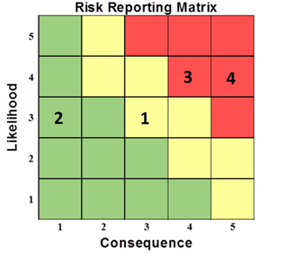

Slide 8
Challenges & Improvement Process
Working on existing project.
Short time to self learn new software, frameworks, languages.
Git
Django
Python
Lack of work experience.
Communication of big team.
Improvement Process:
Divide tasks from beginning.
Create subgroups for easier communication.
Each subgroup responsible for specific tasks.

Slide 9
Thank you!

