Slide 1

CS418: Databases & Software Development

Slide 2
Lesson 11
MongoDB – Querying, the Aggregation Framework and Data Modeling

Slide 3

CS418 Databases and Software Development
Maharishi International University
Department of Computer Science
Except where otherwise noted, the contents of this document are Copyrighted. All rights reserved. Any redistribution, reproduction, transmission, or storage of part or all of the contents in any form is prohibited without the author's expressed written permission. Slides have been modified for Maharishi University of Management Computer Science course CS572. Credit goes to: Andrew Erlichson, Shaun Verch, Richard Kreuter.

Slide 4

Maharishi University of Management - Fairfield, Iowa
© 2018
All rights reserved. No part of this slide presentation may be reproduced or utilized in any form or by any means, electronic or mechanical, including photocopying or recording, or by any information storage and retrieval system, without permission in writing from Maharishi University of Management.

Slide 5
Document Data Model
A record in MongoDB is a Document
Structure of key/value pairs
Values may contain other documents (embedded documents), arrays and arrays of documents (rich document).
{
_id: 1,
name: "Asaad",
email: "asaad@mum.edu",
courses: ["CS472", "CS572"]
}

Slide 6
Document Implications
Documents (objects) correspond to native data types in many programming languages.
Embedded documents & arrays reduce the need for expensive joins.
Dynamic schema supports fluent polymorphism: A polymorphic type is one whose operations can also be applied to values of some other type(s)
Atomic transaction on the document level.
Atomic transaction: is either all occur or nothing occur.
Notes:
Dynamic schema supports fluent polymorphism: A polymorphic type is one whose operations can also be applied to values of some other type(s)
http://stackoverflow.com/questions/36946572/meaning-of-dynamic-schema-supports-fluent-polymorphism-in-mongodb-doc
A polymorphic type is one whose operations can also be applied to values of some other type, or types. Lets have an example,consider the following mongodb collection of cars
A basic car structure
{ "TYPE": "BASIC CAR", "MAX_SPEED": 100, "MILEAGE": 20, "GEARS": 4, "FEATURES": [ { "AC": "yes" } ] }The first 4 keys will be same for almost all cars ----> polymorphic type
A sports car
{ "TYPE": "SPORTS CAR", "MAX_SPEED": 300, "MILEAGE": 10, "GEARS": 8, "FEATURES": [ { "AC": "yes" }, { "NITRO": "yes" }, { "NAVIGATION": "yes" }, . . . . ... so on ] "ADVANCED PROTECTION" : "yes", "SENSORS" : [ {"OBSTACLE" : "yes"} ] }
The sports inherits the features of BASIC CAR and also has some its own features, that's satisfies Polymorphism.
And coming to the part Dynamic Schema we can see that structure of document is different for both documents MongoDB won't restrict to a particular structure so that's satisfies Dynamic Schema.

Slide 7
Data Types
The value of a field can be any of the BSON data types, including other documents, arrays, and arrays of documents.
var mydoc = {
_id: ObjectId("5099803df3f4948bd2f98391"),
name: { first: "Asaad", last: "Saad" },
birth: new Date('Oct 31, 1979'),
courses: [ "CS472", "CS572" ],
students : NumberLong(1250000)
}

Slide 8
BSON
BSON, short for Bin­ary JSON, is a bin­ary-en­coded seri­al­iz­a­tion of JSON-like doc­u­ments.
Both JSON and BSON sup­port Rich Documents (em­bed­ding doc­u­ments and arrays with­in oth­er doc­u­ments and ar­rays).
BSON also con­tains ex­ten­sions that al­low rep­res­ent­a­tion of data types that are not part of the JSON spec. (For ex­ample, BSON has a BinData ObjectId, 64 bits Integers and Date type…etc)
En­cod­ing data to BSON and de­cod­ing from BSON can be per­formed very quickly in most lan­guages. For example, integers are stored as 32 (or 64) bit integers and they don't need to be parsed to and from text.

Slide 9
Schema and Agile Structure
By default, a collection does not require its documents to have the same schema, the documents in a single collection do not need to have the same set of fields and the data type for a field can differ across documents within a collection.
To add more information to a table in relational DBMS, we need to add more columns to the table (which might leave many null values) or add new table.
MongoDB is agile, there will be no need to have same structure in documents. Every document can have its own structure.
(Starting of MongoDB 3.2, you can enforce document validation rules for a collection during update and insert operations)
Notes:
Students in Sept. Like this slide!!!!!!!!!!!!!!!!!!!
db.testCol.save({a:1, b:2})
db.testCol.save({a:3, b:4})
var doc = db.testCol.findOne({a:1}) // {_id:ObjectId(...), a:1, b:2}
doc.fruit = ["apple", "orange"]
db.testCol.save(doc) // upsert
db.testCol.find().pretty()

Slide 10
Collections
MongoDB stores documents in collections. (Collections are similar to tables in relational databases)
If a database/collection does not exist, MongoDB creates the db/collection when you first store data for that collection
use myNewDB
db.myNewCollection.insert( { x: 1 } )
The insert() operation creates both the database myNewDB and the collection myNewCollection if they do not already exist.
Notes:
MongoDB provides the db.createCollection(name, options) method to explicitly create a collection with various options, such as setting the maximum size or the documentation validation rules.

Slide 11
General Rules
Field names are strings.
The field name _id is reserved for use as a primary key. It is immutable and always the first field in the document. It may contain values of any BSON data type, other than an array.
The field names cannot start with the dollar sign ($) character and cannot contain the dot (.) character or null. Field names cannot be duplicated.
The maximum BSON document size is 16 megabytes. (To store documents larger than the maximum size, MongoDB provides the GridFS API)

Slide 12
Modeling Introduction
// posts collection
{ title: '',
body: '',
user: '', // no need for ID
date: '',
comments: [ {user: '', email: '', comment: ''},
{user: '', email: '', comment: ''}]
tags: ['', '', ''] }
// authors collection
{ user:'',
password:''}
Why did we embed tags or comments? Rather than have them in separate collection? Because they need to be accessed at the same time we access the post. We don’t need to access comments or tags independently without accessing the post.
Given the document schema that we proposed for the blog, how many collections would we need to access to display the blog home page?
Notes:
Given the document schema that we proposed for the blog, how many collections would we need to access to display the blog home page? One only!

Slide 13
MongoDB Schema Design
In MongoDB we use Application-Driven Schema, which means we design our schema based on how we access the data.
Note: The only scenario we cannot embed is when data exceeds 16 MB and we need to put it in separate collection.
Notes:
Remember the key features of MongoDB:
Rich documents (arrays, other documents)
Embed data (pre-joins)
No constrains (no FK)
Atomic operations within one document (No transactions)
No declared schema

Slide 14


Third Normal Form
Post_id | Title | Body | Author | Author_email
1 | Post1 | Body1 | Author1 | auth1@gmail.com
2 | Post2 | Body2 | Author1 | auth1@gmail.com
3 | Post3 | Body3 | Author2 | auth2@gmail.com
DB should be free of modification
Minimize the redesign when extending
Avoid any bias toward any particular access pattern
In case we want to change the email address of the author we will need to update many records!
Notes:
We will not modify the DB. Mongo is designed to be schema free! Each document CAN have its own structure.
Again, Schema free DB means we can redesign and extend with no problems
Mongo is in opposition to the third rule, as we tend to design our data based on how we access them!

Slide 15
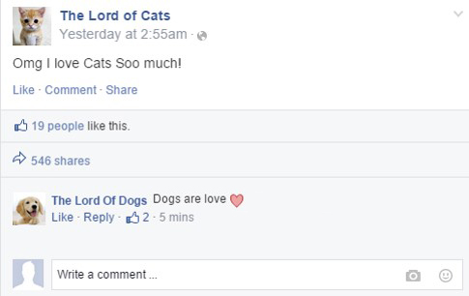
Design Considerations
Posts
users
{ _id,
user_id
title,
body,
shares_no
date }
{ _id,
name,
email,
password }
comments
post_likes
{ _id,
user_id,
post_id
comment_text
order }
{ post_id,
user_id }
Remember that we don’t have constrains, so this design will not work as we need to perform too much work (4 joins) in the code to retrieve our data

Slide 16
Design Considerations
{
_id: objectId(),
user: 'user1', // use it as ID
title: '',
body: '',
shares_no: 0,
date: ,
comments: [
{user:'user2', comment_text:''},
{user:'user3', comment_text:''}]
likes: [ 'user1', 'user2']
}
This design is optimized for data access pattern so we can access the information much faster with 1 query. Especially that there is no need for data to be updated later.

Slide 17
Transactions vs Atomic Operations
In the world of relational DB, our data is usually located in many tables, so in order to update something, we will need to access all these tables and perform the update on all of them in one Transaction.
In MongoDB, our data is usually located in one document, and because most operations are Atomic, we accomplish the same thing without the need for transactions.
Try to restructure your design to use less documents as possible (with one document we guarantee Atomic operations)

Slide 18
To embed or not to embed
One-to-One relation
Linking is fine
Embed in either sides is fine
Embed in two side is fine
One to Many relation
Use linking when large data and have separate collections
Use Embed when One-to-Few
Many to Many relation
Embed is better with Few-to-Few
Linking is better for performance in large data
employee: resume
building: floor plan
patient: medical history
The only scenario we cannot embed is when data exceeds 16 MB and we need to put it in separate collection.
city: people
post: comments
books: authors
students: teachers
Notes:
Linking: Two collections with shared IDs
Embed: One collection that has all information

Slide 19
Considerations
Take into considerations the following
Frequently of access and the way you want to access the data
Size of items (16M)
Atomicity of data
Benefits of Embedding
Improved read performance
One round to the DB

Slide 20
Import/Export JSON in MongoDB
mongoimport -d dbName -c colName file.json
Note: mongoimport and mongoexport might not work very well with rich documents.
Instead you may use
mongodump –db dbName and mongorestore for full support of rich documents.
Database
Name
Collection
Name
JSON File
{ "student" : "Saad", "assignment" : "hw1", "grade" : 90 }
{ "student" : "Saad", "assignment" : "hw2", "grade" : 80 }
{ "student" : "Saad", "assignment" : "hw3", "grade" : 85 }
...
mongoexport -d dbName -c colName -o file.json
Database
Name
Collection
Name
JSON Output File

Slide 21
MongoDB in the Cloud
Atlas is a fully managed cloud database service featuring automated provisioning and scaling of MongoDB databases.
Atlas's Database-as-a-Service platform powers databases across AWS, Azure, and Google Cloud Platform.
Other options:
Use Mongo Docker container

Slide 22

What's Docker?
Docker is a software platform that allows you to build, test, and deploy applications quickly. Docker packages software into standardized units called containers that have everything the software needs to run including libraries, system tools, code, and runtime. Using Docker, you can quickly deploy and scale applications into any environment and know your code will run.
Deciding on the specs of the rail tracks…. so we can concentrate on building better trains….
Notes:
When you start an "image" it becomes a "container"

Slide 23

What are Containers?
Containers are a method of operating system virtualization that allow you to run an application and its dependencies in resource-isolated processes. Containers allow you to easily package an application's code, configurations, and dependencies into easy to use building blocks that deliver environmental consistency, operational efficiency, developer productivity, and version control.
Containers can help ensure that applications deploy quickly, reliably, and consistently regardless of deployment environment.

Slide 24
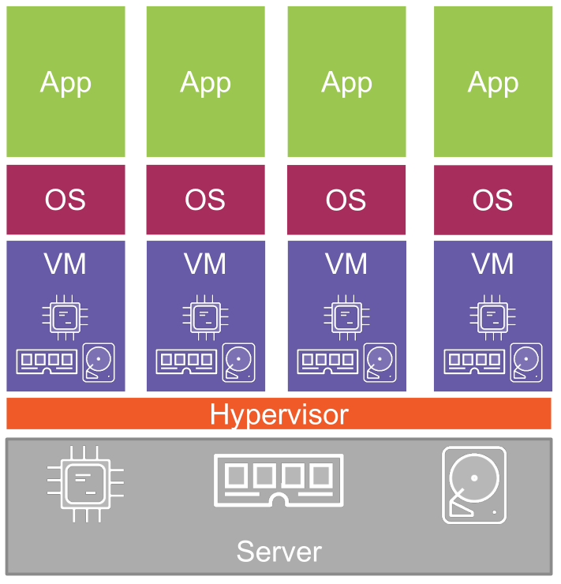
Hypervisor Architecture
Hypervisors allow multiple apps per server
Each OS:
• Uses CPU
• Uses RAM
• Uses disk
• May have license cost
• Requires admin time
More efficient than physical servers

Slide 25
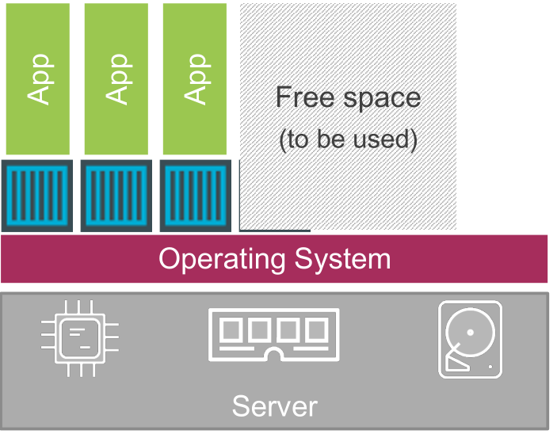
Container Architecture
Open source (Apache License 2.0)
Some of the biggest names in the industry involved
Billions of image pulls
Over 240K Repositories
Over 5 million image pulls per day
The Open Container Initiative (Open standards/specs)
More efficient than Hypervisor virtualization

Slide 26
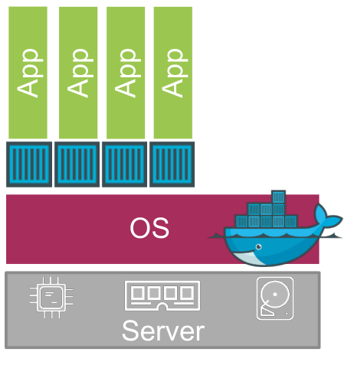

Using Docker
docker pull tutum/mongodb
docker images
docker rmi <IMAGE_ID>
docker run -d -p 27017:27017 -p 28017:28017 tutum/mongodb
docker ps –a
docker stop <CONTAINER_ID>
docker rm <CONTAINER_ID>
The first time that you run your container, a new random password will be set. To get the password, check the logs of the container:
docker logs <CONTAINER_ID>
You can then connect to MongoDB:
mongo admin -u admin -p 5elsT6KtjrqV
Docker Image
Docker Container
Notes:
https://hub.docker.com/
rmi remore image
ps list containers (-a all = Show all containers (default shows just running))
-d detach (Run container in background and print container ID)
-p publish to port

Slide 27

Exercise – Schema Design
Create a NoSQL design model for an application to manage a library, taking into consideration the following requirements:
Books have an ISBN number and are categorized by author and tagged by keywords to facilitate search
Books can be borrowed by students, so the librarian will be able to check all borrowed books and their return date so he may contact students who are late returning their books.
Notes:
Add suggested indexes you must have for your collections

