Slide 1
Overview of Partner Operations Q2 2020- Q1 2021

Slide 2




The Pipeline
Opportunities
Channel
Managers
Partners
Sales
Notes:
The first step in any data analysis problem is to understand the business model. From the model we can begin to understand what our data represents and how analysis might help shed insights that solve business problems and improve business efficiency.
Looking at our model, all opportunities are funneled through the partners. Each Partner is assigned a unique channel manager and together they foster opportunities into sales.

Slide 3



Qualify
Problem
Solution
Proof
Agreement
Order
Sales Pipeline
When the dust settles, there should be approximately
68% Lost
32% Won
475 Opportunities
475 Opportunities
1002 Opportunities
Notes:
Our sales pipeline consists of 6 steps with two eventual outcomes. One being downgraded, the other a winning sale. Looking at our data, 28% of the opportunities are still active. However, if we assume the business processes have been roughly constant, we can extrapolate that the overall churn of customers is around 68%. Meaning 32% should end in sales. If processes would allow it, I think there would be a great benefit to tracking where is the sales process opportunities are lost. Having details about which step in the process are accounting for what percentage of the lost opportunities would make targeted business changes more precise.

Slide 4
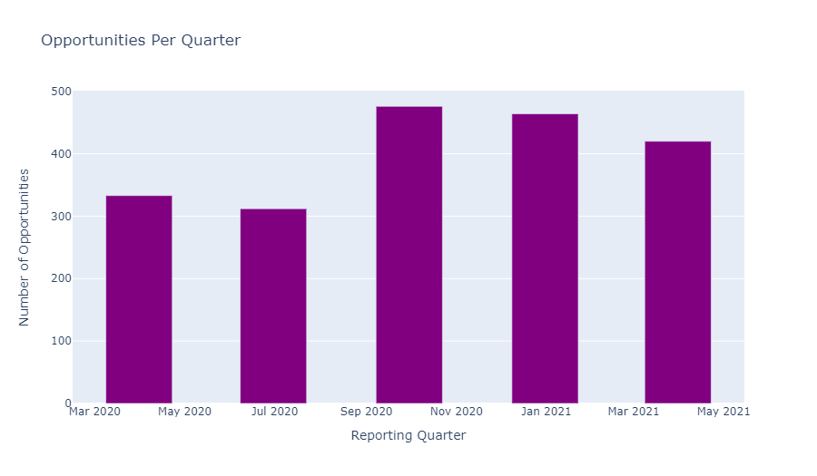
Our opportunities
Notes:
From these 5 quarters there does appear to be an upward trend in the rate of opportunities per quarter.

Slide 5
Partners

Slide 6

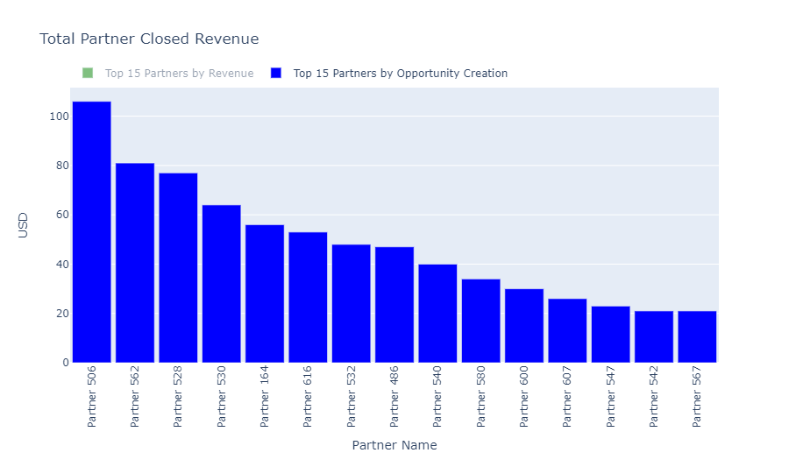
TOP 15 Partners for opportunities
Notes:
Ranking partners by opportunity creation in my mind is a ranking of potential. The partners appear to follow more of an exponential curve in terms of overall opportunity creation. I like to call this a power users graph, by which I mean that a relatively few number of partners account for a substantial percentage of the opportunities.

Slide 7
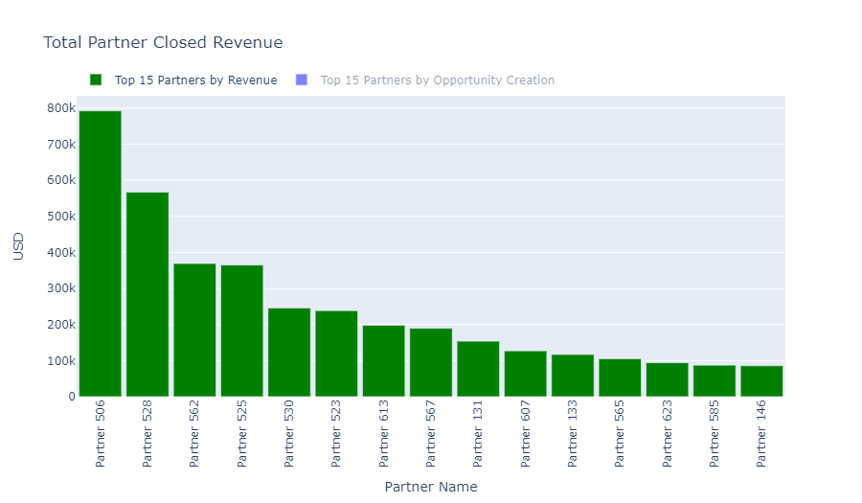
TOP 15 Partners for Closed revenue
Notes:
In addition, I think tracking partner revenue is equally important when considering who our best partners are. Many of the names overlap, but not all. Which brings me to the following slide.

Slide 8

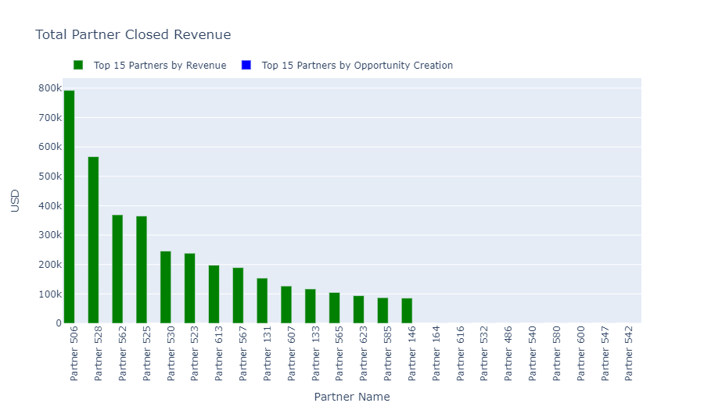
Notes:
While less effective than I would like as a digestible visual, it does show some interesting information. The list of partners shown on the x-axis are the combined lists of the two top 15 graphs. For the most part they overlap, but I want to call attention to the partners missing bars towards the right hand side of the graph. The lack of showing revenue implies, that while these partners are meaningfully contributing to opportunity creation, the given opportunities are disproportionally failing to yield sales. I recommend investigating the underperforming partners and their channel managers to see if there are process issues that could be fixed with a little elbow grease.

Slide 9

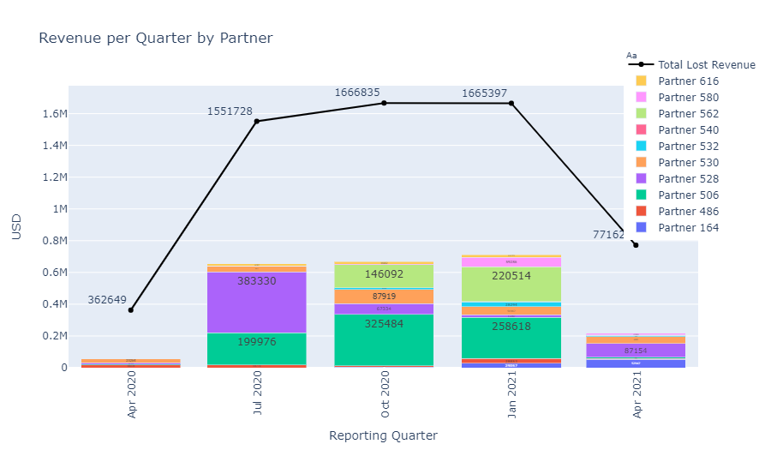
Understanding Partner revenue contributions
Notes:
Taking the top 10 of partners by opportunity creation, we see again that there are power users even among the top partners, namly: 506, 562, 528 and 530. On average, these top 10 partners are accounting for roughly 35% of the total closed on revenue. And I mean to make the distinction that this graph is only showing closed sales and not any pending items that haven’t resolved.

Slide 10

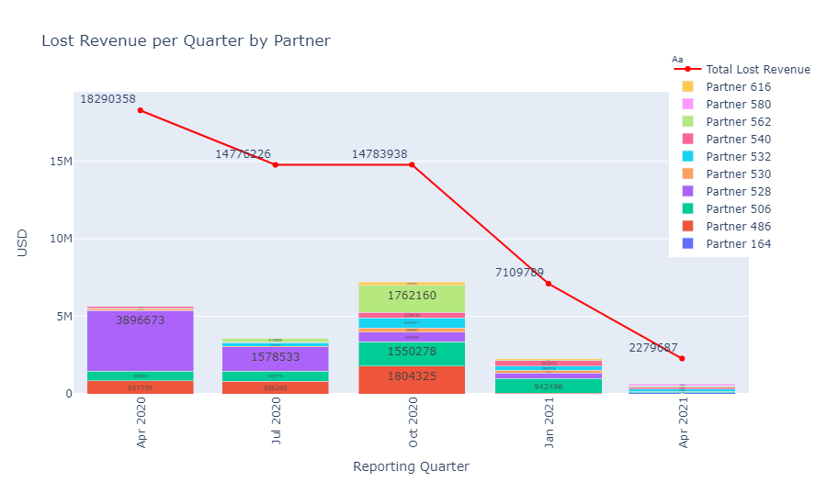
Missed Opportunities
Notes:
Here we have the same idea but with the lost revenue. Unsurprisingly, many of the top 10 partners by opportunity creation also account for a significant portion of the lost revenue. However, we again see that certain partners, the most obvious being 486, are clearly represented here, but not on the previous graph. I think it’s certainly worth pointing out that lost revenue is on a steep downward trend. Given that revenues have increased on average over this 5 quarter period, this is very encouraging and not diminished by a commiserate drop in revenue.

Slide 11
Channel Managers

Slide 12
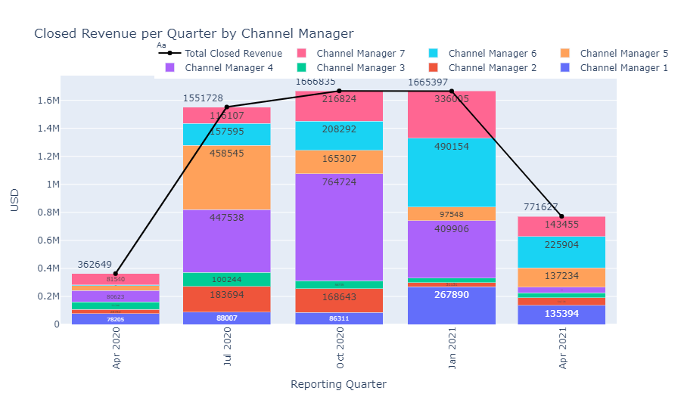
Channel Manager Contributions
Notes:
With only 7 channel managers we get a much more complete picture of the overall contributions. The graph here shows mixed results in terms of trends. Because we’re working with such a small time frame, getting a true sense of what’s a trend vs what’s seasonal is difficult. As for the managers, 4, 6 and 7 are the clear leaders for closed revenue.

Slide 13
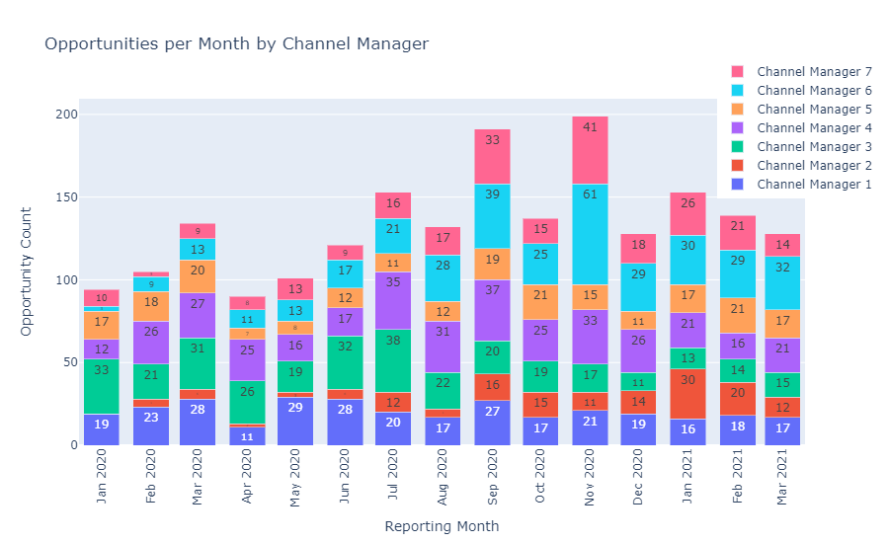
Monthly Contributions
Notes:
This is just a fun slide that shows the previous visual at a monthly level. I personally like this chart because it offers a little bit more insight into sales trends. If I were to make an estimated guess from this chart I would say that Q1 has a typical dip in revenue as a result of the business sales cycle.

Slide 14
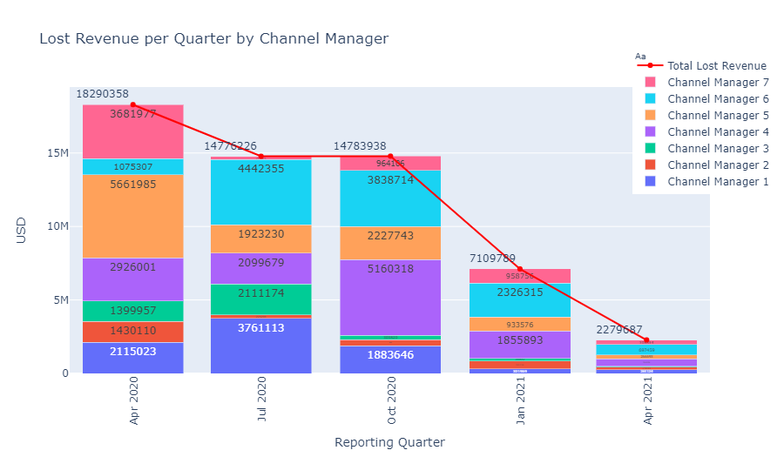
Missed Opportunities
Notes:
This is essentially the same graph we inspected during the partners phase but broken out by channel manager.

Slide 15
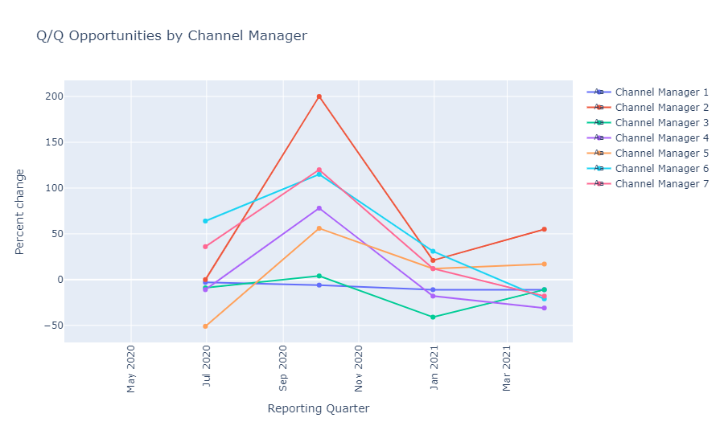
Q/Q opportunity creation by channel manager
Channel Managers Quarter over Quarter

Slide 16
Revenue Predictions

Slide 17
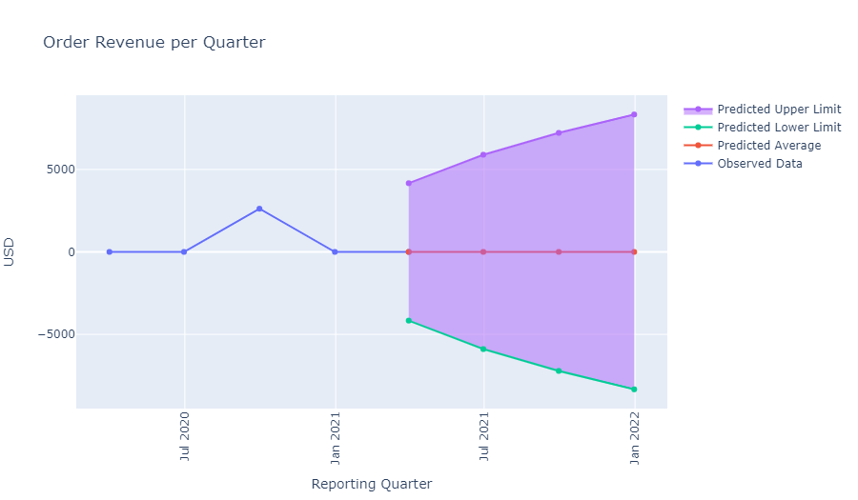
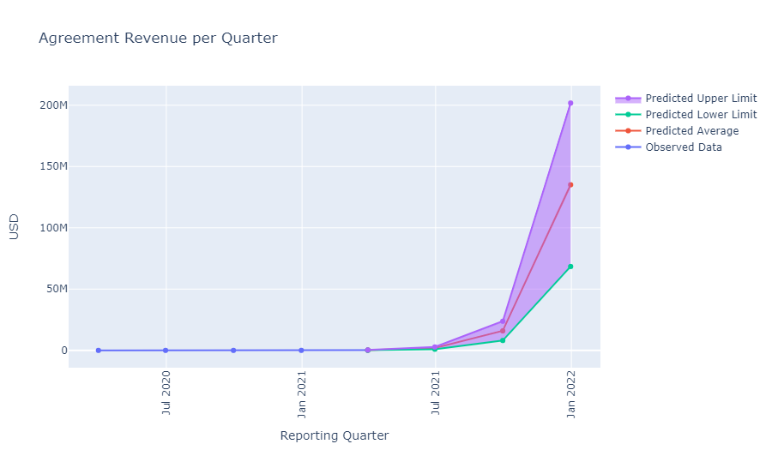
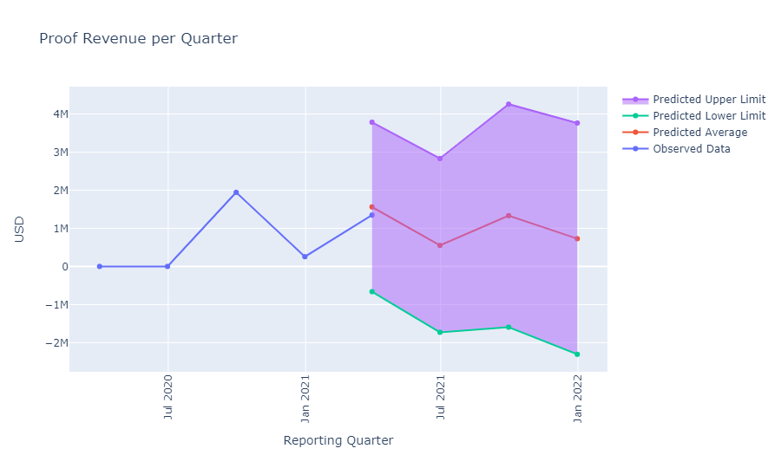
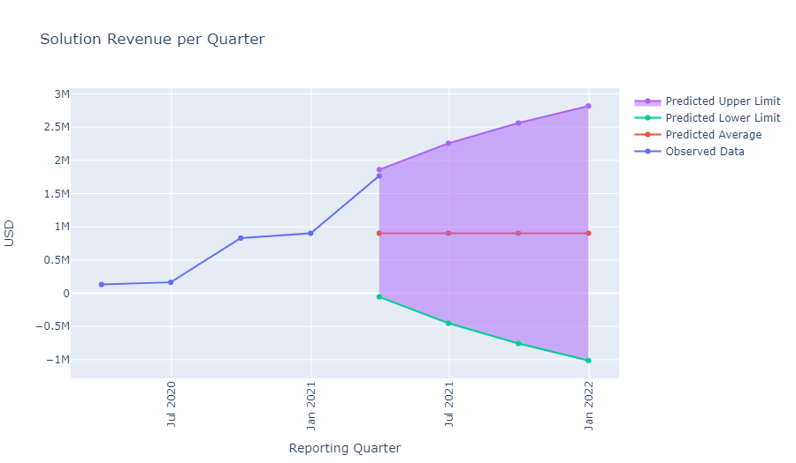

Slide 18
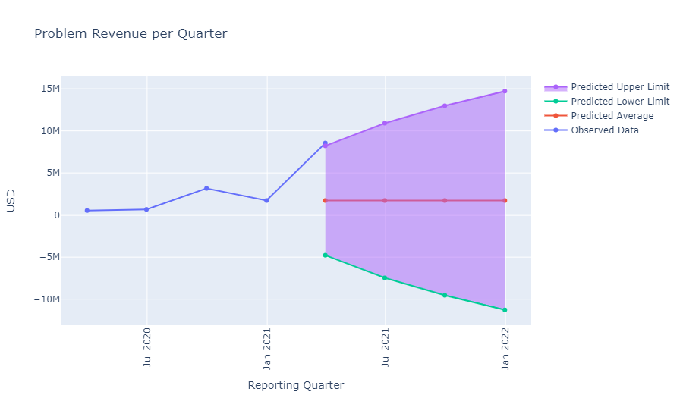
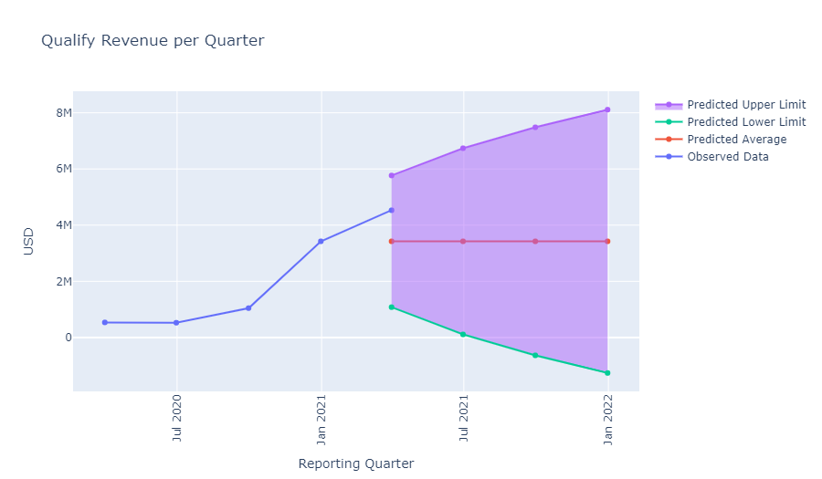
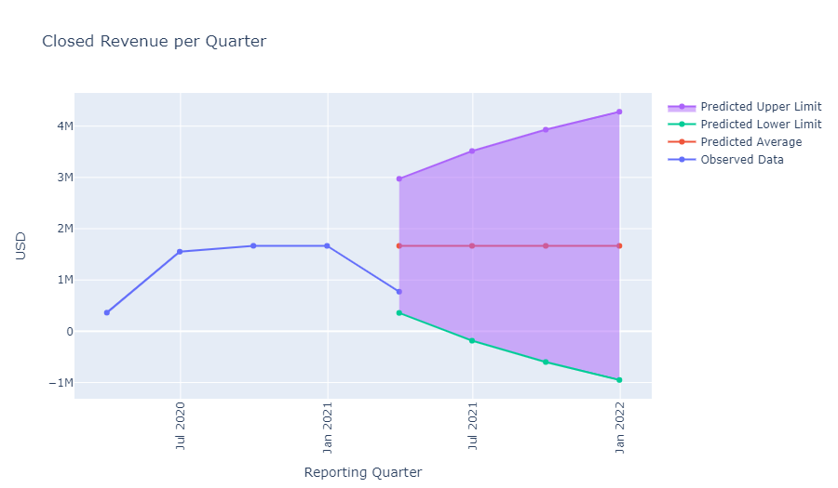
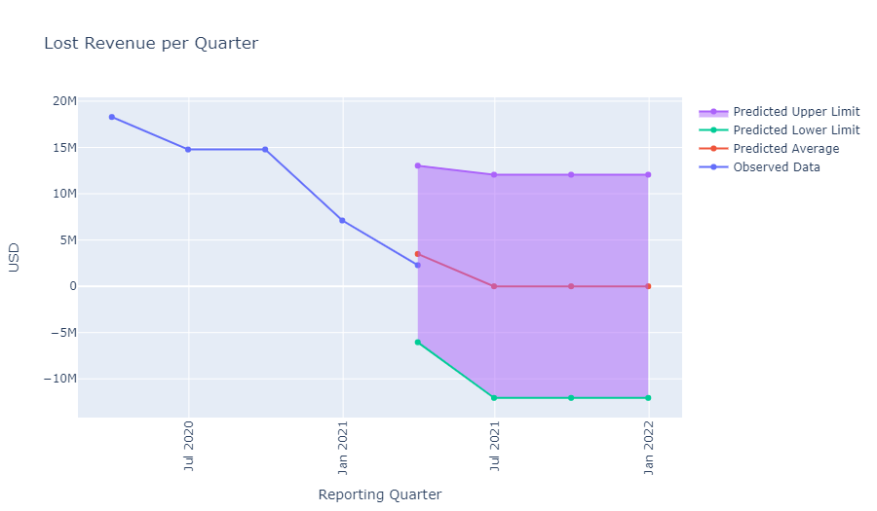

Slide 19
Future work
Drill more into the nature of the underperforming Partners and Channel Managers
Add linear predictions for 2H 2021 projections
Expand working knowledge of top performers to 50
Model the future revenue in terms of more granular timescale

Slide 20
Thank you Questions?

