Slide 1
King County Homes
A Linear Regression Model with Feature Analysis

Slide 2
What We Are Going To Answer
Question:
What features have the largest impacts to my home value and how can I leverage these features to increase my sale price?

Slide 3
The Variables
ID
Date the house was sold
Sale Price
Bathrooms/Bedrooms
Living area of the home
Area of the lot
floors in house
House which has a view to a waterfront
Has been viewed prior to sale
How good the condition is ( Overall )
Overall grade given to the housing unit’s materials, based on King County grading system
Square footage of house apart from basement
Square footage of the basement
Built Year
Year when house was renovated
Zip
Latitude coordinate
Longitude coordinate
The square footage of interior housing living space for the nearest 15 neighbors
The square footage of the land lots of the nearest 15 neighbors

Slide 4
Key Model Takeaways
What mattered the most?
Zipcode, Total Living Area, Having a waterfront property, The county grade, The month of the sale
What mattered somewhat?
The Latitude, Year of sale, Total living area of the 15 closest neighbors, Lot size, Number of views prior to sale, The county condition score, number of bathrooms
What didn’t matter?
Renovation year (this might be on account of lacking data), Number of Floors, Number of Bedrooms,
What hurt sale price?
Longitude, Having a basement, The year the house was built.

Slide 5

So what does all this mean for me!?

Slide 6
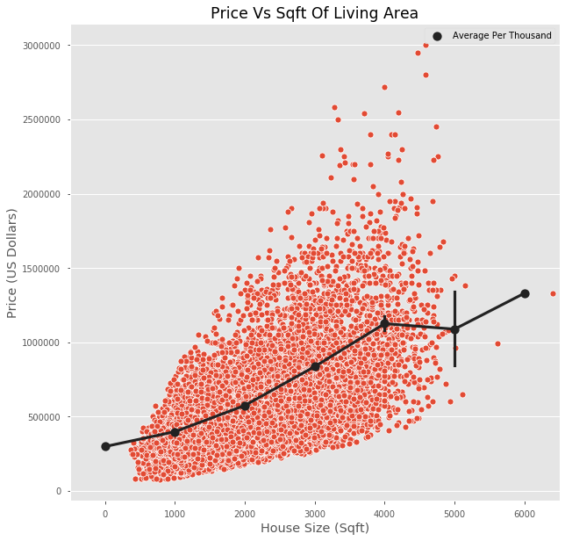
Best Option: Add some square footage
Of the features that are reasonable altered, additional square footage is the go to. Regardless of the quality or condition of your home, adding more area to your home will almost always drastically increase the value.

Slide 7
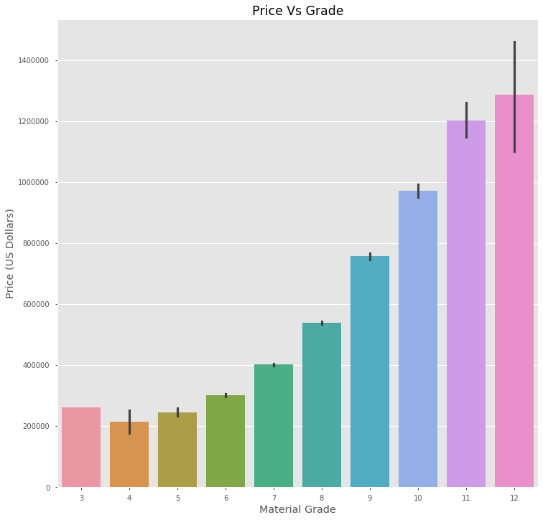
Use Quality Building Materials
King County has a grading system on which they rate the overall quality of the materials used in the homes construction. The visual to the left is the average sale price per the given grade.

Slide 8
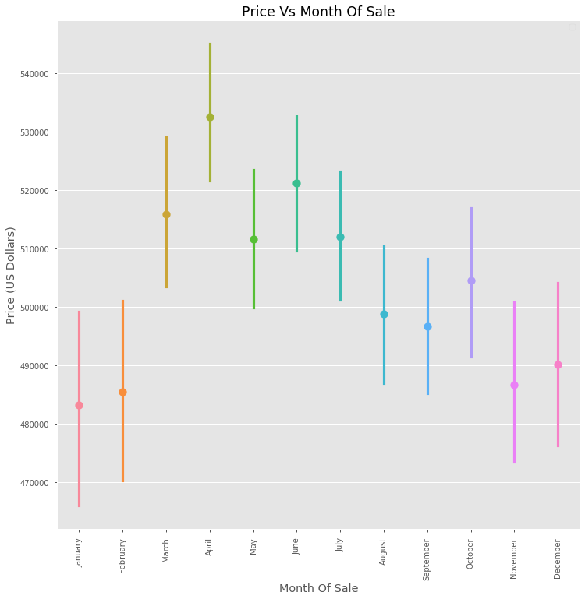
When to sell
For the most impact, your home needs to sell in June. Keep in mind that the sale date is recorded as the final closing date which means the highest offers will come in a month to two months earlier. So list your home anywhere from mid March to mid April.

Slide 9
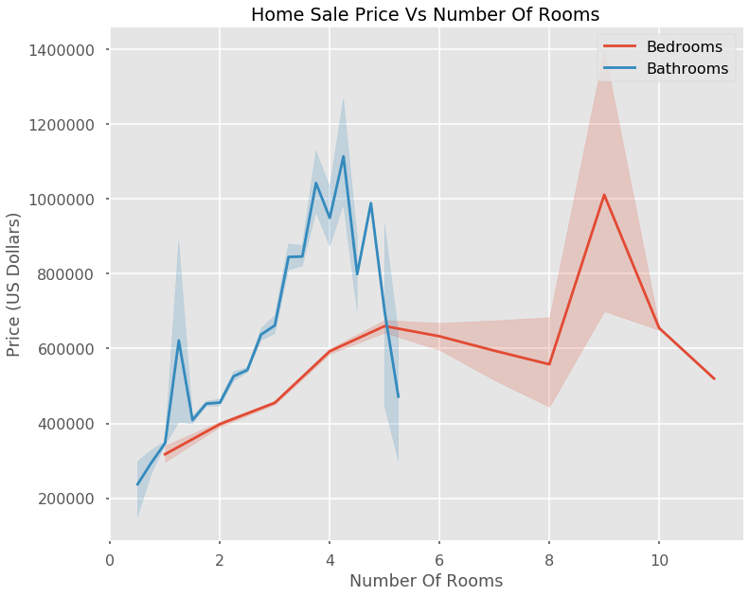
Bed or Bath?
If I have space to add an additional room, what should I put in the space if I want to increase my home value the most?
Answer:
Add a bathroom
Bathrooms had the largest positive effect on sale price when compared to any other space

Slide 10
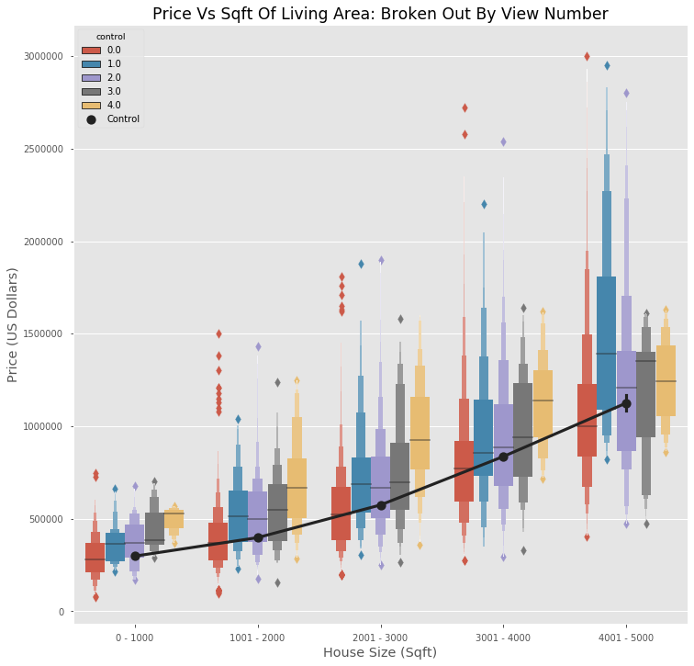
Advertising
As they say, the more the people who view the home prior to sale, the merrier.

Slide 11
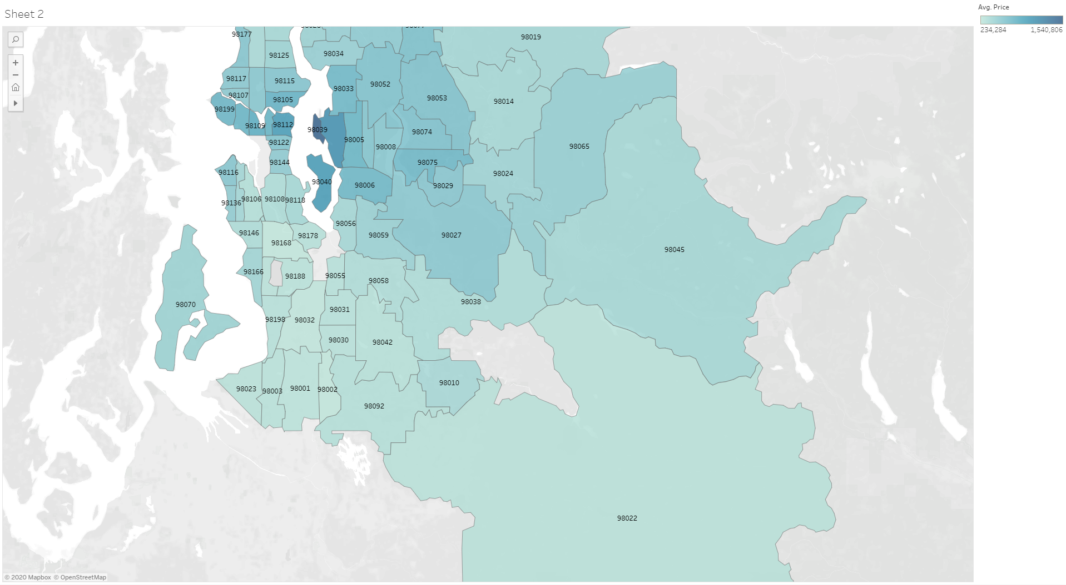

Slide 12

Future Exploration
Updating the data using a more recent copy of the data set.
Scraping websites for selling homes to fill in some of the holes and add new features
Create an application that homeowners can utalize that uses the model to predict their sale price without spending the money on an appraisal.

Slide 13
Thank You
This couldn’t have been possible without you…’re funding!
Life is full of difficult decisions and I hope this presentation made some of them a little bit easier.

Slide 14
Comments On This Presentation
Everything will be available to download if you want to inspect closer
[Git-Hub link Here]
I will not be diving into every detail of the project. If you have in depth or more technical questions, please feel free to join the notebook presentation at [INSERT DATE] or ask me after the presentation.
Want to get a hold of me?
example@email.com

