Slide 1
King County Homes

Slide 2
What We Are Going To Answer
Question 1:
If I have space to add an additional room, what should I put in the space?
Question 2:
I'm looking to buy a house in King County. I like a lot of space and don't really care about the neighborhood. What area should I look in to get the most space for my money if I can only spend 400,000 dollars.
Question 3:
My house is styled from back in the seventies. I'm trying to sell it and want to know if it's worth upgrading.
Question 4:
I’m trying to sell my house but I don't have much money for renovations. My house was built in the 80's and I haven't done much in the way of major renovations. What should I do?

Slide 3
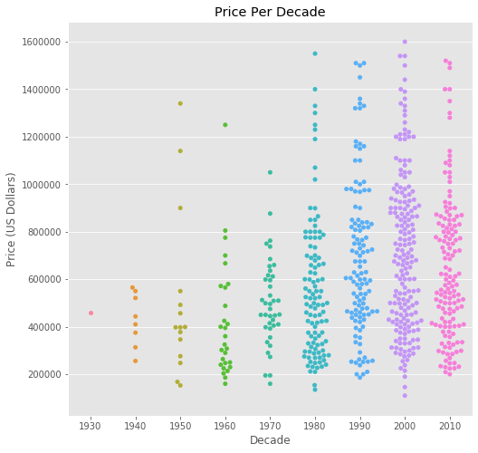
Question 1:

Slide 4
