Slide 1
King County Homes
A Linear Regression Model with Feature Analysis

Slide 2
Comments On This Presentation
Everything will be available to download if you want to inspect closer
[Git-Hub link Here]
I will not be diving into every detail of the project. If you have in depth or more technical questions, please feel free to join the notebook presentation at [INSERT DATE] or ask me after the presentation.
Want to get a hold of me?
example@email.com

Slide 3
What We Are Going To Answer
Question 1:
What is the one thing I can do to increase my house value the most?
Question 2:
If I have space to add an additional room, what should I put in the space if I want to increase my home value?
Question 3:
My I'm looking to buy a house in King County. I like a lot of space and don't really care about the neighborhood. What area should I look in to get the most space for my money if I can only spend 400,000 dollars.
Question 4
I'm looking to sell my house, but I don't have much money for renovations. What should I do to squeeze a little extra money out of the sale?

Slide 4
The Variables
ID
Date the house was sold
Sale Price
Bathrooms/Bedrooms
Living area of the home
Area of the lot
floors in house
House which has a view to a waterfront
Has been viewed prior to sale
How good the condition is ( Overall )
Overall grade given to the housing unit’s materials, based on King County grading system
Square footage of house apart from basement
Square footage of the basement
Built Year
Year when house was renovated
Zip
Latitude coordinate
Longitude coordinate
The square footage of interior housing living space for the nearest 15 neighbors
The square footage of the land lots of the nearest 15 neighbors

Slide 5
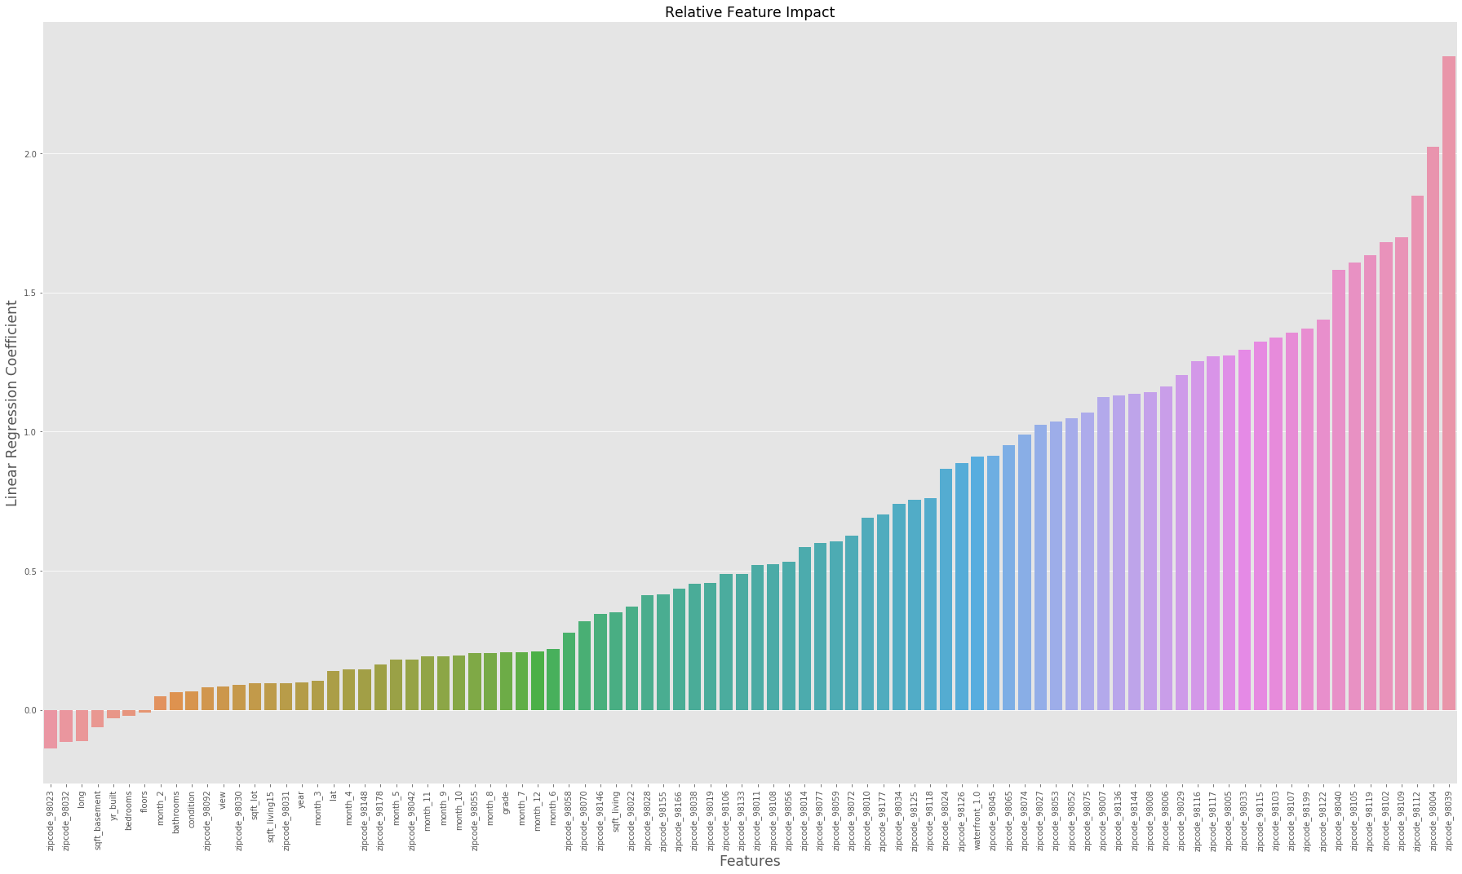
The Result

Slide 6
Key Model Takeaways
What mattered the most?
Zipcode, Total Living Area, Having a waterfront property, The county grade, The month of the sale
What mattered somewhat?
The Latitude, Year of sale, Total living area of the 15 closest neighbors, Lot size, Number of views prior to sale, The county condition score, number of bathrooms
What didn’t matter?
Renovation year (this might be on account of lacking data), Number of Floors, Number of Bedrooms,
What hurt sale price?
Longitude, Having a basement, The year the house was built.

Slide 7
Question 1:
What is the one thing I can do to increase my house value the most?
Answer:
If you’re unwilling to relocate your home or build a lake where your neighbor’s house is, increasing the total living square footage is the most effective.

Slide 8
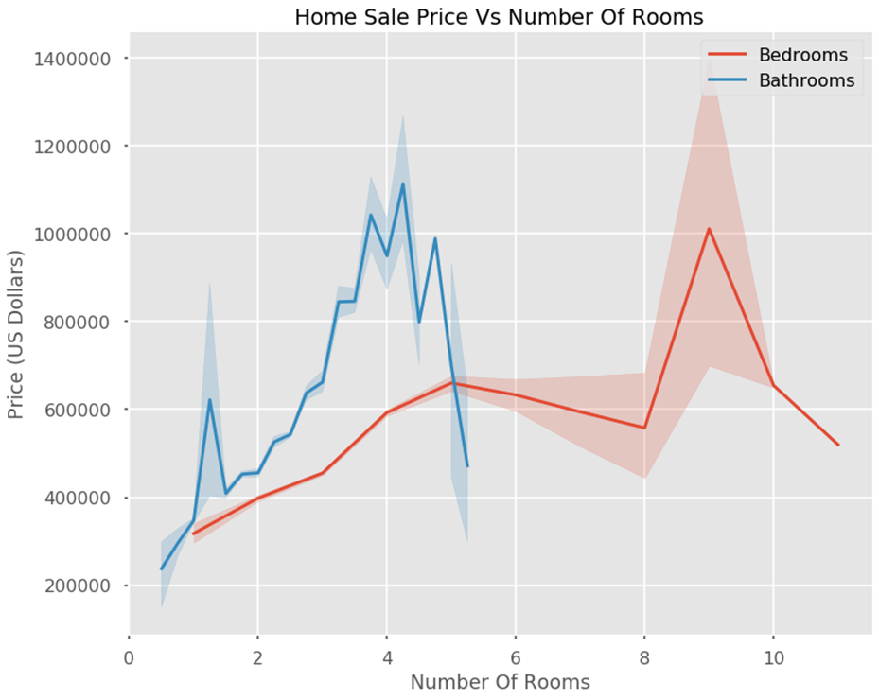
Question 2:
If I have space to add an additional room, what should I put in the space if I want to increase my home value the most?
Answer:
Add a bathroom
Bathrooms had the largest positive effect on sale price when compared to any other space

Slide 9
My I'm looking to buy a house in King County. I like a lot of space and don't really care about the neighborhood. What area should I look in to get the most space for my money if I can only spend 400,000 dollars.
Question 3:
Zip Codes:
98023
98030
98031
98032
98092
98148
98178

Slide 10
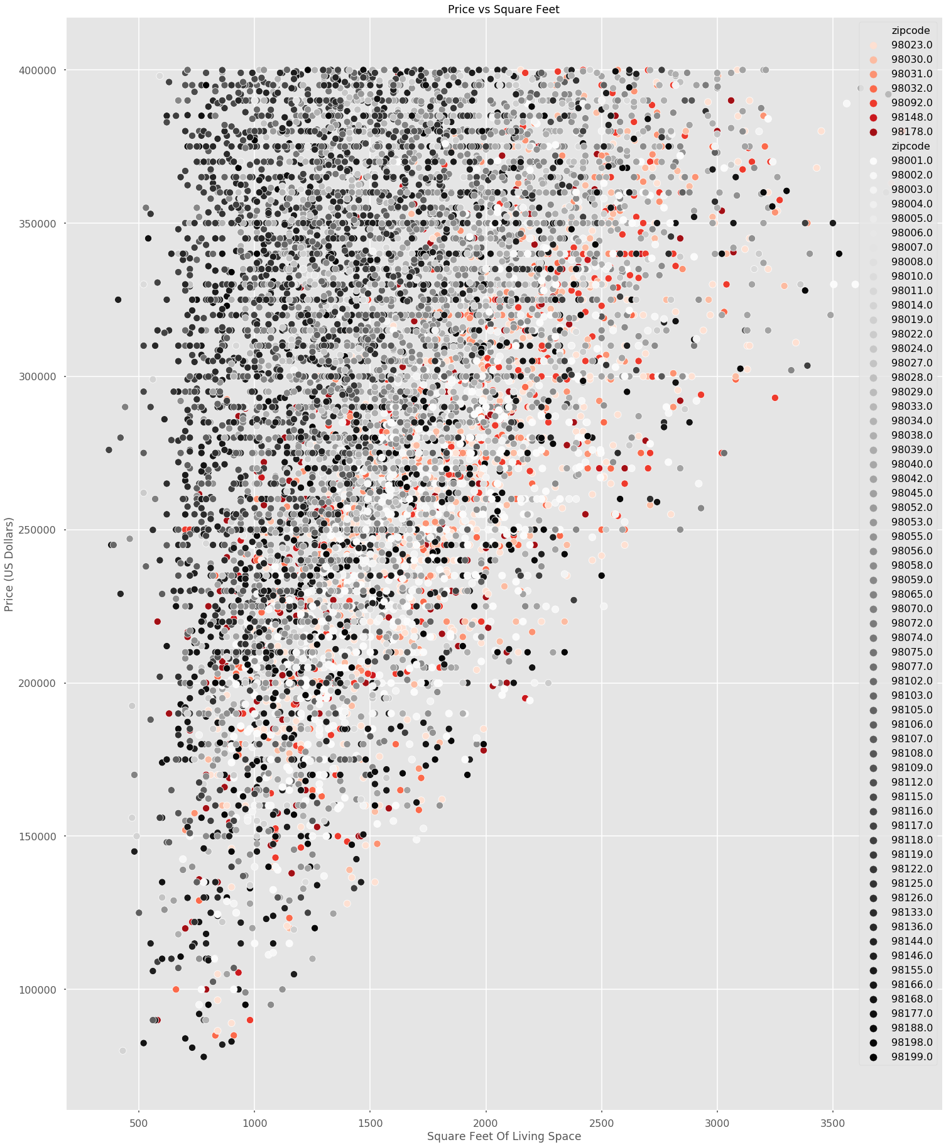

Slide 11
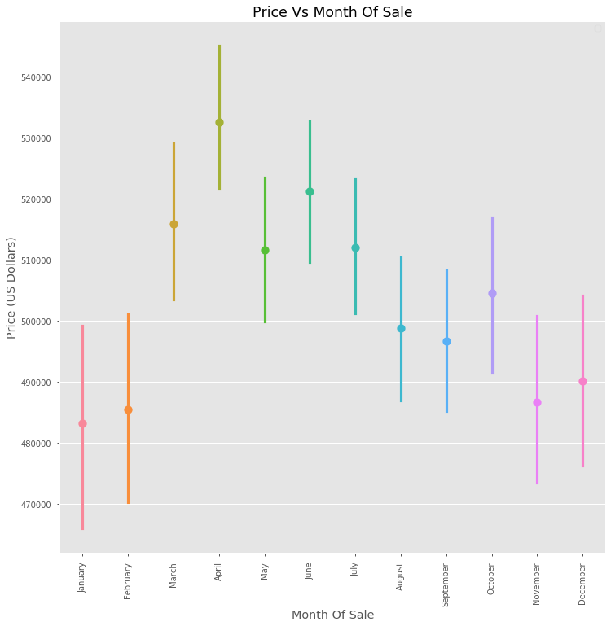
Question 4:
I'm looking to sell my house, but I don't have much money for renovations. What should I do to squeeze a little extra money out of the sale?
Answer:
Sell you house in June. If this isn’t feasible, sell it in December or July

Slide 12
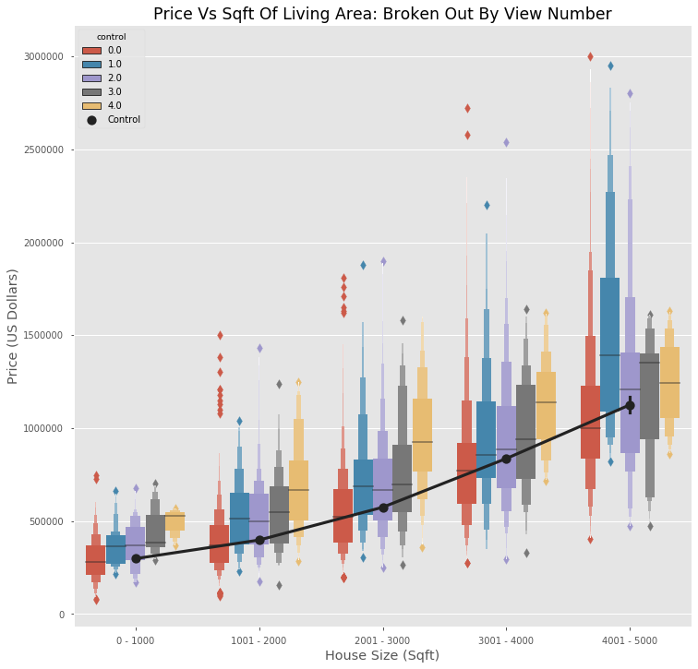
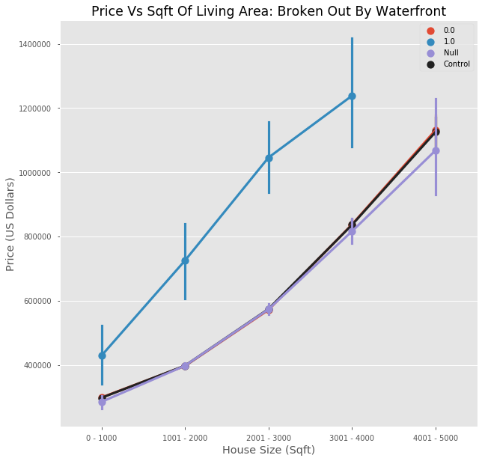
IF THERE’S TIME!

Slide 13
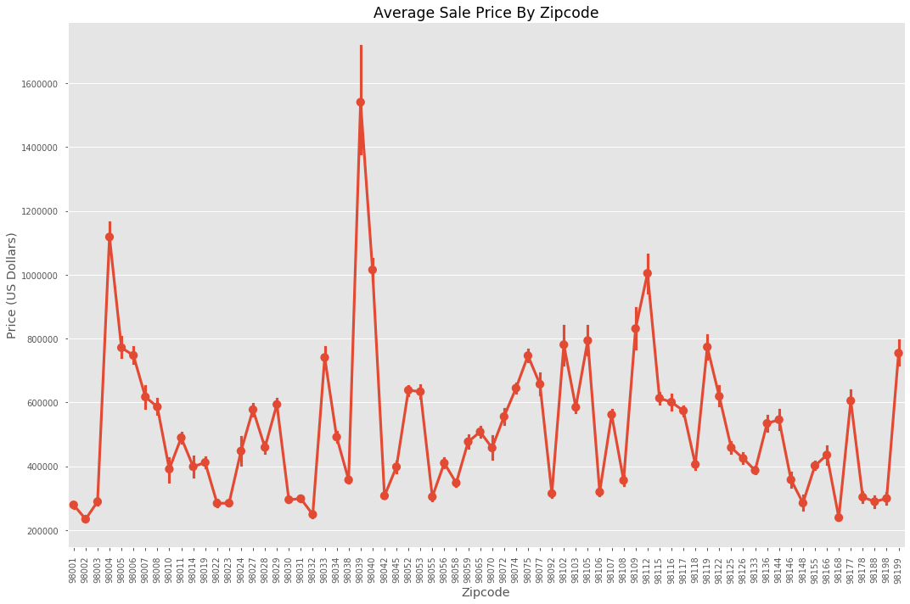
IF THERE’S TIME!

Slide 14
Thank You
This couldn’t have been possible without you…’re funding!
Life is full of difficult decisions and I hope this presentation made some of them a little bit easier.

Slide 15

Future Exploration
Apply a more complex model to the dataset in order to refine accuracy without losing comprehension.
Scraping websites for selling homes to fill in some of the holes and add new features

