Slide 1
X-Ray Analysis: Pneumonia Classification
A Convolutional Neural Network approach to image classification

Slide 2
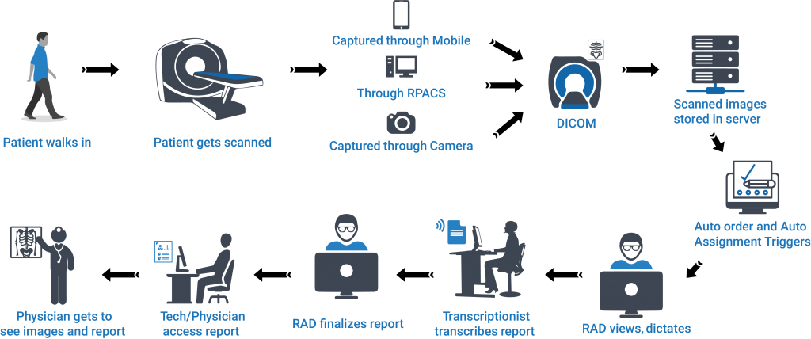
Why We’re Here
https://www.teleradtech.com/radspa/workflow/
Neural networks have a place in the modern radiologist workflow.

Slide 3

Recommendation: Triage
Get medication to those who might need it.
Schedule sooner follow ups or expedite a patient to emergency level

Slide 4
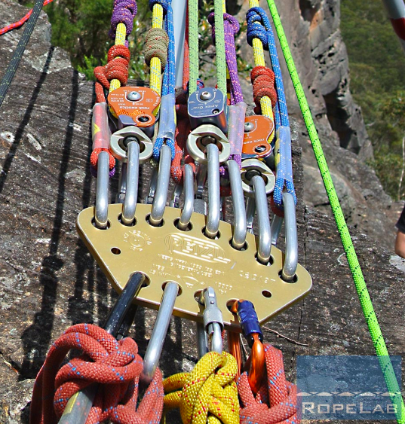
Recommendation: Redundancy
https://rigginglabacademy.com/wp-content/uploads/2018/08/Screen-Shot-2018-08-03-at-10.10.27-PM.png
Redundancy is a good system design in high impact industries
A study conducted and featured in the National Center for Biotechnology Information Journal, concluded that among various groups of credentialed radiologists, the maximum accuracy when diagnosing pneumonia achieved by any group was 86%.
Radiologists are hard to come by (and never cheap)
AI offers cost effective second opinions in a fraction of the time.

Slide 5
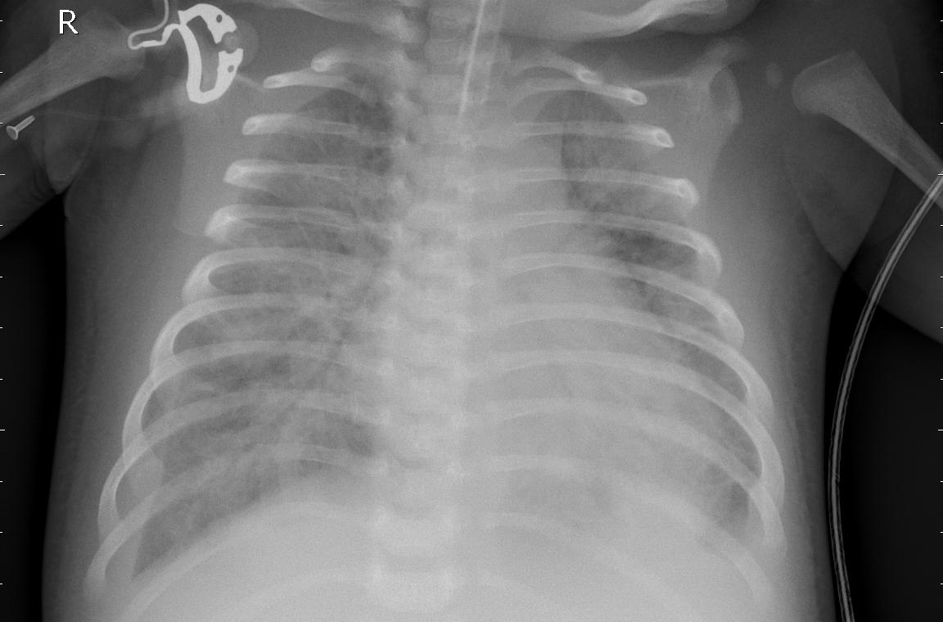
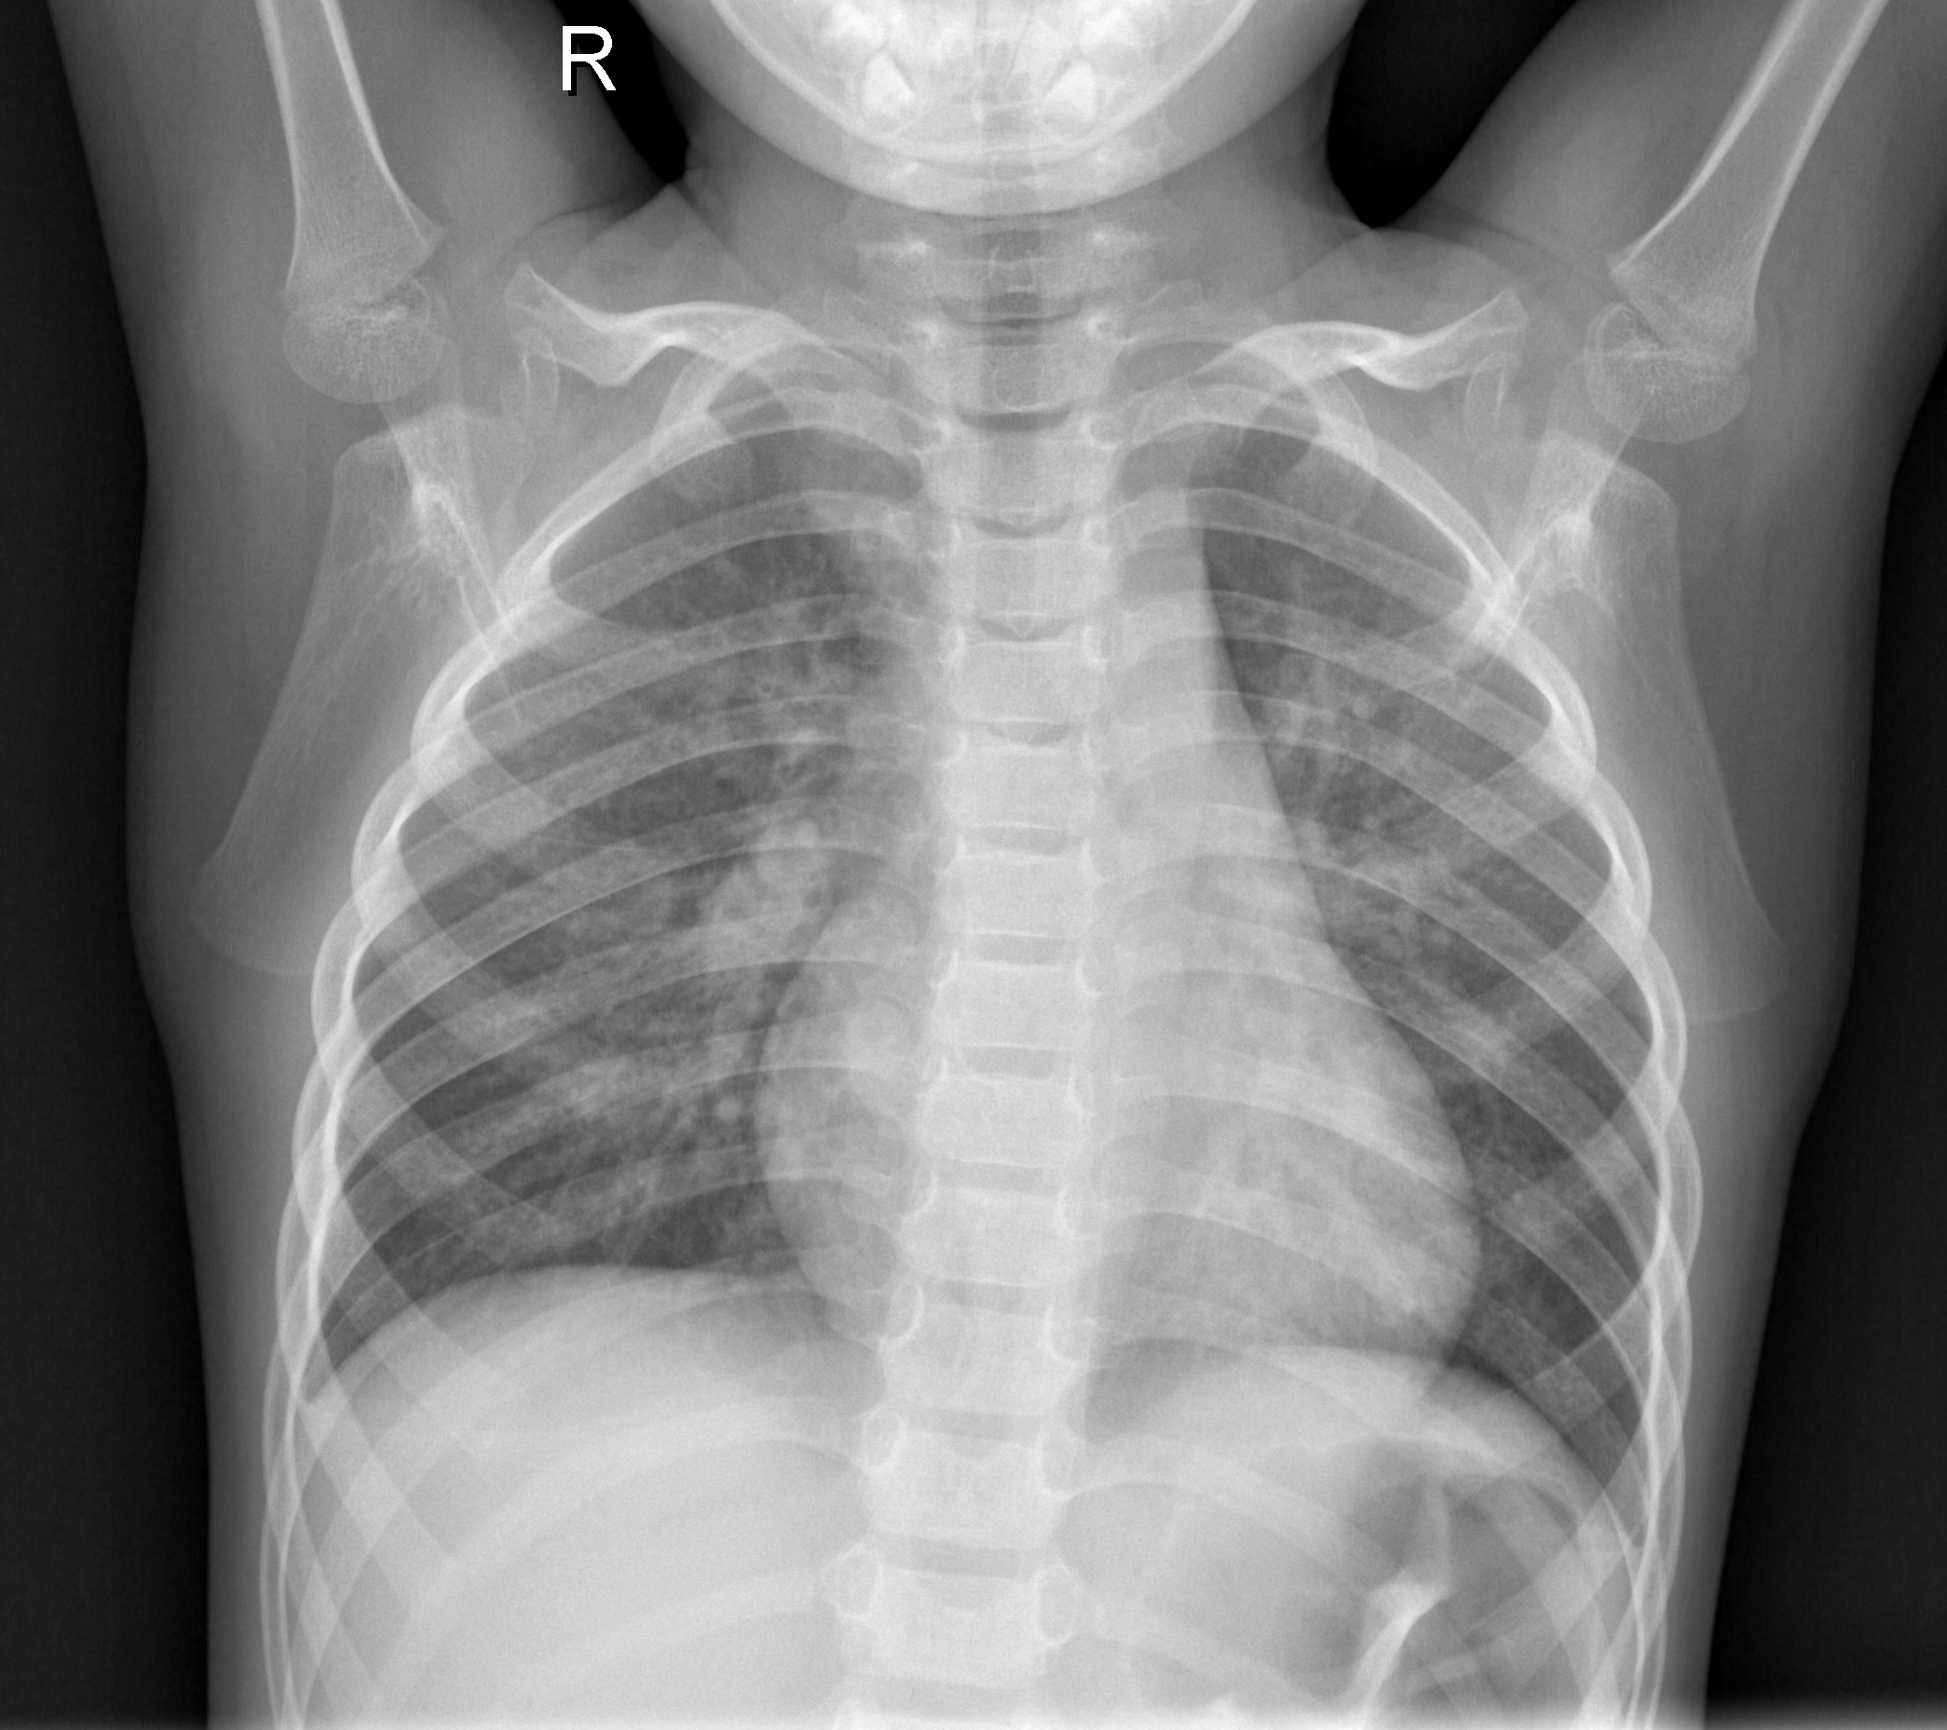
Data Basics
Around 5800 X-rays were analyzed by the model.
Pneumonia
Non-Pneumonia

Slide 6
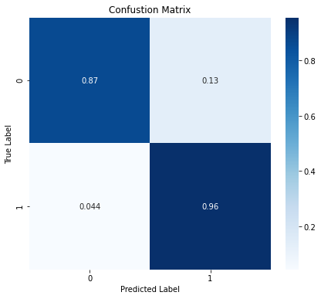
The Model & Performance Metrics
The convolutional neural network we designed for this task had an overall accuracy of 93%
Final Recall was 96% -- Captured 96% of the patients who actual had pneumonia.

Slide 7
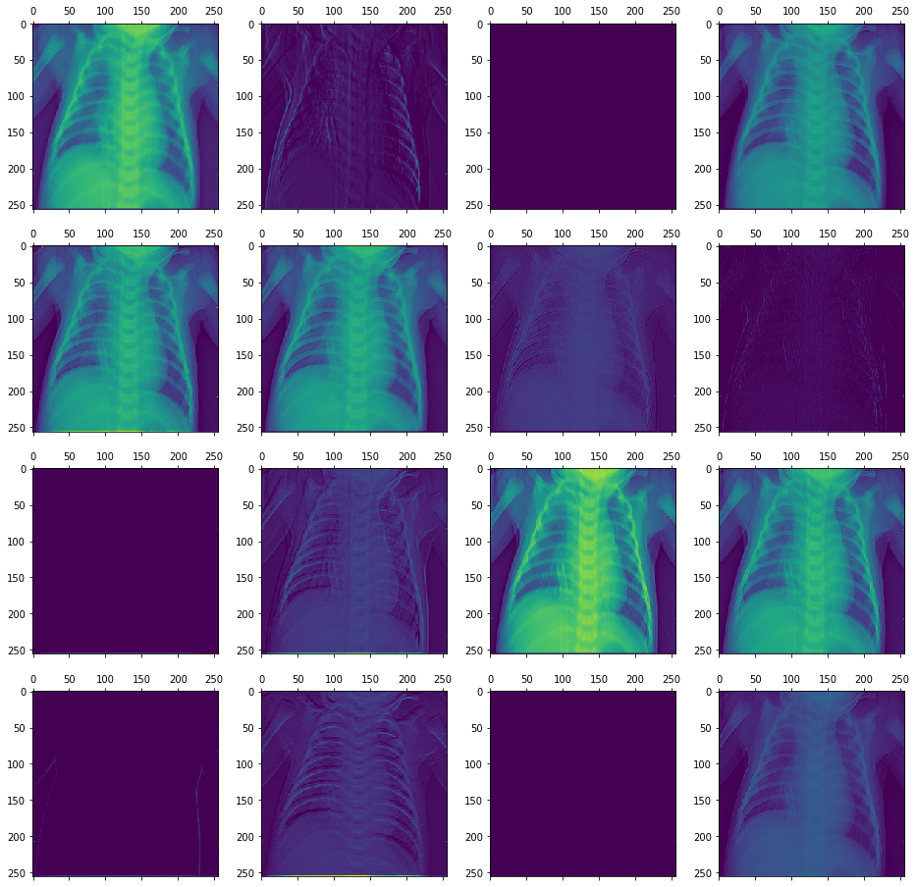
A Glimpse Under The Hood
These images are examples of looking at the data through the models “eyes” . While not crystal clear, they do give some insight into what the model has extracted from the X-Rays in order to make its classifications.
The CNN is hosted at mod4-dash.herokuapp.com Go test it out on your own x-rays!

Slide 8
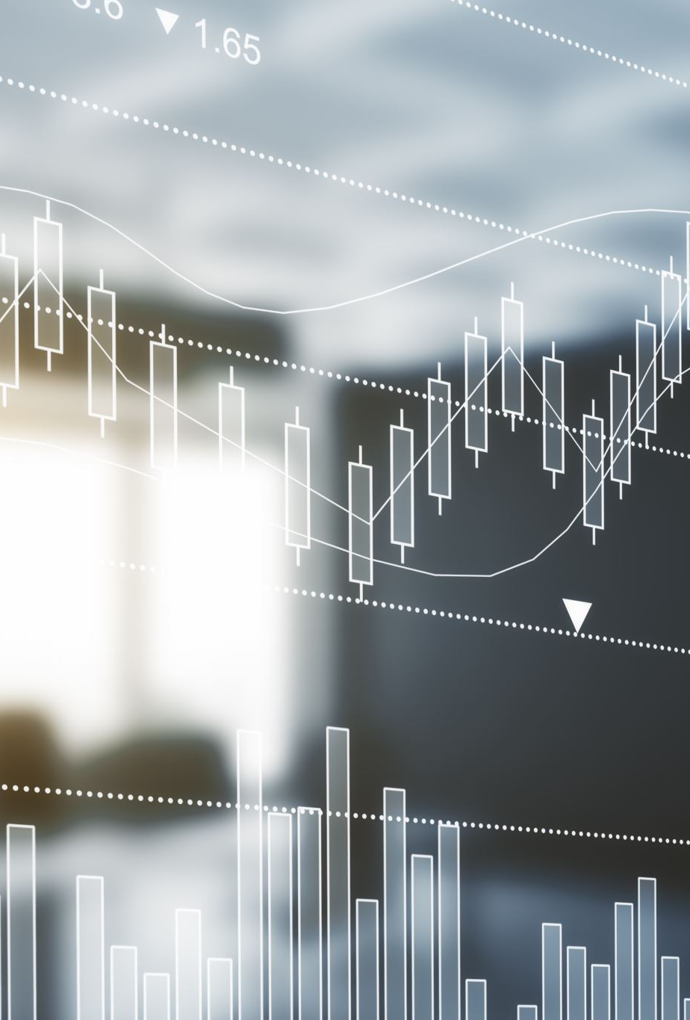
Future Work: There’s Lots Still To Do
Additional image augmentation and sampling techniques
Non-Sequential Modeling
Detecting and weighting edge cases

Slide 9


Thank you

