Slide 1



Team Details
  Team name: Super Power Rangers
  Team leader name: Pyae Sone Myo (Ricky) Members: Min Thein Kyaw, May Myat Noe Aung
  Problem Statement: Recruitment ads on Facebook, Viber and Telegram lure young job seekers from Myanmar and the region into forced online scam work; OHCHR says at least 120,000 people in Myanmar may be held in it. Kakwe helps them see the warning signs, in their own language, before they pay, send documents or travel.

Slide 2
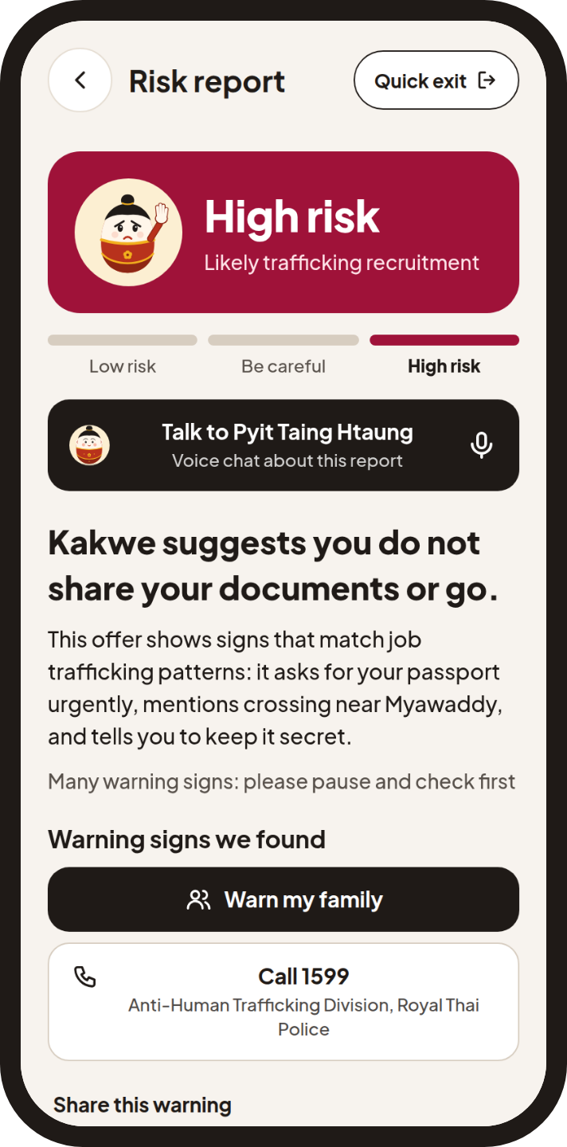
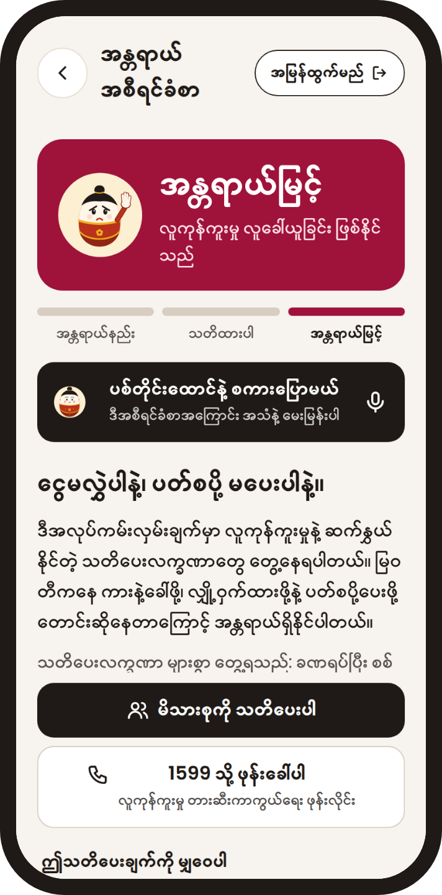
Brief about the idea
Kakwe checks a job offer before you pay, send documents or travel.
Kakwe (ကာကွယ်, Burmese for "protect") is an Android app and a web demo for migrant job seekers from Myanmar, Thailand, Indonesia and the Philippines.
Paste a job ad, chat, link or screenshot, or tap the floating doll over any Android app. Gemini reads the evidence, Google Search checks named companies, and fixed rules set the verdict: Low risk, Be careful or High risk.
The report quotes the user's own words, gives a verified hotline and speaks the warning in English, Burmese, Bahasa Indonesia, Tagalog or Thai.
The package name and web addresses keep the earlier project name saferoute.

Slide 3
Opportunities
How different is it from any of the other existing ideas?
It reads whole chat screenshots in Burmese and four other languages, not only links or numbers. Job Shield puts the job ad next to the recruiter's chat and shows each gap. Every warning quotes the words behind it.
How will it be able to solve the problem?
It works at the moment of risk: before paying, sending a passport or travelling. One tap on the floating doll checks any Android app. The report gives the next step, a verified hotline and a way to warn family.
USP of the proposed solution
Gemini finds evidence; deterministic rules decide. Wording stays in likelihood, never accusation. A Burmese voice companion answers from the finished report. The benchmark and its dataset are public.

Slide 4
List of features offered by the solution
Check anything
Paste a message or link, or share a screenshot. Get Low risk, Be careful or High risk, with the quoted words.
Job Shield
Compares the job ad with what the recruiter asks in chat and shows each gap.
Screen bubble
Android. A floating doll checks whatever is on screen, in any app, with one tap.
Scam radar
Shows which scams people are reporting right now, from opt-in anonymous signals.
Voice companion
Talk to Pyit Taing Htaung about a report, in your language, on Gemini Live.
Warn my family
Sends the warning to a trusted contact by SMS or the share sheet.
Scam network
Opt-in. Repeat numbers and handles, kept as keyed hashes, raise the next warning.
Five languages
English, Burmese, Bahasa Indonesia, Tagalog and Thai. Quick exit clears the screen.

Slide 5
Process flow diagram or Use-case diagram
Ma Su's journey (a fictional story)
A Viber message offers a factory job in Thailand
She pastes it into Check, or taps the floating doll
High risk. Her own words are quoted as warning signs
Job Shield: the ad says no fees, the chat asks for a deposit
She asks Pyit Taing Htaung, in Burmese
She warns her mother. She does not pay or travel
The check flow, within a 15 second budget
Text, link or screenshot, with the user's language
Gemini extraction: flags, quotes and links as JSON
In parallel: Search grounding, link checks, scam network
Likelihood guard rewrites certainty words
Rules engine sets the score and the verdict
Report, spoken warning (TTS) and voice chat (Live)

Slide 6
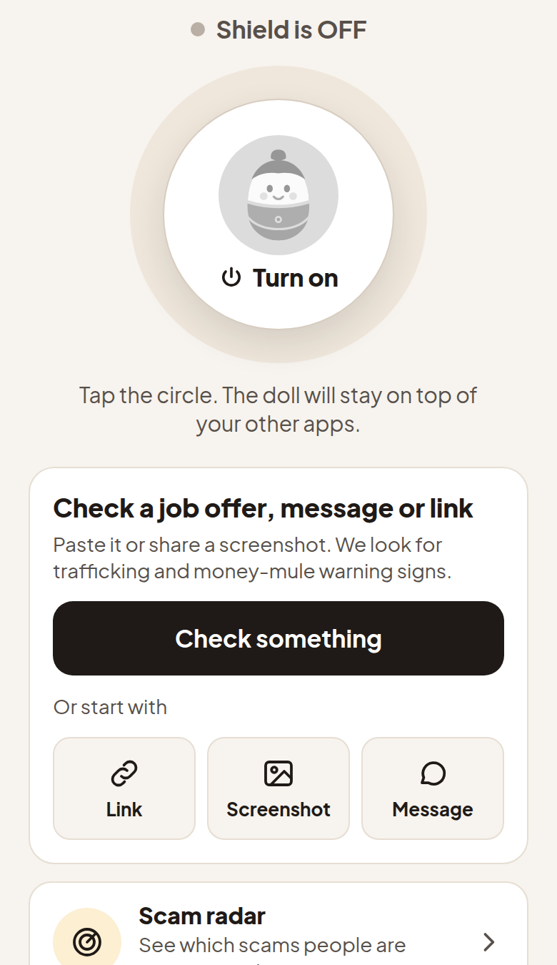
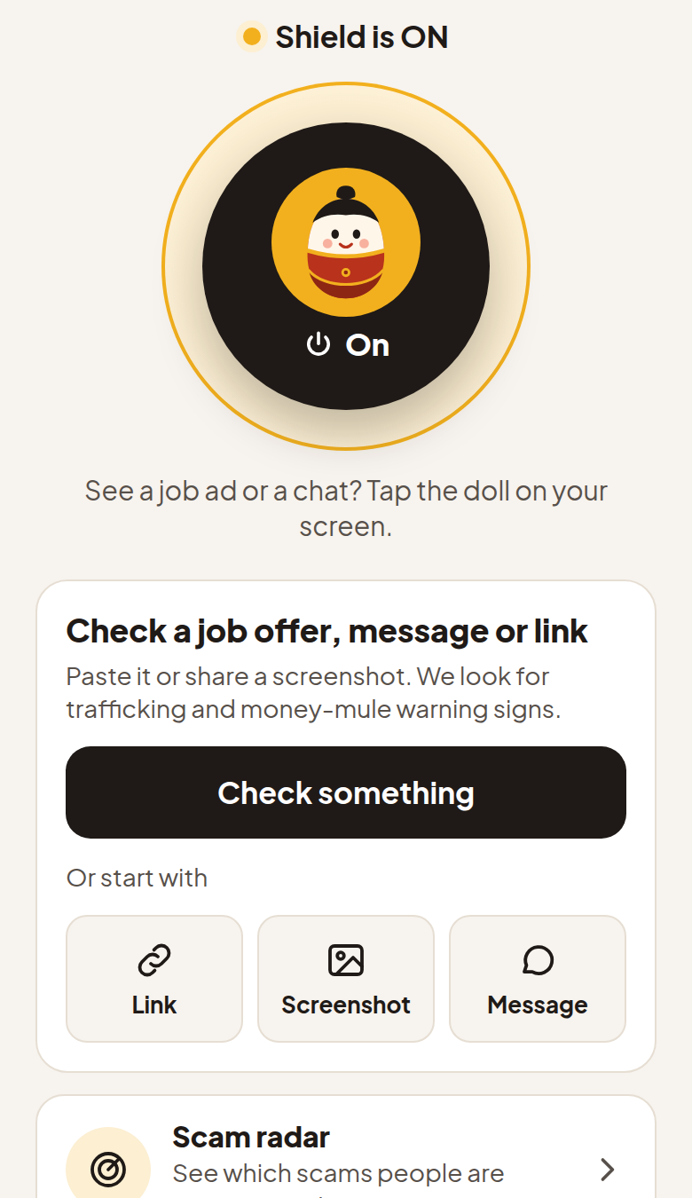
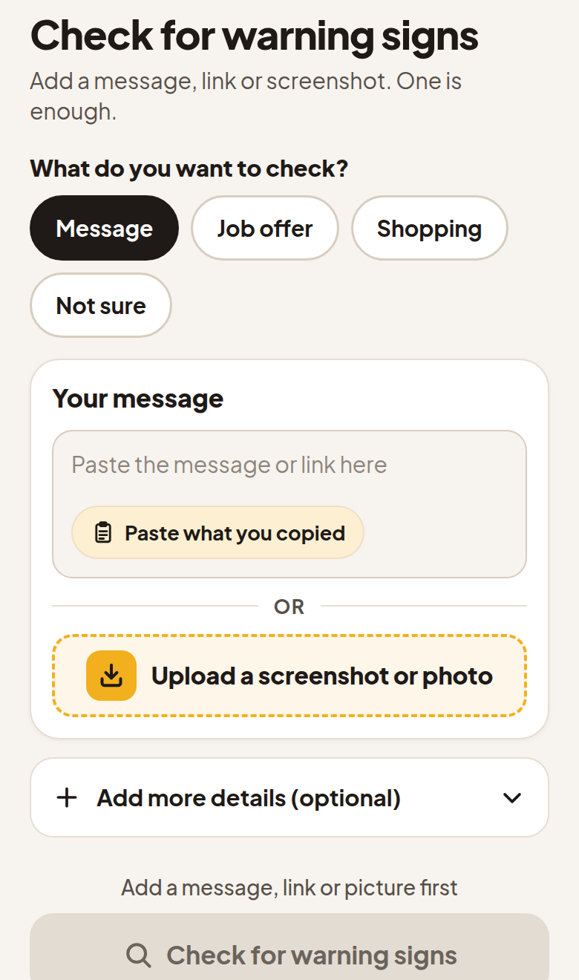
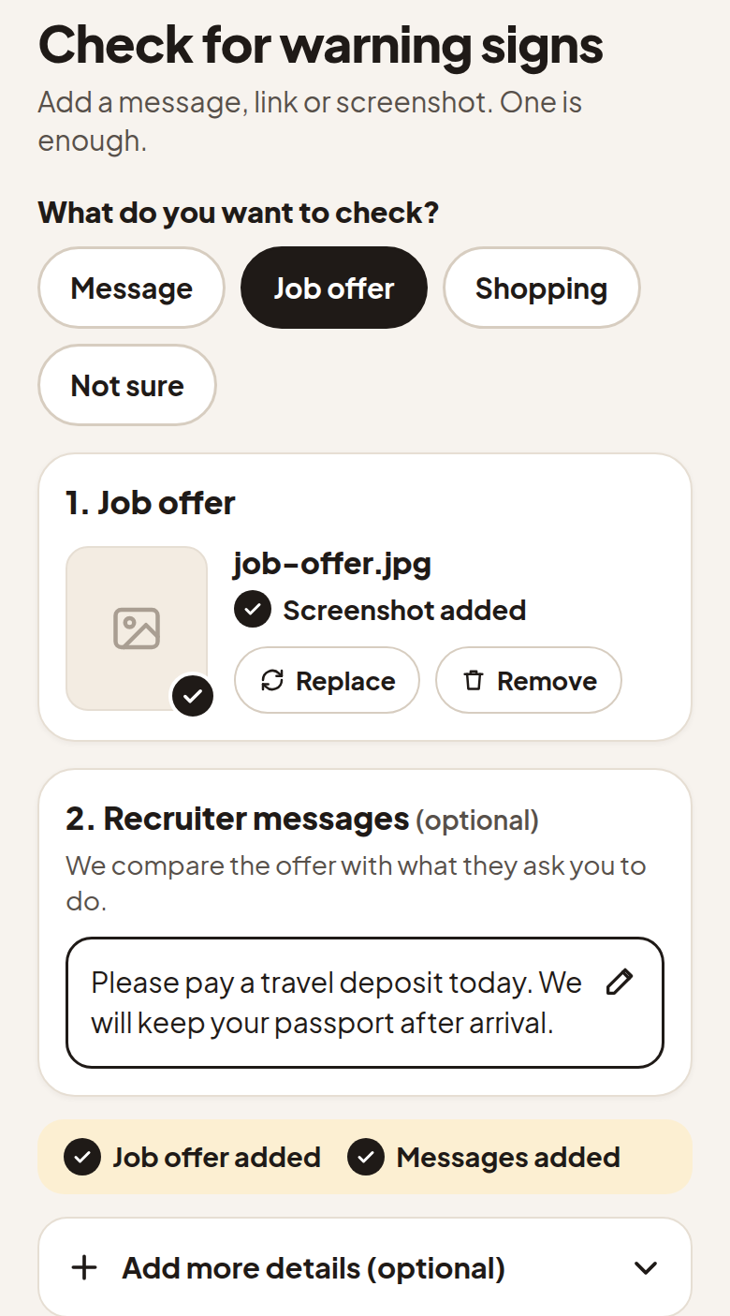
Wireframes/Mock diagrams of the proposed solution (optional)
Home, shield off
Home, shield on
Check, message
Check, job offer filled
Approved design mockups for Home (one big shield button) and the Check v3 page with kind chips, in English. The logo row and the footer line are cropped.

Slide 7
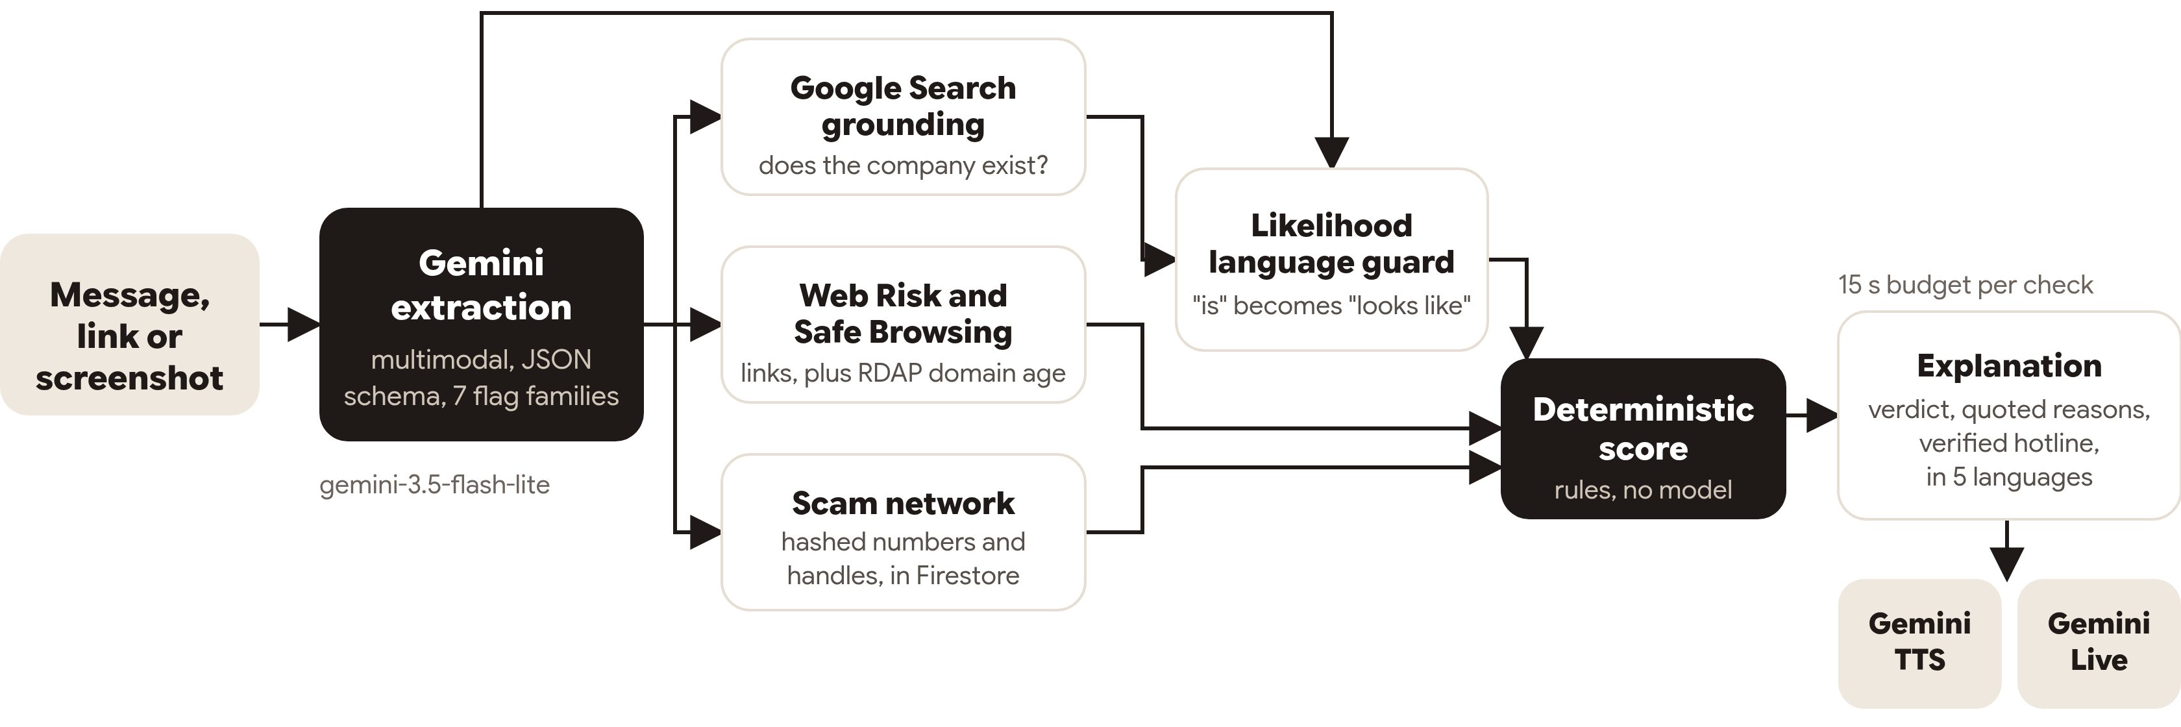
Architecture diagram of the proposed solution
Hosting
API on Cloud Run (asia-southeast1, Singapore). Firebase for sign-in, data, web hosting and test builds.

Slide 8
Technologies to be used in the solution
Technology | Use in Kakwe
Gemini API, gemini-3.5-flash-lite | Multimodal extraction with a JSON response schema; Job Shield fact extraction
Grounding with Google Search | Checks that named agencies and companies exist
Gemini TTS, gemini-3.8-flash-tts | Spoken warnings in five languages
Gemini Live API, gemini-3.8-live | The voice companion, Pyit Taing Htaung
Web Risk API, Safe Browsing API | Known malicious links
Firebase Auth, Firestore | Anonymous and Google sign-in, synced history and contacts, the scam network
Firebase Hosting, App Distribution | The web demo and Android test builds
Cloud Run, asia-southeast1 | Hosts the check API and the voice relay
Expo 52, React Native 0.76, TypeScript | The Android app and the web demo
Hono on Node 22, TypeScript | The check API, the rules engine and the voice relay
Kotlin Android module | The screen bubble overlay

Slide 9
Estimated implementation cost (optional)
Model calls per check
• One Gemini extraction call (gemini-3.5-flash-lite), text plus an optional image.
• A second Gemini call with Google Search grounding, only when a company, agency or website is named.
• One Web Risk or Safe Browsing lookup and one RDAP lookup per link.
• Gemini TTS only when a spoken warning is played.
• A voice session lasts at most 120 seconds and counts as two checks.
Cost controls in the API
• An identical check within 10 minutes comes from the result cache.
• Hourly limits: 20 checks anonymous, 60 signed in, and 30 requests a minute per IP.
• Each check has a 15 second budget; a late stage returns "unknown".
• The Firebase project serves the web demo with no billing account linked.
• We have not measured a cost per check yet, so this deck gives no dollar figure.

Slide 10
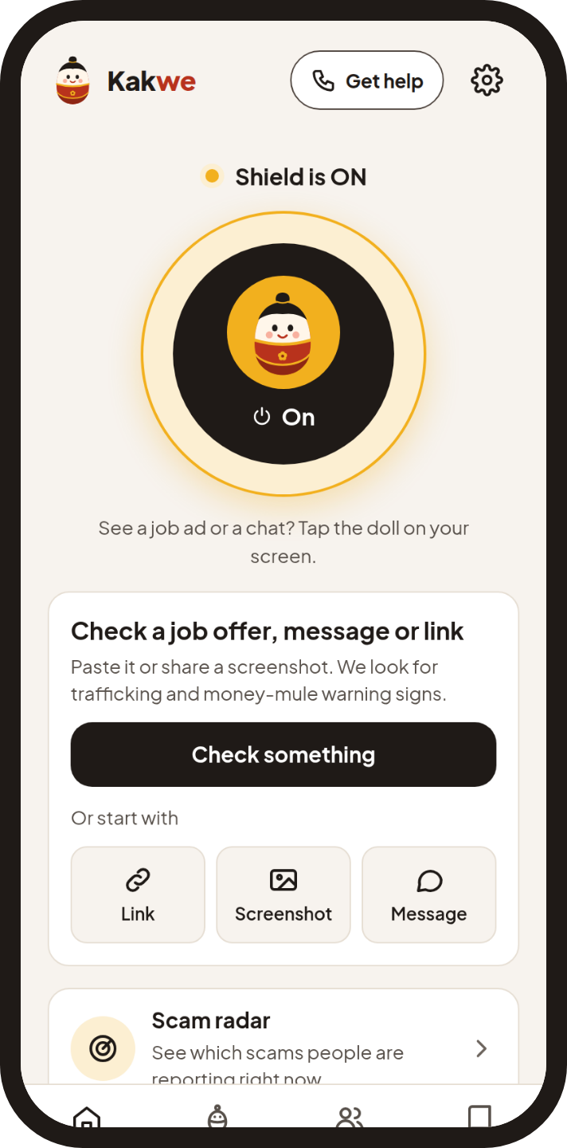
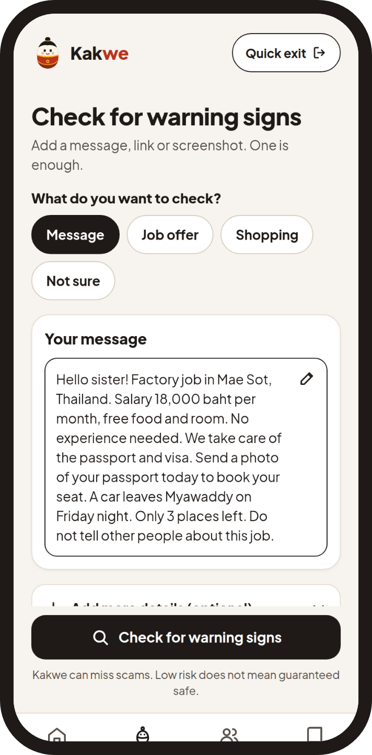
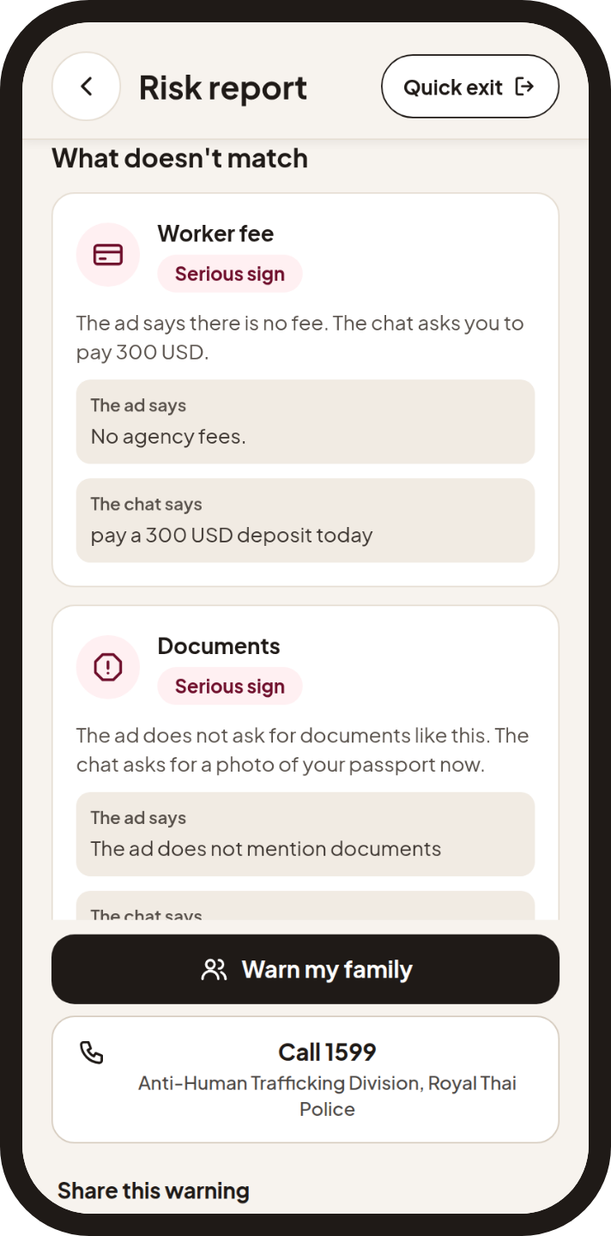
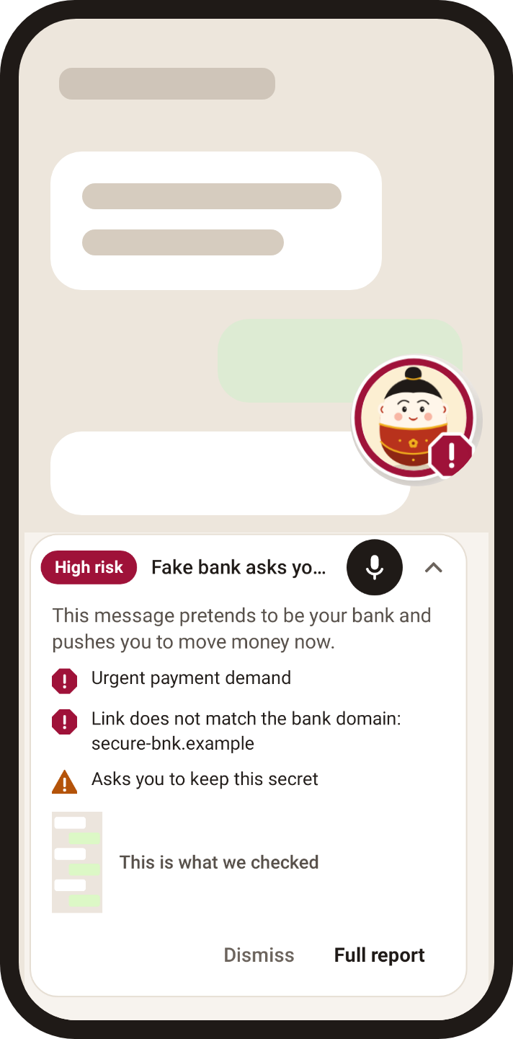
Snapshots of the prototype
Home: the shield circle
Check: pick what to check
High risk report
Job Shield: what doesn't match
Screen bubble (Android)
Web build of the release commit against the live API, with fictional inputs. The bubble shows the Android overlay views on a drawn chat.

Slide 11
Prototype Performance report/Benchmarking
31/31
Text eval cases correct
0 responses with certainty wording after the guard. p50 2.8 s, p95 4.4 s.
89.7
Protection Score, 24 synthetic screenshots
5 languages, 0 critical failures, 48/48 quotes found in the image.
about 67
Protection Score, 96 real screenshots
Provisional. Draft labels from two models; no human review yet.
10/10
Job Shield ad and chat pairs
No legit pair reached Pause. No scam pair stayed at the lowest tier.
93 + 28
Public dataset on Hugging Face
Real redacted and synthetic screenshots with labels.
98%
Verdict stability, 210 variants
Low resolution, JPEG, crop, rotation, dark mode, overlays and prompt injection.
gemini-3.5-flash-lite, production prompt, runs of 16 October 2026. A live link check also flags Google's Safe Browsing test phishing URL as High risk.

Slide 12
Additional Details/Future Development (if any)
Next
Known limits today
1
Native review of every Burmese string
• Burmese app strings are machine translated and not yet reviewed by a native speaker.
• Real-screenshot labels are drafts from two models, so that score is provisional.
• The web demo has no screen bubble; it needs the Android app.
2
Human review of the real-screenshot labels
3
More languages for the region
4
Pilots with migrant worker NGOs

Slide 13
Provide links to your:
GitHub Public Repository: https://github.com/minthein128/scamshield
Demo Video Link (3 Minutes)
Final Product Link: web demo https://saferoute-aibc.web.app, Android APK https://saferoute-aibc.web.app/saferoute.apk
Public dataset: https://huggingface.co/datasets/Rickaym/saferoute-scam-screenshots
Team: Super Power Rangers. Pyae Sone Myo (Ricky), team leader; Min Thein Kyaw; May Myat Noe Aung
Contact: support@akkhayar.com

Slide 14
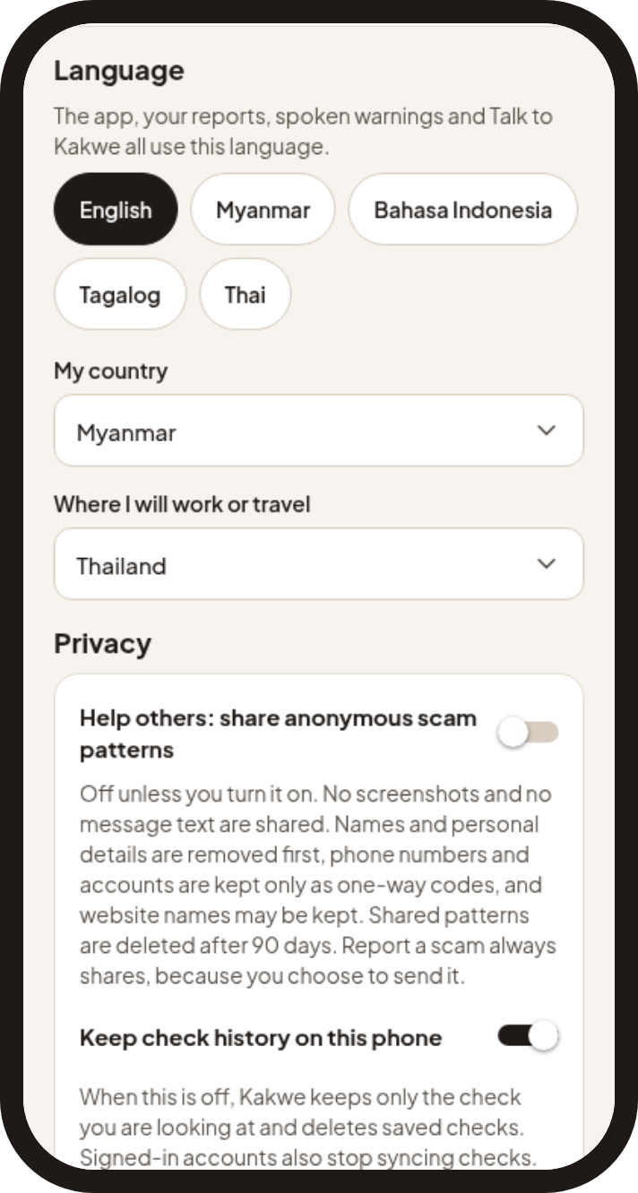
Safety and privacy
Likelihood words
"Shows signs of", never "is a scam". A guard rewrites certainty phrases in all five languages.
No accusations
No named person, company, number or handle is called a criminal.
Consent first
Sharing is off until turned on. Overlay, screen capture, microphone, notifications and contacts are asked only when needed.
Hashed indicators
Phone numbers and handles are kept as one-way hashes; signals expire after 90 days.
Quick exit
One button on every report clears the screen back to Home and stops audio.
Slim sync, 18+
History keeps the verdict, a score band, the title and the summary, and can be turned off.
Images and message text are not stored or logged. Personal details are redacted before a signal is kept.

Slide 15


