Slide 1
Arcane
Knockout
Four-player wizard arena brawler
$30,000 funding proposal
Min Thu Kyaw | October 2026
01
Promotional artwork
Notes:
Project title and funding ask supplied by Min Thu Kyaw. Cover image: ArcaneKnockout-Website/public/images/hero-mage.webp. Promotional key art, not a gameplay screenshot. Proposal dated 15 October 2026.

Slide 2
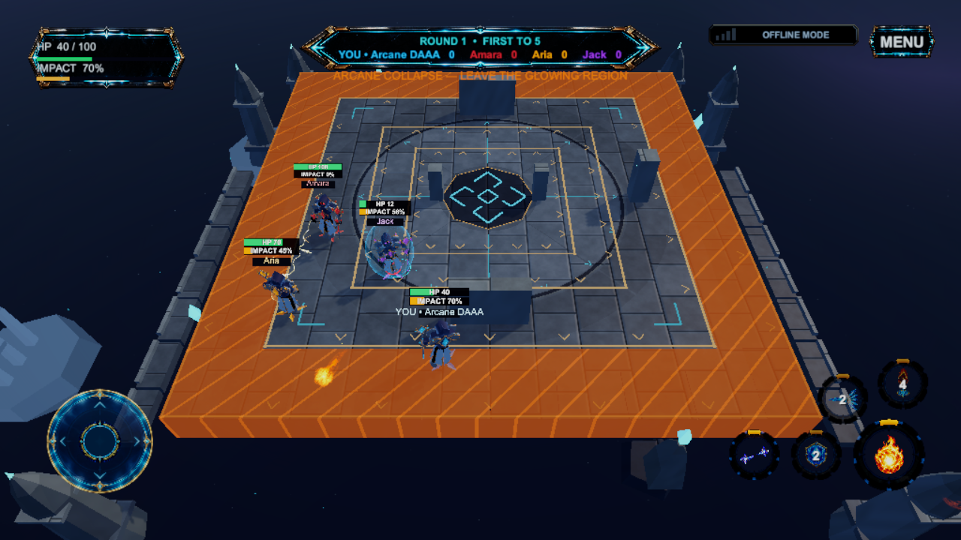
Every hit makes the next shove stronger
Build Impact
Land spells to increase an opponent’s knockback.
Fight for safe ground
Arena collapse pushes the fight into less space.
Recover the round
Use movement and defensive spells to escape danger.
Actual Unity Editor gameplay with offline bots
02
Notes:
Source: current game prototype and PROJECT_STATE.md. Image: Recordings/FundingGameplay/arena-1-frame-432.png, actual Unity Editor capture with offline bots. Impact increases knockback. Survival hazards drain health and allow recovery. Sudden Knockout uses instant ring-out. Video: https://minthukyawdev-droid.github.io/ArcaneKnockout-Screenshots/

Slide 3
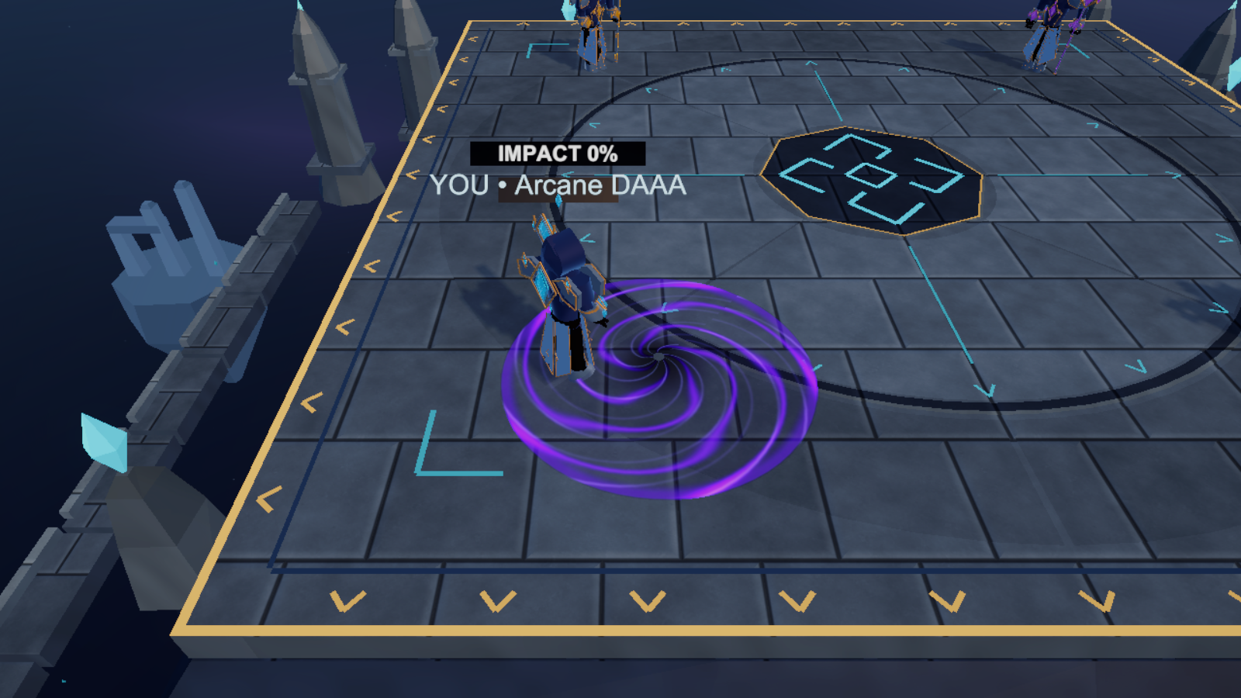
Five spells, chosen around your playstyle
Fire Orb anchors every loadout.
Choose four secondary spells:
movement, defense, direct attack
and area control.
Win rounds, then adapt.
Choose upgrades between rounds.
First to five round wins takes
the match.
Gravity Well • in-engine spell capture
03
Notes:
Sources: game loadout and round systems, current prototype. Fixed Fire Orb primary plus movement, defense, direct attack and area-control slots. First to five round wins, upgrades between rounds. Image: public funding media 04-arcane-knockout-gravity-well.png, staged in-engine camera with overlay controls hidden. https://arcaneknockout.minthukyaw.com/

Slide 4
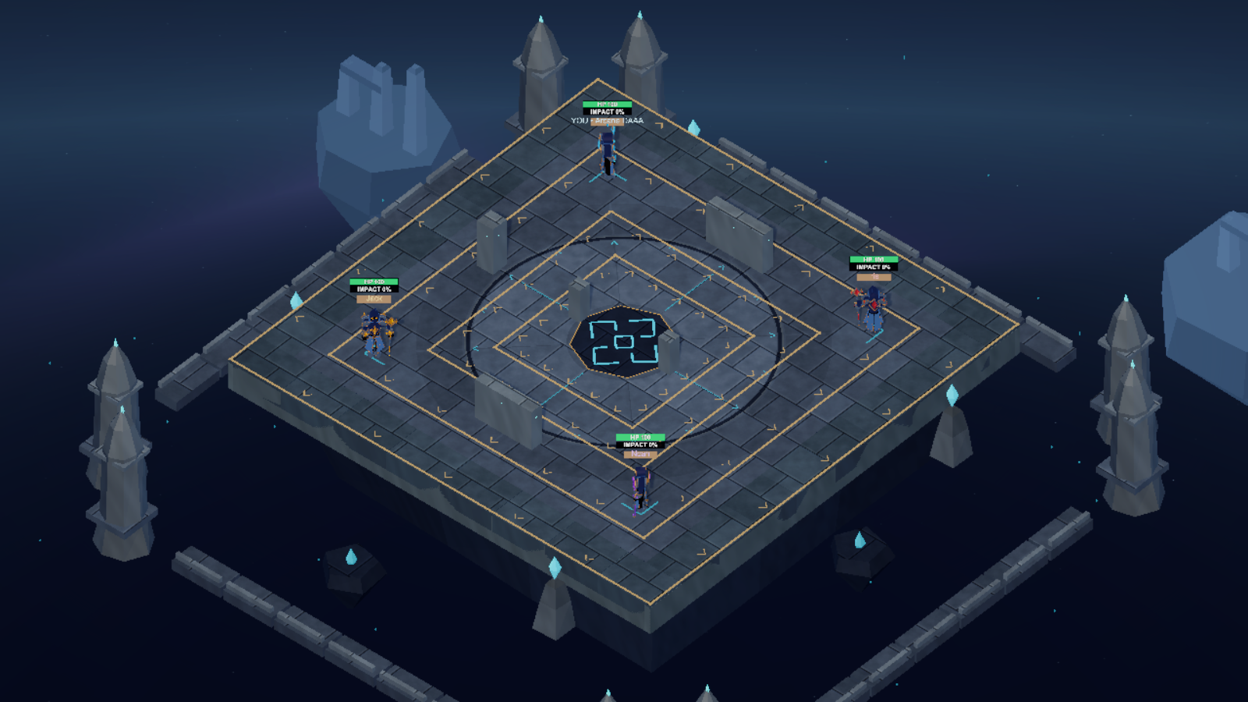
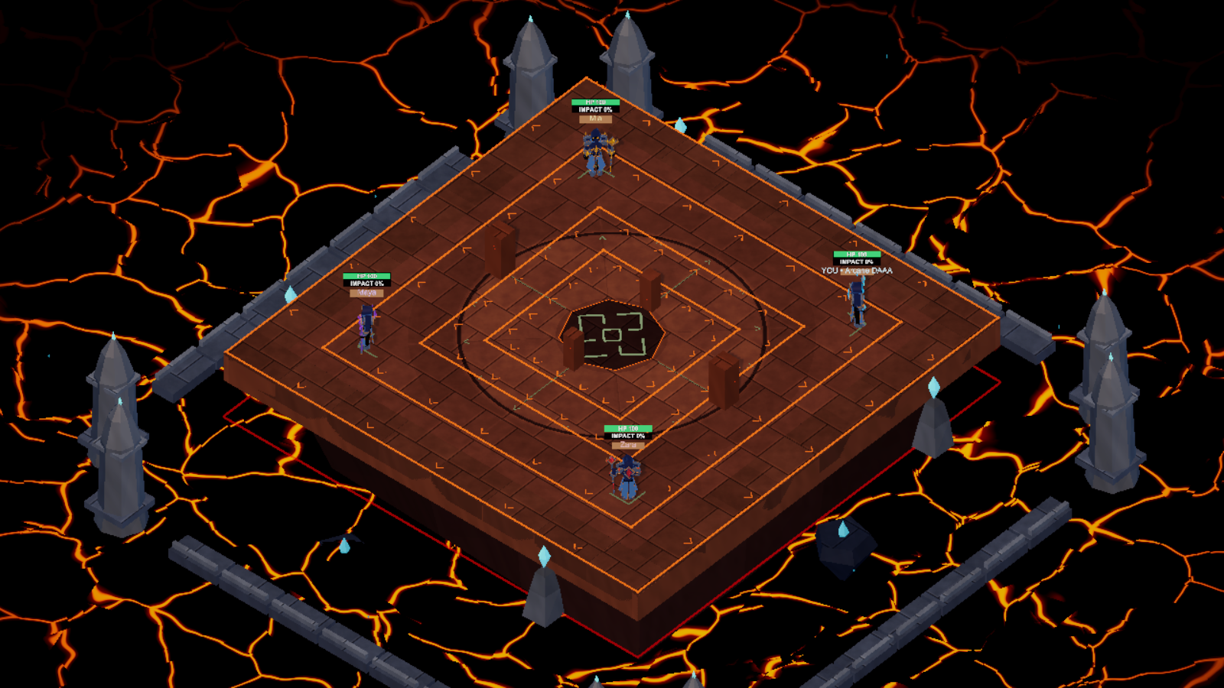
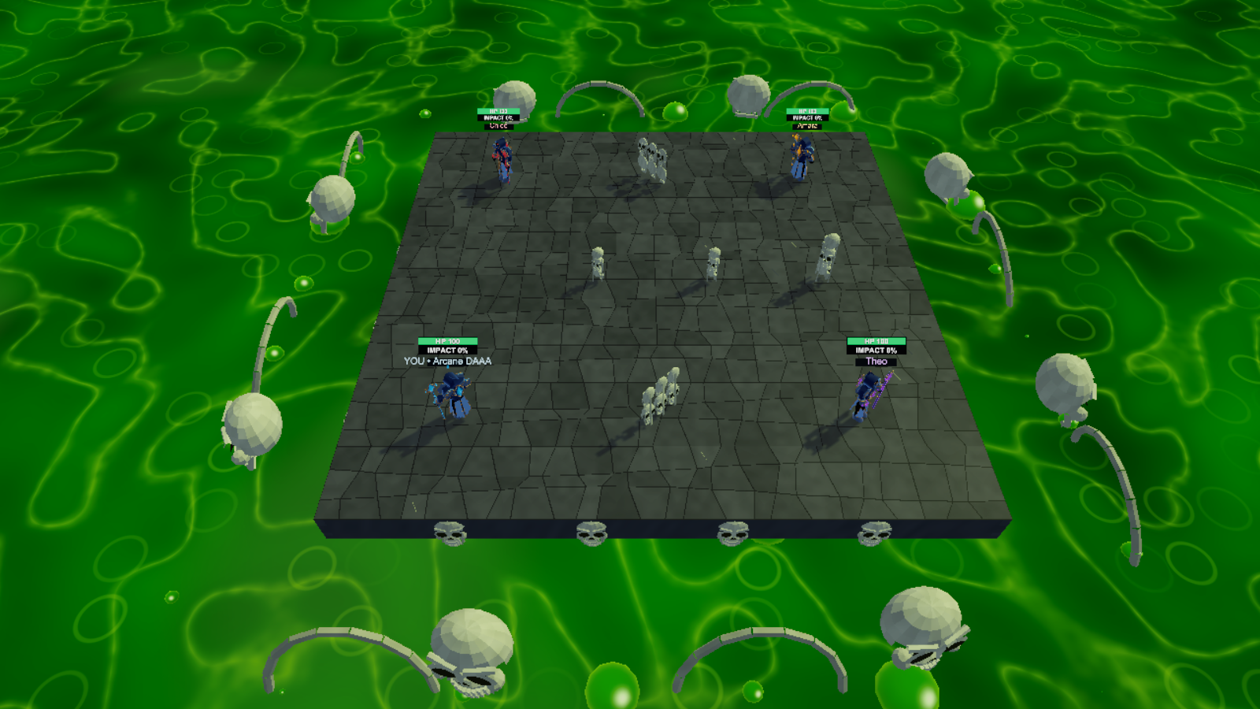
Three arenas that change the fight
Arcane Citadel
Molten Crucible
Venom Sanctum
Free-for-all or 2v2 Team Survival
Survival allows a recovery from danger. Sudden Knockout uses instant ring-outs.
In-engine arena captures with staged cameras
04
Notes:
Sources: current map and mode implementation. Images: Documentation/Art/MapIdentity-v1/citadel-opening.png, public media 03-arcane-knockout-molten-crucible.png and 02-arcane-knockout-venom-sanctum.png. In-engine staged captures, controls hidden. Current modes include FFA, Team Survival 2v2 and Sudden Knockout. Website: https://arcaneknockout.minthukyaw.com/

Slide 5
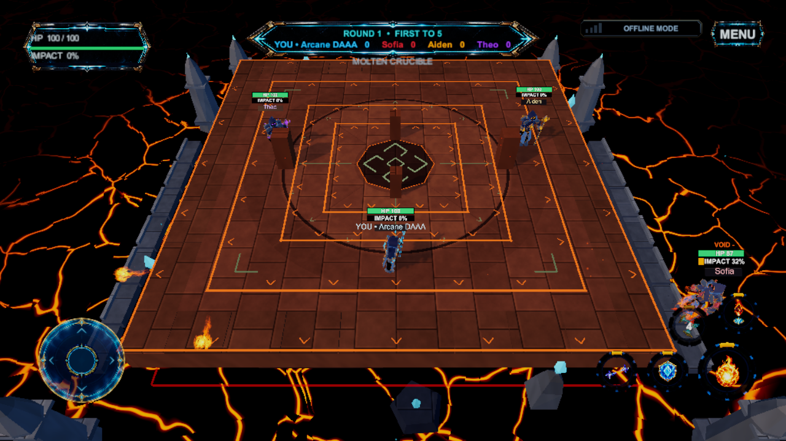
A playable prototype is ready to review
Android APK
Preferred touchscreen experience
Android 8.0+ / ARM64
Windows x64 ZIP
Extract and run the prototype.
Start with offline bot matches.
Watch 90 seconds of gameplay
Actual Unity Editor gameplay with offline bots
Online play still needs external validation.
05
Notes:
Prototype links verified during funding preparation. Android v0.1.0 APK user-built 13 October 2026, Android 8.0+ ARM64. Windows x64 ZIP built 15 October 2026. Offline startup and four targeted PlayMode checks passed for Windows preparation, not a complete human playthrough or live multiplayer validation. No macOS build supplied. Image: Recordings/FundingGameplay/arena-2-frame-96.png, Unity Editor, offline bots. Android: https://arcaneknockout.minthukyaw.com/downloads/ArcaneKnockout-v0.1.0.apk?build=2026-10-13-db63d313
Windows: https://github.com/minthukyawdev-droid/ArcaneKnockout-Screenshots/releases/download/funding-prototype-2026-10-15/ArcaneKnockout-Windows-x64-Prototype-2026-10-15.zip
Gameplay: https://minthukyawdev-droid.github.io/ArcaneKnockout-Screenshots/

Slide 6
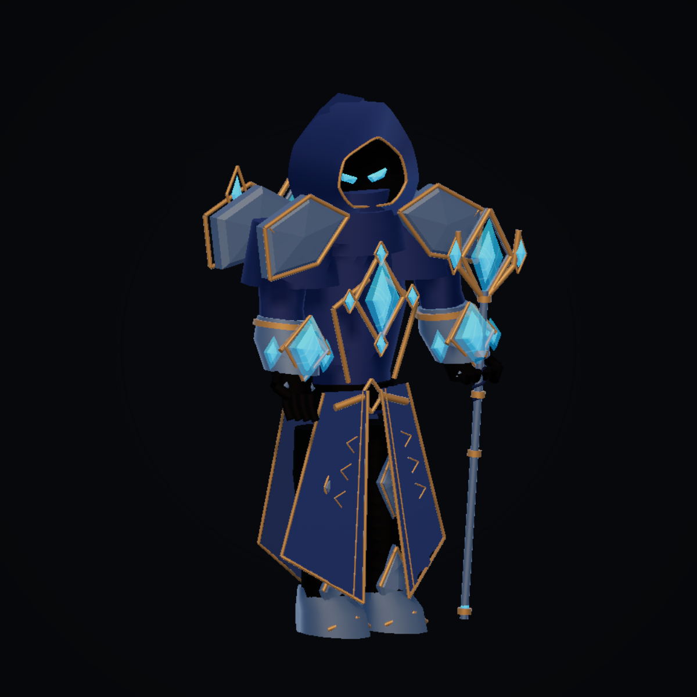
Competitive mobile play, cosmetic purchases
Designed for players who enjoy
Spell duels, tactical positioning and
comebacks in competitive arena matches.
Planned revenue model
Optional wizard skins, staff designs and
visual customization. Purchases would
not increase spell power.
Pre-launch • Cosmetic purchases are not implemented or validated.
06
Notes:
Business model is a proposal, not integrated or validated. Target audience is a positioning hypothesis, not audience research. No verified player-acquisition, retention or revenue metrics. MMP has not been integrated. Current stage: pre-launch without integrated monetization. User application planning and existing prototype are the sources. Image: Documentation/Art/StaffWizard/hero.png, in-engine character capture.

Slide 7
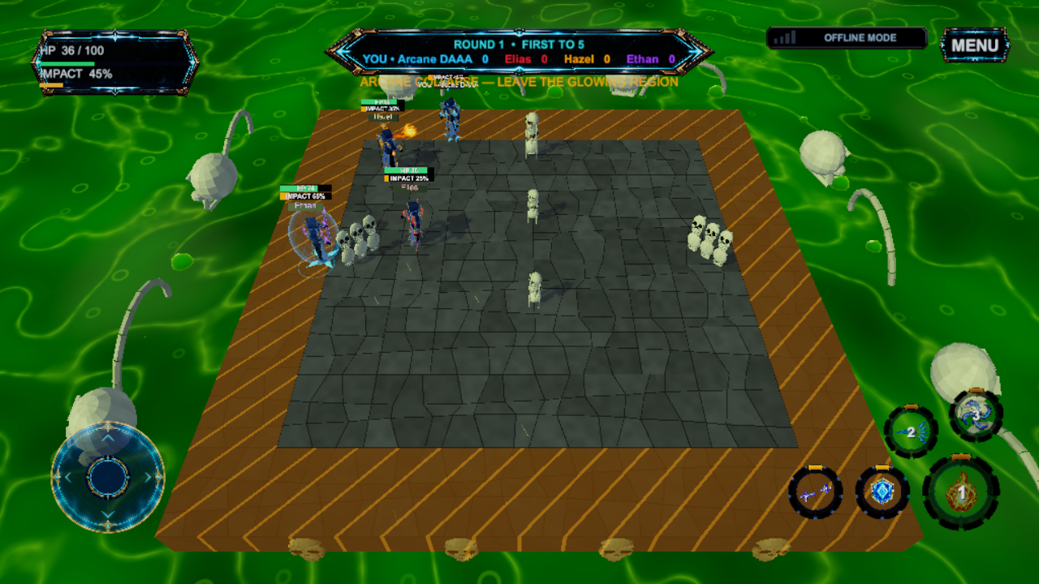
The next milestone is external validation
Prototype playtest questions
Can new players understand and use
the full spell loadout?
Does online combat stay responsive
and readable on target devices?
Do players want another match
after learning the core loop?
First priorities: clearer spell controls, multiplayer testing and device performance.
07
Notes:
Development priorities derived from user feedback and prototype state. The user reported difficulty with Windows spell controls. Real multiplayer, physical-device performance, retention and monetization remain validation tasks. No traction or test results are invented. Screenshot: Recordings/FundingGameplay/arena-3-frame-432.png, Unity Editor offline bots.

Slide 8
Solo today. A small team with funding.
Min Thu Kyaw
Software engineer and AI product manager
Myanmar • 12+ years in software and product delivery
“I started ArcaneKnockout to make a game
I wanted to play myself.”
Current
Planned after funding
Solo developer, using
AI-assisted coding.
Hire two developers for gameplay, networking,
performance and release preparation.
Personal portfolio: minthukyaw.com
08
Notes:
Source: founder statements and personal portfolio https://minthukyaw.com/about . Min Thu Kyaw is based in Myanmar, with 12+ years across software engineering, solution architecture and product delivery, outside the professional game industry. Initial motivation: create a game he wanted to play. AI-assisted workflow. Two hires are conditional, roles are proposed and candidates are not represented as secured. No established studio or team website.

Slide 9
Four funded months toward a 2027 release
Period | Main work | Review outcome
Month 1 | Onboard hires, improve controls and finish core gameplay | A clearer, complete core loop
Month 2 | Polish content, UI and audio Validate networking and performance | Build ready for external tests
Month 3 | Run multiplayer and external playtests Resolve crashes, balance and usability | Evidence for release decisions
Month 4 | Complete QA and store preparation Fix remaining release blockers | Release candidate if criteria are met
PR and marketing run during months 2–4.
Timing depends on funding, recruitment and validation. The 2027 date is a target.
09
Notes:
Source: proposed funding budget Milestones sheet. Periods are relative to funding and recruitment, not calendar commitments. Four months is the funded development window, not a guaranteed release deadline. Ship-year target is 2027. Timing depends on hiring, playtest outcomes and release readiness. https://raw.githubusercontent.com/minthukyawdev-droid/ArcaneKnockout-Screenshots/main/ArcaneKnockout-Funding-Budget-30000-USD.xlsx

Slide 10
$30,000 covers the four-month proposal
Budget item | USD
Founder + two planned developers | 18,000
Art and UI assets | 3,000
Audio and music | 500
QA and device coverage | 1,500
Hosting and tools | 300
Publishing and admin | 100
PR and marketing | 3,000
Contingency | 3,600
Total requested | 30,000
Development allowance
3 people × 4 months
× $1,500 per month
PR and marketing
$700 press / store assets
$800 creator outreach
$1,500 paid experiments
All costs and pay rates are proposed estimates. Hires depend on funding.
10
Notes:
All USD. Planning estimates, not confirmed quotations. Source: published ArcaneKnockout-Funding-Budget-30000-USD.xlsx, Budget sheet. Development $18,000 = 3 people × 4 months × $1,500/person/month. Art/UI $3,000, audio $500, QA/devices $1,500, tools/hosting $300, publishing/admin $100, PR/marketing $3,000, contingency $3,600. PR/marketing = press/store assets $700 + creator outreach $800 + paid experiments $1,500. Total checked: $30,000. https://raw.githubusercontent.com/minthukyawdev-droid/ArcaneKnockout-Screenshots/main/ArcaneKnockout-Funding-Budget-30000-USD.xlsx

Slide 11
Help bring ArcaneKnockout to release
$30,000
Fund four months of development, two planned
hires, external testing and release preparation.
Review the prototypes, gameplay and budget
Official game website
Min Thu Kyaw
arcaneknockout.minthukyaw.com
minthukyaw.com
11
Notes:
Funding request supplied by founder. Four-month funded plan and 2027 target are conditional on funding, hiring and validation. Review materials: https://github.com/minthukyawdev-droid/ArcaneKnockout-Screenshots/blob/main/SUPPORTING_MATERIALS.md
Official website: https://arcaneknockout.minthukyaw.com/
Founder portfolio: https://minthukyaw.com/about
The game source repository remains private. All prototype and evidence links are public.

