Slide 1
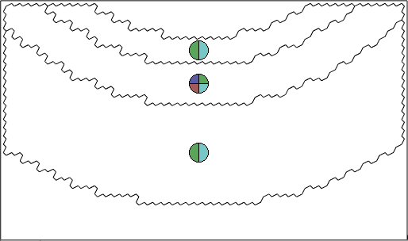




All Configurations
Possible Color
Adjacent Cells
-1
1 2 3 4
$$①$$
2
1
-1
$$②$$
-1
3
2
$$③$$
-1
168，168，208
217，235，217
208，208，230
226，240，217
221，193，193
201，234，234
252，230，228
218，227，243

Slide 2
1
4
1
4
2
3
2
3

Slide 3
1
4
1
4
1
4
2
3
2
3
2
3
1
4
1
4
2
3
2
3

Slide 4
Enforce connecting
cell 1 and cell 2
①
①
+
Unconnectable
area
②
②
All different divisions
(having same cost)
=
=
=
=
Solve the graph without inner cell
Place the inner cell arbitrarily afterwards
=

Slide 5





$0$ cycle
$1$ cycle
$2$ cycles
$n$ cycles
$$⋯$$

Slide 6
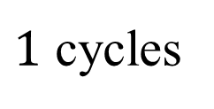
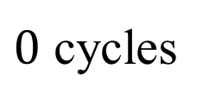

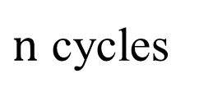
Enforce connecting
cell 1 and cell 2
$0$ cycles
$1$ cycles
$n$ cycles
①
=
$$⋯$$
②
=
=
=
=

Slide 7
One cutting path
Connecting two inner cells
One cutting path
Connecting two outer cells
Contradiction

Slide 8
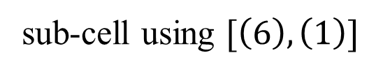
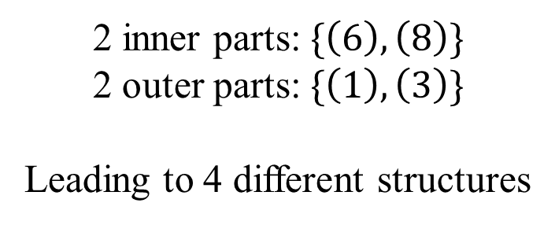
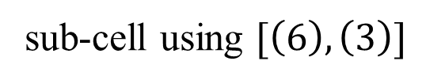
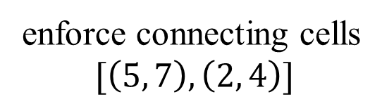
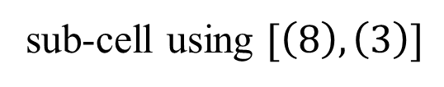
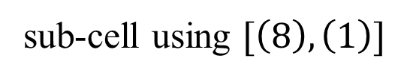
sub-cell using $[\left(6\right), \left(1\right)]$
sub-cell using $[\left(8\right), \left(1\right)]$
enforce connecting cells
$$[\left(5, 7\right), \left(2, 4\right)]$$
②
①
②
①
⑥
⑥
⑤
⑦
⑤
⑦
⑧
⑧
②
①
③
④
③
④
⑥
⑦
⑤
⑧
sub-cell using $[\left(6\right), \left(3\right)]$
sub-cell using $[\left(8\right), \left(3\right)]$
③
④
②
①
②
①
2 inner parts: $\{\left(6\right), \left(8\right)\}$
2 outer parts: $\{\left(1\right), \left(3\right)\}$
Leading to 4 different structures
⑥
⑥
⑤
⑦
⑤
⑦
⑧
⑧
③
④
③
④

Slide 9

all possible solutions of a $\left(3, 4, 5, 4\right)$-cell
(16)
(17)
⑾
⑾
⑩
⑩
⑿
⑿
⑨
⑨
⑧
⑧
(15)
⑥
⑥
⑦
⑤
⑦
⑤
④
(18)
④
①
③
①
③
②
②
(14)
(13)

Slide 10
all possible solutions of a $\left(3, 4, 5, 4\right)$-cell
(16)
(16)
(17)
⑾
(17)
⑾
⑩
⑩
⑿
⑿
⑧
⑨
⑧
⑨
(15)
(15)
⑥
⑥
⑦
⑤
⑦
⑤
(18)
④
(18)
④
①
③
①
③
②
②
(14)
(14)
(13)
(13)

Slide 11


enforce connecting
cell 1 and cell 2
①
①
$$φ$$
unconnectable
inner part
(shrink the inner part)
②
②
direct solving
solve the outer part without the inner part
=
=
$$φ^{−1}$$
=
place the inner part arbitrarily afterwards
=

Slide 12



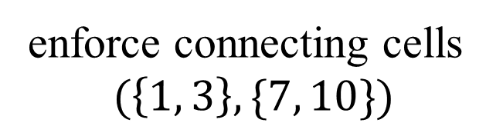














divisions
sub-divisions
$$(\left\{3, 4, 5, 1\right\}, \{10, 6, 7\})$$
$$1101100$$
⑥
⑩
⑥
⑩
⑤
①
⑤
①
④
④
$$③$$
②
$$③$$
②
⑦
⑨
⑦
⑨
⑧
⑧
$$(\left\{1, 2, 3\right\}, \{10, 6, 7\})$$
$$101101$$
⑥
⑩
⑥
⑩
enforce connecting cells
$$(\left\{1, 3\right\}, \{7, 10\})$$
⑤
①
⑤
①
④
④
$$③$$
②
$$③$$
②
⑥
⑩
⑦
⑨
⑦
⑨
⑤
①
⑧
⑧
④
$$③$$
②
⑦
⑨
$$(\left\{3, 4, 5, 1\right\}, \{7, 8, 9, 10\})$$
$$11001100$$
⑥
⑩
⑥
⑩
⑧
⑤
①
⑤
①
④
④
$$③$$
②
$$③$$
②
⑦
⑨
⑦
⑨
⑧
⑧
$$(\left\{1, 2, 3\right\}, \{7, 8, 9, 10\})$$
$$1011001$$
⑥
⑩
⑥
⑩
⑤
①
⑤
①
④
④
$$③$$
②
$$③$$
②
⑦
⑨
⑦
⑨
⑧
⑧

Slide 13


①
①
$$=$$
②
②
③
$$=$$
①
②
①
②

Slide 14
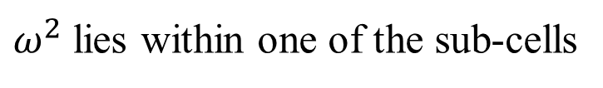





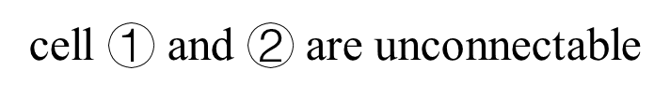

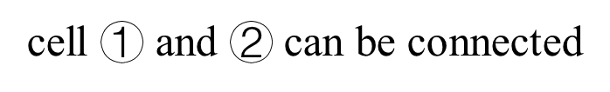

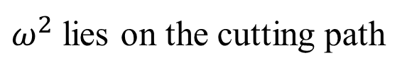
$ω^{2}$ lies within one of the sub-cells
cell $①$ and $②$ can be connected
the first stage has finished
$$①$$
$$②$$
$$①$$
$$②$$
$ω^{2}$ lies on the cutting path
$$≥$$
$$②$$
cell $①$ and $②$ are unconnectable
$$①$$

Slide 15
⑾
⑾
①
⑥
⑩
…
①
⑥
⑩
…
③
⑦
⑤
⑿
③
⑦
⑤
⑿
②
④
⑧
⑨
②
④
⑧
⑨
…
…
…
…

Slide 16
⑾
⑾
⑩
①
⑥
…
⑩
①
⑥
…
⑿
③
⑤
⑿
③
⑦
⑤
⑨
②
⑦
④
⑨
②
④
⑧
⑧
⑾
⑾
①
⑩
⑥
…
①
⑩
⑥
…
③
⑿
⑦
⑤
③
⑿
⑤
②
⑨
④
②
⑨
⑦
④
⑧
⑧
⑾
⑾
⑩
①
⑥
…
⑩
①
⑥
…
⑿
③
⑤
⑿
③
⑦
⑤
②
⑦
④
⑨
②
④
⑧
⑨
⑧

Slide 17
starting with no cutting paths
…
(n inner parts)
stage 1: consider the first inner part
stage 1: create two cutting paths
…
…
stage 2: create two cutting paths
stage 2: consider the second inner part
…
…
…
…
stage 3: consider the third inner part
stage 3: create two cutting paths
…
…
…

Slide 18
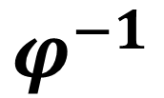
enforce connecting
cell 1 and cell 2
①
①
$$φ$$
unconnectable
inner part
(shrink the inner part)
②
②
direct solution
solve the outer part without the inner part
=
=
$$φ^{−1}$$
=
=
place the inner part arbitrarily afterwards

Slide 19
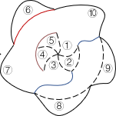
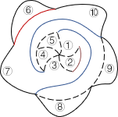
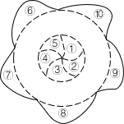
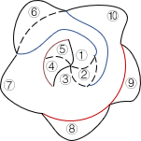
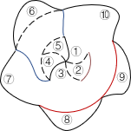
Different structures of the cutting paths
Enforce connecting cell 1, 3, 7, 10

Slide 20
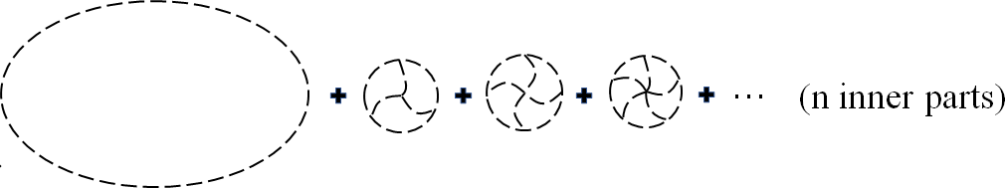
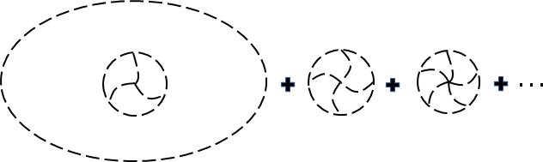
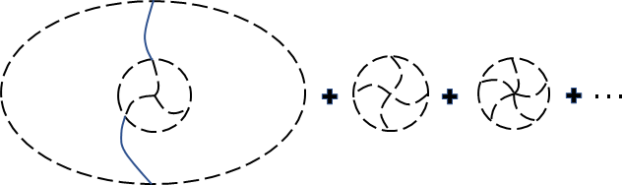
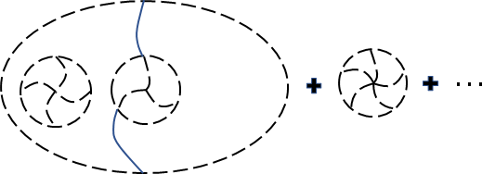
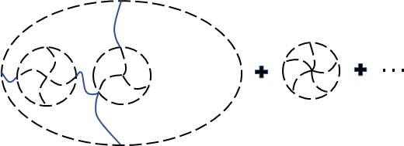
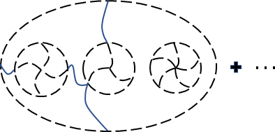
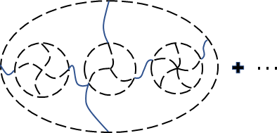

Init graph
Stage 1
Stage 2
Stage 3
$$⋯$$

Slide 22
{1}
{1, 2}
{2}

Slide 23




$$01$$
$$11$$
$$00$$
$$10$$

Slide 24

$ω^{2}$ lies within one of the sub-cells
cell $①$ and $②$ can be connected
the first stage has finished
$$①$$
$$②$$
$$①$$
$$②$$
$ω^{2}$ lies on the cutting path
$$≥$$
$$②$$
cell $①$ and $②$ are unconnectable
$$①$$

Slide 25





final version
Different structures of the cutting paths
⑥
⑩
⑥
⑩
Enforce connecting cell 1, 3, 7, 10
⑤
⑤
①
①
④
④
⑥
②
②
⑩
⑦
$$③$$
⑨
⑦
$$③$$
⑨
⑤
①
⑧
⑧
④
②
⑥
⑦
$$③$$
⑨
⑥
⑩
⑩
⑤
①
⑤
①
⑧
④
④
②
②
⑦
$$③$$
⑨
⑦
$$③$$
⑨
⑧
⑧

Slide 26
final version
①
①
$$=$$
②
②
③
$$=$$
①
②
①
②

Slide 27
enforce connecting
cell 1 and cell 2
①
①
$$φ$$
unconnectable
inner part
(shrink the inner part)
②
②
direct solution
solve the outer part without the inner part
=
=
$$φ^{−1}$$
=
=
place the inner part arbitrarily afterwards

Slide 28


For final video, we need two other figures
⑥
⑩
⑥
⑩
⑤
①
⑤
①
④
④
②
②
⑦
$$③$$
⑨
⑦
$$③$$
⑨
⑧
⑧

