Slide 1
000
001
010
011
3-edge cell
adj cell 1
adj cell 3
100
101
110
111
adj cell 2

Slide 2




0000
0001
0010
$××$11
0100
0101
$×$11$×$
0111
4-edge cell
1000
1$××$1
1010
1011
11$××$
1101
1110
1111

Slide 3







$$⋯1\left(0⋯\right)1⋯$$
$$⋯10\left(⋯\right)1⋯$$
$$⋯$$
$$⋯$$
$$=$$
$$⋯$$
$$⋯$$

Slide 4






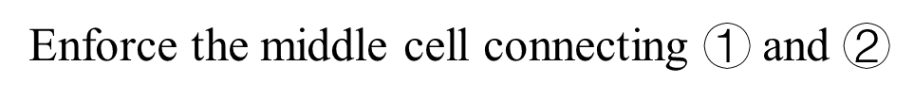
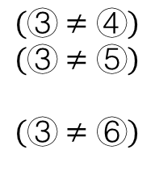









Enforce the middle cell connecting $①$ and $②$
$$④$$
$$(③≠④)$$
$$(③≠⑤)$$
$$(③≠⑥)$$
$$④$$
$$⑤$$
$$⑥$$
$$=$$
$$≥$$
$$⋯$$
$$②$$
$$②$$
$$③$$
$$②$$
$$③$$
$$①$$
$$①$$
$$①$$

Slide 5



$$cost=3$$
only one cell required solving
optimal
greedily
non optimal
$$cost=2$$
$$cost=3$$

