Slide 1















$$②=③$$
$$②$$
$$⋯$$
$$=$$
$$①$$
$$(①≠②)$$
$$②$$
or
$$①$$
$$③$$
$$③$$
$$=$$
$$①=③$$
$$②$$
$$⋯$$
$$①$$

Slide 2












$$②=③$$
$$②$$
$$①$$
$$=$$
$$③$$
$$①≠②$$
$$②$$
or
$$①$$
$$③$$
$$=$$
$$①=③$$
$$②$$
$$①$$
$$③$$

Slide 3







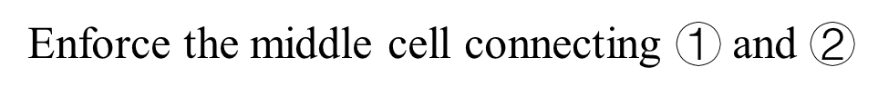












Enforce the middle cell connecting $①$ and $②$
$$③=④$$
$$⋯$$
$$③$$
$$④$$
$$=$$
$$⑤$$
$$⑥$$
$$=$$
$$②$$
$$②$$
$$③$$
$$②$$
$$①$$
$$①$$
$$①$$
$$≥$$
$$⋯$$
$$③≠④$$
$$③$$

Slide 4






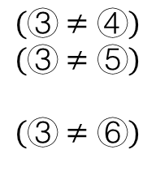







Enforce the middle cell connecting $①$ and $②$
$$④$$
$$(③≠④)$$
$$(③≠⑤)$$
$$(③≠⑥)$$
$$④$$
$$⑤$$
$$⑥$$
$$=$$
$$≥$$
$$⋯$$
$$②$$
$$②$$
$$③$$
$$②$$
$$③$$
$$①$$
$$①$$
$$①$$

Slide 5



two cutting paths intersect
$$=$$
$$=$$
$$=$$

Slide 6




two cutting paths intersect
$$cost=2$$
$$cost=1$$
$$cost=2$$
$$cost=2$$

