Slide 1
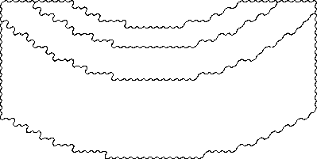
{2}
{2}
{2}
{2, 4}
{1, 2, 3, 4}
{2, 4}
{4}
{4}
{4}

Slide 2
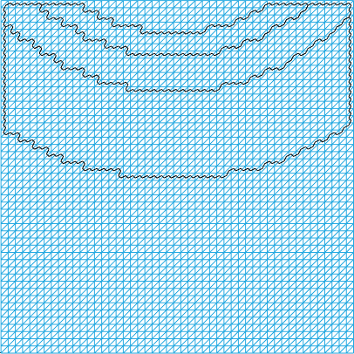

Slide 3
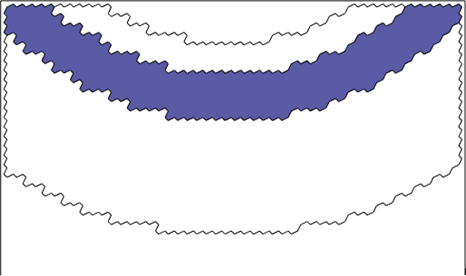

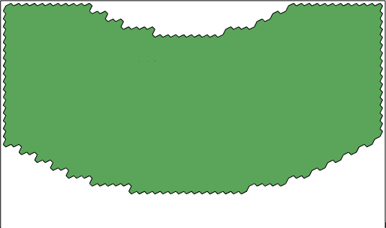
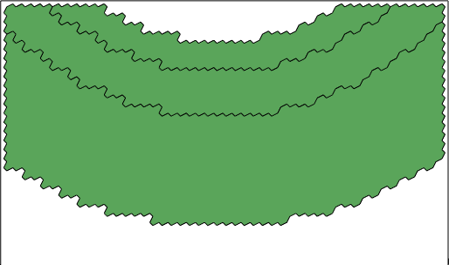

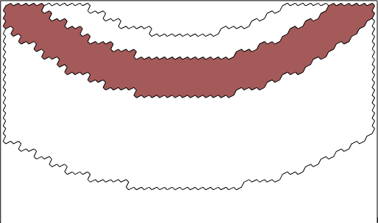

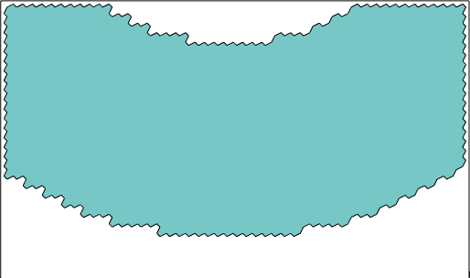
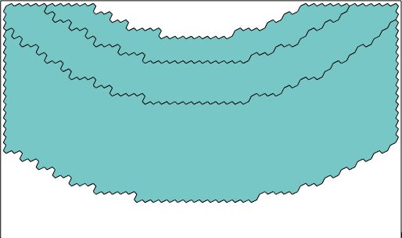
Available Configurations
Topological Graph
Optimal
Topological Divisions
Mapping to Physical Mesh

Slide 4

All Configurations
Possible Color
Adjacent Cells
-1
1 2 3 4
2
1
2
3
1
Cell Index
-1
-1
3
2
-1

Slide 5
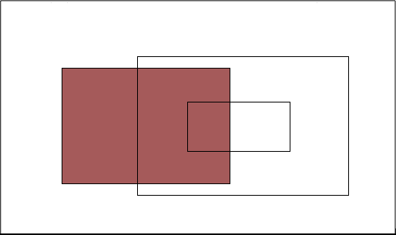
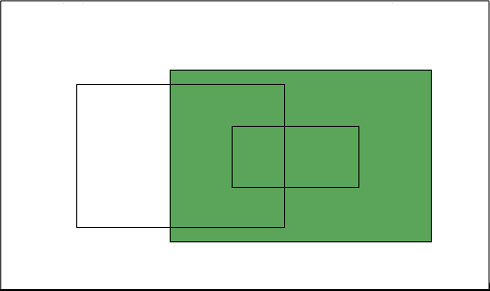
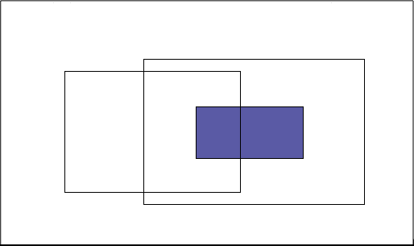

All Configurations
Topological Graph
Reduced Topological Graph
$$≥$$
Discard the 3rd Configurations

