Slide 1
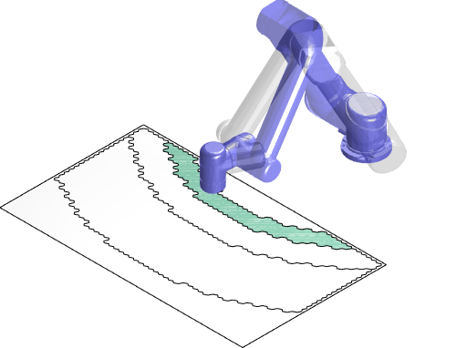
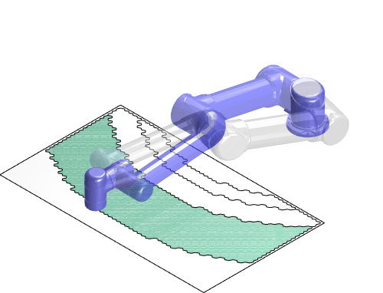
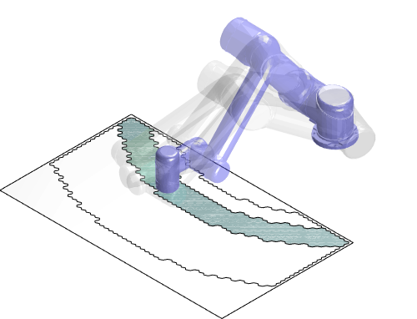
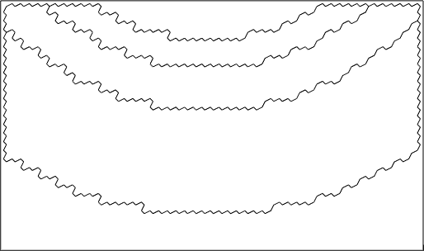
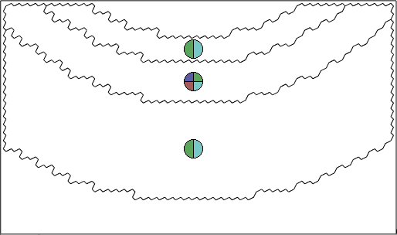
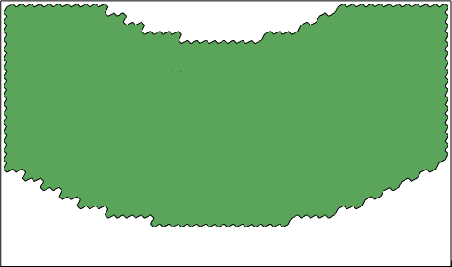
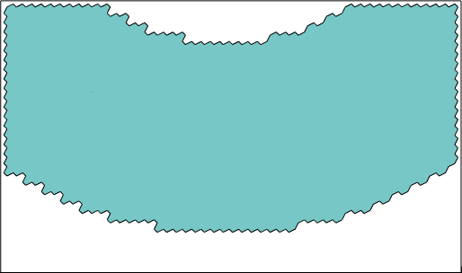
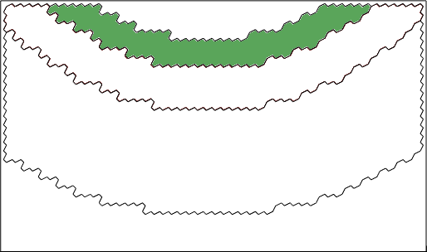
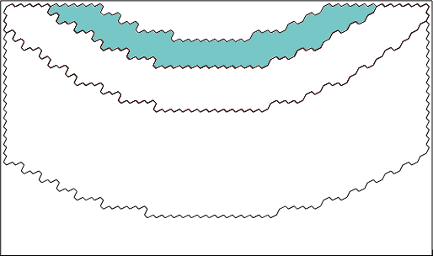




given the mesh, the manipulator and other environment settings
collect all valid configurations (under given constraints)
classification based on joint-space continuity
s-r & w-u
s-l & w-u
s-r & w-f
s-r & w-u
s-l & w-f
s-l & w-u
s-r & w-u
s-l & w-u
(use colours for notation)
initial graph (cells with possible colours and adjacency relations)
$$①$$
cell 1: two colours, connecting cell 2, -1
cell 2: four colours, connecting cell 1, -1, 3, -1
cell 3: two colours, connecting cell 2, -1
(the uncoverable area is denoted by -1)
$$②$$
$$③$$
enumeratively
solving cell 2
enumeratively
solving cell 2
enumeratively
solving cell 1
$$⋯$$
(for each possible branch)
(for each possible branch)
only two optimal solutions
for this example
iteratively looping through all possible branches

Slide 2
Input: object (mesh) and pose, manipulator pose, other environmental settings
(e.g. obstacle poses, EE orientation constraint)
Output: generate all valid configurations (IK)
classification based on joint-space continuity
s-r & w-u
s-l & w-u
s-r & w-f
s-r & w-u
s-l & w-f
s-l & w-u
s-r & w-u
s-l & w-u
(use colours for notation)
initial graph (cells with possible colours and adjacency relations)
$$①$$
cell 1: two colours, connecting cell 2, -1
cell 2: four colours, connecting cell 1, -1, 3, -1
cell 3: two colours, connecting cell 2, -1
(the uncoverable area is denoted by -1)
$$②$$
$$③$$
enumeratively
solving cell 2
enumeratively
solving cell 3
enumeratively
solving cell 1
$$⋯$$
(for each possible branch)
(for each possible branch)
only two optimal solutions
for this example
iteratively looping through all possible branches

Slide 3
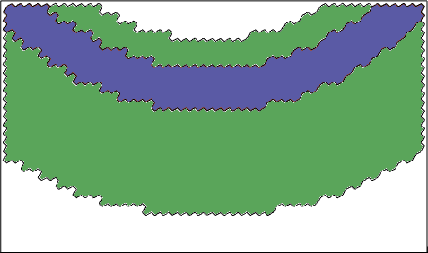
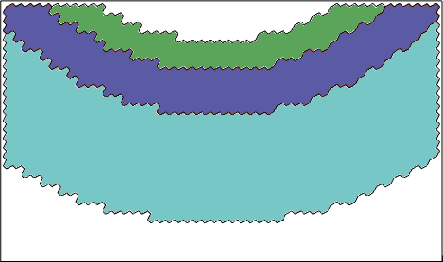
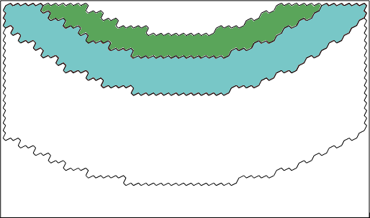
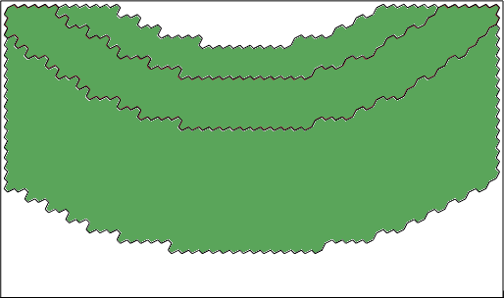
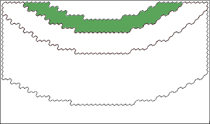
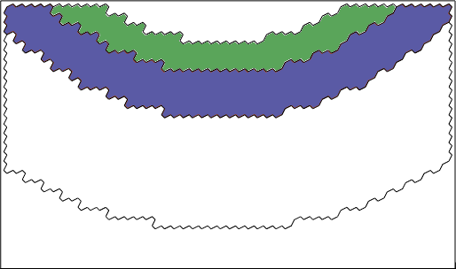
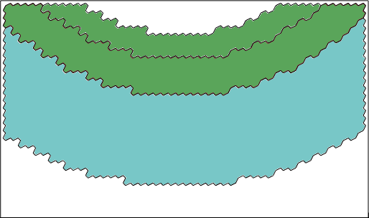
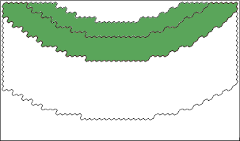
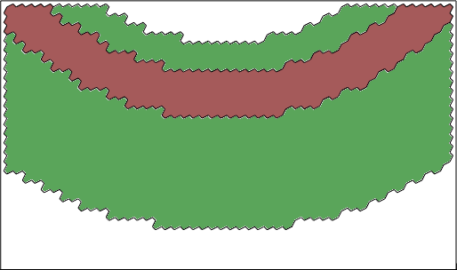
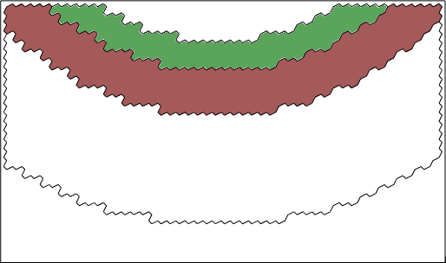
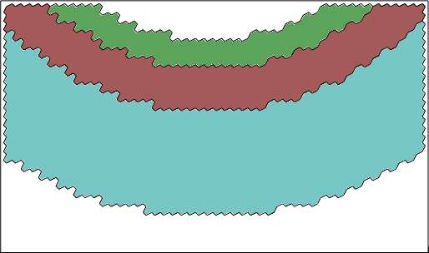
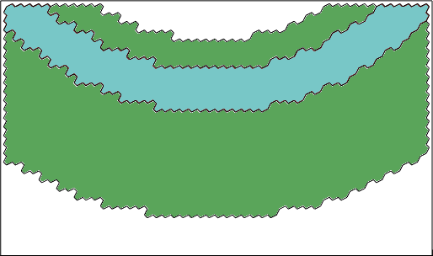
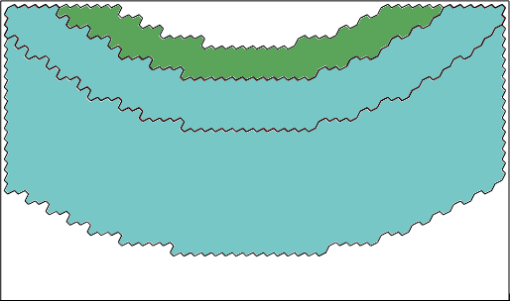
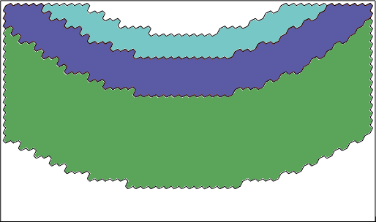
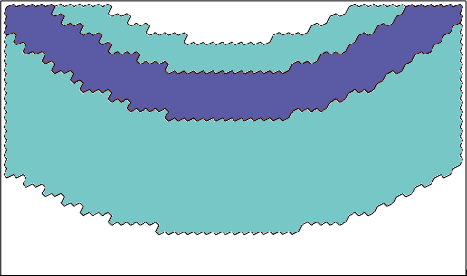
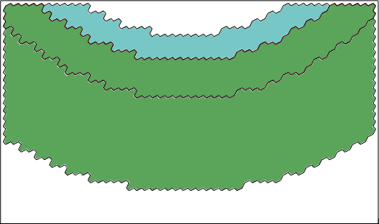
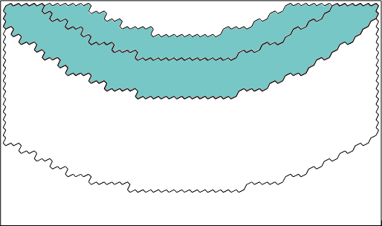
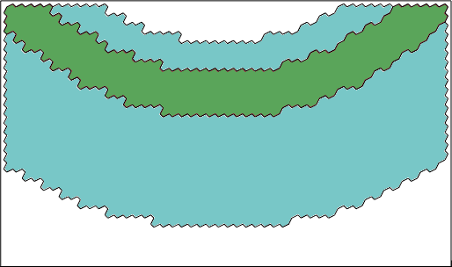
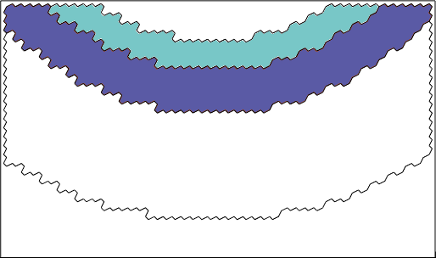
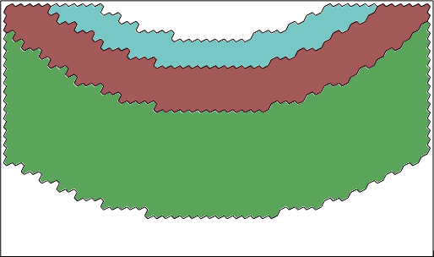

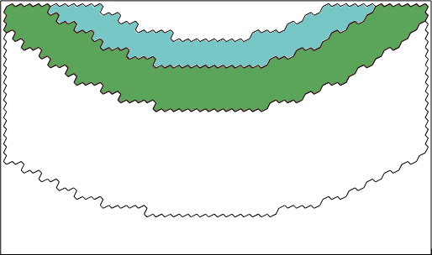
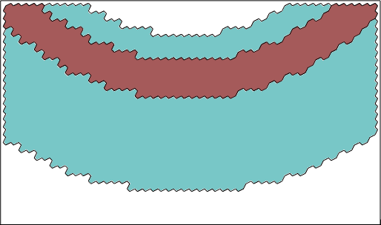
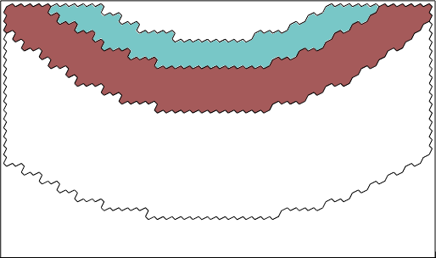
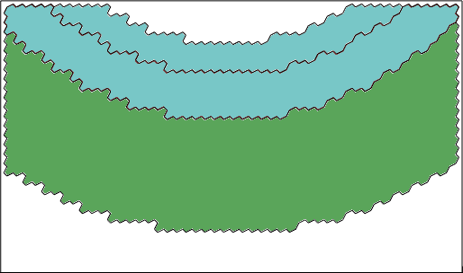
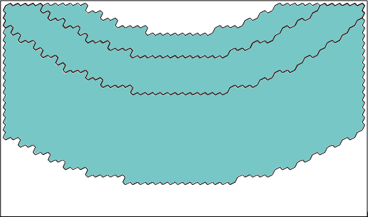
Input: object (mesh) and pose, manipulator pose, other environmental settings
(e.g. obstacle poses, EE orientation constraint, manipulability)
Output: generate all valid configurations (IK)
classification based on joint-space continuity
s-r & w-u
s-l & w-u
s-r & w-f
s-r & w-u
s-l & w-f
s-l & w-u
s-r & w-u
s-l & w-u
(use colours for notation)
initial graph (cells with possible colours and adjacency relations)
$$①$$
cell 1: 2 colours, connecting cell 2, -1
cell 2: 4 colours, connecting cell 1, -1, 3, -1
cell 3: 2 colours, connecting cell 2, -1
(the uncoverable area is denoted by -1)
$$②$$
$$③$$
only two optimal solutions
for this example
enumeratively
solving cell 1
enumeratively
solving cell 2
enumeratively
solving cell 3
iteratively looping through all possible colouring schemes

Slide 4
all environment settings
for coverage task
the proposed cellular decomposition
other cellular decomposition
physical coverage path generator
(e.g., spiral path)
motion controller

Slide 5
Input: object (mesh) and pose, manipulator pose, other environmental settings
(e.g., obstacle poses, EE orientation constraint)
Cellular decomposition
Proposed algorithm
Other algorithms
Path within each cell
(e.g., spiral, boustrophedon)
motion controller

