Slide 1
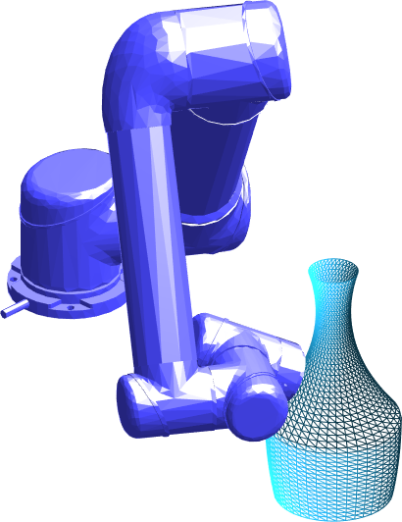
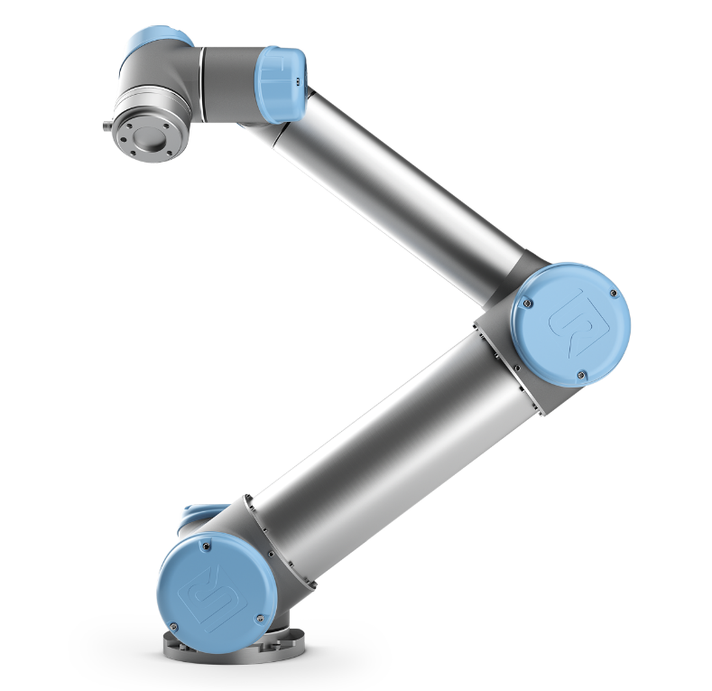
Input: object (mesh) and pose, manipulator pose, other
environmental settings (e.g. obstacle poses,
EE orientation constraints, etc.)
Cellular decomposition
Proposed algorithm
Other algorithms
Path within each cell
(e.g. spiral, boustrophedon)
Robot
motion controller

