Slide 1
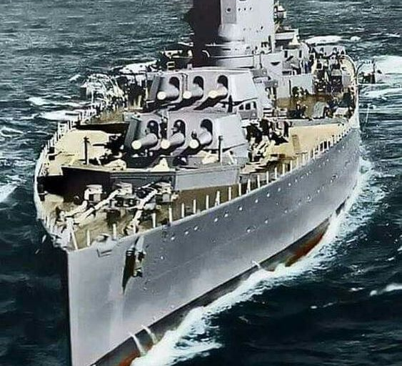
Battleship
Experiential Learning Project

Slide 2
About Battleship
Battleship is a strategy type guessing game for two players. Battleship is known worldwide as a pencil and paper game which dates from World War I. It was published by various companies as a pad-and-pencil game in the 1930s and was released as a plastic board game by Milton Bradley in 1967.
It is played on ruled grids on which each player's fleet of ships (including battleships) are marked. The locations of the fleets are concealed from the other player. Players alternate turns calling "shots" at the other player's ships, and the objective of the game is to destroy the opposing player's fleet.
Notes:
Battleship is a strategy type guessing game for two players, this game dates back to the first world war it is played on a board but in this project I have used basic concepts of C++ to create a program that enables the two players to play on a computer.

Slide 3
Concept
This game uses the concept of 2D arrays to take place of the board that is present in the actual game. Two separate arrays are initialised for both the players which contain the location of their ships and the shots they take against the enemy player.
Besides that several for loops, while loops and if else statements are used for making the functions.

Slide 4
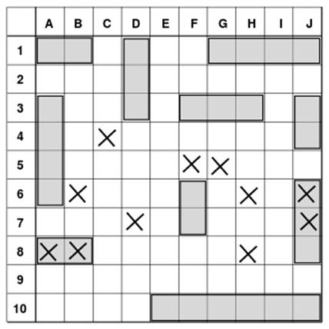
The Game Board
The game is played on two grids, one for each player.
The grids are typically square – usually 10×10 – and the individual squares in the grid are identified by letter and number.
Notes:
The game is played on a 10 by 10 grid board where each grid is addressed by a number and a letter

Slide 5
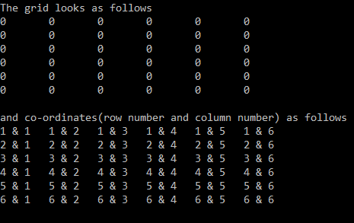
Grid Board in Program
2D Arrays and nested for loops are used here to show the board to the players and each grid is named with the help of the same.
Notes:
In my code I have simplified the game to a 6X6 board and named the grids with a row and column number with the help of 2D arrays and nested for loops, in this image the zeroes represent each grid on the board

Slide 6
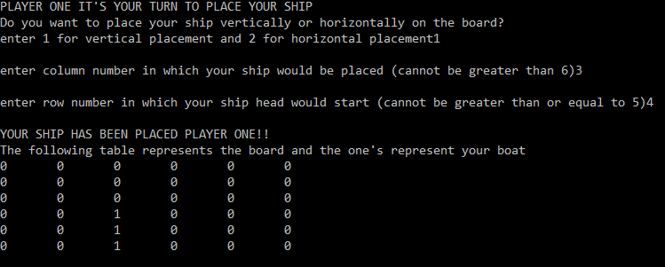
Placing Ships
The program asks the two players to place their ships on the board, there are two options for placing ships which appear on the screen-vertically and horizontally.
This is done through a if else statement. This process is repeated for both the players
Notes:
The board game uses a fleet of 5 ships but in this version I have limited the ships to only one, the ships are placed using simple if else statements, In the image visible here the grids with the ship are replaced with the number one.

Slide 7
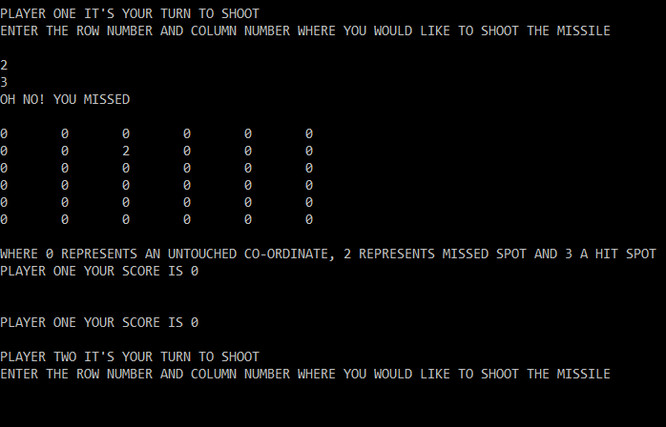
The Game
Once the boards are displayed the shoot function is executed and the game begins.
The function called “shoot” is declared which contains the main mechanism of the game.
This function contains a while loop which ends only after someone wins the game
Notes:
Using while loops I have declared a function named shoot which enables the players to take shots at the each other, this while loop only ends when someone wins the game .For every shot that hits the enemy ship the player receives 1 point. This image shows how the first player chooses a row and column number to shoot but misses his shot and hence his score is still 0.

Slide 8
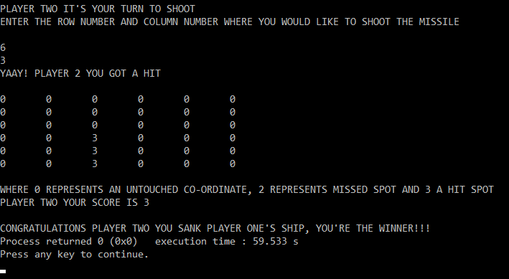
Winning The Game
The while loop keeps running until a player gets 3 points after which a message appears on the screen congratulating the winner and the program stops.
Notes:
The ship takes the space of 3 grids so once a player scores 3 points he/she will win the game and the program will stop. Here in the image player two has scored 3 points and therefore the program has stopped right after declaring the winner.

Slide 9
References
https://en.wikipedia.org/wiki/Battleship_(game)
https://www.google.com/search?q=battleships&tbm=isch&ved=2ahUKEwj4-93WiqPwAhXUn0sFHWz4BosQ2-cCegQIABAA&oq=battleships&gs_lcp=CgNpbWcQAzICCAAyAggAMgIIADICCAAyAggAMgIIADICCAAyAggAMgIIADICCAA6BQgAELEDOgYIABAHEB46BggAEAoQGFDBH1iMNmCGOGgBcAB4AIABqwWIAZcPkgELMC43LjAuMS4wLjGYAQCgAQGqAQtnd3Mtd2l6LWltZ8ABAQ&sclient=img&ei=rXSKYLjxCtS_rtoP7PCb2Ag&bih=610&biw=1280

Slide 10
THANK YOU
Made by Shishir Saxena
Registration Number:209303240
Section C
1st Year BTech Computer and Communication Engineering

