Slide 1
Loan Default Analysis Using EDA
Understanding Risk Factors in Loan Default through Exploratory Data Analysis
Contributors :
Mintu Ghosh
Mayank

Slide 2
Problem Statement
The goal is to identify key factors that lead to loan defaults. The company can then utilize these insights to better assess loan applicants' risk and improve their portfolio risk management.

Slide 3
Business Understanding
The company is the largest online loan marketplace, providing personal, business, and medical loans to urban customers. The main challenge is to reduce credit losses due to defaults. Understanding driving factors behind default can help mitigate risks.

Slide 4
Steps in EDA
2. Data Cleaning: Removing duplicates and handling missing values.
3. Univariate Analysis: Exploring the distribution of individual variables.
4. Bivariate Analysis: Exploring relationships between two variables.
5. Multivariate Analysis: Understanding the correlation between multiple variables.
6. Data Visualization: Plotting graphs to better understand data.
1. Data Collection: Loading the datasets

Slide 5
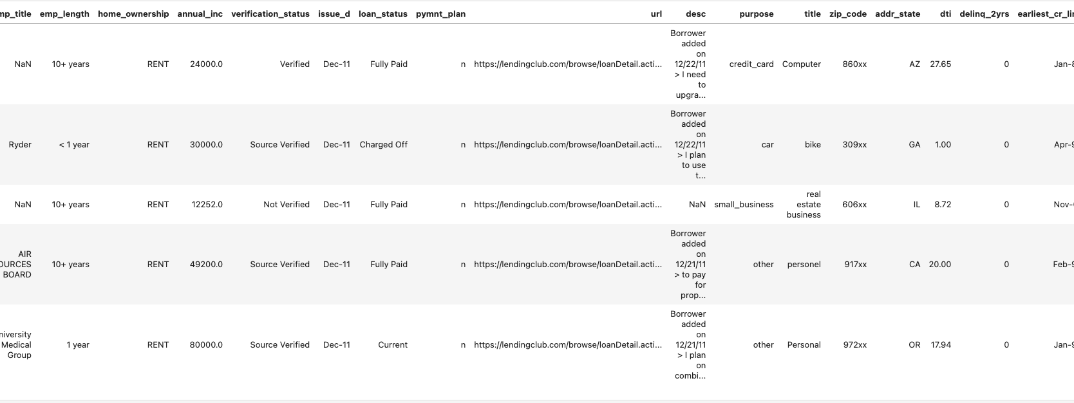

Data Collection
We would be importing the libraries that we would be working on for this project.
We would load the data sets. Based on the data, we would be performing cleaning and analysis

Slide 6
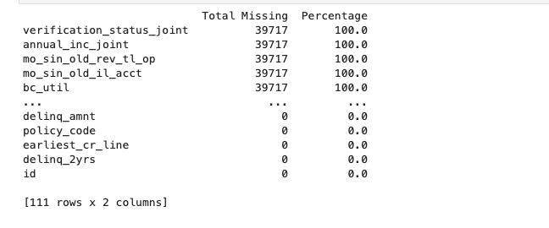
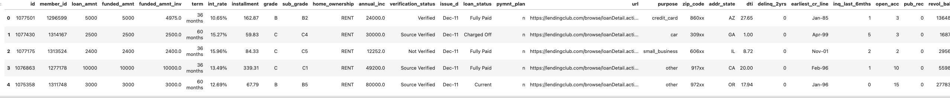
Data Cleaning
Upon analyzing the datasets, we found there are huge number of null values found to be seen.
We will remove the null values as it will not be adding any values to our analysis.
We will also look for duplicate values and remove them if found any.

Slide 7
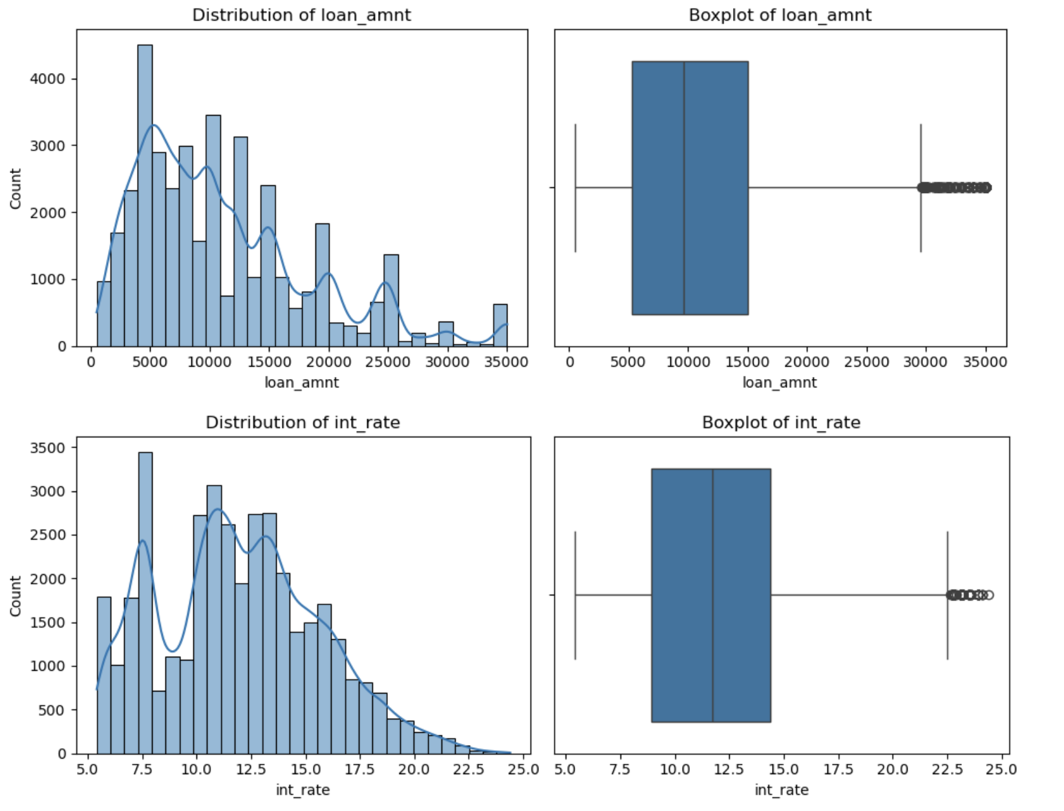
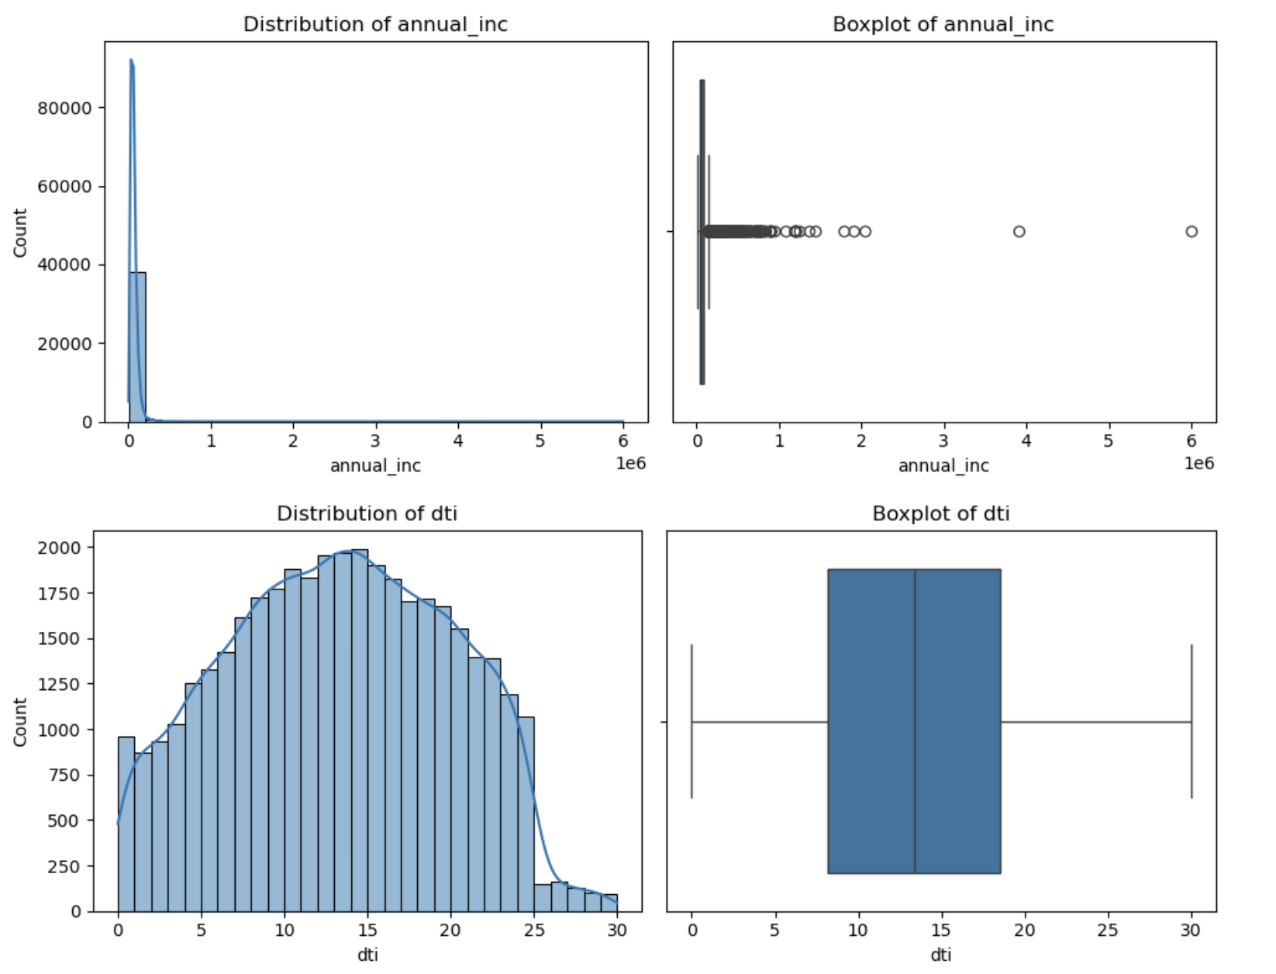
Univariate Analysis
Numerical Variables
Loan Amount - Majority of the loans falls between 5000 to 15000 dollars range but the higher loan amount could correlate with higher risks of default hence outliers observed.
Interest Rate - Interest Rate are distributed across but it has been found most of it found in 5.0 to 15.0 interest rate with the peak on 7.5%
Annual Income - It has been found that there are heavy outliers with very high incomes so we can consider that majority of borrowers have incomes below $100,000.
DTI - The Debit to Income is most distributed with most values between 10% to 15 %. Higher DTI could mean that there is more stress to the borrower

Slide 8
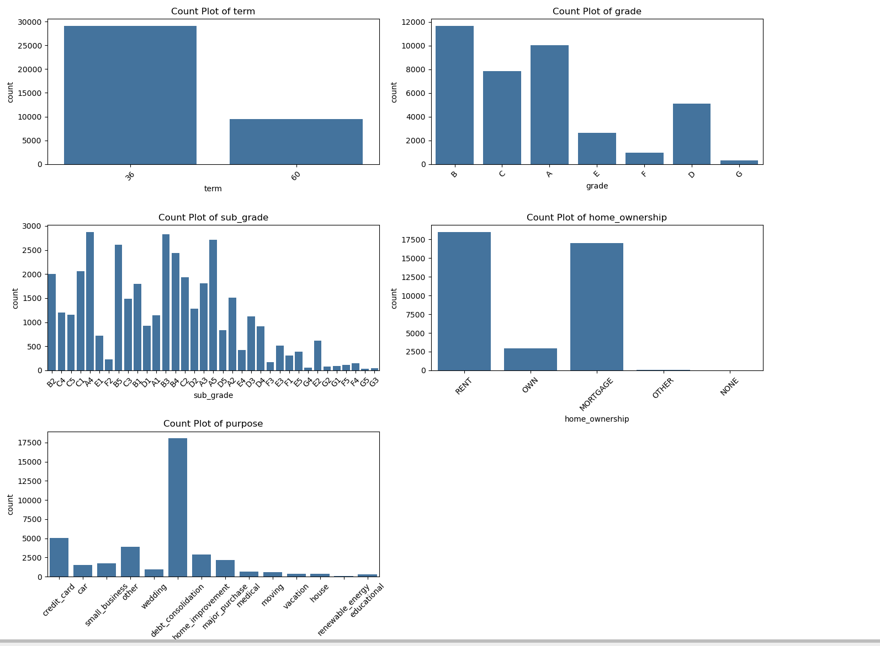
Univariate Analysis
Categorial Variables
Loan Term - Most loans taken are for shorter duration (36 months).
Grade - Majority of Loan are from B, C and A whereas lower Loan Grade which are D, E, F and G may have high risks associated with them.
Home Ownership - Most borrowers are either RENT or have mortgage. Renters may pose higher risk to default in comparison to the ones who owns it or have a mortage on them.
Purpose - Debt Consolidation is the most common reasons for taking loan

Slide 9
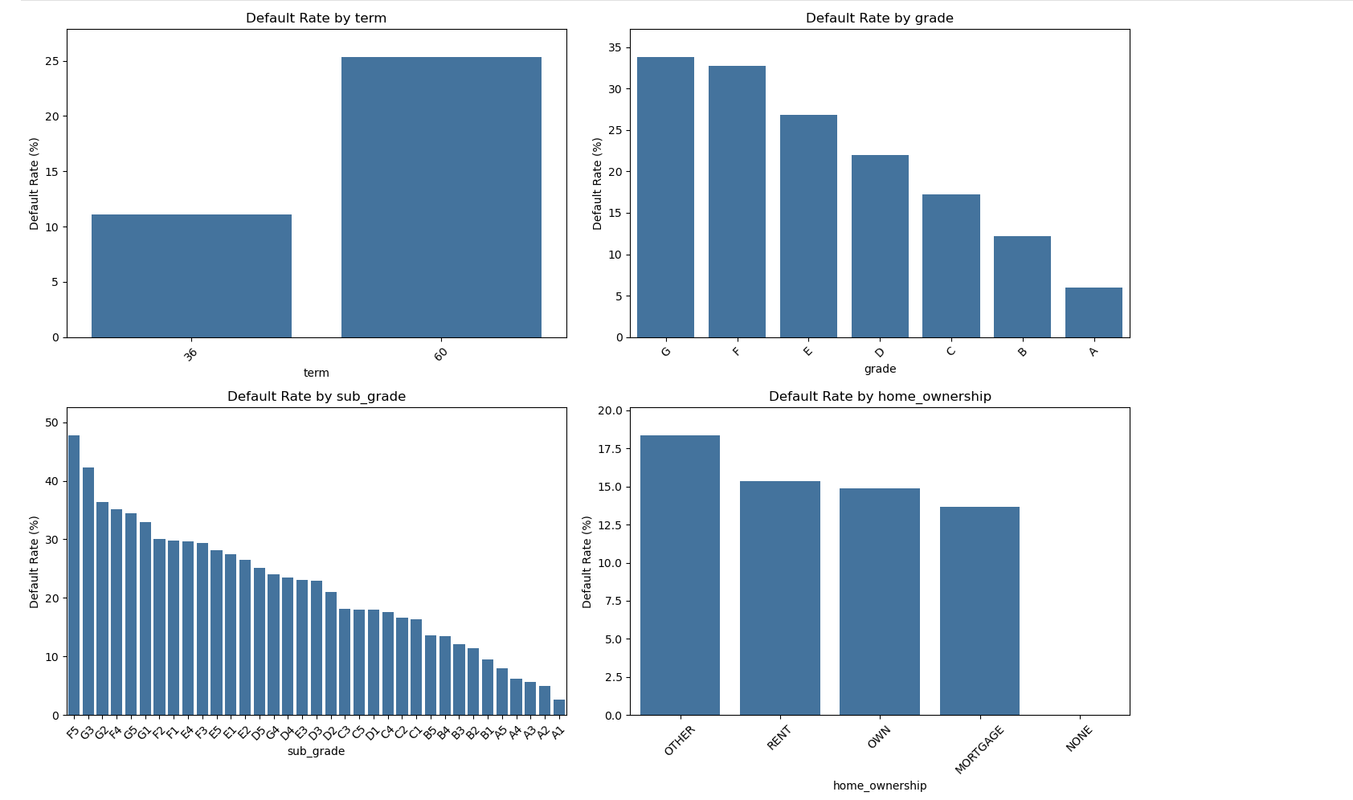
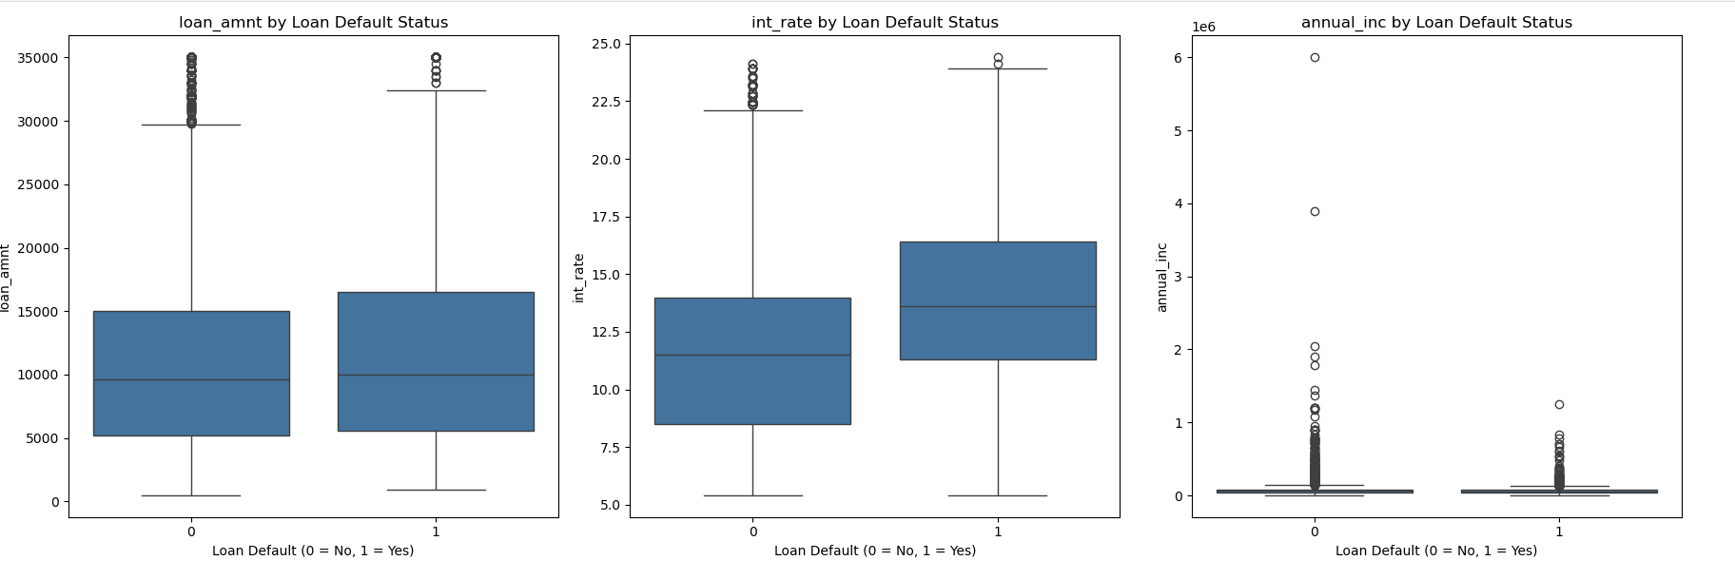
Bivariate Analysis
Loan Term: Longer mortgage terms (60 months) are related to significantly better default quotes. This shows that longer-term loans pose extra chance.
Grade and Sub-Grade: Loan grade is a totally robust predictor of default danger. Lower grades (D, E, F, G) are much more likely to default, and this holds real at the sub-grade stage as well.
Interest Rate: Borrowers with higher interest charges are much more likely to default, reinforcing the concept that higher prices can be given to riskier borrowers.
Home Ownership: Renters and those classified as "OTHER" are much more likely to default than homeowners or those with mortgages.
Loan Purpose: Small business loans have the very best default fees, suggesting that this cause is in particular risky.
Analyzed relationships between default and variables like interest rate, loan term, and debt-to-income ratio (DTI). This helped us identify which factors are more likely to impact loan defaults.

Slide 10
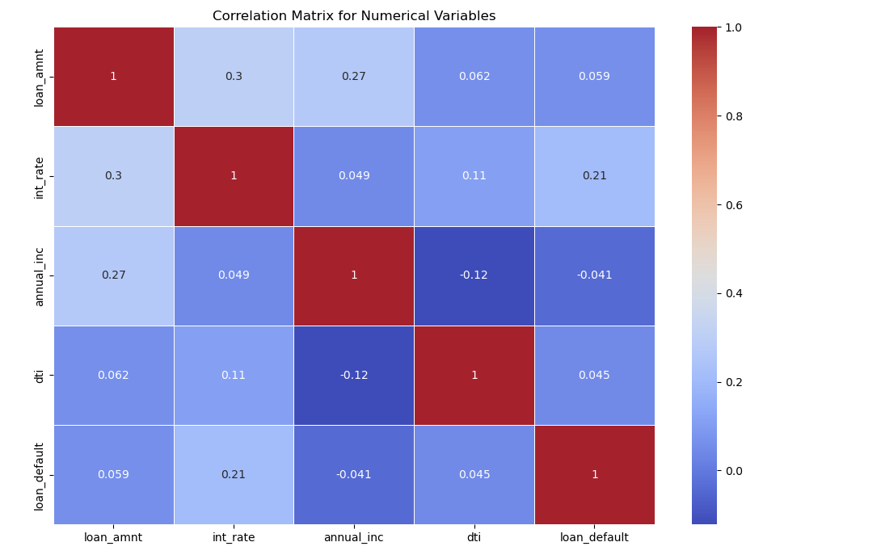
Multivariate Analysis
The multivariate analysis shows how loan amount, interest rate, and other numerical variables interact and how they correlate with loan defaults.
Loan quantity has weak positive correlation (0.059) with loan default. So we can understand that the loan amount does not influence loan default.
There is a moderate positive correlation (0.21) between the interest rate and loan default. So, we can understand that - with increase in interest rates, there is a tendency to loan default.
The correlation between DTI and loan default is weak (0.045). hence it does not give any desired relationship on this dataset
The annual income shows a slight negative correlation (-0.041) with loan default which gives us the impression that the higher-income borrowers are less likely to be default

Slide 11
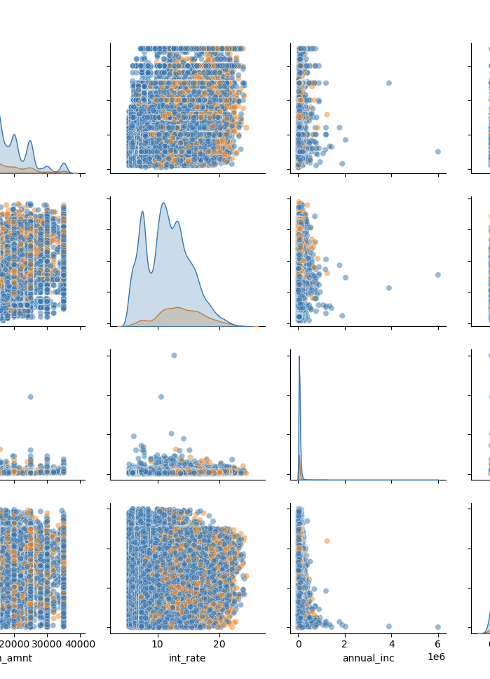
Multivariate Analysis
Loan Amount: Most loans disbursed are in lower amounts (below 20,000), with few visible patterns regarding default for higher loan amounts.
Interest Rate: There is a clear indication that higher interest rates causes the maximum defaults. Borrowers with loans in higher interest rates tend to have a higher chances to default.
Annual Income: Most of the data is concentrated among borrowers with lower annual income, but a few outliers exist in the higher income brackets, which do not show much association with default.
DTI: With increase in DTI, there are higher chnaces of default, especially in the medium-to-high DTI range.

Slide 12
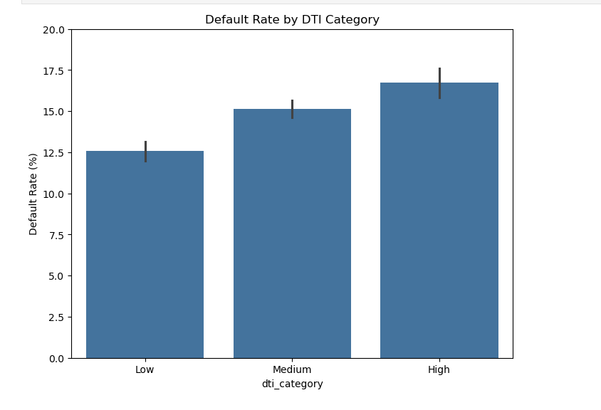
DTI Analysis
Borrowers with a higher Debt-to-Income ratio (DTI) are more likely to default. The default rate increases significantly for 'High' DTI borrowers.
The load default rate increases from Low DTI to High DTI Category.
Borrowers with a higher debt-to-income ratio are more likely to default, which aligns with typical risk assessment in finance.
It has been observed that High DTI has the highest default rate (around 17.5%), followed by Medium DTI (around 15%), and Low DTI (around 12%)

Slide 13

Recommendations
Higher Interest Rates Signal Risk: There’s a moderate link between high interest rates and loan defaults. The company should be careful when issuing loans with higher interest rates and might need to tighten its lending criteria for applicants considered to be at higher risk.
Keep an Eye on the Debt-to-Income (DTI) Ratio: Borrowers with a high DTI ratio are more likely to default on their loans. To mitigate this risk, the company should consider stricter standards for applicants with a high DTI, potentially denying loans or adjusting the terms for these borrowers.
Use DTI Categories: Including DTI categories in future risk assessments could help the company evaluate loan applicants more accurately. By separating applicants into groups based on their DTI—such as low, medium, or high-risk—the company can adjust its lending strategies to better fit each group’s risk level.
Examine Income and Loan Outliers: Investigating unusual patterns in annual income and loan amounts could provide insights into the behaviors of borrowers who default versus those who don't default.
Interest Rate Adjustments: The company should consider offering variable interest rates based on the risk profile of the borrower. For higher-risk applicants, either deny the loan or offer it at significantly higher interest rates with stricter repayment conditions.
Income and Loan Defaults: Although the link between annual income and default rates is weak, borrowers with higher incomes tend to default less. A deeper analysis of income brackets may yield useful information for refining lending strategies.

