Slide 1
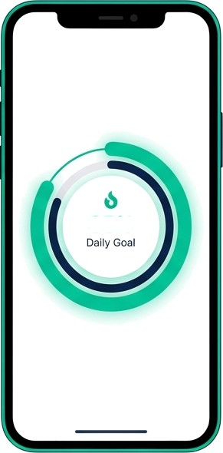

Product Sentiment
Analysis Feature
Roadmap
Prioritization
Milestone 4 — A/B Test Design & Product Dashboard
85%
App: FitLife — Health & Fitness Mobile App
Course: DA 401 — Minor in Business Analytics, IIT Mandi
Presented by: [Mintu Kumar]

Slide 2
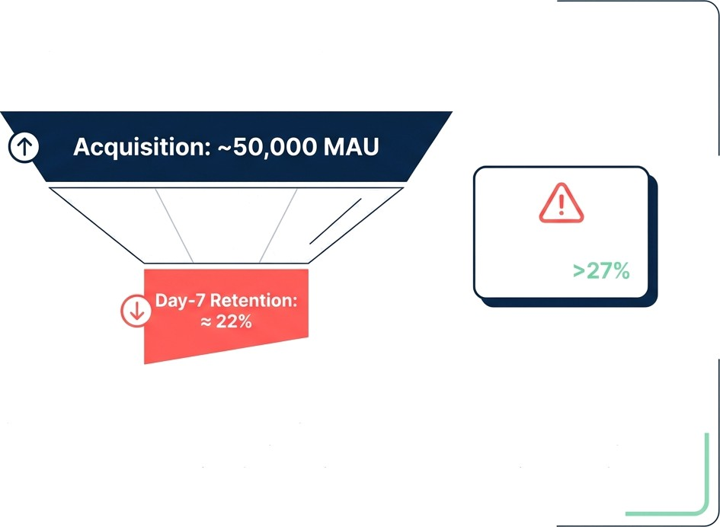
High Acquisition, Low Retention: The ’Leaky Bucket’ Challenge
Benchmark Target:
The Paradox
High Average Rating (4.1/5) masks deep churn drivers found in 1—2 star reviews.
The Conflict
Users demand features (Offline Mode, Wearable Sync) exceeding current engineering capacity.
The Objective
Use NLP & Statistical Testing to prioritize the single feature that drives retention.

Slide 3
From Raw Text to Quantifiable Strategy
Data Extraction
1,561 Reviews (Google Play)
Analysis (M1 & M2)
VADER Sentiment & TF-IDF Topic Modeling
Validation (M4) A/B Test Design & Tableau Dashboard
Preprocessing
Tokenization, Stop-word removal,
Lemmatization
Prioritization (M3)
RICE Framework Scoring

Slide 4

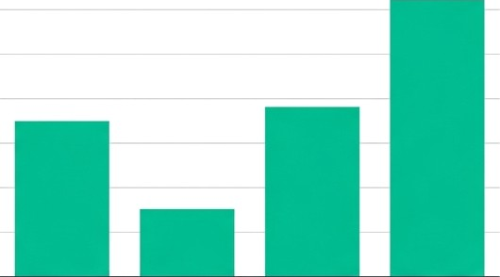

Overall Satisfaction Masks Specific,
Actionable Dissatisfaction
Rating Distribution
VADER Sentiment Breakdown by Rating
700
100
600
80
Number of Reviews
500
400
cc 60
0
Sentiment
M Pos!t!ve
Neutral M Negative
ZOD
200
20
100
0
0
4.0
4.3
4.5
4.6
4.0
4.3
4.5
4.6
Insight: 1-Star reviews are longer (>100 chars) and contain detailed ’bug reports’ rather than simple venting.

Slide 5
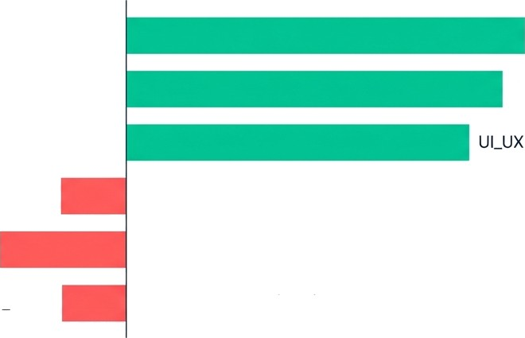
Feature Sentiment: Core Tracking Wins, Connectivity Fails
Workout_Tracking Core Value Proposition
Calorie Nutrition
Sync_lntegration
Bug Technical
Offline Mode
Lowest Sentiment (0.05) - Critical Pain Point
-0.20
-0.10
0.00
0.10
Average Sentiment Polarity
0.20
0.30
0.40

Slide 6
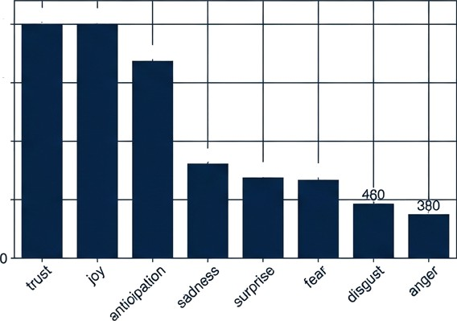
Emotional Drivers: Trust Drives Retention,
Technical Failures Trigger Anger
Emotion Word Counts (NRC)
Top Keywords (TF-IDF): Workout, Calorie, Track, Offline, Sync, Timer.
The Emotional Split:
Trust & Joy (Positive): Linked to
Calorie Nutrition & UI.
Anger & Sadness (Negative): Tightly clustered around 'Offline Mode' and 'Bugs'.
2000
>200O >200O
•1700
z
0
1500
1000
TOO
680
660
500
Emotion

Slide 7





The Ask' Gap: What Users Are
Explicitly Requesting
Top Feature Requests (Non-General)
Wearable_integration
21
Strategic Risk: Competitors offer Offline Mode and Wearables. FitLife risks obsolescence without these 'hygiene' features.
Social_features
Meal_planning
6
Water_intake_tracking
6
Offline mode
0
5
10 15
Number of Mentions
20
25

Slide 8
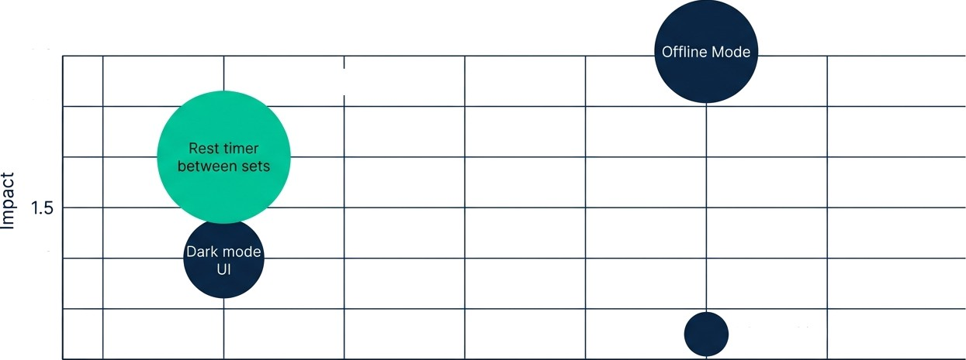
RICE Prioritization: Identifying the High-Impact “Quick Win”
Rest Timer selected for max impact with min Effort.
3.0
Winner: RICE Score 4,646
2.5
2.0
1.0
0.5
Adv. Nutrition
0.5
1.0
1.5
2.0 2.5
Effort (person-months)
3.0
3.5
4.0

Slide 9






Milestone
A/B Test Design for Rest Timer’
New Users at Launch
Control Group A (50%)
Existing Workout Flow
Treatment Group B (50%) Workout Flow + Rest Timer
Goal: Day-7 Retention
Hypothesis: Increase Retention
from 22 % to 27% (+5pp)

Slide 10
Statistical Parameters &
Implementation Timeline
Sample Size
Power
Confidence
Duration
21-28
Days
To account for
weekly variance
1,
Users per group (Total -2,152)
80 6
O
Probability of detecting effect
Significance level (alpha — 0.05)
Implementation Timeline

Slide 11
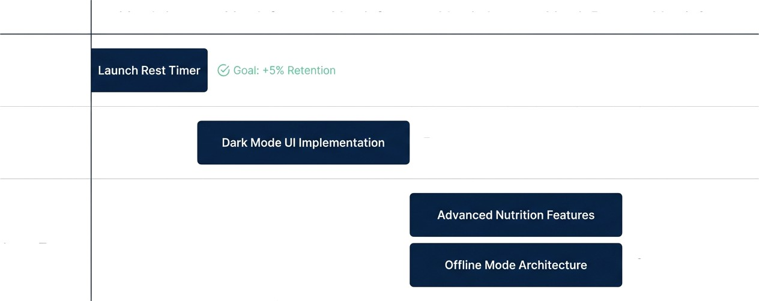
Post-Test Product Roadmap: 6-Month Outlook
Month 1
Month 2
Month 3
Month 4
Month 5
Month 6
Phase 1: Immediate
Phase 2:
Short Term
RICE #2 - Quick Win
@ RICE #3 - High Value
Phase 3: Long Term
@ Strategic Necessity

Slide 12



Executive Summary & Success Criteria
Retention Rating
Growth
Increase Day-7 Retention from 22% to >27%.
Improve Average Rating from 4.1 to 4.4.
Scale MAU beyond 60K via reduced churn.
Recommendation: Approve immediate deployment of Rest Timer A/B Test.
Data confirms users love core tracking but need workflow tools. This is the highest ROI intervention.

