Slide 1
WHAT IS DOCKER
Docker is tool that perform OS level virtualization , also known as containerization.
Docker is an open-source centralized platform designed to create , deploy and run the applications.
Uses host OS but to run itself it uses linux. It's written in GO language.
First release in March 2013 by soloman hykes and Sebastian paul.
It's set of platform as service that uses OS level virtualization whereas VMware is hardware level virtualization.

Slide 2

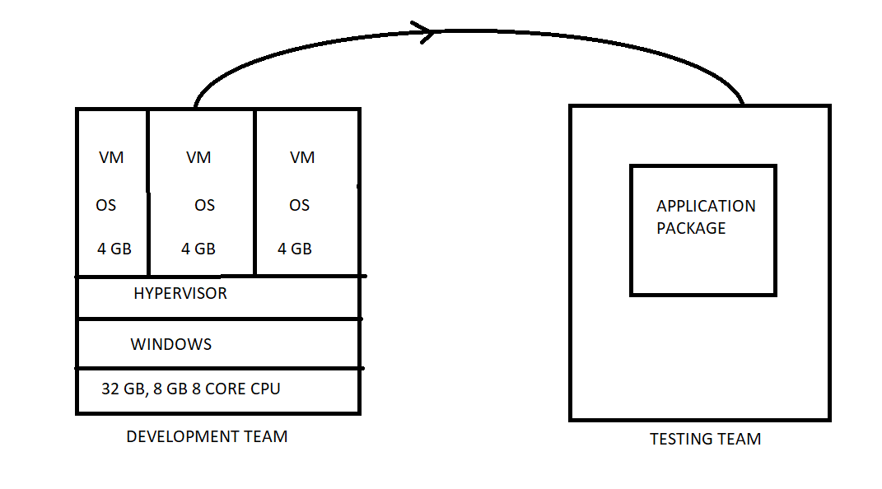

Slide 3
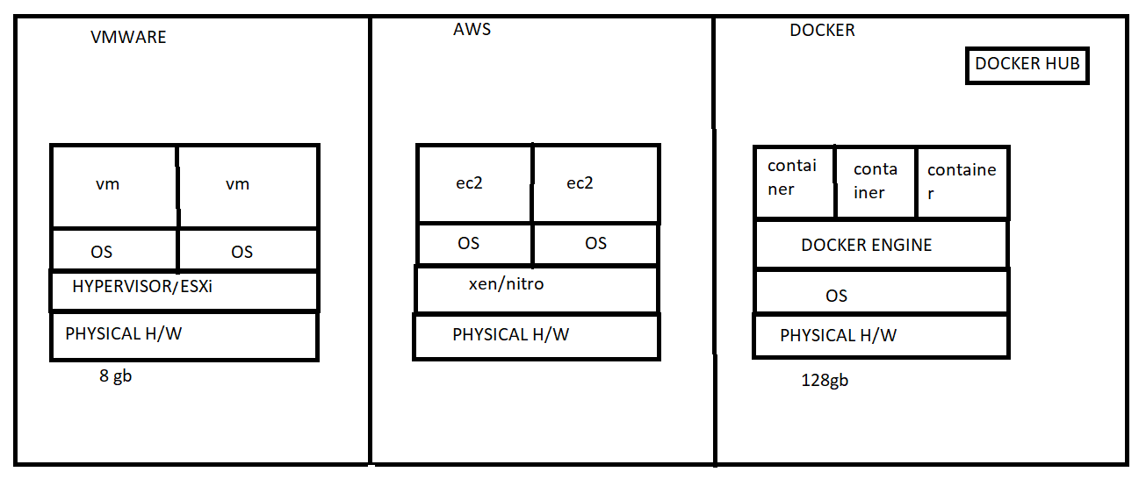
COMPARISON /DIFFERENCES

Slide 4
