Slide 1
Brute-Force Linear Regression on Army Training Data
Log-Scale Grid Search | No Calculus | No Matrices
Noah Gallego, Gerardo Gomez, Justin Lo, Juancarlos Sandoval
CSUB -- Computer Science & Engineering -- 2026

Slide 2
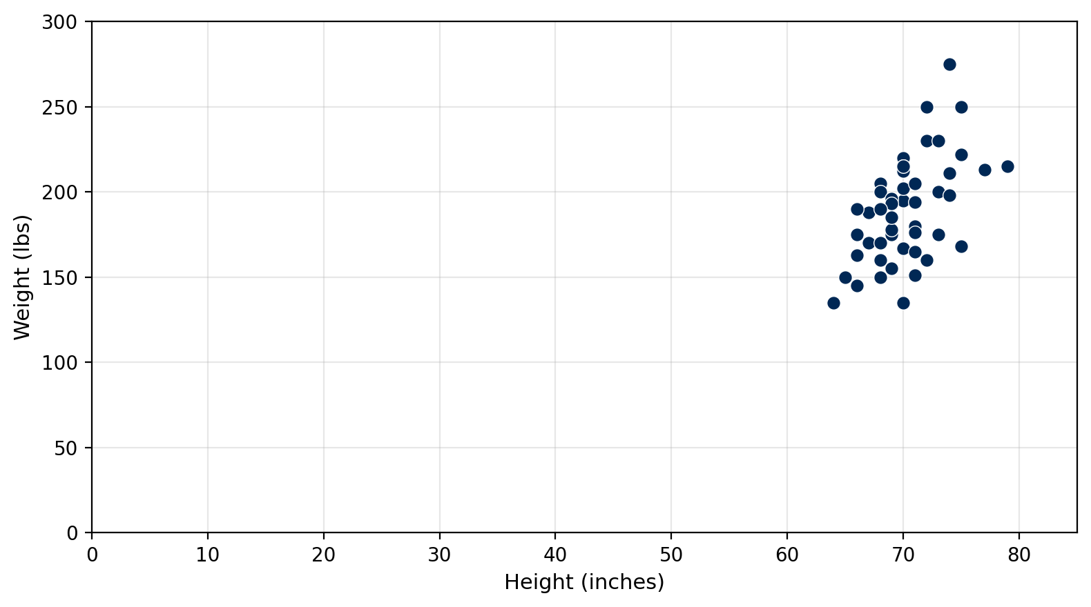
Dataset
X (predictor)
Height: 64 - 79 in
Y (response)
Weight: 135 - 275 lbs
Training size
n = 50
Goal: y-hat = B * height + A (minimise SSE)

Slide 3
Objective: Minimise SSE
SSE(B, A) = B^2*Sxx + A^2*n + Syy + 2BA*Sx - 2B*Sxy - 2A*Sy
Pre-compute 5 sums once --> evaluate any (B, A) in O(1)
Sum | Sum
Sx = SUM(xi) | Sy = SUM(yi)
Sxx = SUM(xi^2) | Sxy = SUM(xi*yi)
Syy = SUM(yi^2)

Slide 4
Log-Zoom Grid Search
1
Pick huge bounds: B and A both in [-100M, +100M]
2
Place 500 log-spaced test values per parameter (dense near center)
3
Try all 500 x 500 = 250,000 (B, A) pairs, keep lowest SSE
4
Shrink window to 1/10th its size, centered on winner
5
Repeat until B and A stop changing (< 0.0005 between zooms)
[-100M, 100M] -> [-10M, 10M] -> ... -> [5.349, 5.359] (12 zooms)

Slide 5
Convergence
Zoom | B (slope) | A (intercept) | SSE | Delta B | Delta A
1 | 100.000 | -6,781.49 | 4,496,525.79 | -- | --
2 | 34.041 | -2,308.46 | 1,023,898.86 | 6.60e+01 | 4.47e+03
3 | 12.891 | -705.878 | 63,922.30 | 2.11e+01 | 1.60e+03
4 | 6.476 | -270.813 | 33,288.60 | 6.42e+00 | 4.35e+02
5 | 5.529 | -199.129 | 31,376.34 | 9.46e-01 | 7.17e+01
... | ... | ... | ... | ... | ...
10 | 5.353986 | -186.9958 | 31,359.74 | 2.00e-04 | 1.36e-02
11 | 5.353957 | -186.9936 | 31,359.74 | 2.95e-05 | 2.11e-03
12 | 5.353961 | -186.9939 | 31,359.74 | 4.35e-06 | 2.79e-04
Both deltas < 0.0005 at zoom 12 --> converged to 3 decimal places
Why stop at 3? B = 5.353 vs 5.354 changes a prediction by ~0.001 lbs.

Slide 6
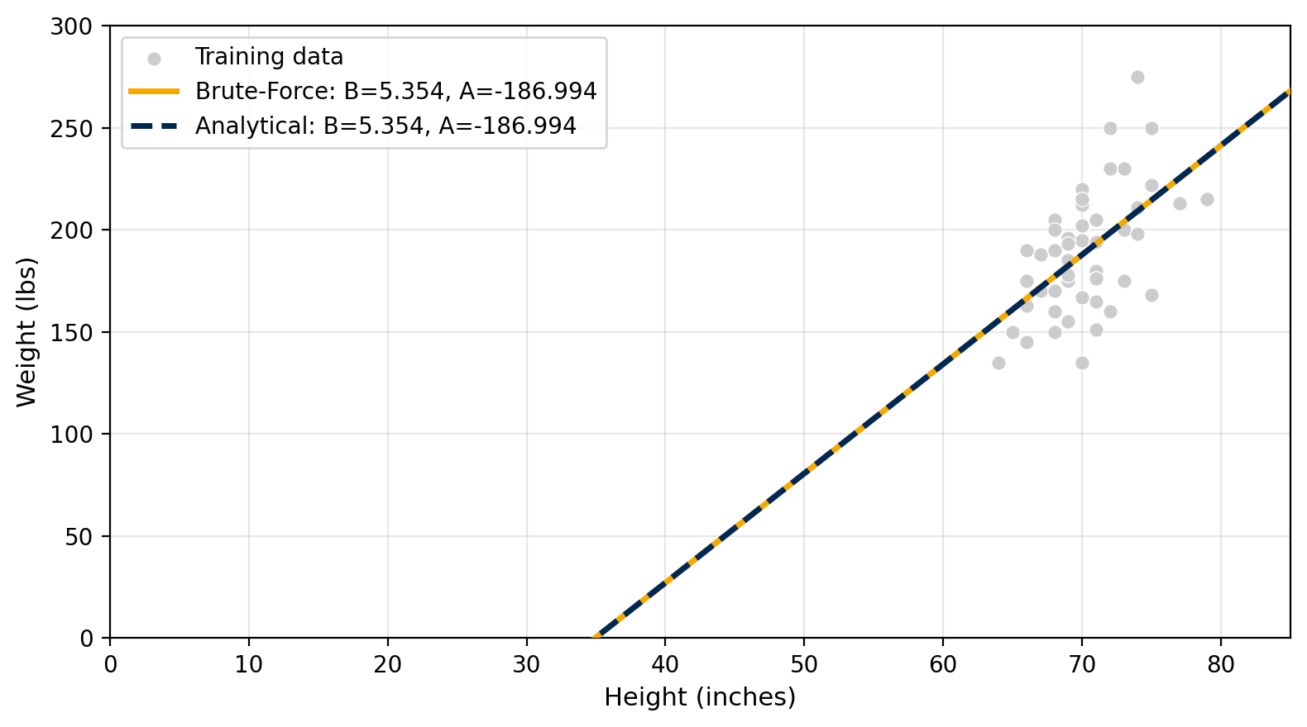
Analytical vs. Numerical
B = (n*Sxy - Sx*Sy) / (n*Sxx - Sx^2)
A = (Sy - B*Sx) / n
Method | B (slope) | A (intercept) | SSE
Brute-Force | 5.354 | -186.994 | 31,359.740
Analytical | 5.354 | -186.994 | 31,359.740
Difference | 0.000 | 0.000 | 0.000
Lines overlap -- same answer

Slide 7
Test Set Predictions
# | Height (in) | Predicted (lbs) | Actual (lbs)
1 | 71.0 | 193.137 | 240.000
2 | 73.0 | 203.845 | 185.000
3 | 65.0 | 161.014 | 161.000
4 | 70.0 | 187.783 | 215.000
5 | 67.0 | 171.721 | 173.000
6 | 72.0 | 198.491 | 310.000
7 | 71.0 | 193.137 | 147.000
8 | 70.0 | 187.783 | 190.000
9 | 68.0 | 177.075 | 220.000
10 | 75.0 | 214.553 | 215.000
SSE (predicted vs actual) = 19,704.226

Slide 8
Conclusion
y-hat = 5.354 * height - 186.994
1
Grid search finds the same answer as the analytical formula
2
Log-spacing clusters points near the center for finer resolution
3
Each zoom shrinks 10x -- 12 zooms narrows [-100M, 100M] to [5.349, 5.359]
4
Stops when B and A stable to 3 decimal places

