Slide 1
Brute-Force Linear Regression on Army Training Data
Log-Scale Grid Search | No Calculus | No Matrices
Noah Gallego, Gerardo Gomez, Justin Lo, Juancarlos Sandoval
CSUB -- Computer Science & Engineering -- 2026

Slide 2
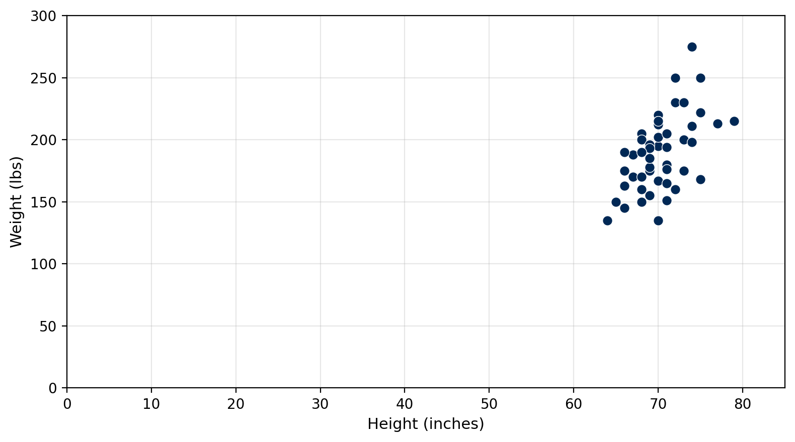
Dataset
X (predictor)
Height: 64 - 79 in
Y (response)
Weight: 135 - 275 lbs
Training size
n = 50
Goal: y-hat = B * height + A (minimise SSE)

Slide 3
Objective: Minimise SSE
SSE(B, A) = B^2*Sxx + A^2*n + Syy + 2BA*Sx - 2B*Sxy - 2A*Sy
Pre-compute 5 sums once --> evaluate any (B, A) in O(1)
Sum | Sum
Sx = SUM(xi) | Sy = SUM(yi)
Sxx = SUM(xi^2) | Sxy = SUM(xi*yi)
Syy = SUM(yi^2)
No need to loop over 50 data points each time -- just plug B and A into this formula

Slide 4
Initial Search Range
B (slope) in [ -5,000 , +5,000 ]
A (intercept) in [ -100,000 , +100,000 ]
We don't know where the answer is -- that's the whole point of brute force. So we just pick ranges big enough that the answer is definitely inside. Could we use [-1,000,000, 1,000,000]? Yes. It would just cost a few extra zooms. Each zoom shrinks the window 10x, so: [-1M, 1M] -> [-100K, 100K] -> [-10K, 10K] -> ... -> [5.349, 5.359] A range 1,000,000x too wide only adds ~6 extra zooms (10^6 = 6 powers of 10). Bigger range = safer, and the cost is just a few more iterations.

Slide 5
Log-Zoom Grid Search
1
Start with wide bounds: B in [-5000, 5000], A in [-100000, 100000]
2
Place 200 test values per parameter, clustered near center of range
3
Try all 200 x 200 = 40,000 (B, A) pairs, keep the one with lowest SSE
4
Shrink window to 1/10th its size, centered on that winner
5
Repeat until B and A stop changing (< 0.0005 between zooms)
B range each zoom: [-5000, 5000] -> [-500, 500] -> [-50, 50] -> ... -> [5.349, 5.359]

Slide 6
Why Logarithmic Spacing?
Linear: ... -50, 0, 50, 100 ...
Log: ... -0.01, 0, 0.01, 0.1, 50 ...
200 points across [-5000, 5000] Smallest gap = 50 Can't tell 5.35 from 5.40
200 points, but gaps vary: 0.01 apart near center, 5000 apart near edges
How: pick 100 offsets spaced on a log scale from 0.000001 to 1.0 Place points at center + offset * half_range and center - offset * half_range Result: most points cluster tightly around the center, fewer spread out to the edges So we can find a needle (B ~ 5.354) in a haystack ([-5000, 5000]) on the first try

Slide 7
Convergence
Zoom | B (slope) | A (intercept) | SSE | Delta B | Delta A
1 | 5.361336 | -187.3817 | 31,360.61 | -- | --
2 | 5.355975 | -187.1340 | 31,359.74 | 5.36e-03 | 2.48e-01
3 | 5.354092 | -187.0018 | 31,359.74 | 1.88e-03 | 1.32e-01
4 | 5.353950 | -186.9931 | 31,359.74 | 1.42e-04 | 8.70e-03
5 | 5.353962 | -186.9940 | 31,359.74 | 1.24e-05 | 8.70e-04
6 | 5.353962 | -186.9940 | 31,359.74 | 1.33e-07 | 7.05e-06
Both deltas < 0.0005 at zoom 6 --> converged to 3 decimal places
Why 3 decimal places? It's our choice -- we could keep zooming for 5, 10, or 20 decimals. The SSE surface has one true minimum (it's a parabola), so the zooms will always keep closing in on it. We stop at 3 because extra precision doesn't change the predicted weight by even 1 lb (B = 5.353 vs 5.354 changes a prediction by ~0.001 lbs).

Slide 8
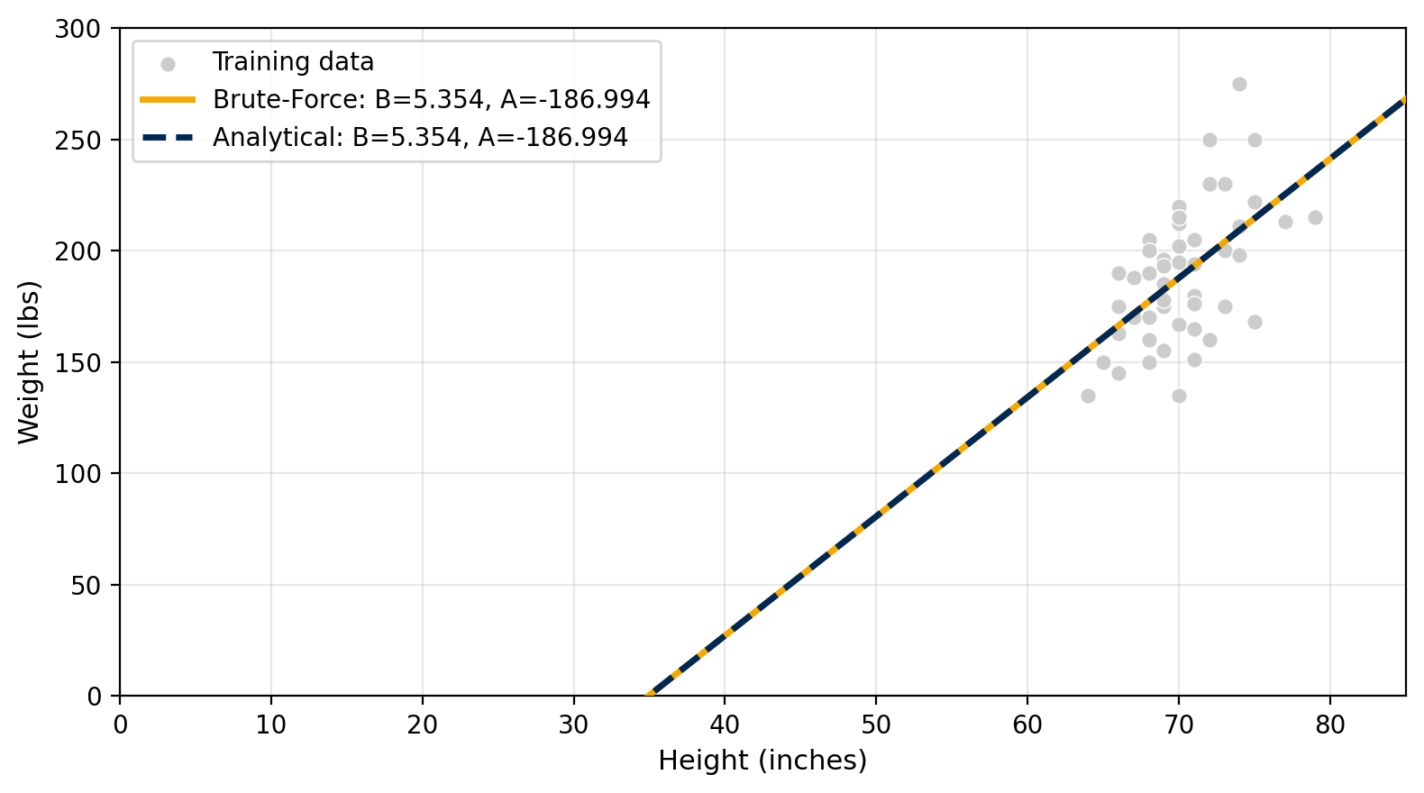
Analytical vs. Numerical
B = (n*Sxy - Sx*Sy) / (n*Sxx - Sx^2)
A = (Sy - B*Sx) / n
Method | B (slope) | A (intercept) | SSE
Brute-Force | 5.354 | -186.994 | 31,359.740
Analytical | 5.354 | -186.994 | 31,359.740
Difference | 0.000 | 0.000 | 0.000
Lines overlap -- both methods give the same answer

Slide 9
Test Set Predictions
# | Height (in) | Predicted (lbs) | Actual (lbs)
1 | 71.0 | 193.137 | 240.000
2 | 73.0 | 203.845 | 185.000
3 | 65.0 | 161.014 | 161.000
4 | 70.0 | 187.783 | 215.000
5 | 67.0 | 171.721 | 173.000
6 | 72.0 | 198.491 | 310.000
7 | 71.0 | 193.137 | 147.000
8 | 70.0 | 187.783 | 190.000
9 | 68.0 | 177.075 | 220.000
10 | 75.0 | 214.553 | 215.000
SSE (predicted vs actual) = 19,704.226

Slide 10
Conclusion
y-hat = 5.354 * height - 186.994
1
Grid search finds the same answer as the analytical formula
2
Log-spacing clusters points near the center, so we find B ~ 5.35 even in [-5000, 5000]
3
Each zoom shrinks the window 10x, so 6 zooms = 10^6 x finer than where we started
4
Stops automatically when B and A stop changing to 3 decimal places

