Slide 1
Brute-Force Linear Regression on Army Training Data
Log-Scale Grid Search | No Calculus | No Matrices
Noah Gallego, Gerardo Gomez, Justin Lo, Juancarlos Sandoval
CSUB -- Computer Science & Engineering -- 2026

Slide 2
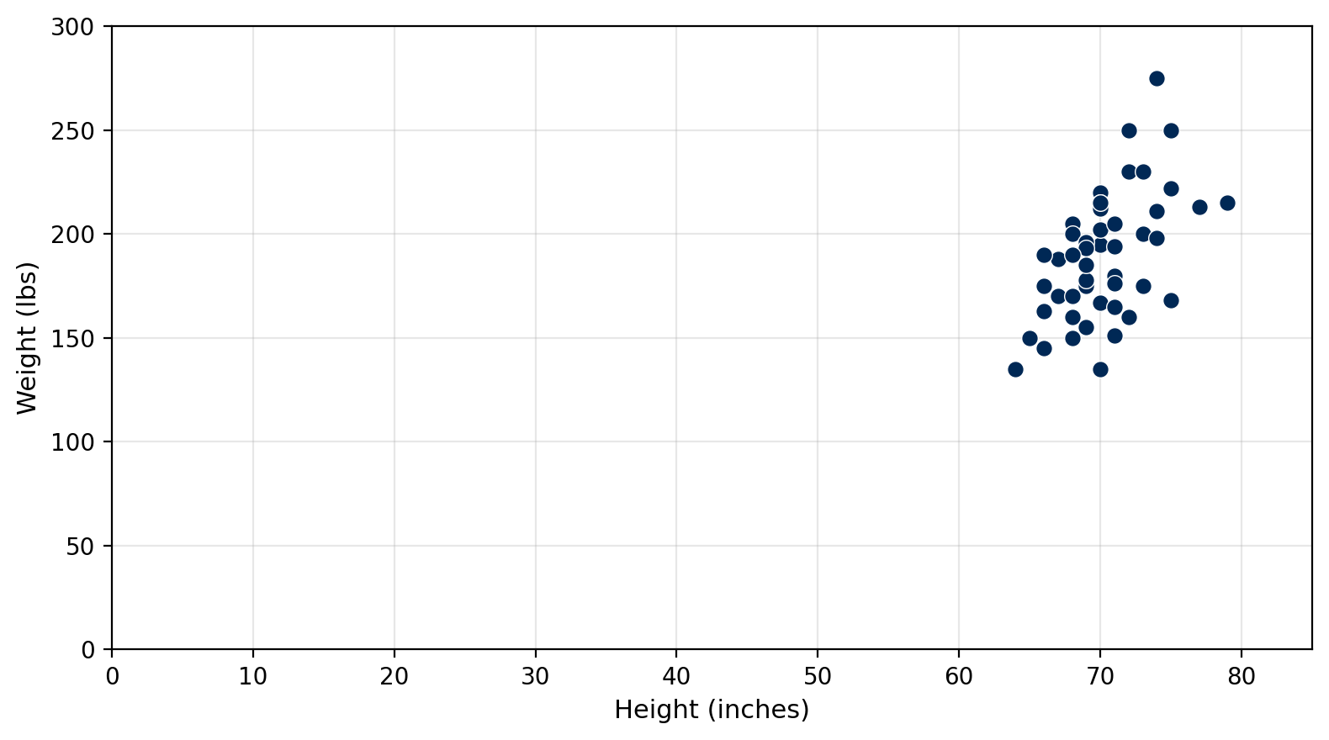
Dataset
X (predictor)
Height: 64 - 79 in
Y (response)
Weight: 135 - 275 lbs
Training size
n = 50
Goal: y-hat = B * height + A (minimise SSE)

Slide 3
Objective: Minimise SSE
SSE(B, A) = B^2*Sxx + A^2*n + Syy + 2BA*Sx - 2B*Sxy - 2A*Sy
Pre-compute 5 sums once --> evaluate any (B, A) in O(1)
Sum | Sum
Sx = SUM(xi) | Sy = SUM(yi)
Sxx = SUM(xi^2) | Sxy = SUM(xi*yi)
Syy = SUM(yi^2)
No need to loop over 50 data points each time -- just plug B and A into this formula

Slide 4
Initial Search Range
B (slope) in [ -100M , +100M ]
A (intercept) in [ -100M , +100M ]
We don't know where the answer is -- that's the whole point of brute force. So we just pick a range so big the answer is definitely inside. Each zoom shrinks the window 10x, so even starting at 100 million: [-100M, 100M] -> [-10M, 10M] -> [-1M, 1M] -> ... -> [5.349, 5.359] The cost is just a few extra iterations (12 total instead of 6). Bigger range = safer. We also use 500 grid points per axis to keep resolution high.

Slide 5
Log-Zoom Grid Search
1
Start with huge bounds: B and A both in [-100M, +100M]
2
Place 500 test values per parameter, clustered near center of range
3
Try all 500 x 500 = 250,000 (B, A) pairs, keep the one with lowest SSE
4
Shrink window to 1/10th its size, centered on that winner
5
Repeat until B and A stop changing (< 0.0005 between zooms)
B range each zoom: [-100M, 100M] -> [-10M, 10M] -> ... -> [-50, 50] -> ... -> [5.349, 5.359]

Slide 6
Why Logarithmic Spacing?
Linear: ... -50, 0, 50, 100 ...
Log: ... -0.01, 0, 0.01, 0.1, 50 ...
500 points across [-100M, 100M] Smallest gap = 400,000 Can't tell 5 from 100
500 points, but gaps vary: 0.1 apart near center, millions apart near edges
How: pick 250 offsets spaced on a log scale from 0.000001 to 1.0 Place points at center + offset * half_range and center - offset * half_range Result: most points cluster tightly around the center, fewer spread out to the edges Combined with 10x zoom, each pass narrows in on the answer

Slide 7
Convergence
Zoom | B (slope) | A (intercept) | SSE | Delta B | Delta A
1 | 100.000 | -6,781.49 | 4,496,525.79 | -- | --
2 | 34.041 | -2,308.46 | 1,023,898.86 | 6.60e+01 | 4.47e+03
3 | 12.891 | -705.878 | 63,922.30 | 2.11e+01 | 1.60e+03
4 | 6.476 | -270.813 | 33,288.60 | 6.42e+00 | 4.35e+02
5 | 5.529 | -199.129 | 31,376.34 | 9.46e-01 | 7.17e+01
... | ... | ... | ... | ... | ...
10 | 5.353986 | -186.9958 | 31,359.74 | 2.00e-04 | 1.36e-02
11 | 5.353957 | -186.9936 | 31,359.74 | 2.95e-05 | 2.11e-03
12 | 5.353961 | -186.9939 | 31,359.74 | 4.35e-06 | 2.79e-04
Both deltas < 0.0005 at zoom 12 --> converged to 3 decimal places
Why stop at 3? B = 5.353 vs 5.354 changes a prediction by ~0.001 lbs -- more precision is pointless. We could keep zooming forever, but it wouldn't change the answer in any meaningful way.

Slide 8
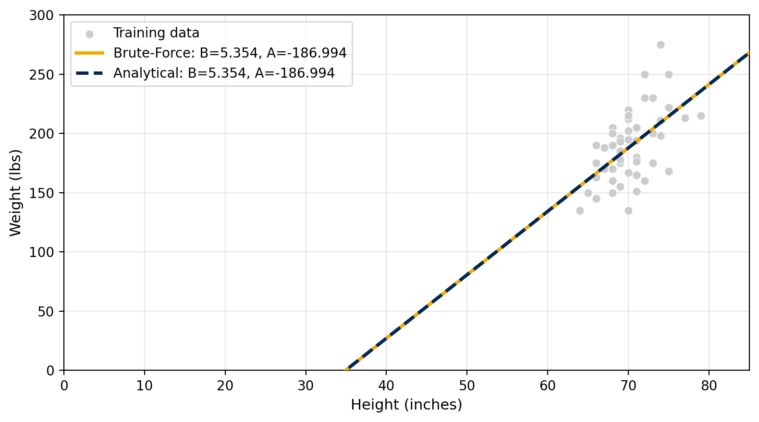
Analytical vs. Numerical
B = (n*Sxy - Sx*Sy) / (n*Sxx - Sx^2)
A = (Sy - B*Sx) / n
Method | B (slope) | A (intercept) | SSE
Brute-Force | 5.354 | -186.994 | 31,359.740
Analytical | 5.354 | -186.994 | 31,359.740
Difference | 0.000 | 0.000 | 0.000
Lines overlap -- both methods give the same answer

Slide 9
Test Set Predictions
# | Height (in) | Predicted (lbs) | Actual (lbs)
1 | 71.0 | 193.137 | 240.000
2 | 73.0 | 203.845 | 185.000
3 | 65.0 | 161.014 | 161.000
4 | 70.0 | 187.783 | 215.000
5 | 67.0 | 171.721 | 173.000
6 | 72.0 | 198.491 | 310.000
7 | 71.0 | 193.137 | 147.000
8 | 70.0 | 187.783 | 190.000
9 | 68.0 | 177.075 | 220.000
10 | 75.0 | 214.553 | 215.000
SSE (predicted vs actual) = 19,704.226

Slide 10
Conclusion
y-hat = 5.354 * height - 186.994
1
Grid search finds the same answer as the analytical formula
2
Log-spacing clusters points near the center, so we find B ~ 5.35 even in [-5000, 5000]
3
Each zoom shrinks the window 10x, so 12 zooms = 10^12 x finer than where we started
4
Stops automatically when B and A stop changing to 3 decimal places

