Slide 1
PROJECT III, Analysis of the STOCK dataset
Group Member:
Ethan Edwards
Jie Hu
Xun Sun
Yijun Yang

Slide 2
Introduction
Instead of analysis the overall stock market, our study today is focus on two famous and well representative companies, APPLE and GOOGLE.

Slide 3
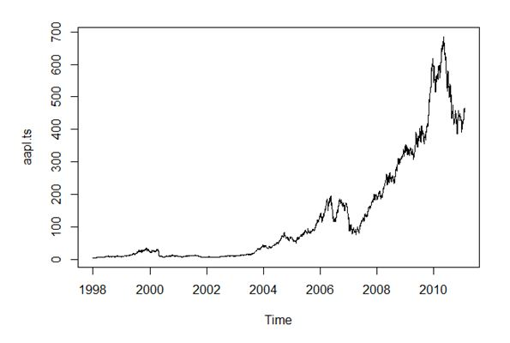
Case I, APPLE Company
Firstly, We transformed the data to the time series, and plot the trend.
This is the time trend for Apple stock closing price from 1998 to 2013.

Slide 4
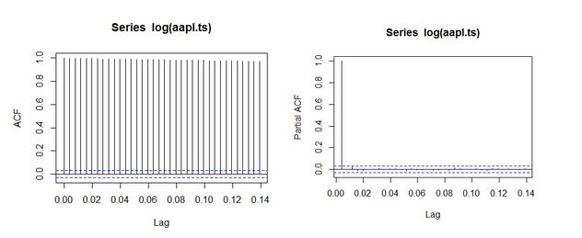
ACF
Then, we plot the ACF for Apple stock closing price. It suggests there is strong autocorrelation in the time series. Also, use the log transformation to adjust the scale.

Slide 5
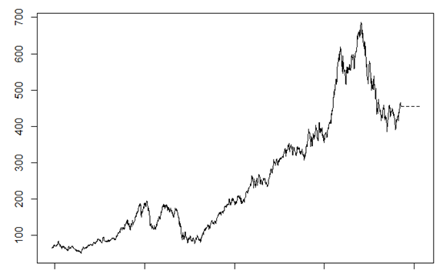
Model
We use the ARIMA model for the time series in order to adjust for the autocorrelation.

Slide 6
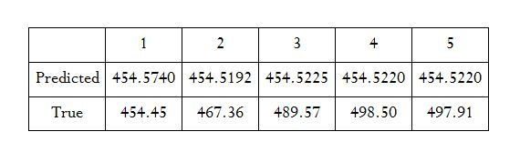
Prediction
The predicted and the true values of the Apple stocks are compared in the table. The prediction was a bit conservative, that is lower than the true prices.

Slide 7
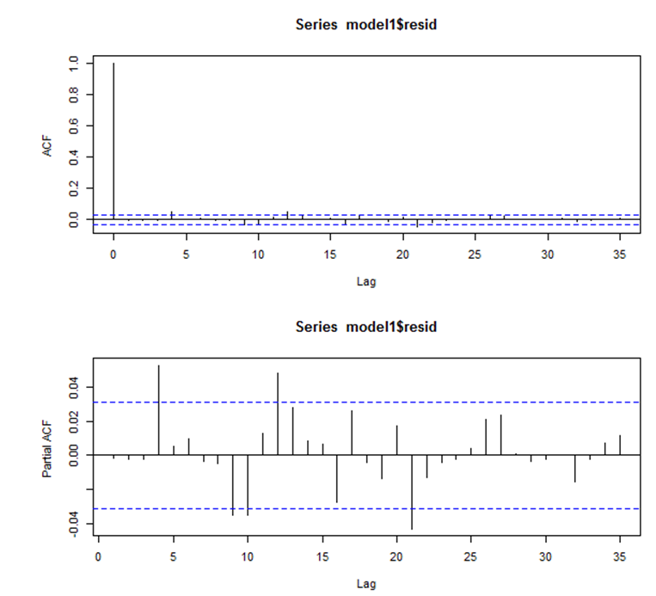
Diagnostics
In order to check whether the model is fit or not, we need to see the ACF and PACF of the model, it shows the autocorrelation was adjusted. That is good.

Slide 8
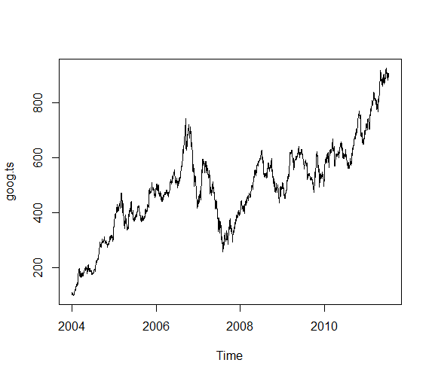
Case III, GOOGLE Company
Here is the time trend for Google stock closing price from 2004 to 2013.

Slide 9
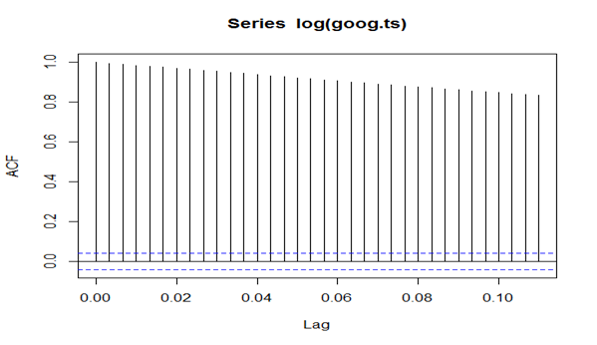
ACF
The plot below is the ACF for Google stock closing price. It suggests there is strong autocorrelation in the time series. Also, use the log transformation to adjust the scale.

Slide 10
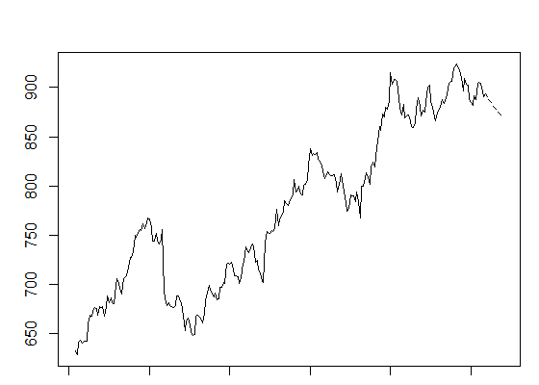
Model
We use the ARIMA model for the time series in order to adjust for the autocorrelation.

Slide 11
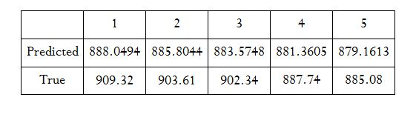
Prediction
The predicted and the true values of the Google stocks are compared in the table. The prediction was still a bit conservative, that is lower than the true prices.

Slide 12
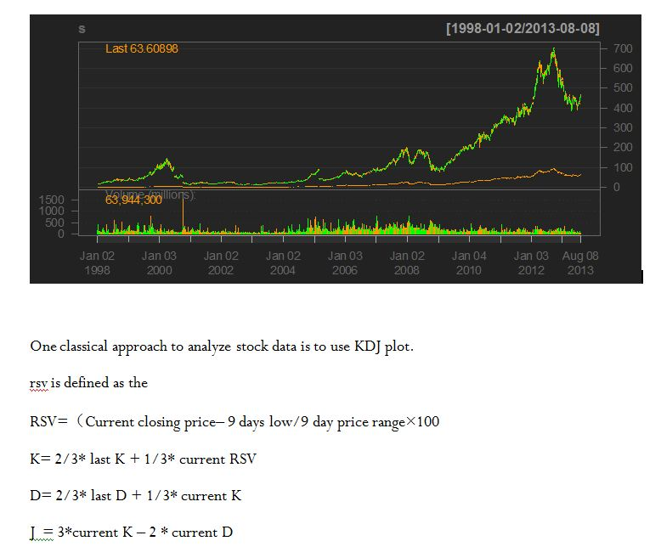
Using R-package “quantmod” for APPLE Company
R package “quantmod” provides a function that does this. However, the difficulty was associated with the package since the plotting fuction barChart and candleChart identifies only xtsible object. The data set was transformed into the set using as.date function.

Slide 13
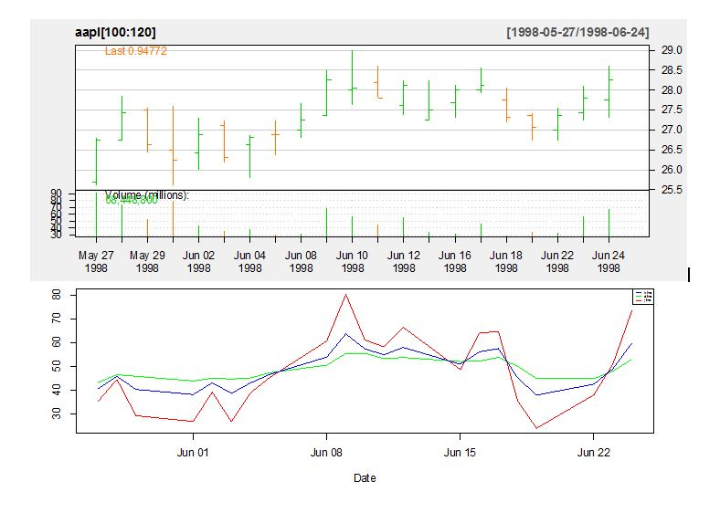
By plotting KDJ line to the corresponding candle line, it is easy to see that when K line cross D line from below indicates a start of price increment. In addition, a lower K value (K<30) indicates a oversell in the market.
The data was screened by the decision function built on the two categories, the result was 97 out of 110 trade in point was profitable.

Slide 14
Obstacles
The prevalence of NAs was fairly sizeable in the data.
ts() time series format.

Slide 15
Future Works
For error analysis, we would consider GARCH-modeled errors (General Autoregressive Conditionally Heteroskedastic).
Not accurate prediction
Stock Market is unpredictable!!

