Slide 1
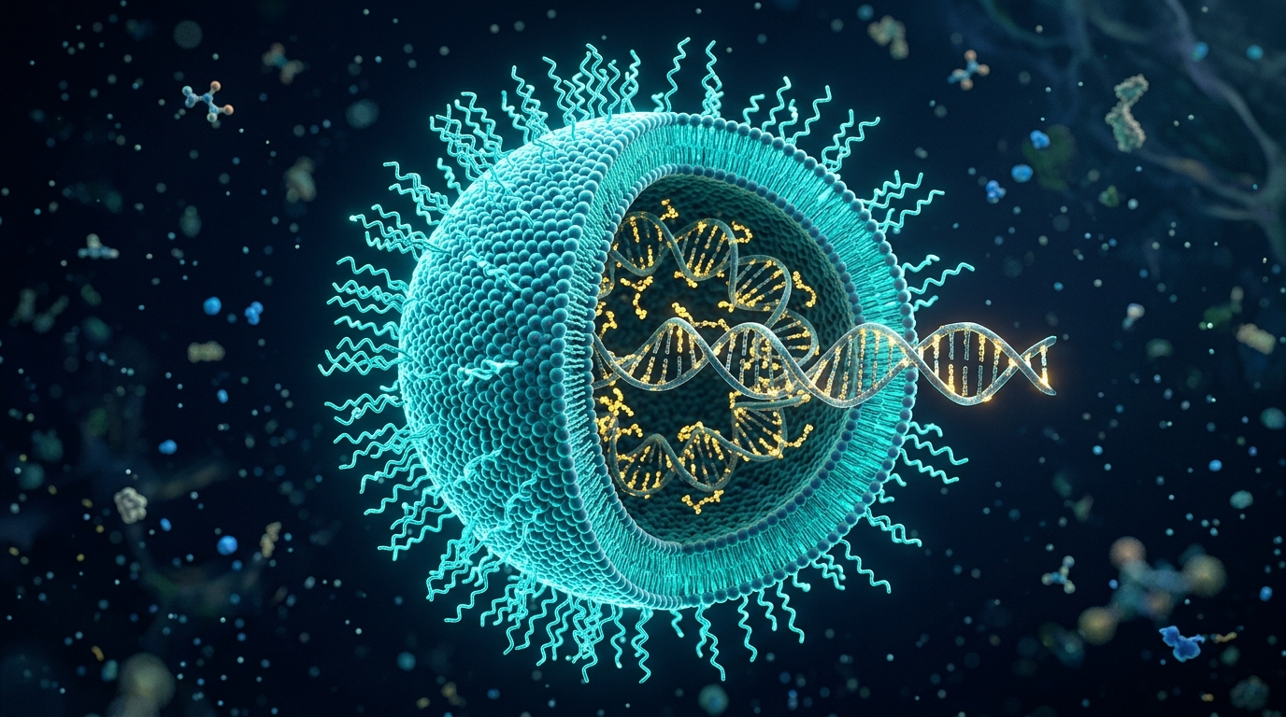
BIOTECHNOLOGY ENTERPRISE CASE STUDY
Moderna, Inc.: The mRNA Platform Revolution
Decoding the Paradigm Shift from Empirical Drug Discovery to Programmable Genetic Medicine
EXECUTIVE CASE STUDY HIGHLIGHTS
• Core Innovation: Modified mRNA transcripts (m1Ψ) encapsulated within 4-component Lipid Nanoparticles (LNPs)
• Flagship Approvals: Spikevax (COVID-19), mRESVIA (RSV, approved May 2024), INT (Melanoma Phase 3 with Merck)
• Broad Applications: Prophylactic Vaccines, Individualized Immuno-Oncology, Rare Metabolic Diseases, & Gene Editing
• High-Stakes Complexities: Extra-hepatic delivery bottlenecks, $2.25B Arbutus patent settlement, and post-pandemic pivot
Notes:
WELCOME & INTRODUCTORY REMARKS:
Good morning / afternoon. Today, we present an in-depth case study of Moderna, Inc., examining how it redefined modern biotechnology.
Rather than viewing drugs as single handcrafted molecules, Moderna established the concept of mRNA as biological software. We will examine the molecular biology behind the platform, the lipid nanoparticle engineering that enabled clinical delivery, the commercial impact across infectious disease and oncology, foundational challenges including intellectual property litigation, and the strategic road ahead for programmable medicine.

Slide 2
02 | COMPANY PROFILE
Executive Summary: The 'Biotech as Software' Thesis
How Moderna evolved from a stealth venture-backed startup into a commercial biopharma titan.
2010
Founded in Cambridge, MA
Originated at Flagship Pioneering
$604M
Record 2018 Biotech IPO
$7.5B initial valuation
66 Days
Sequence to Phase 1 Trial
Fastest development in history
45+
Active Pipeline Programs
Vaccines, Oncology, Rare Diseases
Strategic Thesis & Leadership
• Founders: Derrick Rossi, Timothy Springer, Robert Langer, Kenneth Chien, and Noubar Afeyan (Flagship Pioneering).
• Leadership: Stéphane Bancel joined as CEO in 2011, instilling a relentless, tech-like operational velocity.
• The Paradigm: Treat mRNA as digital code. Changing nucleotide sequences changes the therapeutic protein without altering the manufacturing chassis.
• Capital Aggression: Raised >$2B in venture funding and strategic alliances (AstraZeneca, Merck, DARPA) before commercialization.
Platform Flywheel Advantage
• Shared Chemistry: Same 4-component LNP formulation adapted across multiple therapeutic targets.
• Compounding Data: Safety dossiers, toxicology data, and analytical methods transfer across clinical assets.
• Digital Foundry: Norwood, MA manufacturing hub integrates cloud MES, robotics, and automated synthesis.
• Transition: Evolving from pandemic emergency response into a diversified, multi-pillar biopharmaceutical enterprise.
Notes:
SLIDE 2 SPEAKER NOTES:
To understand Moderna, one must understand its origin. Founded in 2010 out of Flagship Pioneering, Stéphane Bancel ran Moderna not like a traditional biotech, but like a high-growth tech platform. While typical biopharma spends 10 years and $1.5 billion per individual drug asset, Moderna invested over $2 billion building a reusable infrastructure. When SARS-CoV-2 emerged, they proved that digital sequence in a computer could become a physical vialed drug in just 42 days, entering human trials in 66 days. Today, their pipeline exceeds 45 clinical programs across infectious disease, oncology, and rare metabolic conditions.

Slide 3
03 | CORE BIOTECHNOLOGY INNOVATION
Molecular Engineering: Overcoming Biological Barriers
Re-engineering the central dogma (DNA -> mRNA -> Protein) to turn patient cells into bioreactors.
1. Nucleoside Modification (m1Ψ)
• Unmodified foreign mRNA triggers Toll-Like Receptors (TLR3/7/8) & RIG-I, causing lethal cytokine storms and shutdown.
• Solution: 100% substitution of uridine with N1-methylpseudouridine (m1Ψ).
• Efficacy: Completely evades innate immune sensors while increasing protein translation efficiency.
2. Cap 1 Enzymatic Mimicry
• Natural mammalian mRNA possesses a specialized 5' 7-methylguanylate cap.
• Moderna synthesizes synthetic Cap 1 structures (m7GpppAm).
• Prevents IFIT1-mediated degradation and maximizes binding affinity for eukaryotic translation initiation factor 4E (eIF4E).
3. Codon & UTR Optimization
• Algorithmic GC enrichment replaces low-efficiency human codons with preferred synonymous codons.
• Eliminates cryptic splice sites and secondary hairpins that cause ribosomal pausing.
• Synthetic 5' and 3' UTRs derived from long-lived human alpha-globin transcripts maximize cellular half-life.
4. Poly(A) Tail Engineering
• Strictly calibrated Polyadenylated [Poly(A)] tail length (~100–120 nucleotides).
• Binds Poly(A)-Binding Protein (PABP), bridging with 5' eIF4G to form a closed-loop translation circle.
• Shields transcript against 3'->5' exonucleolytic deadenylation and enzymatic degradation.
Notes:
SLIDE 3 SPEAKER NOTES:
Let's dive into the molecular biology innovation. For 30 years, scientists knew mRNA carried instructions, but introducing foreign synthetic mRNA in vivo was lethal—it triggered massive innate immune shock via TLR7 and TLR8. The breakthrough—building on Karikó and Weissman's Nobel Prize-winning work—was replacing uridine with N1-methylpseudouridine. Furthermore, Moderna algorithmically optimizes the 5 structural domains: the Cap 1 structure for ribosome docking, the 5' UTR for scanning, the coding sequence with preferred codons, the 3' UTR for longevity, and a calibrated poly(A) tail that forms a circular translating machine inside human cells.

Slide 4
04 | NANOTECHNOLOGY & FORMULATION
Overcoming the Delivery Barrier: 4-Component LNPs
Naked mRNA degrades in milliseconds; Lipid Nanoparticles provide protection, targeting, and endosomal escape.
The 4-Component LNP Formulation (~80-100 nm)
• Ionizable Cationic Lipid (SM-102, ~50 mol%):
• • The core engine: Positively charged at acidic pH during manufacturing to condense RNA; neutral at blood pH (7.4) to eliminate systemic toxicity.
• • Re-protonates inside acidic endosomes (pH ~5.5) to disrupt endosomal membranes and release mRNA into the cytoplasm.
• PEGylated Lipid (PEG2000-DMG, ~1.5 mol%):
• • Provides steric shielding to prevent particle aggregation and regulates nanoparticle size.
• Cholesterol (~38.5 mol%):
• • Intercalates into the lipid bilayer, optimizing membrane fluidity, structural rigidity, and fusion.
• Helper Phospholipid (DSPC, ~10 mol%):
• • High-melting zwitterionic phospholipid providing lamellar bilayer stability.
Cellular Delivery Mechanism
• 1. ApoE Opsonization: Binds endogenous blood ApoE, triggering LDLR endocytosis.
• 2. Proton Sponge Effect: Endosomal acidification (pH 5.5) reprotonates SM-102 tertiary amines.
• 3. Hexagonal Inversion: Cationic lipids bind host anionic lipids, rupturing endosome.
• 4. Ribosomal Translation: Intact mRNA enters cytosol for instant protein synthesis.
Notes:
SLIDE 4 SPEAKER NOTES:
In biotechnology, there is an axiom: 'Delivery is the drug.' Bare mRNA injected into the bloodstream is torn apart by RNase enzymes in seconds and repelled by cell membranes. Moderna's four-component lipid nanoparticle is a masterpiece of biophysical engineering. The ionizable lipid SM-102 acts as a chemical chameleon: it is positively charged in the lab at pH 5 to encapsulate the RNA; neutral at pH 7.4 in your blood so it doesn't pop red blood cells; and turns positively charged again inside the endosome, ripping open the endosomal membrane like a Trojan horse so the mRNA escapes into the cytoplasm for translation.

Slide 5
05 | FLAGSHIP PRODUCT
Spikevax (mRNA-1273): Planetary Validation at Scale
The COVID-19 vaccine transformed global public health and established proof-of-concept for mRNA.
42 Days
Sequence to Clinical Batch
Jan 11 to Feb 24, 2020
94.1%
Phase 3 COVE Efficacy
100% against severe disease
1B+
Global Doses Delivered
Distributed in >80 nations
$37B+
Peak 2021-2022 Revenue
Commercial financial explosion
Scientific & Clinical Execution
• Target Antigen: Prefusion-stabilized full-length Spike glycoprotein with 2 consecutive proline substitutions (2P).
• Speed vs Rigor: 30,000-participant Phase 3 COVE trial completed with full FDA/EMA regulatory scrutiny.
• Bivalent Adaptability: Rapid variant updates for Beta, Omicron BA.1, BA.4/5, XBB.1.5, and seasonal variants.
• Durability: Induced neutralizing antibody titers significantly higher than natural infection, paired with durable CD8+ cytotoxic T-cell memory.
Biopharmaceutical Industry Impact
• Demolished Timelines: Compressed traditional 10-to-15-year vaccine development into just 11 months.
• Regulatory Blueprint: Established FDA Emergency Use Authorization (EUA) and standard BLA precedents for mRNA.
• Cold-Chain Logistics: Pioneered mass distribution protocols initially at -20°C, later optimizing to standard refrigerated (2-8°C) stability.
• De-risked Modality: Proved conclusively that mRNA is clinically viable and mass-manufacturable.
Notes:
SLIDE 5 SPEAKER NOTES:
Spikevax was not just a commercial product; it was an existential proof-of-concept for an entire scientific discipline. Prior to 2020, cynics claimed mRNA was too fragile, too immunogenic, or impossible to scale. Within 11 months, Moderna enrolled 30,000 participants, demonstrated 94.1% efficacy against symptomatic infection and 100% protection against death or hospitalization, and delivered over a billion doses. It generated over $37 billion in revenue across 2021 and 2022, creating the war chest that now finances the next wave of therapeutics.

Slide 6
06 | COMMERCIAL PIPELINE EXPANSION
mRESVIA & The Next-Gen Respiratory Franchise
Proving the platform's multi-product viability beyond COVID-19 with FDA approval in May 2024.
mRESVIA (mRNA-1345) Breakthrough
• FDA Approval Milestone (May 31, 2024):
• • First non-COVID mRNA vaccine approved in pharmaceutical history.
• • Indicated for prevention of RSV lower respiratory tract disease in older adults (60+); expanded to high-risk adults (18-59) in 2025.
• Antigen Engineering:
• • Encodes the RSV fusion (F) glycoprotein locked in its prefusion conformation.
• Clinical Efficacy (ConquerRSV Trial):
• • 83.7% efficacy against RSV-LRTD with 2+ symptoms; 82.8% against 3+ symptoms.
• Prefilled Syringe Delivery:
• • First mRNA vaccine formulated in ready-to-use prefilled syringes, simplifying healthcare provider administration.
Pan-Respiratory Combination Franchise
• The Market Problem:
• • 'Vaccine fatigue' causes poor adherence to separate seasonal shots for COVID, Flu, and RSV.
• mRNA-1083 (Combination COVID + Influenza):
• • Phase 3 trial met all primary immunogenicity endpoints.
• • Demonstrated higher immune responses than licensed stand-alone influenza and COVID vaccines in adults 50+.
• Strategic Commercial Synergies:
• • Captures dominant market share by offering a single annual jab.
• • Demonstrates modular platform flexibility: blending multiple unique mRNA sequences into one LNP vial without formulation redesign.
Notes:
SLIDE 6 SPEAKER NOTES:
A critical question faced by investors and analysts was: Is Moderna a one-hit wonder? In May 2024, Moderna answered decisively with FDA approval of mRESVIA for RSV. This was the first time an mRNA vaccine was approved for an entirely different pathogen. Furthermore, Moderna solved healthcare ease-of-use by launching mRESVIA in prefilled syringes. Looking forward, the true commercial crown jewel is mRNA-1083: a combination Flu plus COVID shot that outperformed standalone vaccines in Phase 3. A single jab solves patient vaccine fatigue and locks in recurring annual seasonal revenue.

Slide 7
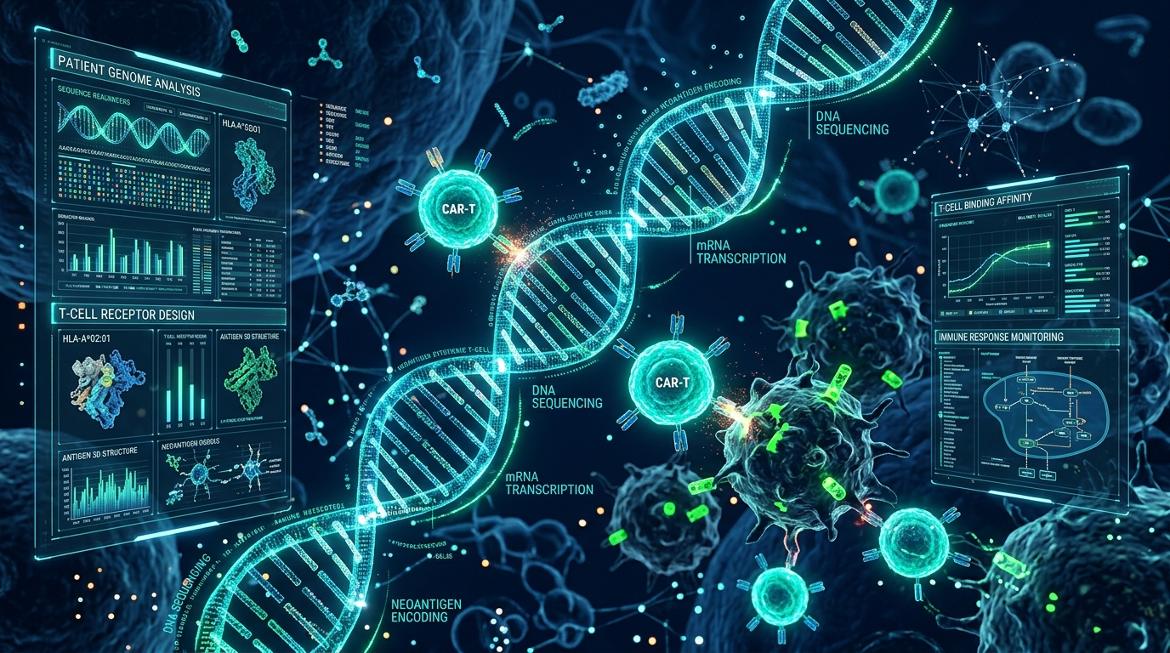
07 | IMMUNO-ONCOLOGY
Individualized Neoantigen Therapy (INT): mRNA-4157 / V940
Revolutionizing oncology: Creating bespoke personalized cancer vaccines tailored to each patient's tumor.
The Bespoke Medicine Workflow
• Step 1: Patient Biopsy & Blood Sampling
• • High-throughput Next-Generation Sequencing (WES) identifies somatic tumor-specific mutations vs normal DNA.
• Step 2: AI & Machine Learning Epitope Selection
• • Proprietary bioinformatics algorithm ranks mutations for MHC-I/II binding affinity and immunogenicity.
• • Up to 34 unique neoantigens selected per patient.
• Step 3: Rapid Digital Manufacturing
• • Single synthetic mRNA strand encoding all 34 epitopes concatenated together is synthesized and encapsulated in LNPs.
• • Turnaround time compressed to ~6–8 weeks from biopsy to bedside.
Phase 2b/3 Clinical Evidence (w/ Merck)
• KEYNOTE-942 Trial Breakthrough:
• • INT (mRNA-4157) + Keytruda vs Keytruda alone in stage III/IV melanoma.
• • 44% reduction in risk of cancer recurrence or death (HR = 0.561).
• • 65% reduction in distant metastasis or death.
• Pipeline Expansion: Phase 3 active in melanoma, lung cancer (NSCLC).
Notes:
SLIDE 7 SPEAKER NOTES:
Now we arrive at the most scientifically breathtaking application of Moderna's platform: Individualized Neoantigen Therapy, partnered with Merck. No two cancers have the same genetic mutations. With mRNA-4157, when a patient has a tumor surgically resected, their tumor DNA is sequenced, an AI model picks the 34 most immunogenic mutations, and within weeks, a completely unique mRNA vaccine is synthesized specifically for that individual patient. In Phase 2b melanoma trials, combining this with Keytruda slashed recurrence or death by 44%. This represents the dawn of true personalized genetic oncology.

Slide 8
08 | BIOMANUFACTURING PARADIGM
Agile Biomanufacturing: The Cell-Free Foundry Advantage
Contrasting classical recombinant bioreactors with Moderna's automated digital mRNA synthesis.
Cell-Free In Vitro Transcription (IVT)
• Eliminating Biological Variability:
• • Classical biologics require living mammalian cells (CHO cells) in 10,000L tanks, taking 6–9 months per batch.
• • Moderna uses cell-free enzymatic synthesis using T7 RNA polymerase and linearized plasmid DNA.
• Turnaround in Weeks:
• • Complete batch turnaround reduced to 4–6 weeks from digital sequence to finished vial.
• Chemical Uniformity:
• • Higher batch-to-batch reproducibility without cellular contaminants (host-cell proteins, mycoplasma).
• Purification Innovation:
• • Tangential Flow Filtration (TFF) and specialized chromatography eliminate double-stranded RNA (dsRNA) impurities.
Digital Foundry Architecture (Norwood, MA)
• Robotic Automation & Microfluidics:
• • Continuous-flow impingement jet microfluidic mixing precisely encapsulates mRNA inside LNPs at millisecond speeds.
• Cloud-Integrated MES & AI Quality Control:
• • Real-time sensor monitoring tracks particle size distribution (~80 nm) and % encapsulation efficiency (>90%).
• Universal Production Chassis:
• • The exact same facility, pumps, and mixers produce COVID vaccines, cancer vaccines, or rare disease therapeutics.
• Global Manufacturing Network:
• • Strategic facility partnerships established in the US, UK, Canada, and Australia for sovereign pandemic preparedness.
Notes:
SLIDE 8 SPEAKER NOTES:
To appreciate Moderna's margins and speed, you have to look at manufacturing chemistry. Traditional biopharma manufactures proteins inside living cells—hamster ovary cells—which are notoriously temperamental, sensitive to temperature, contamination, and require 6 to 9 months per run. Moderna's process is completely cell-free. They mix linearized DNA, T7 polymerase, and nucleotide building blocks in a continuous chemical reactor. At their Norwood foundry, microfluidic jets smash the mRNA and lipids together at high velocity to form uniform 80-nanometer spheres. The exact same equipment produces an oncology drug on Monday and an RSV vaccine on Friday.

Slide 9
09 | TECHNICAL ROADBLOCKS
Key Scientific & Biological Challenges
Critical limitations in biodistribution, tolerability, thermal stability, and chronic dosing.
1. Extra-Hepatic Delivery Trap
• Systemic IV-administered LNPs naturally bind serum ApoE and are swallowed by liver hepatocytes via LDLR (>80% liver clearance).
• Delivering mRNA to lungs, heart, bone marrow, or the central nervous system requires novel SORT lipids or targeting ligands.
2. Transient Expression Kinetics
• mRNA does not integrate into the genome; protein expression peaks at 24–48h and decays within days.
• Advantage: High safety margin for vaccines.
• Hurdle: Chronic genetic disease treatments require lifelong repeat infusions every 2–4 weeks.
3. Reactogenicity & Tolerability
• High-dose repeat mRNA triggers systemic inflammatory cytokines, causing fever, fatigue, and myalgia.
• Limits maximum tolerable doses in systemic protein replacement and cardiovascular therapeutics.
• Requires next-gen biodegradable lipids with accelerated tissue clearance.
4. Anti-PEG Immunogenicity
• Repeated exposure to PEGylated lipids can stimulate anti-PEG IgM/IgG antibodies.
• Causes Accelerated Blood Clearance (ABC) and risks complement-activation pseudoallergy (CARPA).
• Driving development of PEG-free hydrophilic polymer coatings.
Notes:
SLIDE 9 SPEAKER NOTES:
An objective case analysis must confront technical vulnerabilities. The foremost challenge is the 'liver trap': when you inject standard LNPs intravenously, they absorb ApoE from your blood and get cleared by the liver. That's fine for liver enzyme deficiency, but useless if you want to target brain tumors or lungs. Second, mRNA expression is temporary—lasting only a few days. While perfect for vaccines, treating a chronic metabolic disease requires repeated dosing, which risks triggering anti-PEG antibodies, inflammation, and reduced therapeutic efficacy over time. Overcoming these delivery barriers is Moderna's central scientific focus.

Slide 10
10 | LEGAL & IP LANDSCAPE
Intellectual Property Warfare & Regulatory Complexity
Navigating high-stakes patent battles, government disputes, and pioneering regulatory standards.
The Multi-Billion Dollar Patent Battles
• Arbutus / Genevant Landmark Settlement (March 2026):
• • Long-standing litigation alleging Moderna's COVID vaccine infringed foundational patents on ionizable lipids and 4-component LNP ratios.
• • Resolved via a landmark $2.25 Billion global settlement ($950M upfront, up to $1.3B contingent), eliminating major legal overhang.
• Moderna vs. Pfizer & BioNTech Litigation:
• • Transatlantic lawsuits filed in the US, Germany, and UK alleging Comirnaty infringed Moderna's patents on modified mRNA chemistry.
• • Ongoing countersuits by BioNTech and Pfizer challenging patent validity.
• US NIH / Government Inventorship Dispute:
• • Public clash over whether federal scientists at the NIH Vaccine Research Center should be credited as co-inventors on the core Spikevax sequence.
Regulatory Precedents & Paradigm Evolution
• Strain Change Regulatory Pathways:
• • Pioneered FDA/EMA frameworks permitting seasonal antigen updates without requiring repeating full 30,000-patient efficacy trials.
• Individualized Medicine Regulation:
• • Establishing novel regulatory review models for bespoke cancer vaccines (mRNA-4157), where each individual batch has a distinct chemical sequence.
• Biosimilar Barriers:
• • Extremely complex LNP/mRNA formulation creates massive technical and regulatory moats, insulating Moderna from rapid generic/biosimilar erosion.
Notes:
SLIDE 10 SPEAKER NOTES:
In biotechnology, patent defense is as critical as laboratory discovery. Moderna was entangled in high-stakes intellectual property warfare. Most notably, Arbutus Biopharma claimed foundational ownership over four-component LNP formulation ratios. Just in March 2026, Moderna reached a historic $2.25 billion global settlement, paying $950 million upfront to finally remove that legal cloud. At the same time, Moderna continues to litigate against Pfizer and BioNTech over modified nucleoside IP. On the regulatory side, Moderna successfully worked with the FDA to treat strain updates like annual flu shots, creating a regulatory expressway for recurring commercial updates.

Slide 11
11 | FINANCIAL & MARKET DYNAMICS
Market Impact: Revenue Transformation & Platform Economics
Managing the post-pandemic revenue normalization while harnessing software-like platform economics.
Financial Hyper-Growth & Transition
• The Revenue Explosion (2020–2022):
• • Scaled from $0 in commercial product sales to $18.5B (2021) and $19.3B (2022) with >60% net margins.
• • Peak cash reserves exceeded $18 billion.
• The Post-Pandemic Normalization:
• • Revenue adjusted to endemic respiratory levels ($6.8B in 2023; stabilizing at $3B–$4B range in 2024–2025).
• Capital Reinvestment Strategy:
• • Sustaining aggressive R&D reinvestment (> $4B annually) across ~45 pipeline assets.
• • Target: Path to cash-flow breakeven driven by respiratory combos and oncology launches.
Platform Economics: Marginal Cost Advantage
• Traditional Pharma Model:
• • High marginal cost per new drug ($1.5B+). Every new drug requires novel chemistry, custom assays, new bioreactor lines, and distinct toxicology.
• The Moderna Software Model:
• • Fixed initial capital spent building LNP chemistry, safety databases, and digital manufacturing.
• • Low marginal cost to add pipeline candidates: Simply modify the digital sequence file.
• Compounding Value:
• • Every clinical trial de-risks the delivery vehicle for all other assets.
• • Higher Probability of Technical Success (PTRS) across pipeline programs.
Notes:
SLIDE 11 SPEAKER NOTES:
Let's evaluate Moderna's financial transformation. In 2019, Moderna had zero commercial product sales. By 2022, they recorded nearly $20 billion in annual revenue. Inevitably, as pandemic crisis urgency faded, revenues faced a steep cliff down to endemic levels. But here is where platform economics shine: unlike traditional pharma, where each drug requires completely new manufacturing plants and custom chemistry, Moderna's platform shares the same LNP formulation, the same Norwood facility, and the same safety data. This drastically lowers the marginal cost of developing asset number 45 compared to asset number 1.

Slide 12
12 | STRATEGIC SYNTHESIS
Conclusion: Key Takeaways for the Biotech Industry
How Moderna established the modern paradigm of programmable biotechnology.
1. Delivery is Paramount
• Without advanced lipid nanotechnology, mRNA is clinically useless.
• Formulation chemistry and microfluidic manufacturing are as critical as the genetic payload itself.
• Future enterprise winners will master targeted extrahepatic delivery.
2. Platform Agility Wins
• Modular, cell-free platforms radically outperform bespoke single-asset pipelines.
• Compressed development from decades to weeks provides unmatched strategic resilience during health crises.
• Platform economics amortize R&D and CMC expenditures across dozens of programs.
3. Tech-Bio Convergence
• Moderna succeeded by fusing molecular genetics, AI computational design, nanotechnology, and robotics.
• Proved that biology can be engineered with software-like iteration cycles.
• mRNA is now an enduring, permanent pillar of global medicine alongside small molecules and biologics.
Notes:
SLIDE 12 SPEAKER NOTES:
In conclusion, Moderna's journey offers three timeless lessons for biotechnology leaders:
First, delivery is paramount—formulation chemistry was the true enabler of mRNA's triumph.
Second, platform models beat bespoke pipelines: by treating mRNA as software, Moderna achieved compounding velocity and capital efficiency.
And third, the future of biotechnology lies in multidisciplinary convergence: computation, synthetic biology, nanotechnology, and robotics.
Moderna did not just develop vaccines; it permanently altered how humanity creates medicine. Thank you, and I look forward to your questions.

