Slide 1
ONLINE HOME SERVICE
MINU ELIZ POTHEN
S4 LE MCA

Slide 2
Online Home Service is a web-based application developed using Laravel framework, it is useful for customers to find employees for online home services. This site provide verified service professionals to Online Home Service taking away the pain of finding the right home service expert to cater to your needs like cleaning,plumbing etc..with reasonable price. Customers get home services in certain locality with just a few click of button.

Slide 3
Overview
The website provides manageable accounts for administrator, employees and customers . This is for the great beneficial of home activities. It will be a simple platform for users to access services for their needs. It provides the services to the users who are registered in the site.

Slide 4
Nowadays every one running on a tight schedule and have little time to find employees for home services. So we cannot get verified employees. In this way we cannot trust anyone. The existing system carries more time to find employees and costly and finding employees directly by people. And all records are keeping manually. So it’s very difficult and time consuming. Since all these services are carried out by the normal people they are suffered from long distance journey. For this reason the online system is implemented.

Slide 5
To safeguard and ensure the customers safety all professionals backgrounds checked and verified. By following this new approach, the information can be accessed from anywhere just with a mouse click. This helps the users by saving lot of time and providing the user with up to date information.
.

Slide 6
Modules
Admin
Approve the qualified employees,only approved employees can become part of the site.
He have the right to block and unblock the employees and customers.
Admin can view all employee details,customer details .
Can add essential information like new service available district,new category of services
Can view account and payment details.
Manage leave and ratings of employees

Slide 7
Employee
Employee can request to Admin to become a part of home services.
They can apply for leave .
Can update their details.
They get notification from customer through email.

Slide 8
Customer
Registered users can book professionals based on their location and schedule services on convenient date for both customer and employee.
They can view their booked histories .
Can update their details .
Can add bank account details.
Can add rating and reviews.
Customers confirm their booking by sending notification through email to employees .

Slide 9
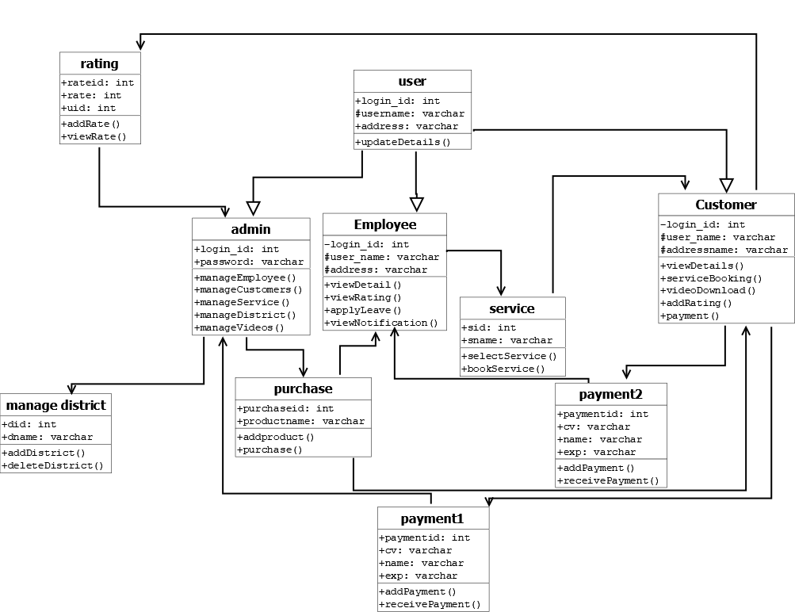
UML Diagrams
Class Diagram

Slide 10
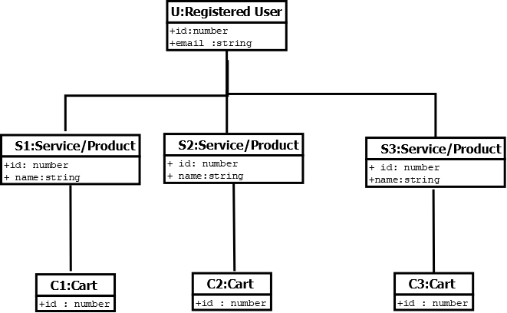
Object Diagram

Slide 11
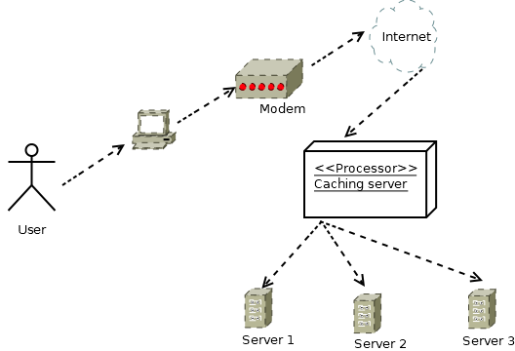
Deployment Diagram

Slide 12
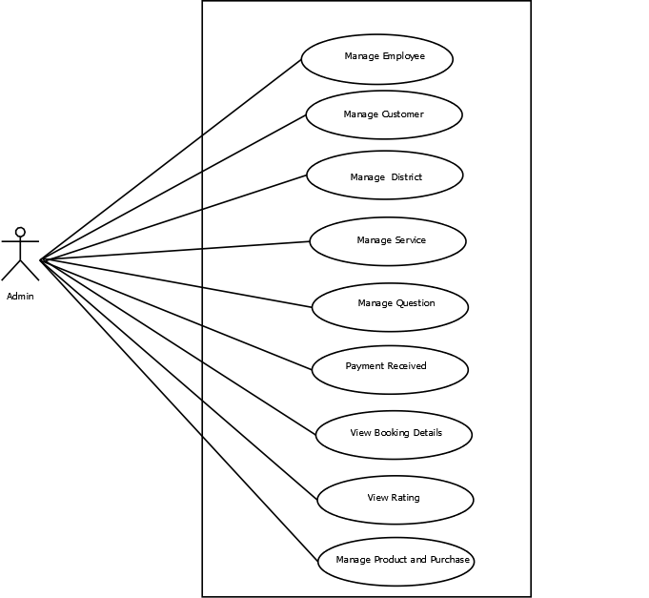
Use case Diagram

Slide 13
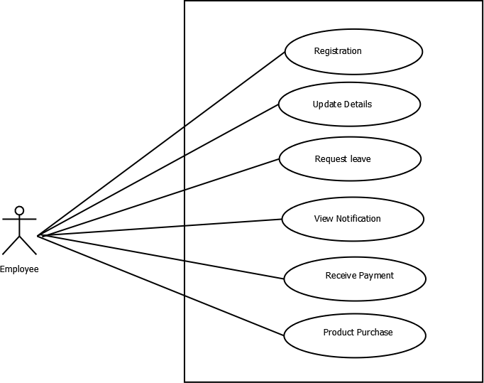

Slide 14
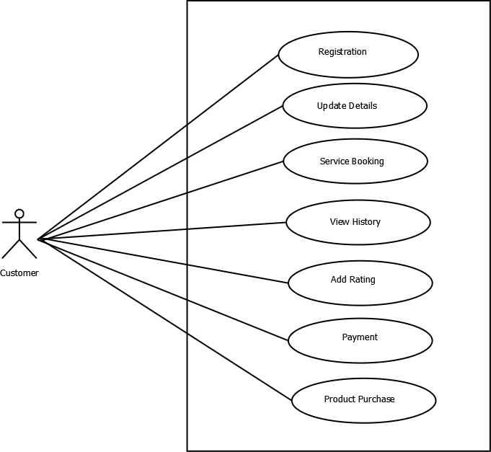

Slide 15
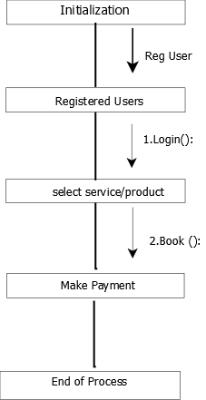
Collaboration Diagram

Slide 16
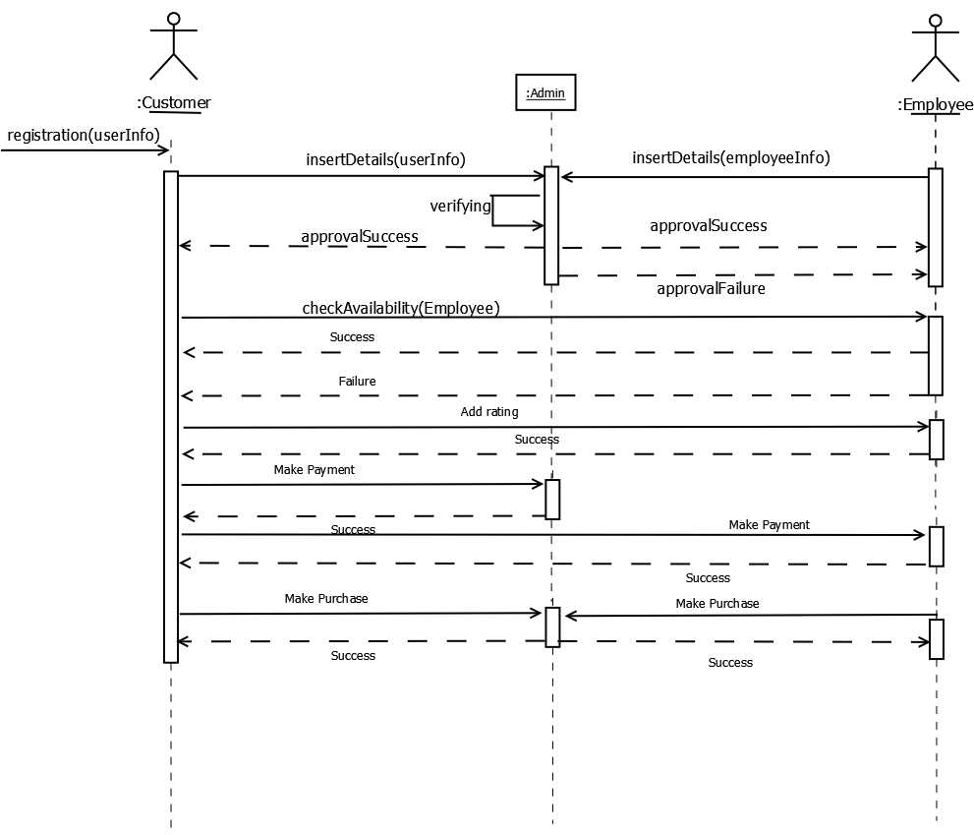
Sequence Diagram

Slide 17
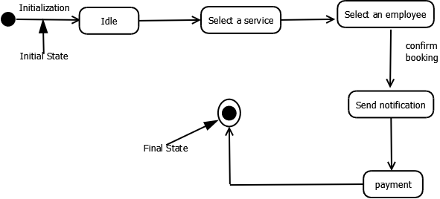
State chart Diagram

Slide 18
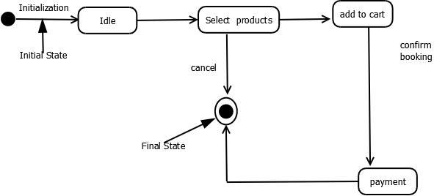
State Chart Diagram

Slide 19
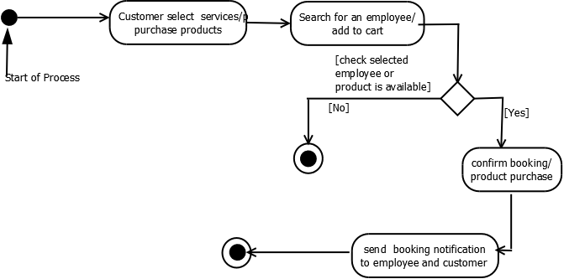
Activity Diagram

Slide 20
Table Design
Table name:users
Primary key: id
Fieldname | Fieldtype | size |  | Description
id | bigint | 20 |  | Primary key
name | varchar | 191 |  | Name of user
email | varchar | 191 |  | Email of user
password | varchar | 191 |  | Password of user
status | tinyint | 1 |  | User blocked or not
worker_approved | tinyint | 4 |  | Approved or not

Slide 21
Table name:user_informations Primary key: id
Fieldname | Fieldtype | Size | Description
id | bigint | 20 | Primary key
user_id | bigint | 20 | Foreign key
service_category | bigint | 20 | Foreign key
addr | varchar | 191 | Address
district_id | int | 11 | District
pin_code | varchar | 20 | Pincode
phone | varchar | 20 | Phonenumber
alt_phone | varchar | 20 | Alternate phone number
sec_q | int | 11 | Security question
sec_a | varchar | 191 | Security answer
img | varchar | 191 | Profile picture
exp_proof | varchar | 191 | Experience proof
id_proof | varchar | 191 | Id proof
per_hour_amount | double |  | Amount per hour

Slide 22
Table name:service_categories
Primary key: id
Fieldname | Fieldtype | Size | Description
id | int | 4 | Primary key
parent_id | int | 11 | Id of main service
category | varchar | 100 | Name of service
img | varchar | 100 | Image of service
status | tinyint | 1 | Blocked or not

Slide 23
Table name:sec_questions
Primary key:id
Fieldname | Fieldtype | Size | Description
id | bigint | 20 | Primary key
question | varchar | 191 | Question
status | tinyint | 1 | Blocked or not

Slide 24
Table name:districts
Primary key:id
Fieldname | Fieldtype | Size | Description
id | int | 4 | Primary key
district | varchar | 20 | District Name
status | tinyint | 4 | Blocked or not

Slide 25
Table name:orders
Primary key:id
Fieldname | Fieldtype | Size | Description
id | int | 4 | Primary key
user_id | int | 11 | Foreign key
amount | double |  | Amount of service or product
status | tinyint | 4 | placed or completed
shipping_address | varchar | 191 | Address to deliver product
service_addr | varchar | 191 | Address of customer

Slide 26
Table name: products
Primary key: id
Fieldname | Fieldtype | Size | Description
id | int | 4 | Primary Key
product_category | int | 4 | Foreign Key
name | varchar | 20 | Name of product
description | varchar | 20 | Description of product
qty | int | 11 | Quantity of each product
amount | double |  | Amount of each product
img | varchar | 191 | Image of product
status | int | 11 | Blocked or unblocked

Slide 27
Table name: product_categories Primary key: id
Fieldname | Fieldtype | Size | Description
id | int | 11 | Primary key
category | varchar | 191 | Category of product
status | tinyint | 4 | Blocked or Unblocked

Slide 28
Table name:leaves Primary key:id
Fieldname | Fieldtype | Size | Description
id | int | 11 | Primary Key
user_id | int | 11 | Foreign Key
from | date |  | From date
to | date |  | To date
reason | text |  | Reason for taking leave
status | int | 11 | Pending,approved or declined

Slide 29
reviews Primary key:id
Fieldname | Fieldtype | Size | Description
id | int | 11 | Primary key
user_id | int | 11 | Foreign Key
item_id | int | 11 | Foreign Key
worker_id | int | 11 | Foreign Key
product_id | int | 11 | Foreign Key
rating | int | 11 | Number of star rating
comment | text |  | Comment of service or product
status | tinyint | 4 | Active or inactive

Slide 30
credits Primary key:id
Fieldname | Fieldtype | Size | Description
id | int | 11 | Primary key
user_id | int | 11 | Foreign Key
card _no | varchar | 16 | Card number
expiry | varchar | 5 | Expiry of card
cvv | int | 3 | Cvv number
name_on_card | varchar | 100 | Name on the card
type | varchar | 100 | Type of card
balance | double |  | Account balance amount

Slide 31
order_items Primary key:id
Fieldname | Fieldtype | Size | Description
id | int | 11 | Primary Key
order_id | int | 11 | Foreign Key
item_id | int | 11 | Foreign Key
item_type | tinyint | 4 | Product or Service
qty | int | 11 | Quantity of product
amount | double |  | Total amount
commision | double |  | A percentage of amount
service_subCat | int | 11 | Subcategory
service_slot_from | datetime |  | From date
service_slot_to | datetime |  | To date
description | text |  | Description to employee
img | varchar | 200 | Image to employee about their need

Slide 32
service_invoice Primary key:id
Fieldname | Fieldtype | Size | Description
id | int | 11 | Primary key
item_id | int | 11 | Foreign Key
hours | int | 11 | Hours of service
additional_purchases | text |  | Additional purchase with service
additional_amount | int | 11 | Additional amount
commission | double |  | Commission of amount
total | int | 11 | Total amount

Slide 33
settings Primary key:id
Fieldname | Fieldtype | Size | Description
id | int | 11 | Primary key
Key | varchar | 50 | Leave or commission
Value | varchar | 50 | Value of key item

Slide 34
cart Primary key:id
Fieldname | Fieldtype | Size | Description
id | int | 11 | Primary Key
identifier | varchar | 191 | Foreign Key
instance | varchar | 191 | Default
content | longtext |  | Content in the cart

Slide 35
Conclusion
The system is designed in such a way that the communication between customers ,employees and administrator should be done in completely online mode.
It provides more security
The software reduces the time consumption and the manual efforts of
searching employees and product purchase. It will be a simple platform for users to access services for their huge needs.

