Slide 1
Apache Giraph
Minumol joseph

Slide 2
Contents
What is Apache Giraph?
Why do I need it?
Key Concepts
Installation
Shortest Distance Path Algorithm
Page Rank algorithm
Tutorial Demo.

Slide 3
What is Apache Giraph
Framework for performing iterative batch processing of semi structured graph data on a massive scale.
Built on the top of Apache Hadoop.
Program: “Think like a vertex”
Input : Graph composed of vertices and directed edges.
Computation proceeds as a sequence of iterations, called supersteps

Slide 4
Why do I need it?
Easy to implement Graph algorithms by Bulk Synchronous parallel Model.
Giraph makes iterative graph processing more practical for Hadoop users.
Giraph avoids costly disk and network operations that are mandatory in Map reduce.

Slide 5
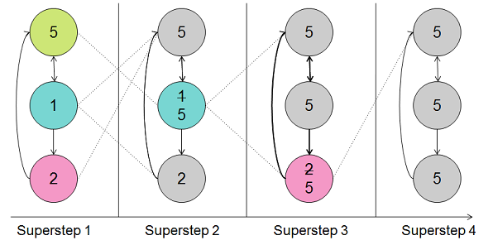
Key Concepts
Iterative Execution of Supersteps (BSP).

Slide 6
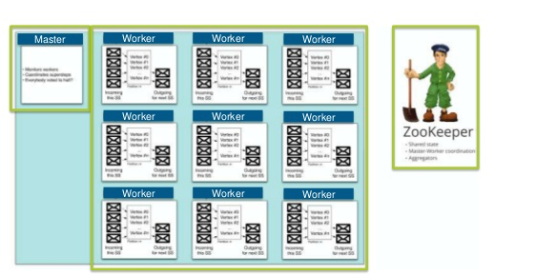

Slide 7
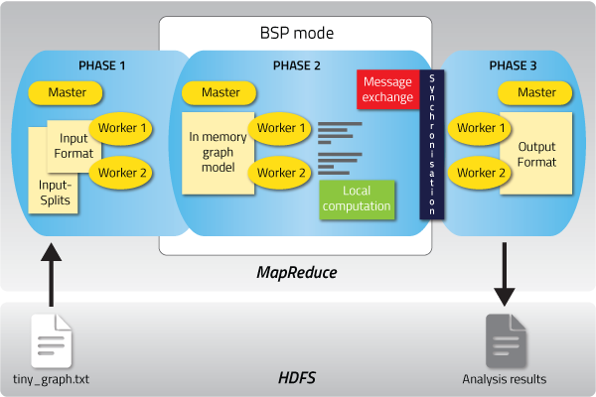

Slide 8
Installation
Prerequisites
Java
Maven
Git
Hadoop
ssh remote login
Giraph

Slide 9
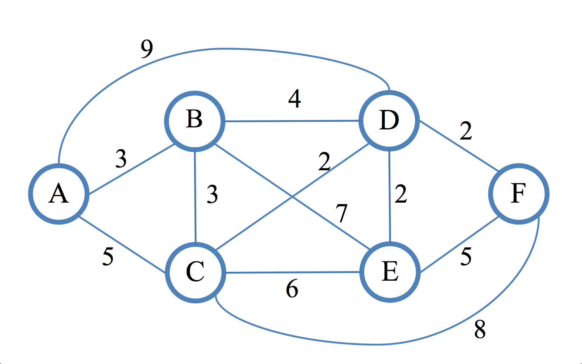
Shortest distance Path Algorithm

Slide 10
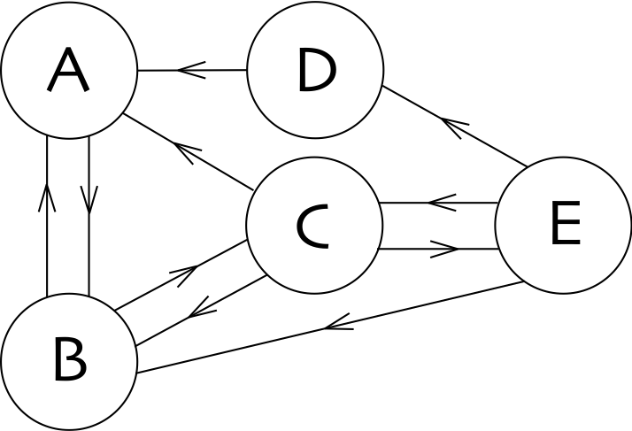
Page Rank algorithm

Slide 11


