Slide 1
Microservices
marin.prcela@minus5.hr

Slide 2
Answers
What are they?
Do you need them?

Slide 3
Microservices
loosely coupled
business capabilities
enable continioius delivery
evolve techology stack

Slide 4
Monolith
Microservices
frontend
frontend
backend
tickets
odds
accounts

Slide 5


Coupling
If you can't build a monolith what makes you think putting network in the middle will help?
Quick fixes?
Joined data?

Slide 6
Latency
trade consistency for improved latency
ticket already processed?
odds are valid?
reserve
money
authorization?
store ticket
confirm
money
reservation

Slide 7
Scalability

Slide 8
Conclusion
What are they?
Do you need them?

Slide 9
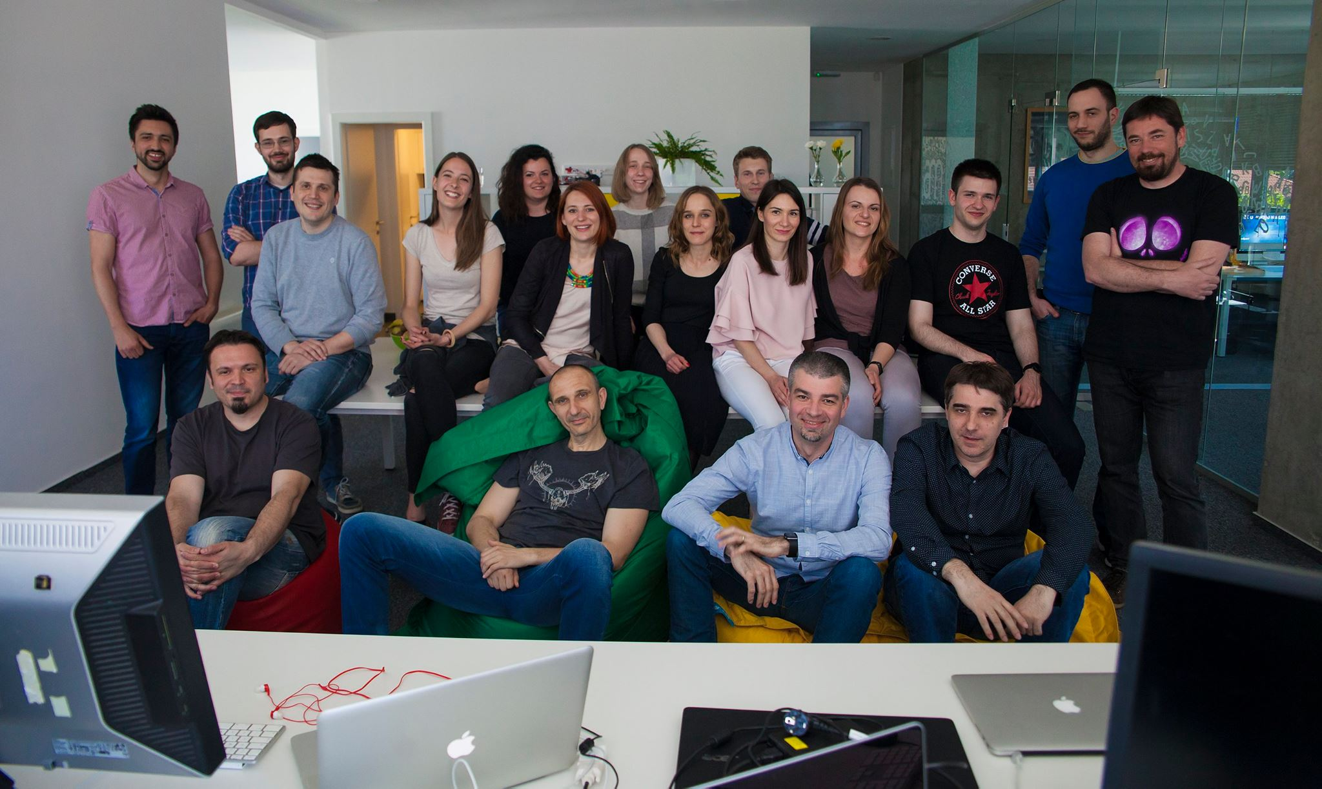
marin.prcela@minus5.hr

