Slide 1



Large Language Model Powered Agentic Framework for Cholera Risk Prediction with Explainable ML and Statistical Insights
Damelin X
Prof GG mailer

Slide 2
Table of Contents
01 The big picture
02 Introduction
03 Research Question
04 Dataset
  Description
  Preprocessing
05 Methodology
  Knowledge base
  LLM framework
06 Langchain + Langraph Integration
07 Streamlit UI
08 Results
  Evaluation – Model Performance
  Feature Importance
  Model Performance
09 Example – User query
10 The Interface
11 Sample Agent response
12 Discussion
13 Conclusion

Slide 3

The Big picture
Cholera is a waterborne disease and a major public health challenge. To predict outbreaks or analyse cholera patterns, we ideally need reliable data such as water quality reports, water treatment records, demographic information, and epidemiological or clinical data. But in many instances, these types of data are limited or unavailable.
The question then becomes: what can we do in a data-constrained environment?
When traditional data sources are missing, we can turn to alternative forms of information. Social media posts, publicly available datasets, environmental data, mobility patterns, and other unconventional sources can help fill the gaps. By combining these alternative data streams, we can still perform meaningful analyses and predictions of cholera. Using non-traditional, accessible data to overcome resource limitations is the core of my research.

Slide 4
Introduction
With the big picture in mind, this study narrowly explored how interpretable machine learning and large language model (LLM)–driven reasoning can work together to provide transparent, actionable insights. Specifically, the research investigates how an LLM-powered agentic framework can integrate explainable ML models with statistical reasoning to identify key risk factors for cholera across multiple regions.
This work contributes by:
Developing a multi-model analytical pipeline using EBM, NGBoost, and TabNet to analyse cholera risk factors.
Integrating a LangChain-based LLM agent that interprets model outputs, supports natural language querying, and enhances decision-making in data-constrained environments.

Slide 5

Research Question
How can an LLM-powered agentic framework integrate explainable machine learning and statistical reasoning to identify key risk factors for Cholera incidence across multiple regions?
Bottom line: When ideal data isn't available, we use explainable AI and natural language processing to extract insights from what we do have, making cholera prediction or analyses possible..

Slide 6
Dataset Description
Source:
Water Pollution and Disease dataset from Kaggle
Published: March 2025
Coverage: 2000–2025
Focus: Environmental, socio-economic, and health factors influencing waterborne diseases, especially Cholera
Overview:
Provides a contemporary and comprehensive view of water pollution indicators and public health outcomes.
Includes environmental metrics, socio-economic conditions, and cholera incidence across multiple regions.

Slide 7
…Dataset Description
Variables
Target Variable:
Cholera Cases per 100,000 people
Predictor Variables:
Environmental:
  Rainfall frequency
  Water source type
  Contaminant levels
  pH, turbidity, dissolved oxygen
  Nitrate and lead concentrations
  Bacterial counts
Socio-economic:
  Sanitation access
  Open defecation rates
  Education levels
  Population density
  Infrastructure-related variables

Slide 8
Dataset Pre-processing
Target Variable Validation:
  Confirmed the presence of Cholera Cases per 100,000 people before transformation.
Feature Categorisation:
  Separated numerical and categorical features.
  Target variable excluded from all preprocessing steps.
Skewness Handling:
  Calculated skewness coefficients for numerical features.
  Applied log1p transformation to variables with skew > 1 to reduce outlier impact and stabilise feature distributions.
Normalisation:
  Standardised numerical features using z-score normalisation for consistent scaling across all variables.
Categorical Encoding:
  Used one-hot encoding with the first category dropped to avoid multicollinearity.

Slide 9
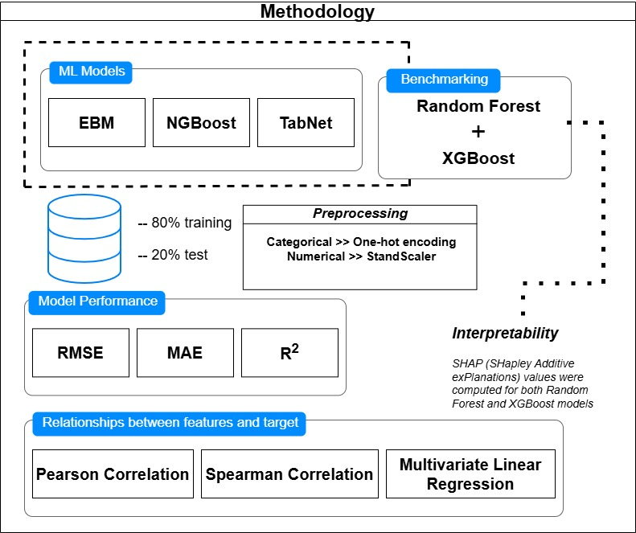
Methodology – Knowledge base

Slide 10
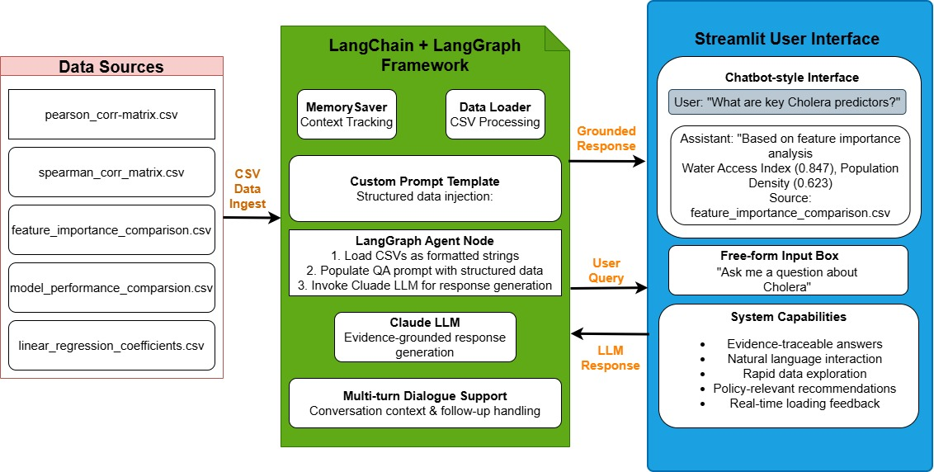
Methodology – LLM Framework

Slide 11
Langchain + Langraph Integration
Framework Structure:
  Built using LangChain’s LangGraph to enable stateful, multi-step reasoning through a directed graph.
  Implemented as a minimal LangGraph with a single question-answering node supported by structured memory.
Data-Grounded Reasoning:
  The agent loads outputs from ML and statistical analyses (correlations, coefficients, importance rankings).
  Each CSV is formatted and injected into a custom prompt template to ensure evidence-based responses.
Prompt Design:
  Delimited sections for:
    Correlation matrices
    Regression coefficients
    Feature importance rankings
  Enables precise, context-aware answer generation.
Execution Logic:
  Load and format the required CSV files
  Populate QA prompt with structured analytics
  Append user query and history
  Invoke Claude LLM for grounded response generation
Conversation Memory:
  MemorySaver ensures multi-turn dialogues remain coherent, allowing the agent to track context across interactions.

Slide 12
Streamlit UI
Lightweight Web Interface:
  Built using Streamlit to make the framework accessible to non-technical users.
Key Features:
  Chatbot-style layout with persistent conversation history
  Free-form input box for user queries
    e.g., “What are the most important features for predicting Cholera?”
  Dynamic loading spinner for real-time response feedback
Interaction Flow:
  User enters a question
  Message is added to the conversation state
  Query is sent to the LangGraph agent
  The LLM response is appended and displayed in the chat interface

Slide 13
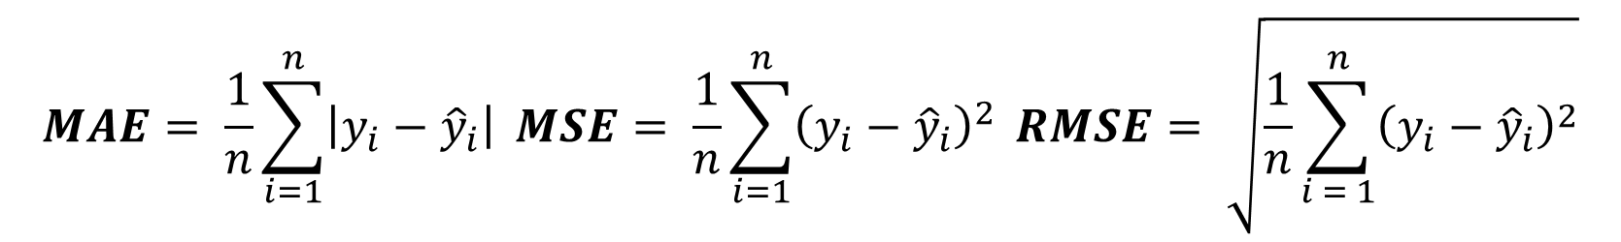
Evaluation – Model Performance
We employed four commonly used regression metrics to provide predictive accuracy and model fit.
$$MAE= \frac{1}{n}\sum_{i=1}^{n}{\left|y_{i}−{\hat{y}}_{i}\right| }MSE= \frac{1}{n}\sum_{i=1}^{n}{{\left(y_{i}−{\hat{y}}_{i}\right)}^{2}} RMSE= \sqrt{\frac{1}{n}\sum_{i = 1}^{n}{{\left(y_{i}−{\hat{y}}_{i}\right)}^{2}}}$$
$$R^{2}=1−\frac{{SS}_{res}}{{SS}_{tot}}=1−\frac{\sum_{i=1}^{n}{{\left(y_{i}−{\hat{y}}_{i}\right)}^{2}}}{\sum_{i=1}^{n}{{\left(y_{i}−\overline{y}\right)}^{2}}}$$

Slide 14
Results – Feature Importance
The analysis identifies Infant Mortality Rate as the most consistent predictor of cholera incidence (average importance 0.058), likely reflecting broader healthcare quality and population vulnerability. Turbidity follows (0.044), underscoring the role of water clarity and contamination in transmission. Overall, feature importance scores are low, with the highest at 0.145 (TabNet for Infant Mortality Rate) and most below 0.050, indicating cholera risk stems from a distributed set of factors rather than a few dominant ones.
Feature | Random Forest | XGBoost | EGM | TabNet
Infant Mortality Rate | 0.054 | 0.030 | 0.004 | 0.145
Turbidity (NTU) | 0.048 | 0.021 | 0.013 | 0.094
Water Treatment Method_Filtration | 0.005 | 0.0184 | 0.000 | 0.0129
Water Source Type_Spring | 0.005 | 0.040 | 0.019 | 0.080
Healthcare Access Index (0 - 100) | 0.003 | 0.017 | 0.004 | 0.111
Contaminant Level (ppm) | 0.054 | 0.020 | 0.011 | 0.025

Slide 15
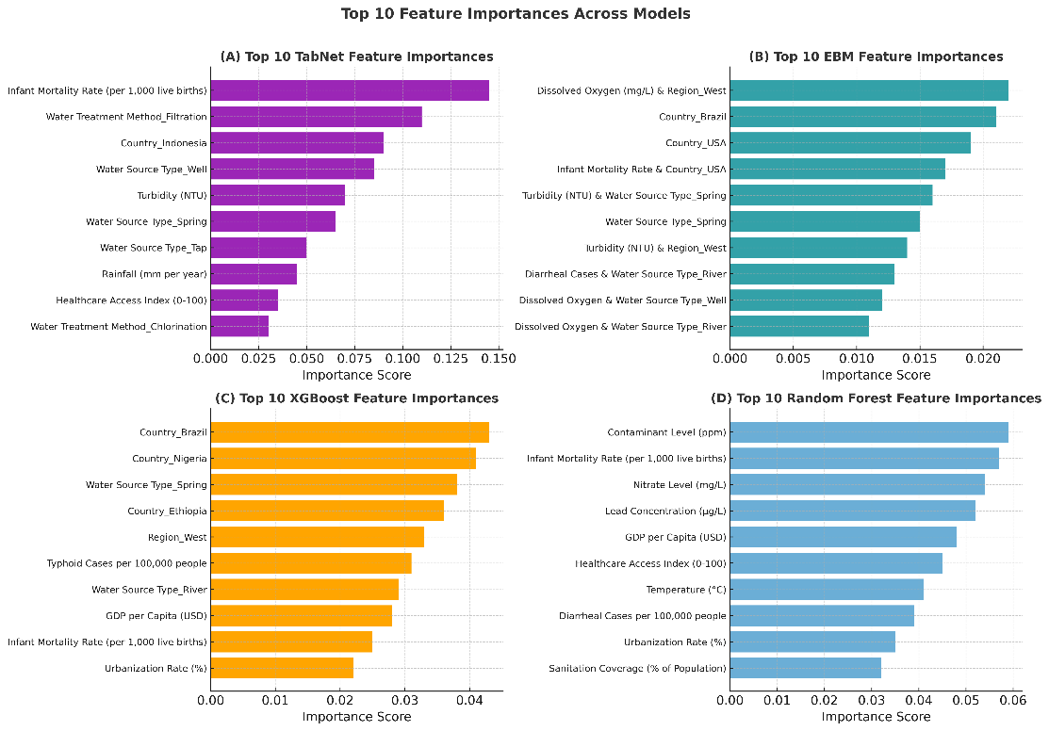
Results – Feature Importance
Figure 4 and subfigures A–D show model-specific top-10 predictors, highlighting distinct feature selection and weighting patterns across the four models.

Slide 16
Results – Model Performance
We employed four commonly used regression metrics to provide predictive accuracy and model fit.
Model | MAE | MSE | RMSE | R²
Random Forest | 12.39 | 207.201 | 14.394 | -0.006
XGBoost | 13.094 | 243.379 | 15.601 | -0.182
EGM | 12.398 | 205.422 | 14.333 | 0.002
TabNet | 12.509 | 211.525 | 14.544 | -0.027

Slide 17
Example - User query
User Question:
“Water Contamination has a strong positive correlation (+0.75) with Cholera cases. How does this result in high Cholera incidences, and what can be done to reduce contamination levels?”

Slide 18
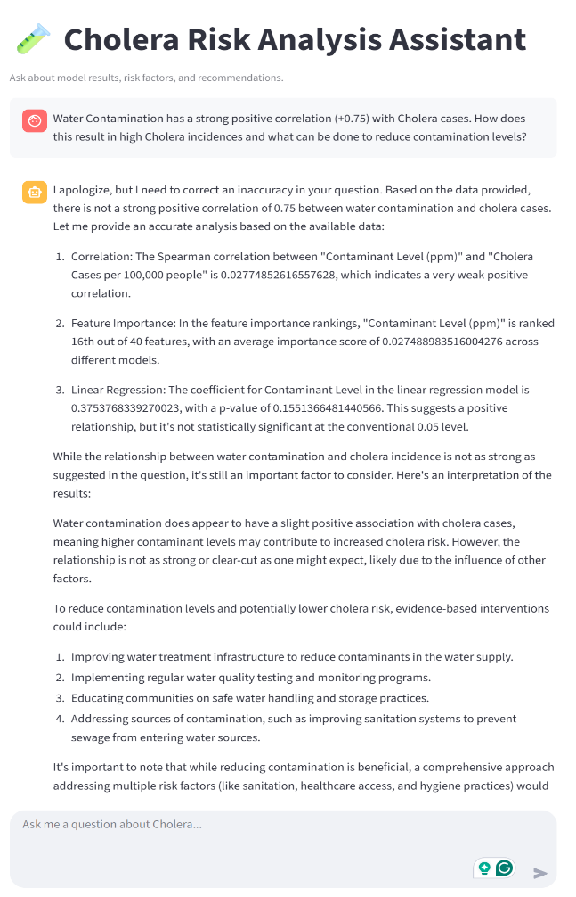
The Interface

Slide 19
Example - Agent Response
I apologize, but I need to correct an inaccuracy in your question. Based on the data provided, there is not a strong positive correlation of 0.75 between water contamination and cholera cases. Let me provide an accurate analysis based on the available data:
Correlation: The Spearman correlation between "Contaminant Level (ppm)" and "Cholera Cases per 100,000 people" is 0.027748526165576628, which indicates a very weak positive correlation.
Feature Importance: In the feature importance rankings, "Contaminant Level (ppm)" is ranked 18th out of 40 features, with an average importance score of 0.027489583516604276 across different models.
Linear Regression: The coefficient for Contaminant Level in the linear regression model is 0.3753168339270028, with a p-value of 0.15513664614404086. This suggests a positive relationship, but it's not statistically significant at the conventional 0.05 level.

Slide 20
Example - Agent Response (Cont’d)
While the relationship between water contamination and cholera incidence is not as strong as suggested in the question, it's still an important factor to consider. Here's an interpretation of the results:
Water contamination does appear to have a slight positive association with cholera cases, meaning higher contaminant levels may contribute to increased cholera risk. However, the relationship is not as strong or clear-cut as one might expect, likely due to the influence of other factors.
To reduce contamination levels and potentially lower cholera risk, evidence-based interventions could include:
Improving water treatment infrastructure to reduce contaminants in the water supply.
Implementing regular water quality testing and monitoring programs.
Educating communities on safe water handling and storage practices.
Addressing sources of contamination, such as improving sanitation systems to prevent sewage from entering water sources.
It's important to note that while reducing contamination is beneficial, a comprehensive approach addressing multiple risk factors (like sanitation, healthcare access, and hygiene practices) would

Slide 21
Discussion
Cholera risk is multifactorial, driven by a combination of environmental and socio-economic factors rather than any single predictor.
Infant Mortality Rate emerged as the most consistent socio-economic indicator of cholera vulnerability.
Water quality variables—including turbidity, contamination, and pH—were key environmental drivers.
EBM delivered the best model performance (RMSE 14.333) while remaining fully interpretable, reinforcing the value of explainable AI in epidemiology.
The LLM-powered agent enabled intuitive, natural-language exploration of analytical outputs, improving accessibility without sacrificing scientific rigour.
The study demonstrates the potential of combining explainable ML + statistical reasoning + LLM interpretation to support public health decision-making, especially in data-constrained settings.

Slide 22
Conclusion
This framework offers a powerful and transformative approach to epidemiological analysis by uniting the strengths of machine learning, statistical inference, and LLM-driven interpretation.
By blending ML’s pattern-recognition abilities with the explanatory rigour of traditional statistical methods and the natural-language reasoning capabilities of LLMs, it delivers insights that are both analytically robust and highly accessible.
Its modular design ensures that complex analyses can be conducted transparently, enabling diverse stakeholders, such as policymakers and public health practitioners, to explore, question, and understand epidemiological patterns with ease.
With future improvement this integrated approach enhances decision-making by making advanced analytical tools interpretable, trustworthy, and usable in real-world public health contexts, especially in settings with limited resources.

Slide 23
Thank you

