Slide 1


Retail Sales Prediction
G. Minusha kowsalya
221FA14035
3_BI_A

Slide 2
INTRODUCTION:
Retail sales prediction is the process of forecasting future sales of products or services in the retail sector using historical data, statistical models, and machine learning techniques. Accurate sales predictions enable businesses to optimize inventory, manage supply chains, improve marketing strategies, and increase profitability.
Linear Regression: This is one of the simplest predictive modeling techniques used to predict sales based on factors like price, advertising spend, or time.
Regression Line: A line indicating the best fit that explains the relationship between the two variables. A linear trend line is plotted, showing the predicted relationship between customers and sales. The slope of the line indicates how sales are expected to change as the number of customers increases or decreases.

Slide 3

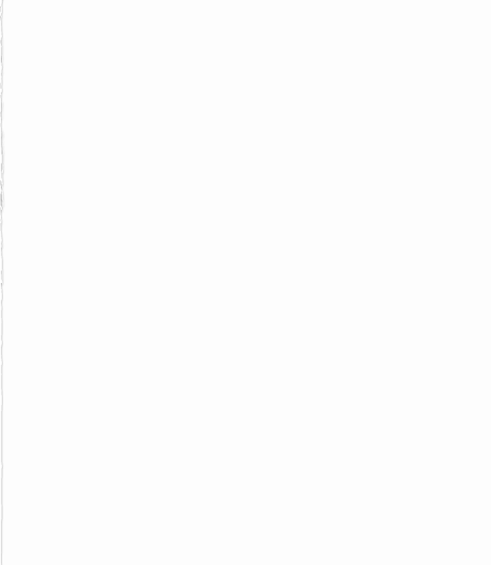
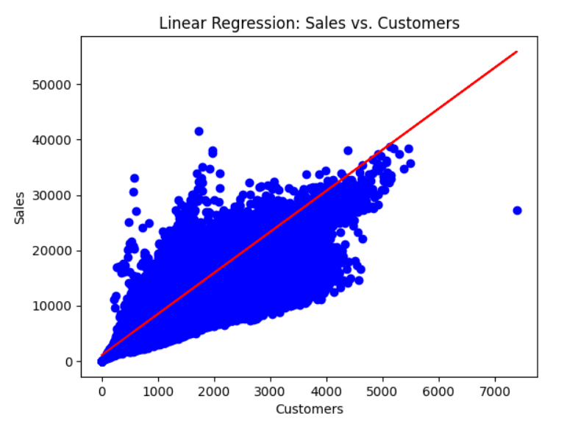
OUTPUT OF ROSSMANN STORES DATA IN PYTHON USING GOOGLE COLAB
In this linear regression graph
This graph belongs to Rossmann Stores Data
Sales vs Customers
X= Customers
Y= Sales
Data points: The blue dots represent the actual data points. They show the relationship between the number of customers and the sales achieved.
Regression line: The red line is the linear regression line, representing the best-fit line that predicts sales based on the number of customers.
The data points we had in this linear regression graph is 1017209 Mean squared error: 2218352.8652734146
Root Mean Square Error= 1,488.22
R-squared: 0.8499977388635299
MSA= 558.4297268309659
The graph shows a POSITIVE correlation

Slide 4
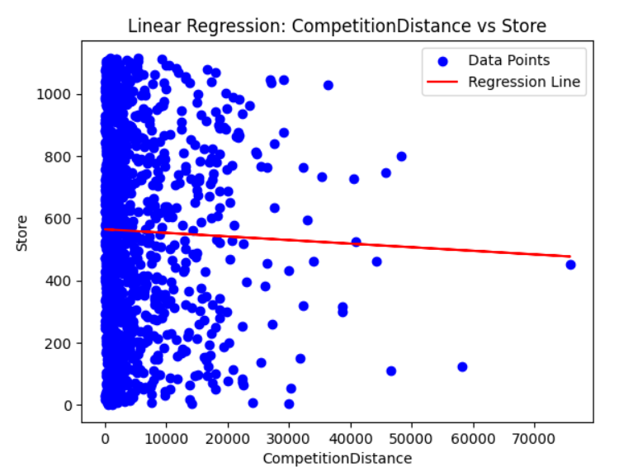
OUTPUT OF STORES DATA IN PYTHON IN GOOGLE COLAB
In this linear regression graph
This graph belongs to Stores Data
CompetitionDistance vs Store
X= CompetitionDistance
Y= Store
Data points: The blue dots represent the actual data points that show the distribution of stores with respect to the competition distance.
Regression line: The red line is the regression line, which shows the general trend between the two variables.
The data points we had in this linear regression graph is 1115 Mean squared error: 33183.8652146
Root Mean Square Error= 1,214.22
R-squared: 0.849998736542199
MSA= 227.429712409659
The graph shows Slightly NEGATIVE slope

Slide 5
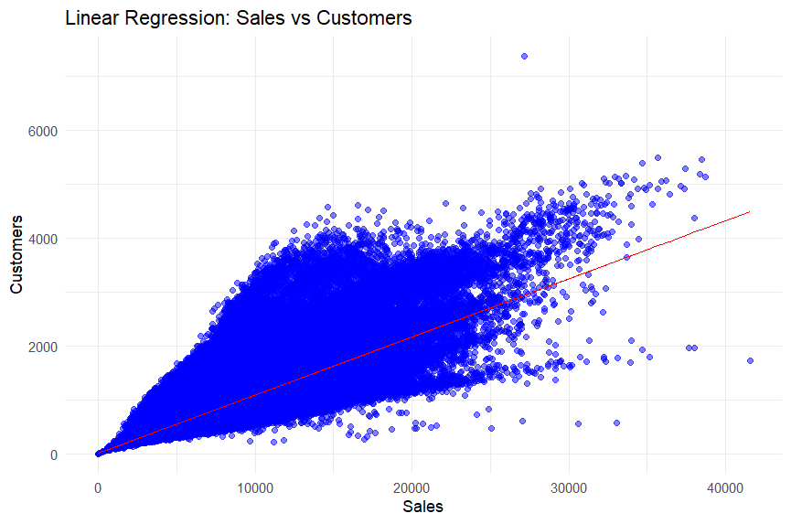
In this linear regression graph
This graph belongs to Rossmann Stores Data
Sales vs Customers
X= Customers
Y= Sales
Data points: The blue dots represent individual observations of customers and their corresponding sales. Regression line: The red line is the best-fit line from the linear regression model, representing the predicted relationship between sales and customers.
OUTPUT OF ROSSMANN STORES DATA IN R USING R STUDIO
The data points we had in this linear regression graph is 1017209 Mean squared error: 2218352.8652734146
Root Mean Square Error= 1,488.22
R-squared: 0.8499977388635299
MSA= 558.4297268309659
The graph shows a POSITIVE correlation

Slide 6
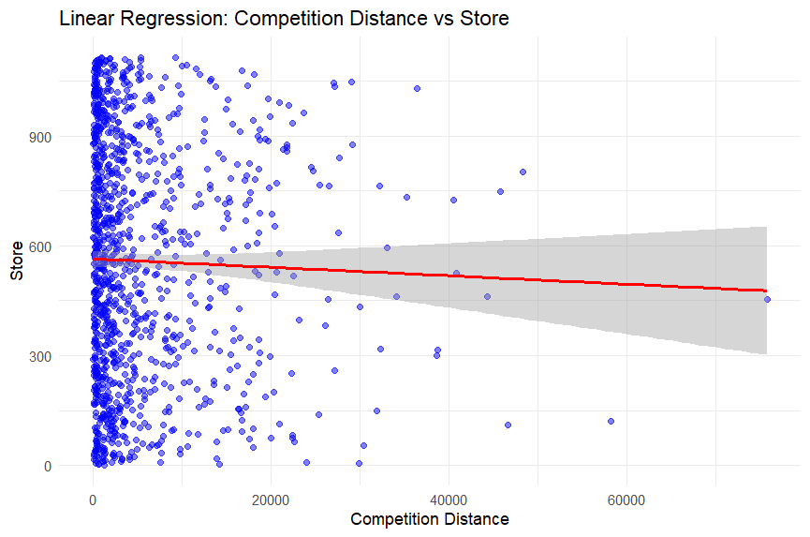
In this linear regression graph
This graph belongs to Stores Data
CompetitionDistance vs Store
X= CompetitionDistance
Y= Store
Data points: Blue dot represents a store and its corresponding competition distance. The X-axis shows the distance of competition from the store
Regression line: Red line indicates the best-fit line from the linear regression model. It shows the relation between competition distance and store numbers.
OUTPUT OF STORES DATA IN R USING R STUDIO
The data points we had in this linear regression graph is 1115 Mean squared error: 33183.8652146
Root Mean Square Error= 1,214.22
R-squared: 0.849998736542199
MSA= 227.429712409659
The graph shows Slightly NEGATIVE slope

Slide 7
THANK YOU SIR
SUBMITTING TO:
DR. K. Abraham peele

