Slide 1
LA Collision Severity Analysis
Finding the Root Causes of Severe injuries due to automobile accidents
Roger Watts & Joe Minutaglio

Slide 2
Determining the severity of injuries
Why this topic
Increase in interest in self-driving cars requires ongoing analysis to highlight key injury causing accident factors
Large accessible dataset
Questions to be answered
Can a ML model be developed that can accurately predict the injury severity based on conditions and driver characteristics
Can key features from the dataset be identified that can be the focus for reducing severe injury events

Slide 3
Data source
Data sourced from Transportation Injury Mapping System(https://tims.berkeley.edu) developed by UCBerkeley
3 year data set of collisions from LA county
147922 crashes
243712 parties
190350 victims
3 sets of data
Crashes data - contains the conditions during the time of the accident
Parties data - contains the details related to the parties involved in each accident
Victims data - contains specific data for each individual involved in the accident and the severity of the injuries

Slide 4
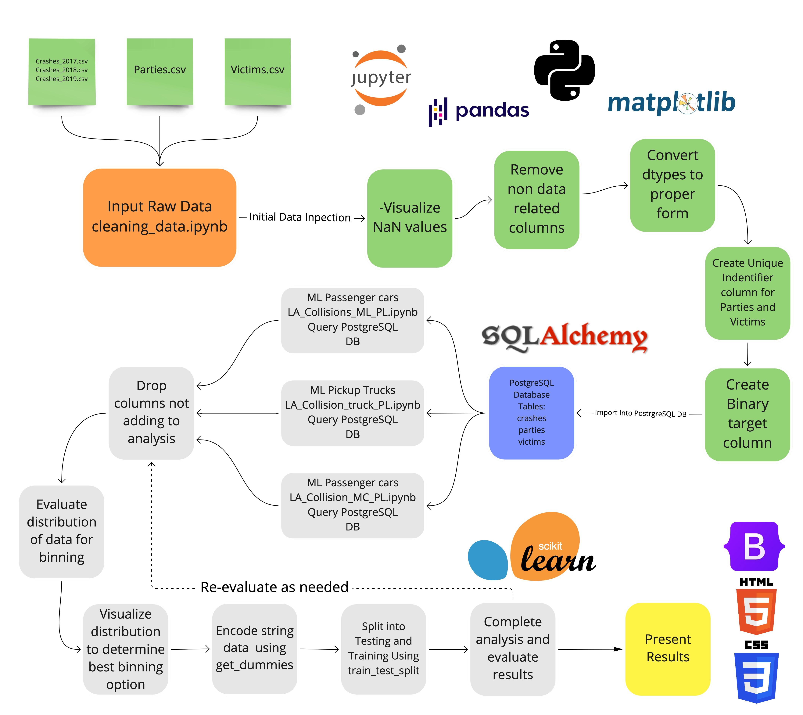
Data analysis methodology

Slide 5
Data cleaning

Slide 6
Data Preprocessing and engineering

Slide 7
Machine Learning Model
Balance Random Forest Classifier
Provided best predictive accuracy
Allowed for top Importances to be presented and explored

Slide 8
Limitations to BRFC

Slide 9
Dashboard
Tableau
Provide interactive and visual representation of the data
Easily publishable and distibuted
HTML
Provide a summary data and results of ML
Allowed for more flexability and interaction
Published on Github pages

Slide 10
Data visualization
Link to website
https://wattsr1.github.io/LA-Collision-Analysis/

