Slide 1
Symbolic Execution

Slide 2
Introduction
symbolic execution is a means of analyzing a program to determine what inputs cause each part of a program to execute.
assuming symbolic values for inputs rather than obtaining actual inputs as normal execution of the program.
state constraints

Slide 3
Angr
angr is a python framework for analyzing binaries
It combines both static and dynamic symbolic ("concolic") analysis, making it applicable to a variety of tasks.
https://github.com/angr/angr

Slide 4
Angr install

Slide 5
Python virtual environment
sudo apt-get install python3-dev libffi-dev build-essential virtualenvwrapper
mkvirtualenv --python=$(which python3) angr && pip install angr

Slide 6
Docker install
# install docker
sudo apt-get install docker.io
#pull the docker image
sudo docker pull angr/angr:m1ghtym0-patch-1
#run it
sudo docker run -it -v “$(pwd):/home/angr/hw3” angr/angr:m1ghtym0-patch-1
https://hub.docker.com/r/angr/angr
https://docs.angr.io/introductory-errata/install

Slide 7
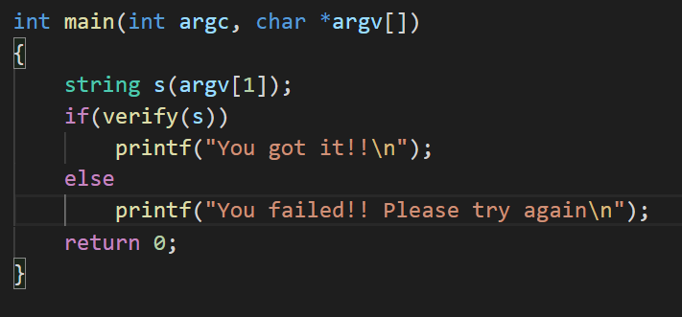
Example

Slide 8
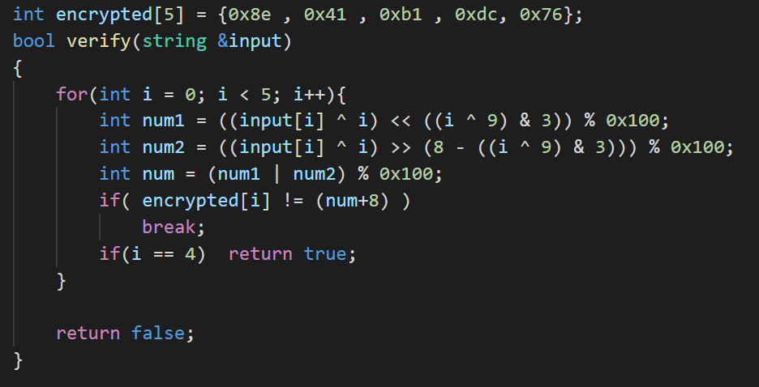
Example

Slide 9
Example
objdump –d ./example

Slide 10
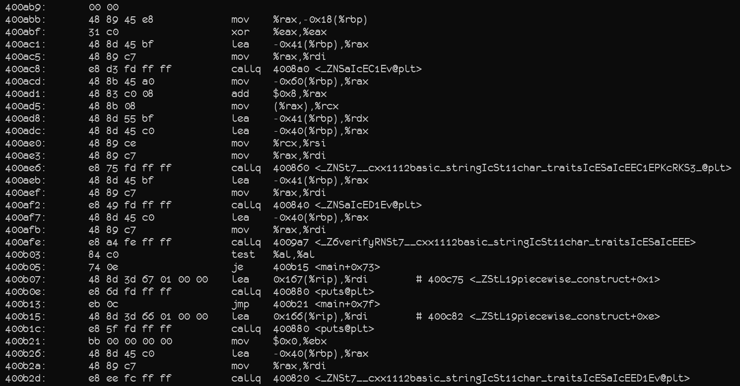
Example

Slide 11
Example

Slide 12
Example

Slide 13
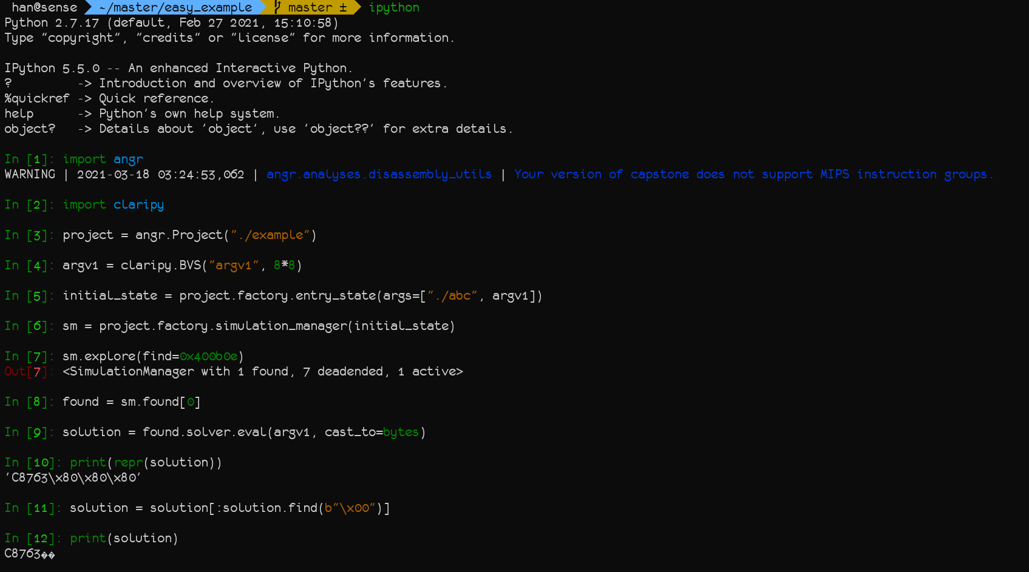

Slide 14
Example
./example c8763
./example C8763

