Slide 1

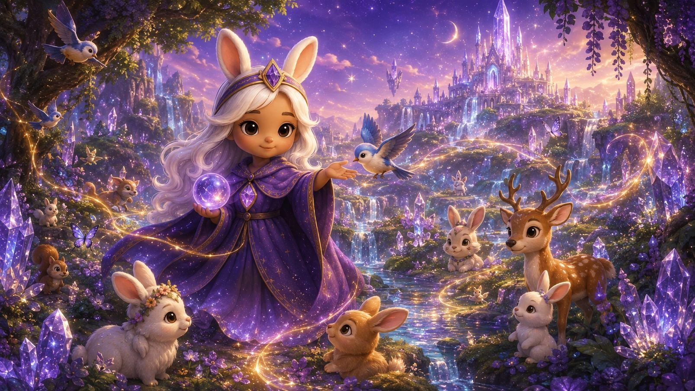
BUNNY / ORIGINAL IP / AWARDS PITCH
Meet
Miss Bunny
BUNNY CRYSTAL ORACLE
Original character. 26 illustrated cards.
Human-centered AI reflection.
LIVE WEB PRODUCT / 26 CARDS
GGC / BUNNY CRYSTAL ORACLE / SOURCE-VERIFIED
26 OCT 2026 01 / 08

Slide 2
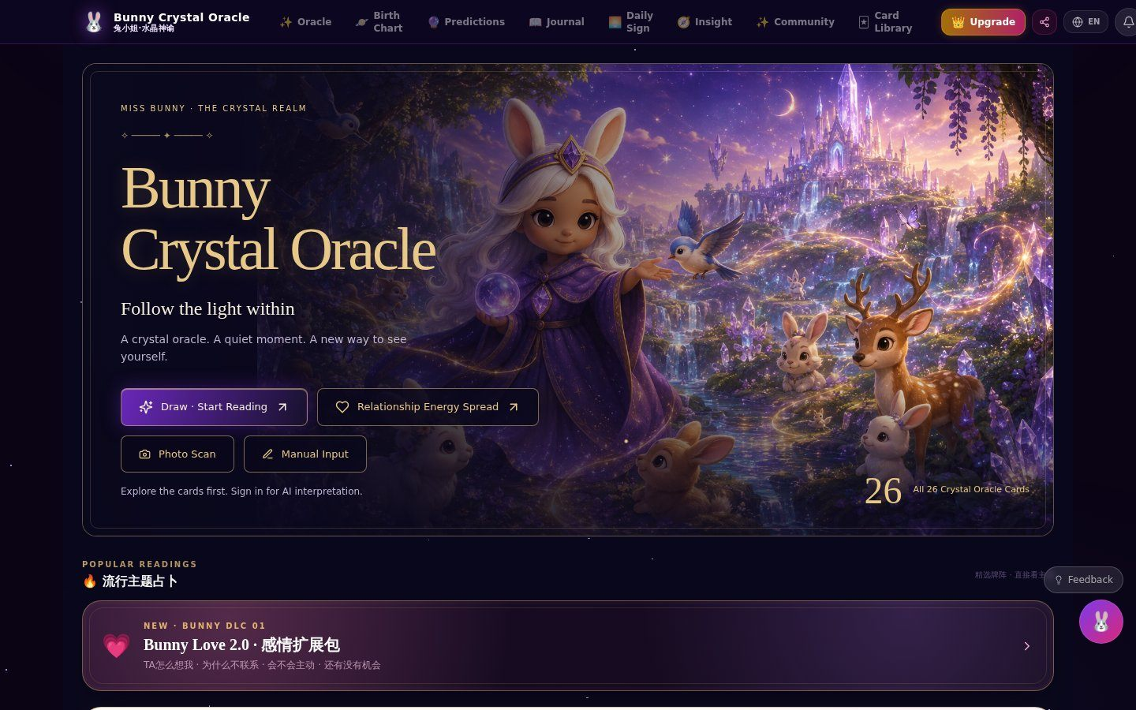
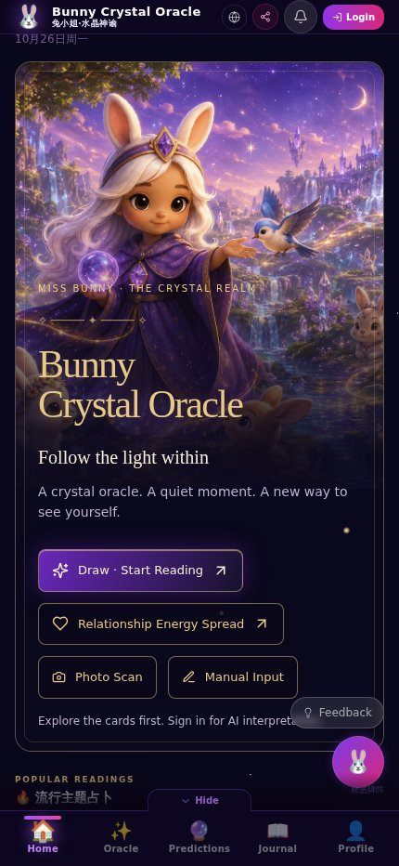
01 / VERIFIED LIVE BUNNY SITE
The real website.
Desktop & mobile • 26 Oct 2026
BUNNY
Source:
Actual deployed
website capture
No mockups.
GGC / BUNNY CRYSTAL ORACLE / SOURCE-VERIFIED
26 OCT 2026 02 / 08

Slide 3
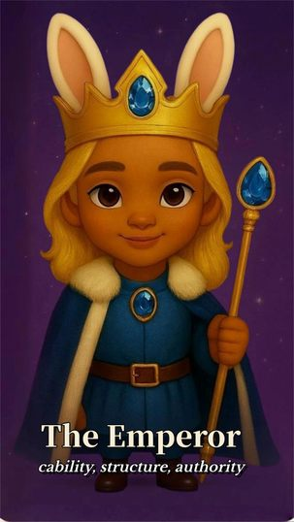
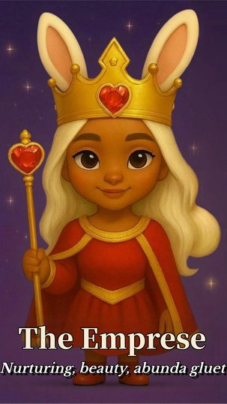
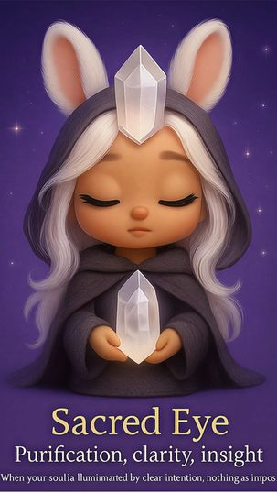
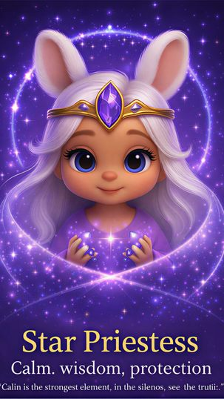
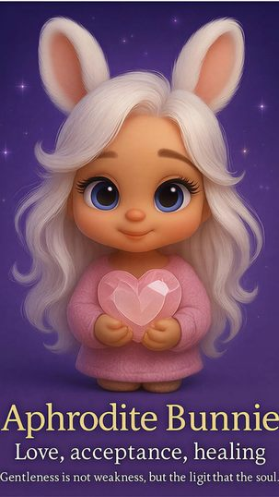
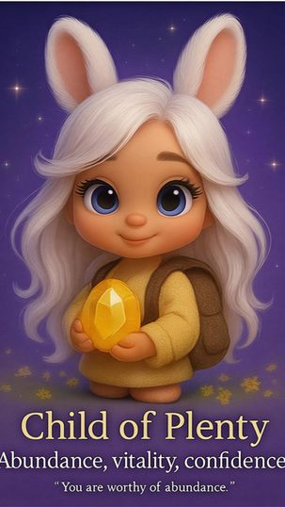
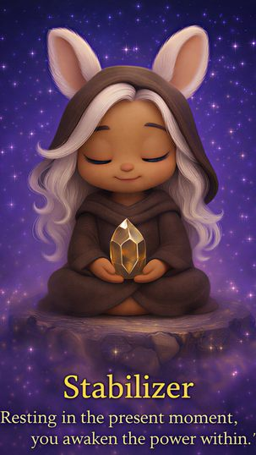
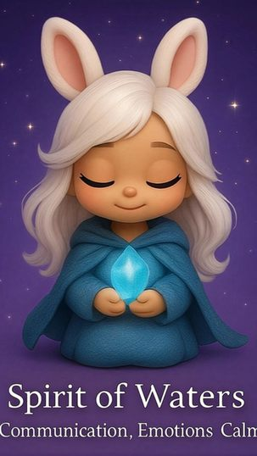
02 / BUNNY'S ORIGINAL CRYSTAL-ORACLE CARDS
The actual
card illustrations.
The Emperor
The Empress
Sacred Eye
Star Priestess
Aphrodite Bunnie
Child of Plenty
The Stabilizer
Spirit of Waters
All eight images above come from Bunny's active production cardImageMap.jsx.
GGC / BUNNY CRYSTAL ORACLE / SOURCE-VERIFIED
26 OCT 2026 03 / 08

Slide 4
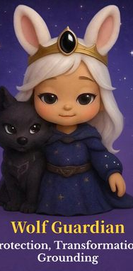
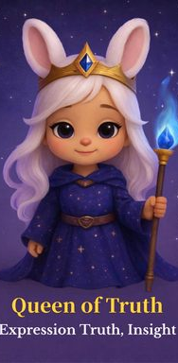
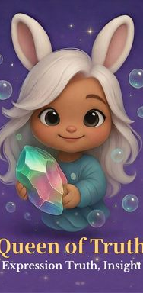
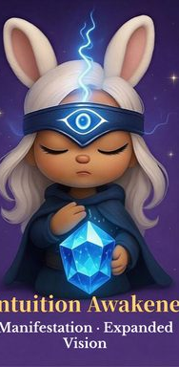
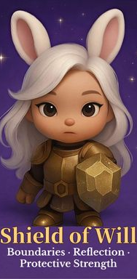
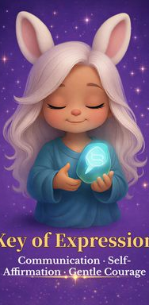
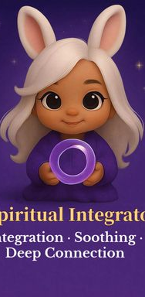
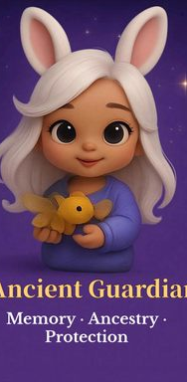
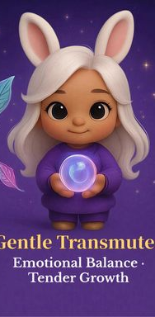
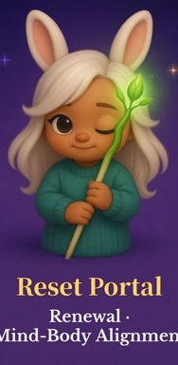
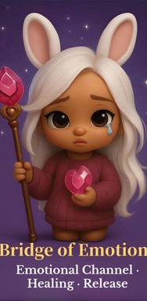
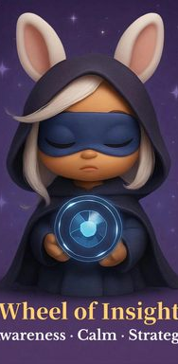
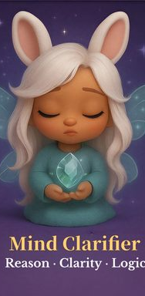
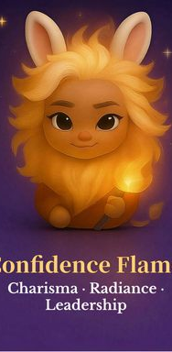
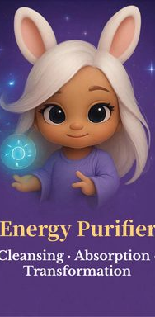
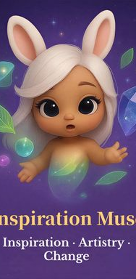
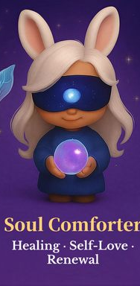
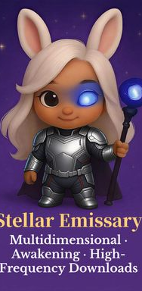
03 / THE COMPLETE 26-CARD UNIVERSE
26 cards. One coherent visual IP.
01
02
03
04
05
06
07
08
09
10
11
12
13
14
15
16
17
18
19
20
21
22
23
24
25
26
Original card image files • exact 26-card production map • no generated replacements
GGC / BUNNY CRYSTAL ORACLE / SOURCE-VERIFIED
26 OCT 2026 04 / 08

Slide 5
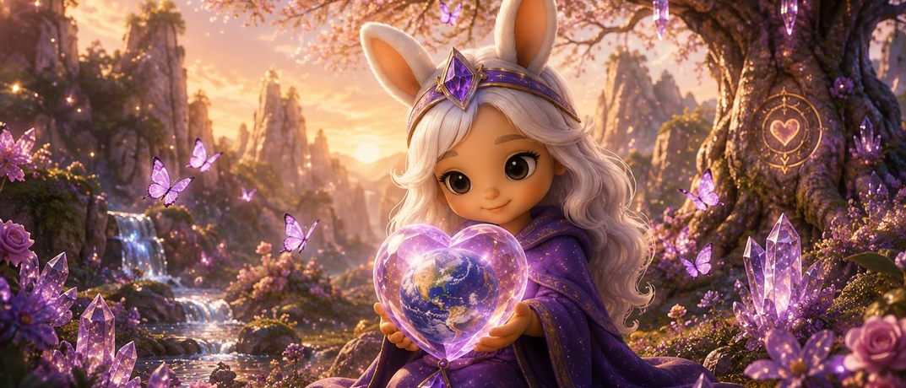
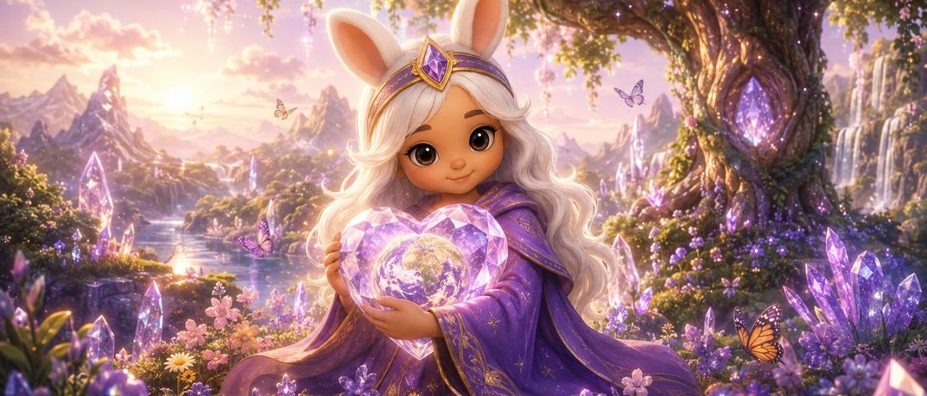
04 / THE PRODUCT EXPERIENCE
Cards become
conversation.
01
02
03
04
Explore original cards
Pick a question
Read an interpretation
Return for daily reflection
Official reading artwork
Official daily sign artwork
GGC / BUNNY CRYSTAL ORACLE / SOURCE-VERIFIED
26 OCT 2026 05 / 08

Slide 6
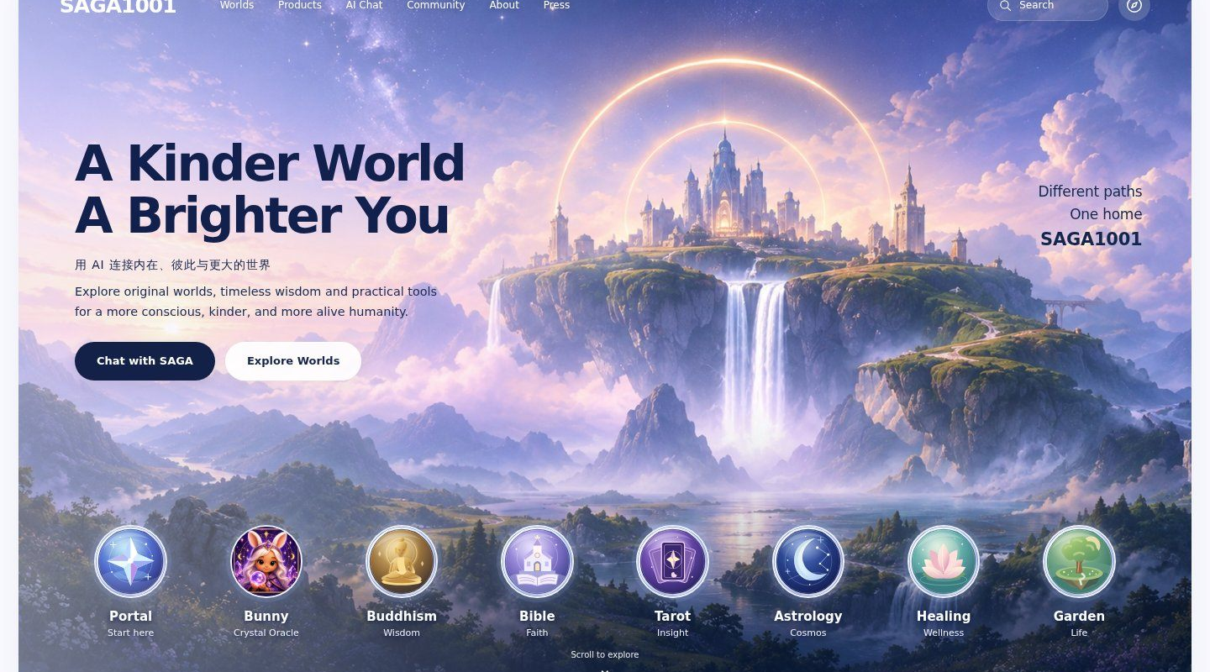
05 / THE REAL SAGA1001 WEBSITE
A Kinder World.
A Brighter You.
Original Bunny artwork
Live SAGA website • 26 Oct 2026
GGC / BUNNY CRYSTAL ORACLE / SOURCE-VERIFIED
26 OCT 2026 06 / 08

Slide 7
06 / THE FOUNDER BEHIND THE EXPERIENCE
An operator-led
consumer AI studio.
JOYCE MI / GGC FOUNDER
Zynga Product Manager
Gameloft Head of Asian Operations
Global game products, LiveOps, publishing
and commercial operating systems
Author: Game Operations and Global Expansion
GGC / BUNNY CRYSTAL ORACLE / SOURCE-VERIFIED
26 OCT 2026 07 / 08

Slide 8
07 / VERIFIABLE PRODUCT & APPLICATION EVIDENCE
Built on
real assets.
WHAT REVIEWERS CAN CHECK
26 original illustrated crystal-oracle cards
A public Bunny interactive web experience
An original Miss Bunny character and visual IP
A separate SAGA1001 product and world website
bunny.saga1001.com / saga1001.com
Source: Bunny Base44 code + SAGA GitHub originals. No fabricated screenshots, card images or metrics.
GGC / BUNNY CRYSTAL ORACLE / SOURCE-VERIFIED
26 OCT 2026 08 / 08

