Slide 1

Transformer: Attention is all you need
Vaswani, Ashish, et al. "Attention is all you need." Advances in neural information processing systems. 2017.
2019. 05. 30.
Jeong-Gwan Lee

Slide 2
Table of contents
RNN-based Encoder-Decoder model
RNN Encoder-Decoder model
Attention mechanism
Limitation of RNN
Transformer
Encoder Part
Embedding & Positional Encoding
Scaled Dot-Product Self-Attention & Multi-Head Self-Attention
Position-wise Feed-Forward Networks
Decoder Part
Masked Self-Attention
Encoder-Decoder Attention
Output Part & Inference Visualization
Why Self-Attention?
Training & Results
Appendix

Slide 3
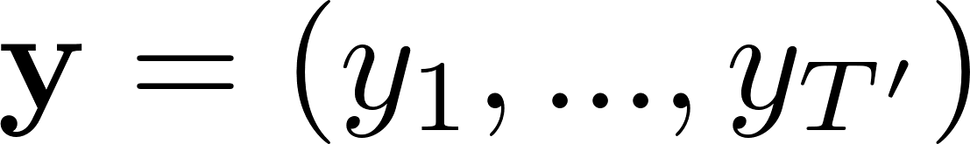
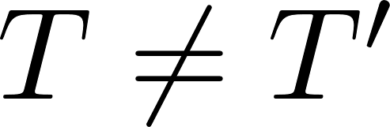
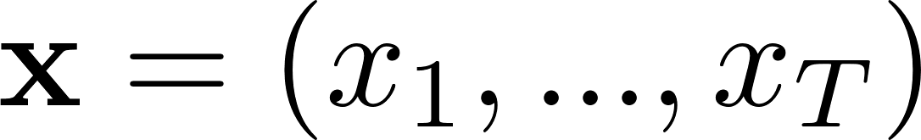
Machine Translation problem
I am a boy.
Output sequence
Machine Translation Model
Input sequence
나는 소년입니다.

Slide 4

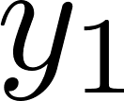
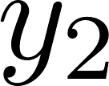
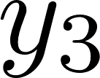
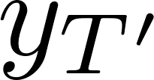
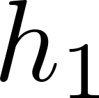
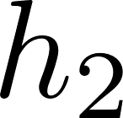
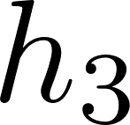
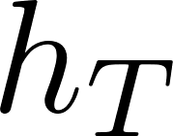


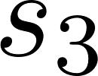



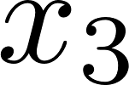

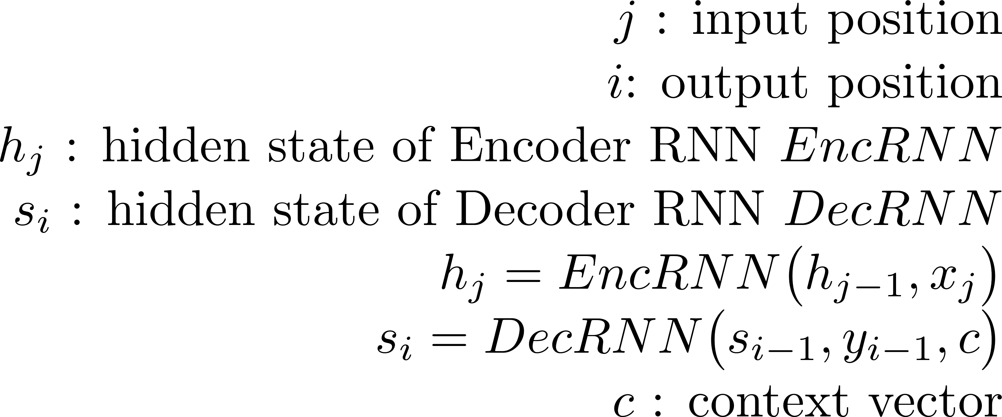
RNN Encoder-Decoder model
Output sequence
Encoder
RNNs
RNNs
RNNs
RNNs
…
RNNs
RNNs
RNNs
…
RNNs
<GO>
Decoder
Input sequence
➔ Static context vector(c) leads to loss of information, especially in long sentences.
Kyunghyun Cho, Bart van Merrienboer, Caglar Gulcehre, Fethi Bougares, Holger Schwenk, Yoshua Bengio
4
"Learning Phrase Representations using RNN Encoder–Decoder for Statistical Machine Translation.” EMNLP 2014

Slide 5
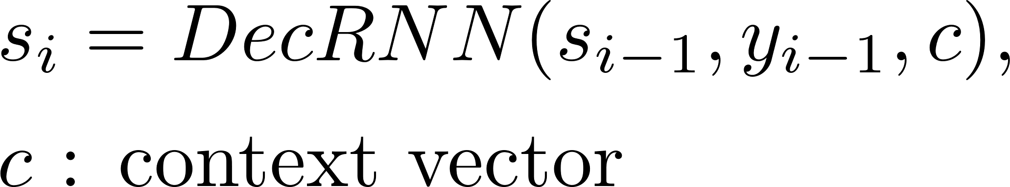
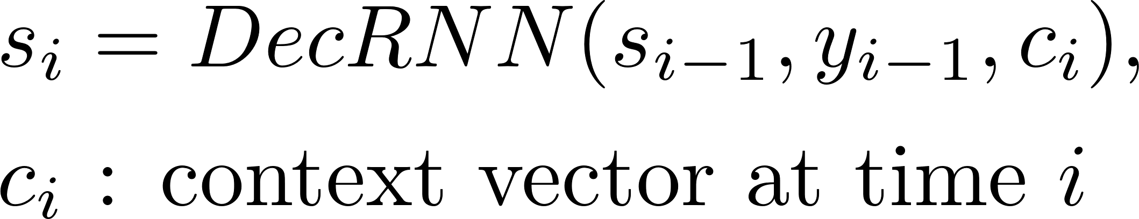
Different context vector for generating next word?
5

Slide 6
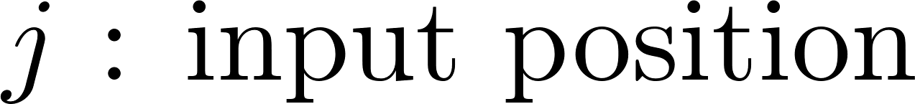
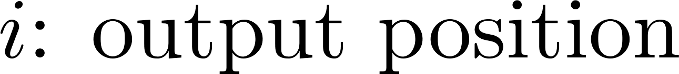
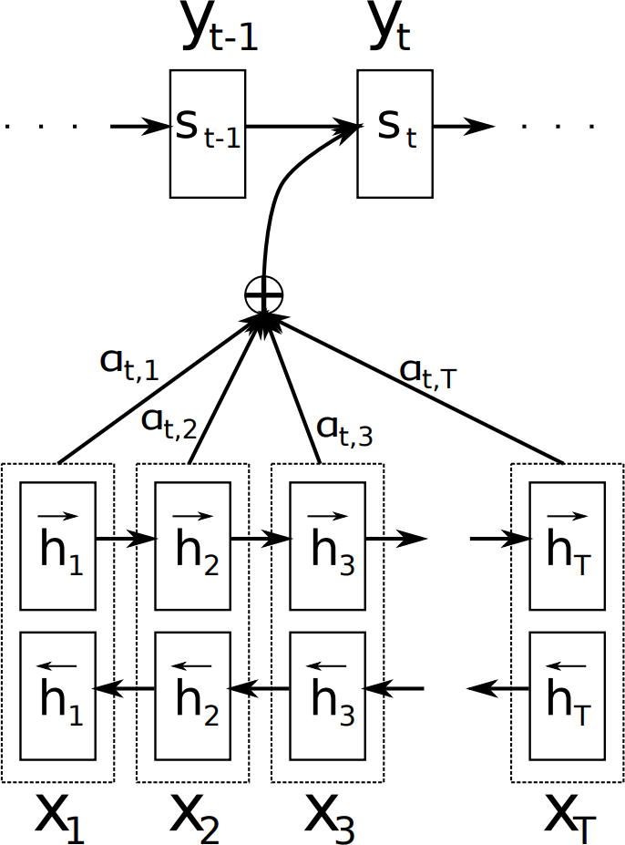
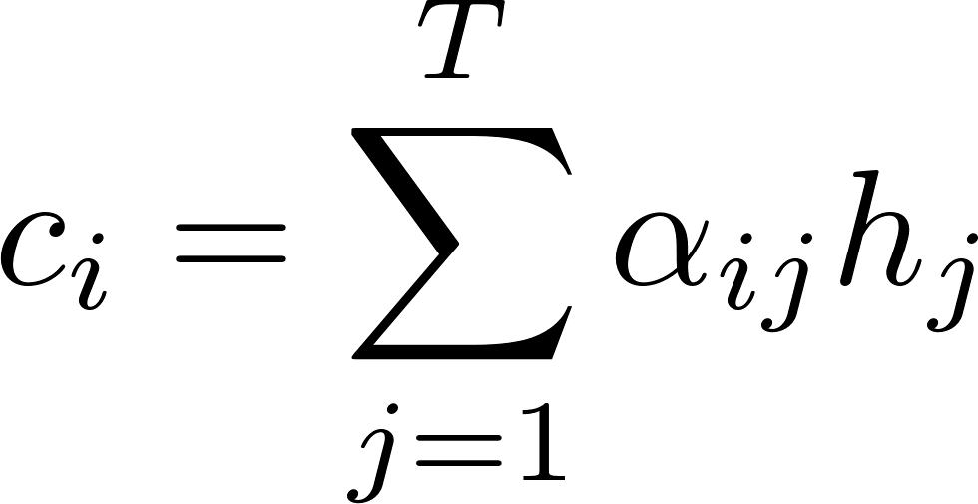

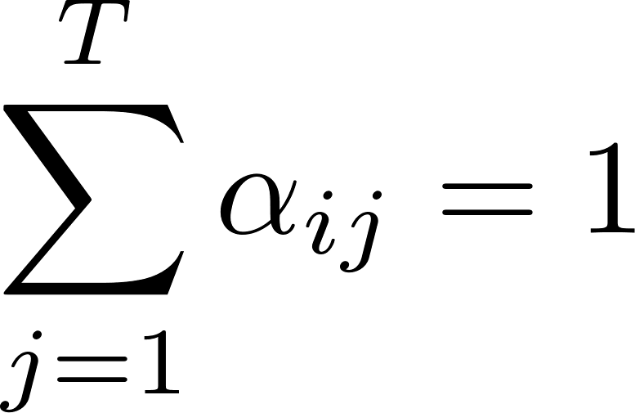


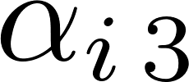
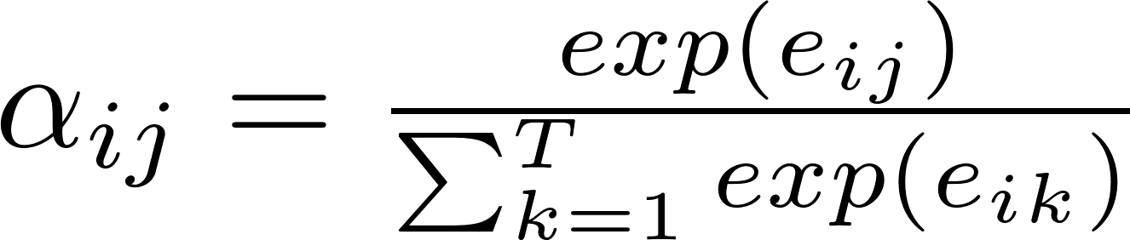
Attention mechanism
Decoder
i-1
i
i-1
i
Convex combination
Define
where,
”Alignment” model scores how well the input position j
matches with the output position i.
➔ Attention mechanism can model c_{i} (attended context vector) regardless of the input length.
Encoder
Bahdanau, Dzmitry, Kyunghyun Cho, and Yoshua Bengio. "Neural machine translation by jointly learning to align and translate." arXiv preprint arXiv:1409.0473 (2014).

Slide 7
Attention mechanism
Decoder
i-1
i
i-1
i
Define
Value
where,
Query Key
Query : “Criteria” to generate(related to) this word
Key : Multiple candidate to attend Alignment : Query Key match scoring Value : Representation of each key
Encoder
Attention(Query, Key, Value) = Alignment(Query, Key) * Value
Bahdanau, Dzmitry, Kyunghyun Cho, and Yoshua Bengio. "Neural machine translation by jointly learning to align and translate." arXiv preprint arXiv:1409.0473 (2014).

Slide 8
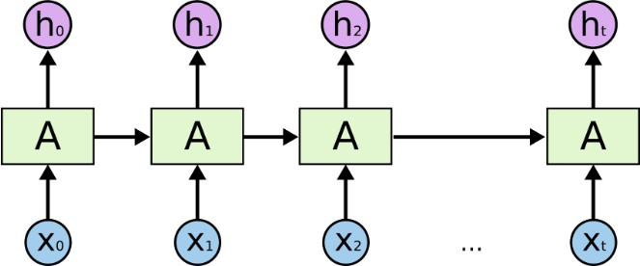
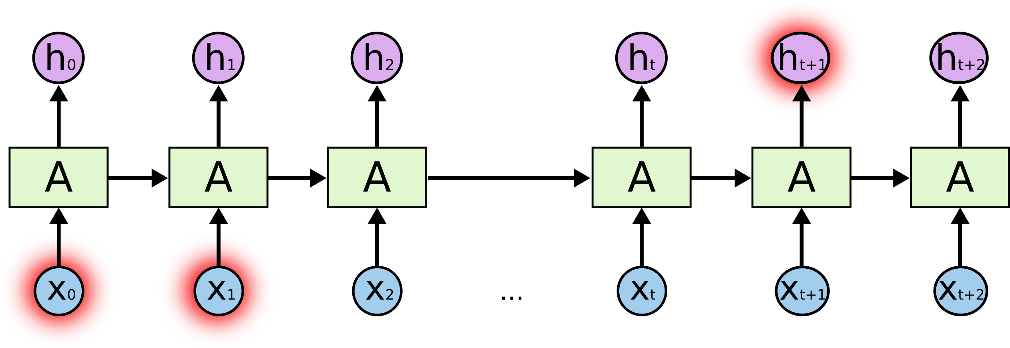
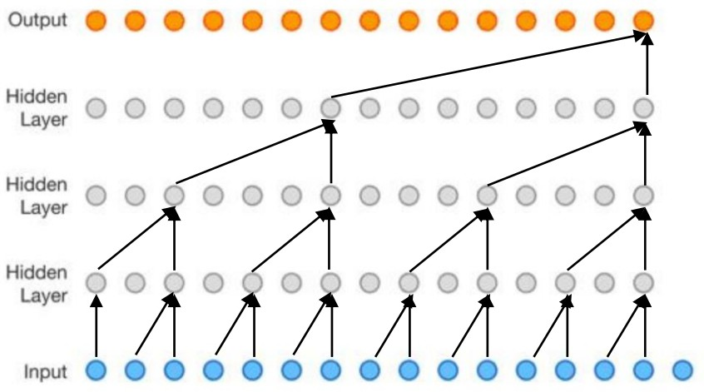
Limits of recurrent neural network
RNN generates each hidden state in series.
This sequential nature precludes parallelization in training time.
RNN has a long-term dependency problem.
It’s hard to memorize long-term contextual information.
Cats which ate
… … ,
were? full was?
RNN can see one word at a time.
CNN can see more words at a time.

Slide 9
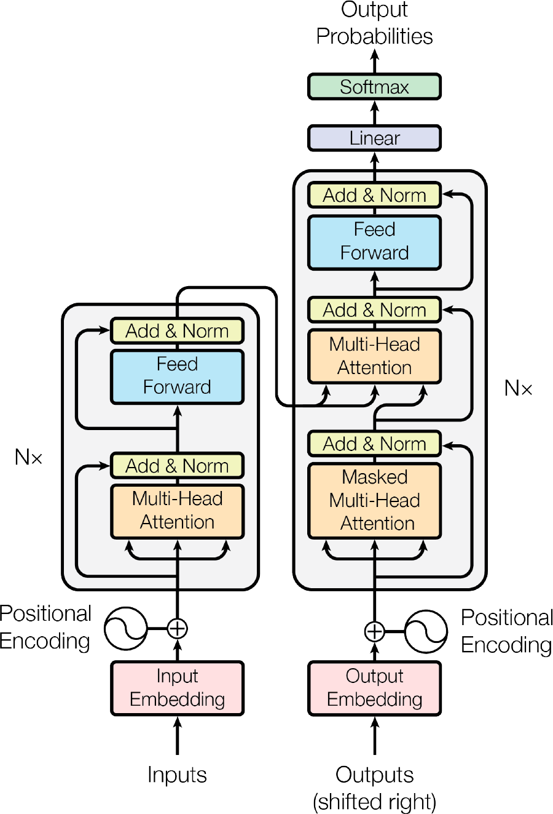
Transformer
Encoder-Decoder model based on (self-)attention mechanism, without recurrence and convolutions
Regardless of sequence length, capture long-term dependencies between input and output and allow more parallelization.
Basically targeting for translation tasks(WMT’14 EN-GE, EN-FR), It achieved state of the art BLEU score.

Slide 10
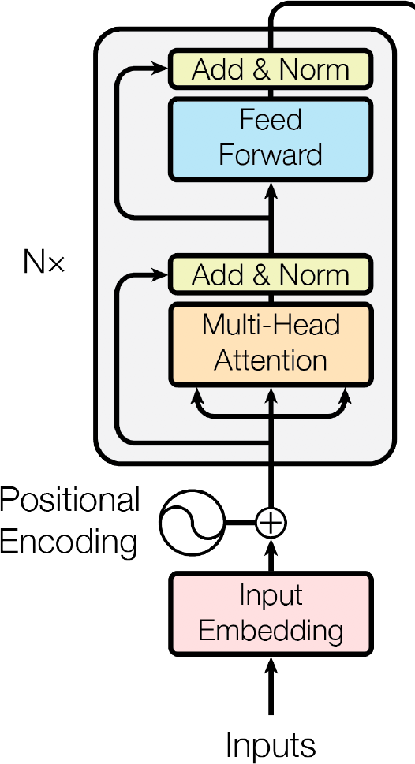
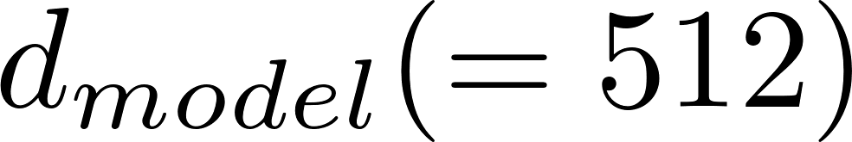
Encoder part
Encoder : 6 identical layers
Multi-Head self-attention layer
+ Position-wise feed-forward network
Residual connection[1]
& Layer normalization[2]
To facilitate these residual connections, all sub-layers, and embedding layers produce dimensions
Lei Ba, Jimmy, Jamie Ryan Kiros, and Geoffrey E. Hinton. "Layer normalization." arXiv preprint arXiv:1607.06450 (2016).
He, Kaiming, et al. "Deep residual learning for image recognition." Proceedings of the IEEE conference on computer vision and pattern recognition. 2016.

Slide 11
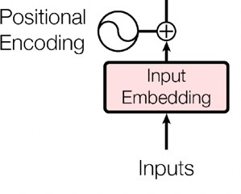
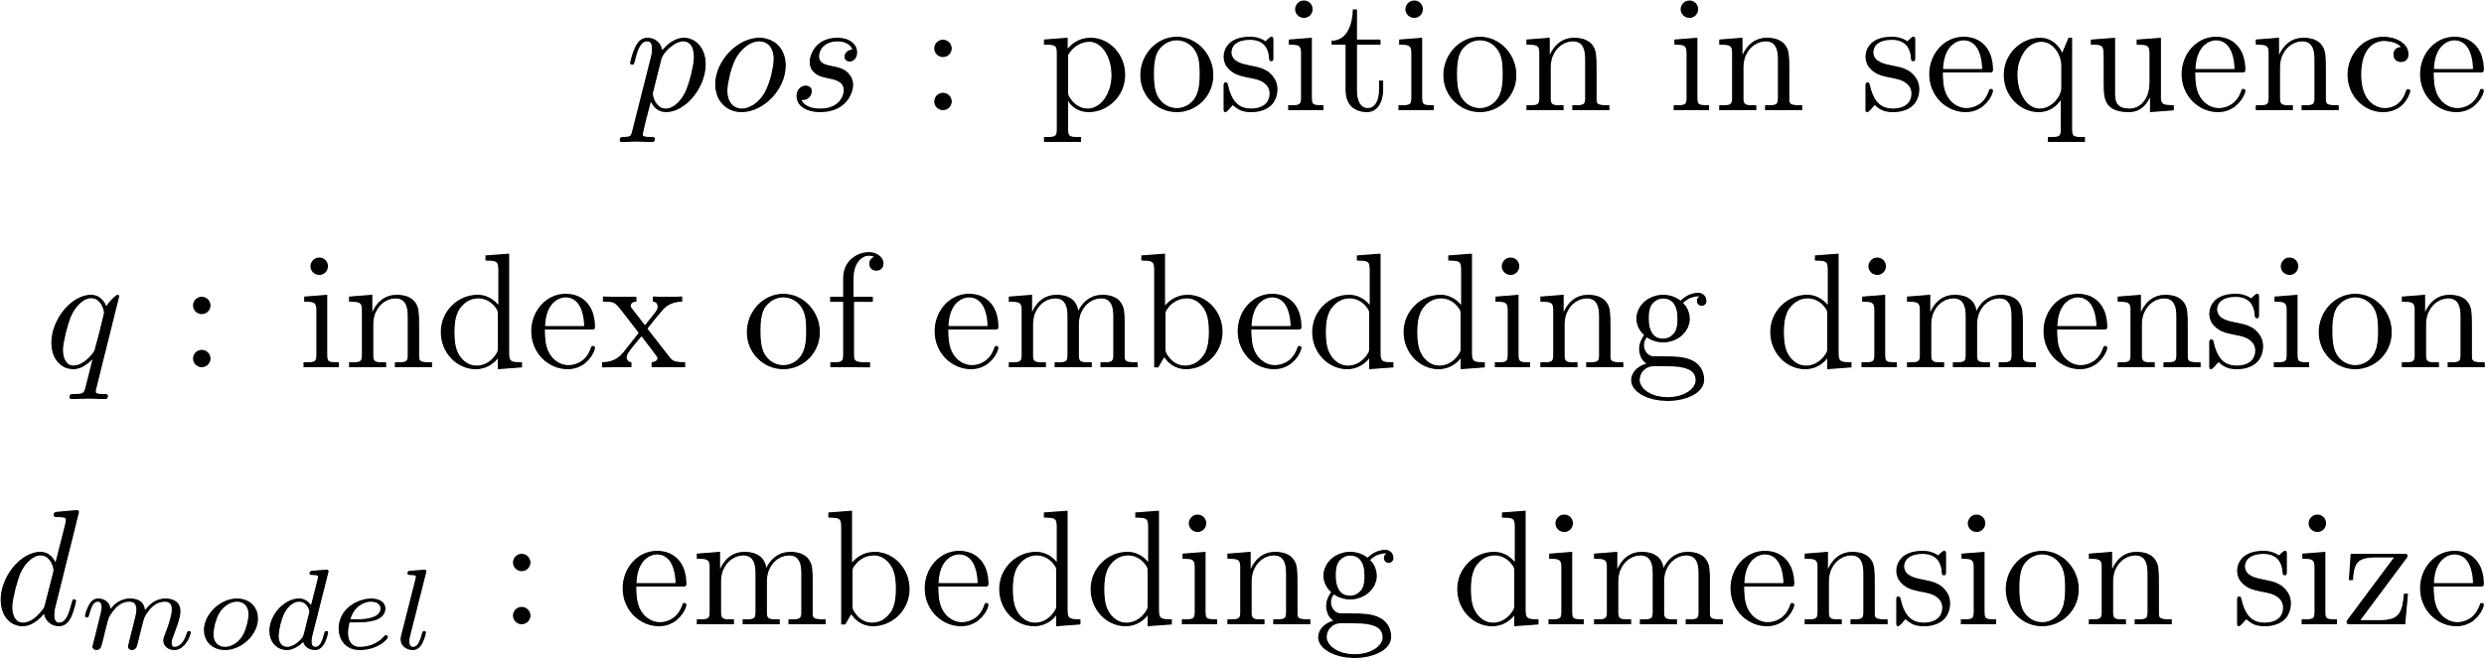
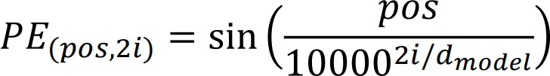
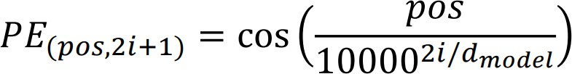
Embedding & Positional Encoding
It uses learned embeddings to convert the input tokens and output tokens to vectors of dimension .
Transformer gets input with length T at one time, and the word embedding itself doesn’t have positional information.
→ Positional encoding injects information about the position of the tokens.
(T, d_{model})
(T, d_{model})
(T)
Transformer easily learns to attend by relative positions, since for any fixed offset
𝑘, 𝑃𝐸_{𝑝𝑜𝑠+𝑘} can be represented as a linear
function of 𝑃𝐸_{𝑝𝑜𝑠}.
q
q
q
q
the wavelengths form a geometric progression from 2𝜋 to 10000 ⋅ 2𝜋

Slide 12

Embedding & Positional Encoding
It uses learned embeddings to convert the input tokens and output tokens to vectors of dimension .
Transformer gets input with length T at one time, and the word embedding itself doesn’t have positional information.
(T, d_{model})
(T, d_{model})
(T)
→ Positional encoding injects information about the position of the tokens.
dmodel /2
pos=20
1.0
-0.7
T
q
q
pos=10
q
q
0.98
0.99
0.785
pos=3
0.78
pos=2
the wavelengths form a geometric progression from 2𝜋 to 10000 ⋅ 2𝜋
q=0
q=1
q=2
q=200
q=201
q=255

Slide 13
Self-Attention
Query : Criteria to generate(related to) this word Key : Multiple candidate to attend
Alignment : Query Key match scoring Value : Representation of each key
Key
I
am a boy
Query
I
am a boy
Key
I
am a boy
Query
I
am a boy
Key
I
am a boy
Query
I
am a boy
Key
I
am a boy
Query
I
am a boy
➔ Self-Attention allow each word to refer to other words in same sequence, to compute a better encoded representation of the sequence.
Attention = Alignment(Query, Key) * Value

Slide 14
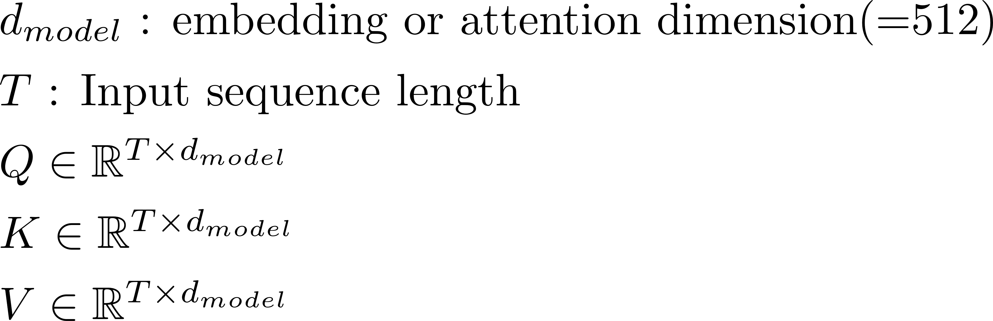
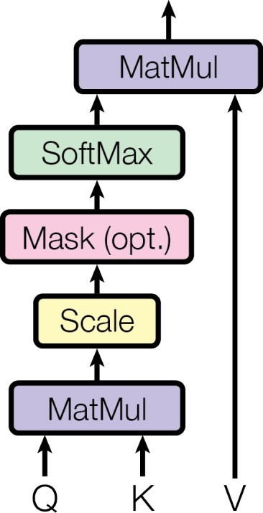
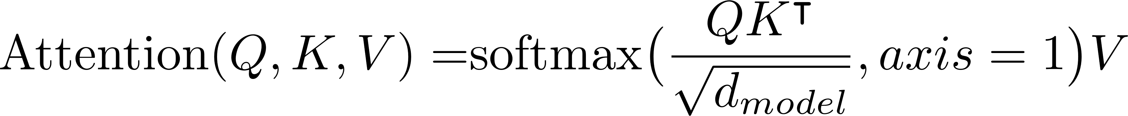
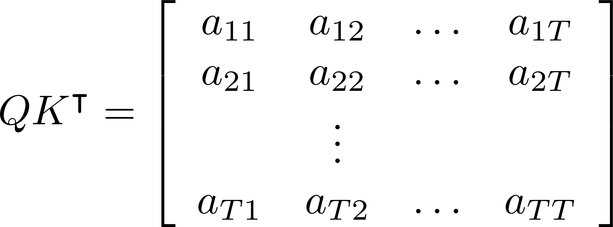
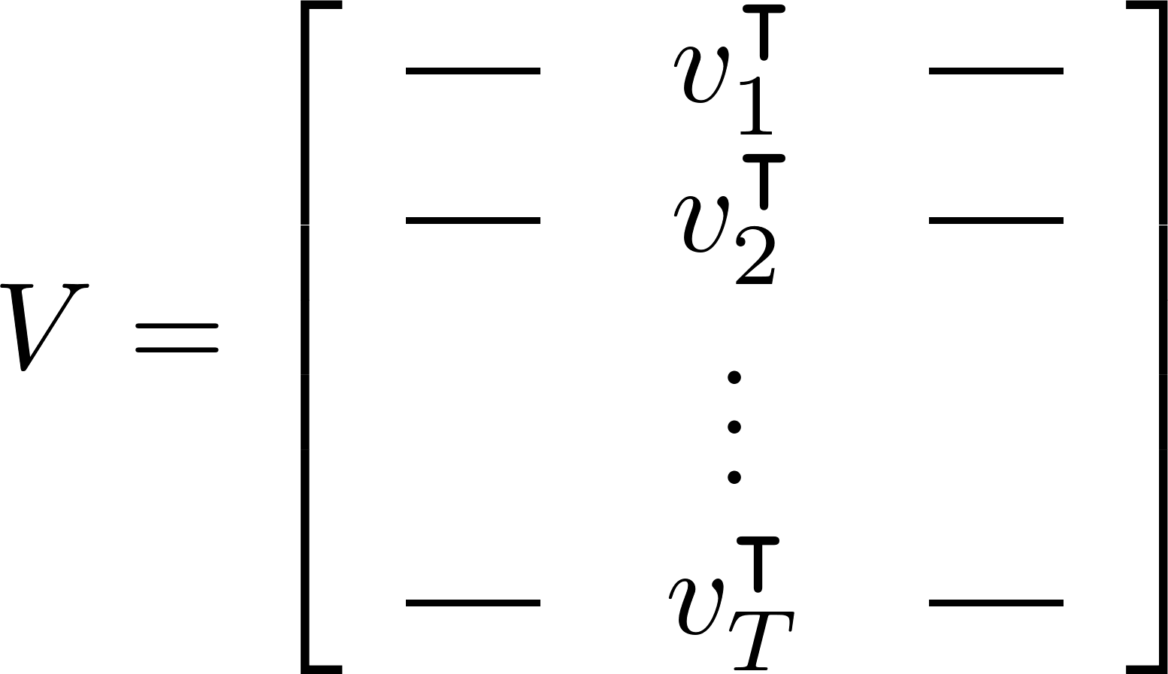
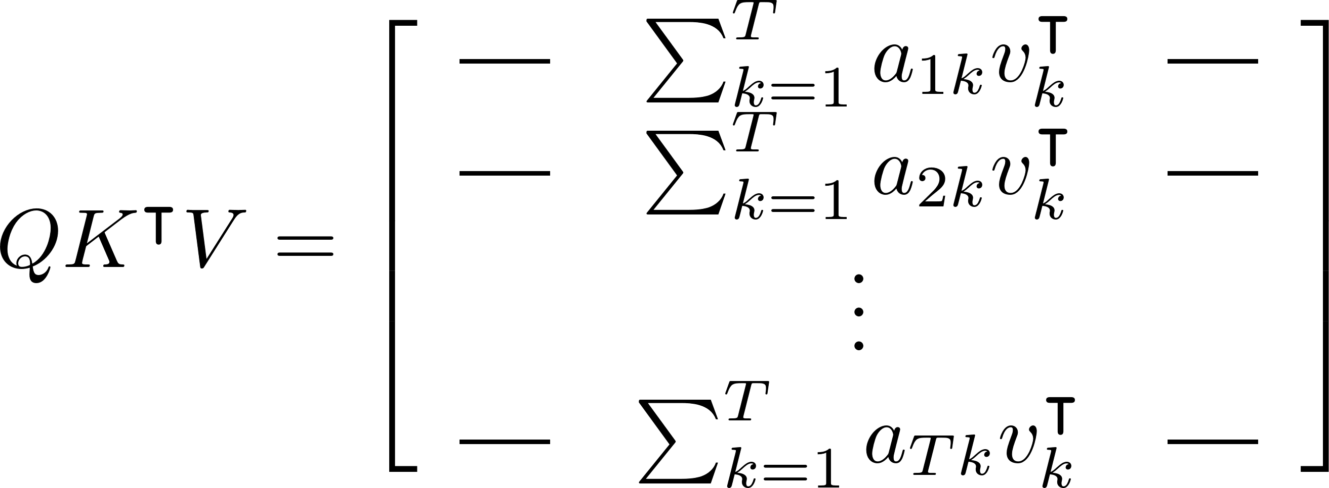
Scaled Dot-Product Self-Attention(single head)
(T, d_{model})
(T, T)
(T, T)
(T, d_{model})
(T, T)
Attention mechanism _{Convex combination}
(T, T)
(T, d_{model})
(T, d )
(T, d_{model})
Value
model
(T, T)
(T, d_{model})
Linear
Linear
Linear
(T, d_{model})
^{(T, d}model⁾ Input

Slide 15
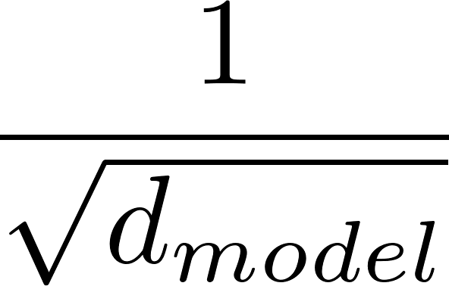
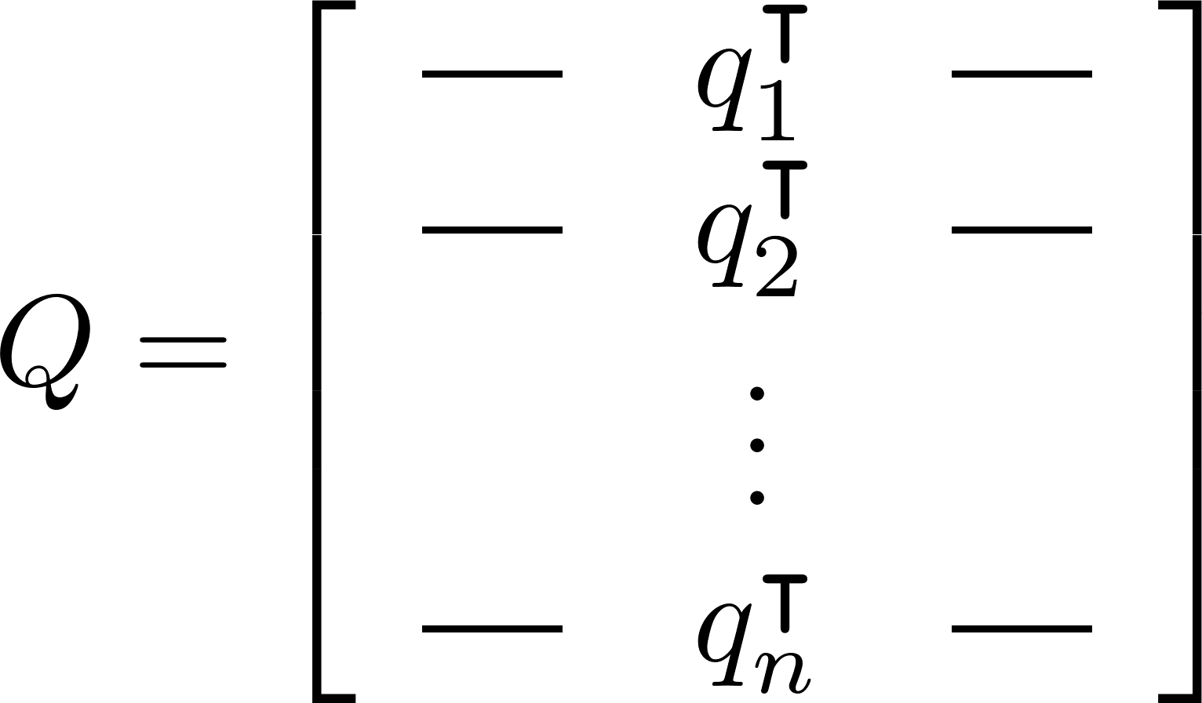
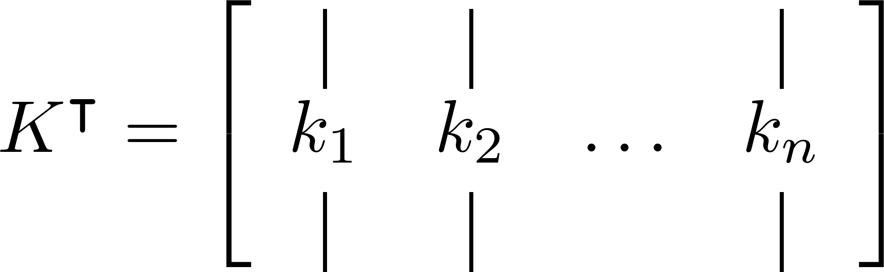
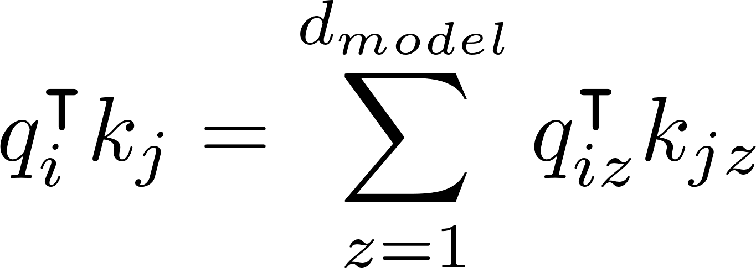
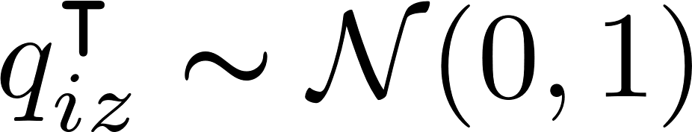
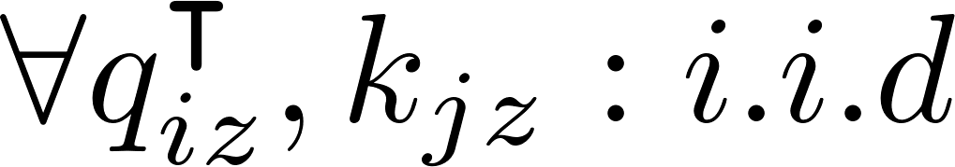
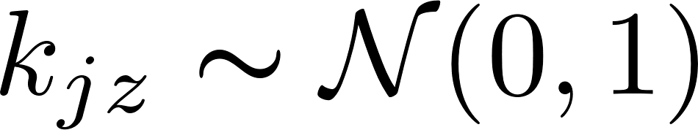
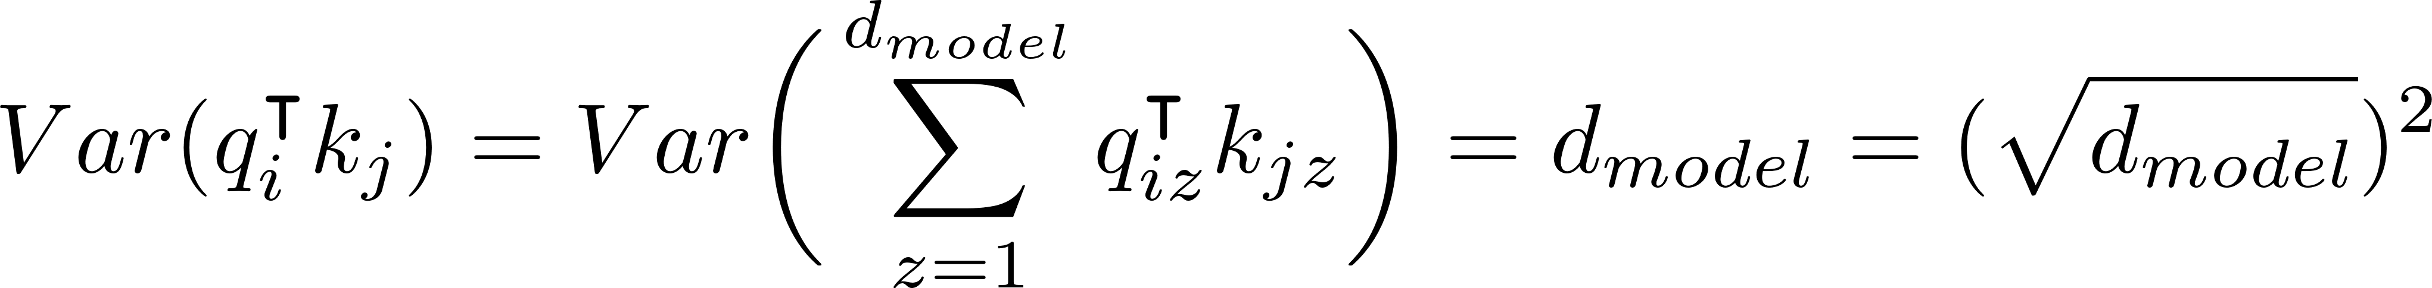
Scaled Dot-Product Self-Attention(single head)
(T, d_{model})
(T, T)
(T, T)
(T, T)
(T, d_{model})
(T, d_{model})
(d_{model} ,T)
(T, T)
Why scaled by
?
(T, d_{model})
(T, d_{model})
(T, d_{model})
Linear
Linear
Linear
^{(T, d}model⁾ Input

Slide 16
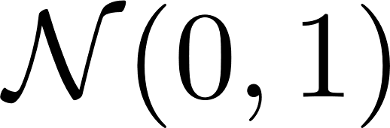
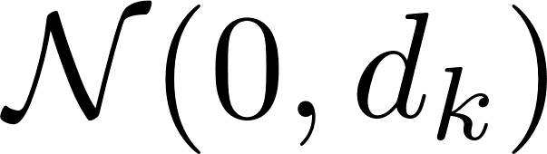
Scaled Dot-Product Self-Attention(single head)
(T, d_{model})
(T, T)
(T, T)
(T, d_{model})
Why scaled by ?
As d_{model} be larger,
The dot product of each elements grow large in magnitude.
(T, T)
(T, T)
(T, d_{model})
(T, d_{model})
(T, d_{model})
Linear
Linear
Linear
^{(T, d}model⁾ Input
Variance Large
Variance Small
16

Slide 17
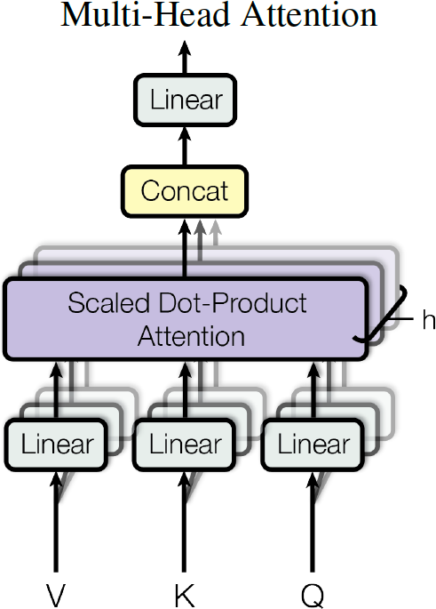





Multi-Head Self-Attention
(T, d_{model})
(T, hd_{v})
(T, d_{v})
(T, d_{v})
(T, d_{k})
(T, d_{k})
It allows the model to jointly attend to information from different representation subspaces at different positions
ex) i=1 : word class, i=2 : pronoun i=3 : singular/plural
(T, d )
(T, d_{model})
(T, d )
model
model
Linear
Linear
Linear
(T, d_{model})_{Input}

Slide 18




Encoder Zoom In
Encoder Output
Linear
Linear
Linear
Input
Transformer Encoder
Multi-Head Self-Attention
Scaled Dot-Product Self-Attention

Slide 19





Position-wise Feed-Forward Networks
The representation of every “single” position is fed into same neural network and is transformed independently.
Relu
…
…
…

Slide 20
Decoder part
Decoder : 6 identical layers
Masked multi-head self-attention layer
+ Multi-head Encoder-decoder attention layer
+ Position-wise feed-forward network
Encoder Output
Masked multi-head self-attention layer for preventing positions from attending to subsequent positions.

Slide 21



Masked Self-Attention
In Decoder part, according to the auto-regressive characteristic, a new word is generated based previous words.
(T, d_{model})
Masking prevents from attending to not- generated position.
(T, T)
(T, T)
(T, T)
<GO>
I
am a boy
<GO> I
am a boy
x x x x
t=0 t=1
(T, T)
x x x
(T, d_{model})
(T, d_{model})
(T, d_{model})
x x
x
Linear
Linear
Linear
t=4
^{(T, d}model⁾ Input
This figure supposes in training phase

Slide 22

Encoder-Decoder Attention
(U, d_{model})
(U, T)
(U, T)
(U, d_{model})
(U, T)
(U, d_{model})
(T, d_{model})
(T, d_{model})
나는
한
소년
이다
.
<GO>
t=0 t=1
I
am
Linear
Linear
Linear
(U, d )
model
a boy
Decoder Input
Encoder Output
t=4

Slide 23


Output part & Inference Visualization
It uses the usual learned linear transformation and softmax function to convert the decoder output to predicted next- token probabilities.
I am a
boy
Encoder Output
Encoder Output
Encoder Output
Encoder Output
I
I
I
I
<GO>
<GO>, I
<GO>,I,am
<GO>,I,am,a

Slide 24
Why self-attention?
Three desiderata
Total computational complexity per layer
The amount of computation that can be parallelized (the minimum number of sequential operations)
The path length between long-range dependencies (distance between any two positions)
Key factor to compute dependencies

Slide 25
















Why self-attention?
Matrix multiplication
Self-attention
Recurrent
Convolutional
kernel
나는
RNN weight
소년
나는
소년
이다
나는
x
→
소년
이다

Slide 26
Why self-attention?
Self-attention layers are faster than recurrent layers when n << d, which is most often in machine translations.
For tasks involving very long sequences, self-attention could be restricted considering only a neighbor of size r.
As side benefit, self-attention could yield more interpretable models.

Slide 27
Training
Task (Machine Translation)
WMT 2014 English-German dataset (4.5 million sentence pairs)
WMT 2014 English-French dataset (36 million sentence pairs)
Training spec
Adam Optimizer (𝛃₁ = 0.9, 𝛃₂ = 0.97, and 𝜺 = 10⁻⁹)
Dropout to the output of each sub-layer before residual input, the embeddings and the positional encodings with P_{drop} = 0.1
(base model) 12 hours with 8 NVIDIA P100 GPUs

Slide 28

Results
Machine Translation
1/4

Slide 29

Results
Model Variations

Slide 30
Thank you for Attention!

Slide 31

Appendix1: Self-attention visualization
Key Query
Results of encoder self-attention in layer 5 of 6.
It seems like attending a distant dependency of the verb ’making’, completing ‘making… more difficult’.
Different colors represent different heads.

Slide 32


Appendix1: Self-attention visualization
Results of encoder self-attention in layer 5 of 6.
The heads clearly learned to perform different tasks.

