Slide 1
Attention Is All you need
Reading Seminar
Kyoto University, Kashima lab
Daiki Tanaka

Slide 2
Today’s Paper : ‘Attention Is All you need‘
Conference : NIPS 2017
Cited 966 times.
Authors :
Ashish Vaswani (Google Brain)
Noam Shazeer (Google Brain)
Niki Parmar (Google Research)
Jakob Uszkoreit (Google Research)
Llion Jones (Google Research)
Aidan N. Gomez (University of Toronto)
Łukasz Kaiser (Google Brain)
Illia Polosukhin

Slide 3
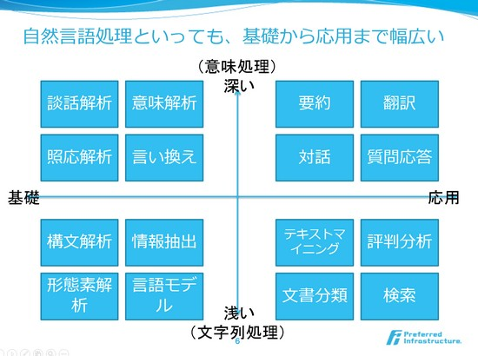
Background : Natural language processing is the important application of ML
There are many tasks which are solved by NLP technique.
Sentence classification
Sentence to sentence
Sentence to tag …

Slide 4
Background : former techniques are not good at parallelization
RNN, LSTM, and GRN have been SOTA in sequence modeling problems.
RNN generates a hidden states, as a function of the previous hidden states and the input.
This sequential nature prevents parallelization within training samples especially when sequence length is long.
Attention mechanisms have become an integral part of recent models, but such attention mechanisms are used with a recurrent network.

Slide 5
Background – challenge of computational cost
Reducing sequential computation is achieved by using CNN, or computing hidden states in parallel.
But in these methods, the number of operations to relate two input and output positions grows in the distance between distances. → It is difficult to learn dependencies between distant positions.

Slide 6
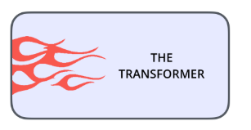
MATOME
Using attention mechanisms allow us to draw global dependencies between input and output by a constant number of operations.
In this work, they propose the Transformer which doesn’t use recurrent architecture or convolutional architecture, and reaches a state-of-the-art in translation quality.

Slide 7

Problem Setting : Sequence to sequence
Input :
Sequence of symbol representations $(x_{1},x_{2},…, x_{n})$
“This is a pen.”
Output
Sequence of symbol representations $(y_{1},y_{2},…, y_{n})$
「これ は ペン です。」

Slide 8
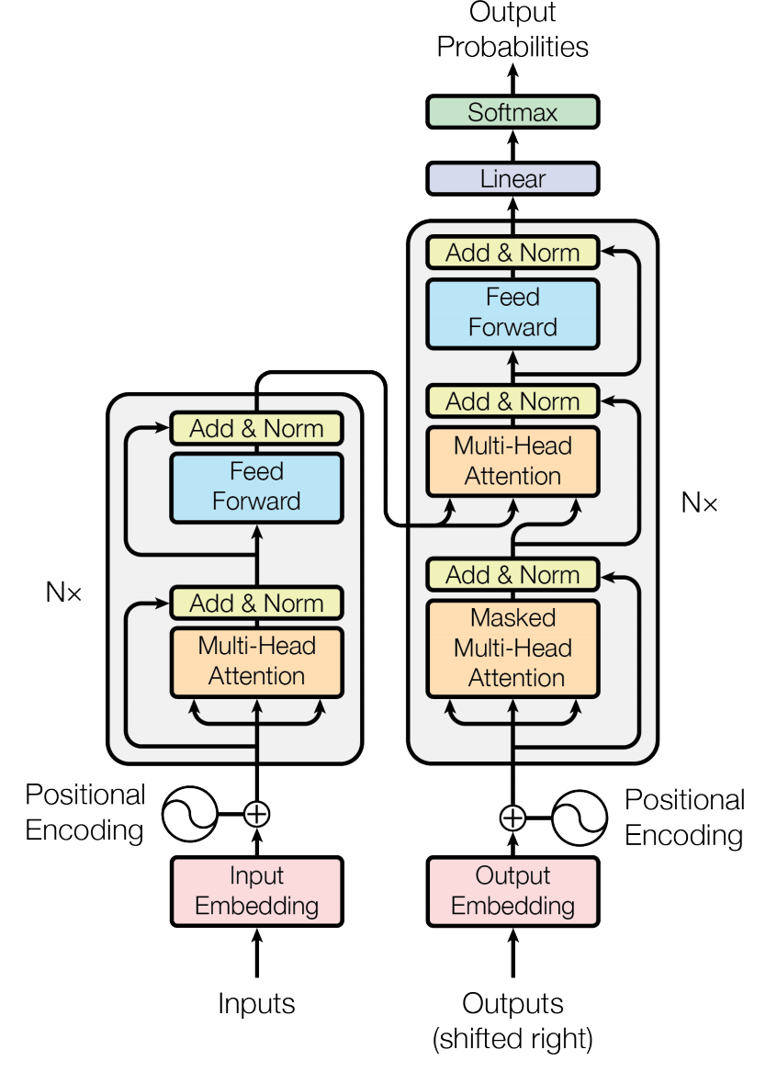
Entire Model Architecture
Left side : Encoder
Right side : Decoder
Consisting layers:
Multi-Head Attention layer
Position-wise Feed-Forward layer
Positional Encoding
(Residual Adding and Normalization layer)

Slide 9
1. Attentions
Encoder-Decoder attention
Self attention in Encoder
Self attention in Decoder

Slide 10
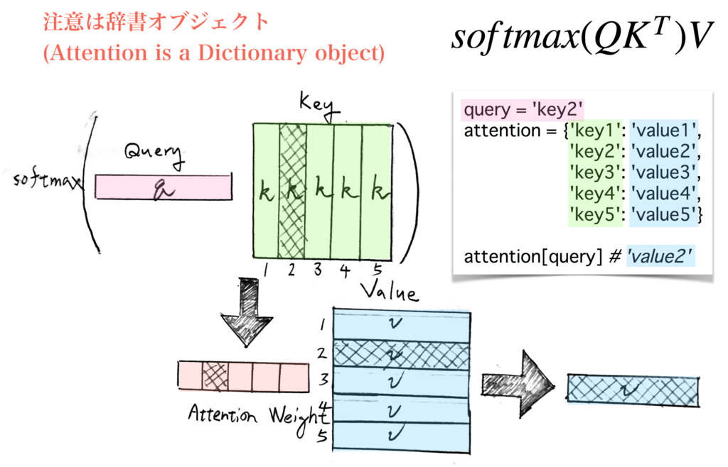

What is Attention?
Attention : (vector, matrix, matrix) $→$vector
$Attention\left(query, Key, Value\right)=Softmax\left(query∙Key^{T}\right)∙Value$
Notes:
memory を KeyKey と ValueValue に分離することで keykey と valuevalue 間の非自明な変換によって高い表現力が得られるという

Slide 11
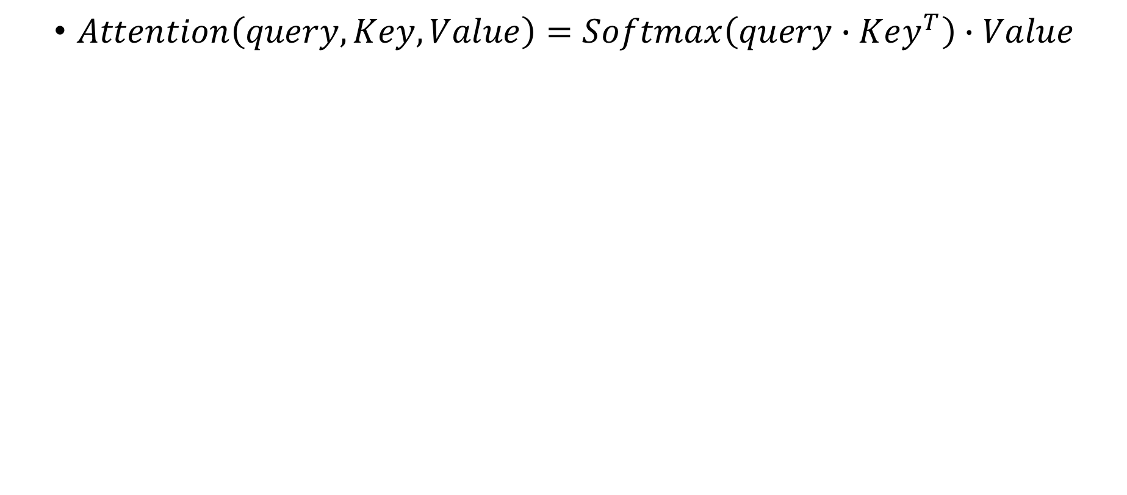
What is Attention?
Attention Weight
$Attention\left(query, Key, Value\right)=Softmax\left(query∙Key^{T}\right)∙Value$
Search keys which are similar to a query, and return the corresponding values.
An attention function can be described as a dictionary object.

Slide 12
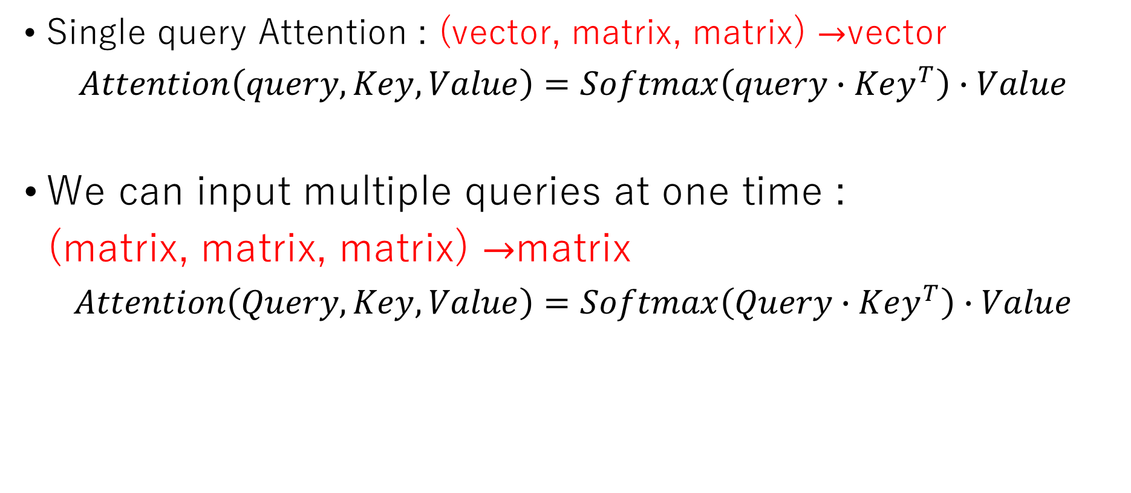
What is Attention?
Single query Attention : (vector, matrix, matrix) $→$vector
$Attention\left(query, Key, Value\right)=Softmax\left(query∙Key^{T}\right)∙Value$
We can input multiple queries at one time :
(matrix, matrix, matrix) $→$matrix
$Attention\left(Query, Key, Value\right)=Softmax\left(Query∙Key^{T}\right)∙Value$
Notes:
memory を KeyKey と ValueValue に分離することで keykey と valuevalue 間の非自明な変換によって高い表現力が得られるという

Slide 13
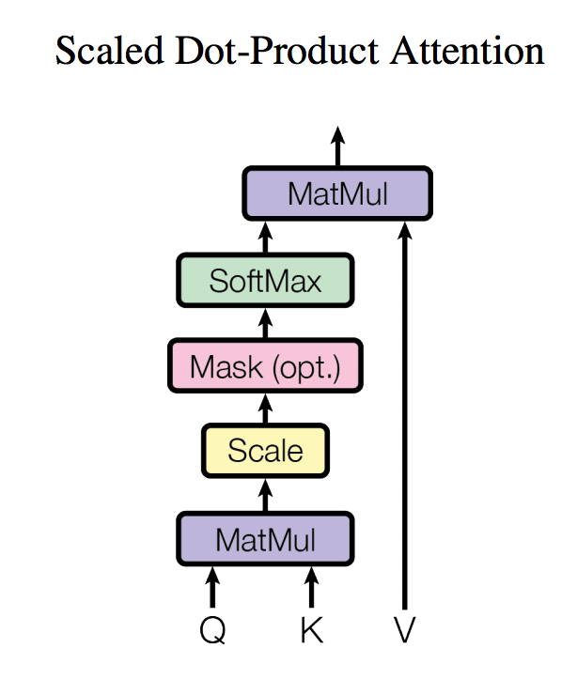

Scaled Dot-Product Attention
There are two most commonly used attention functions : additive attention and dot-product attention.
Additive attention : $Softmax(σ(W\left[Q,K\right]+b))$
Dot-product attention : $Softmax\left(QK^{T}\right)$
Dot-product attention is much faster and space efficient.
They compute the attention as:
$$Attention\left(Q,K,V\right)=Softmax\left(\frac{QK^{T}}{\sqrt{d_{k}}}\right)V$$
where $\sqrt{d_{k}}$ is the scaling factor preventing softmax function pushed into regions where it has extremely small gradients.

Slide 14
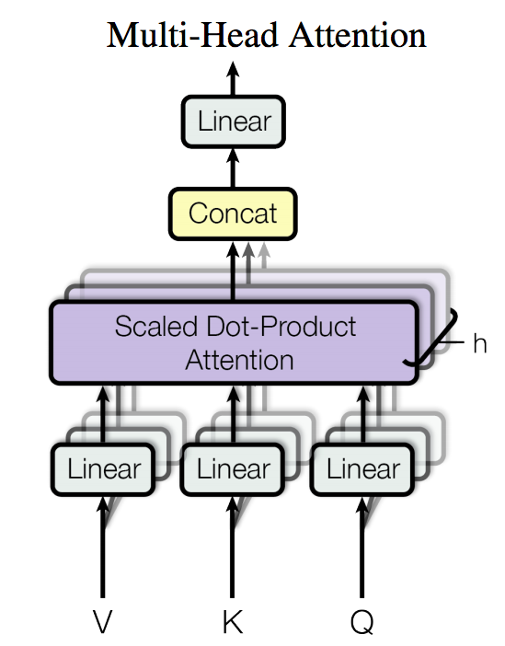
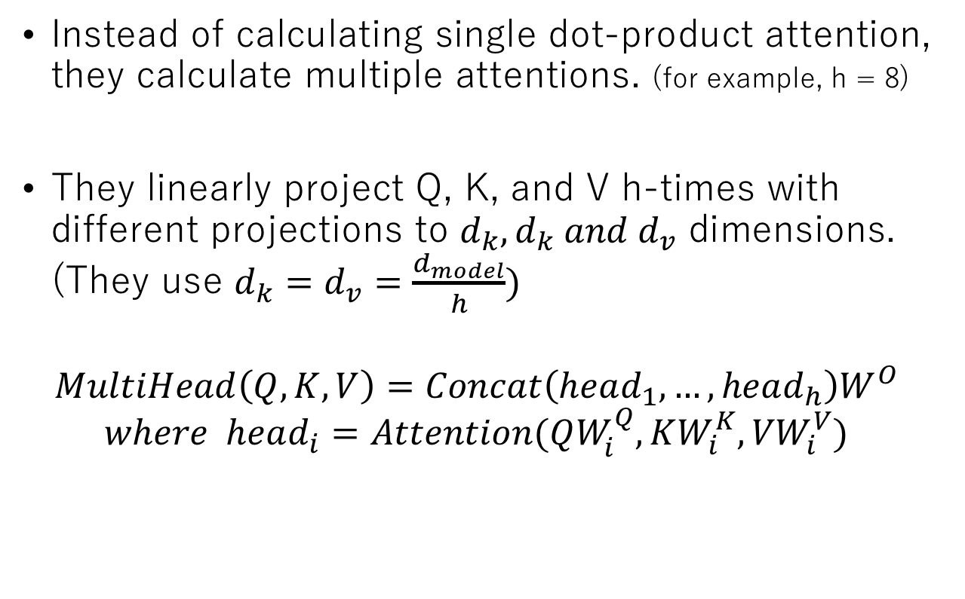
Multi-Head Attention
Instead of calculating single dot-product attention, they calculate multiple attentions. (for example, h = 8)
They linearly project Q, K, and V h-times with different projections to $d_{k},d_{k} and d_{v}$ dimensions. (They use $d_{k}=d_{v}=\frac{d_{model}}{h})$
$$MultiHead\left(Q,K,V\right)=Concat\left(head_{1},…, head_{h}\right)W^{O}$$
$$where head_{i}=Attention(QW_{i}^{Q}, KW_{i}^{K},{VW}_{i}^{V})$$
Parameter weight matrices

Slide 15
Applications of Multi-Head Attention in model
Transformer uses multi-head attention in three ways.
encoder-decoder attention : The queries(Q) come from the previous decoder layer, and keys(K) and values(V) come from the output of the encoder. (traditional attention mechanisms)
Self-attention layers in the encoder : All of the keys(K), values(V) and queries(Q) come from the same place, in this case, the output of the previous layer in the encoder.
Self-attention layers in the decoder : K,V,Q come from the output of the previous layer in the decoder. We need to prevent leftward information flow in the decoder to preserve the auto-regressive property.

Slide 16
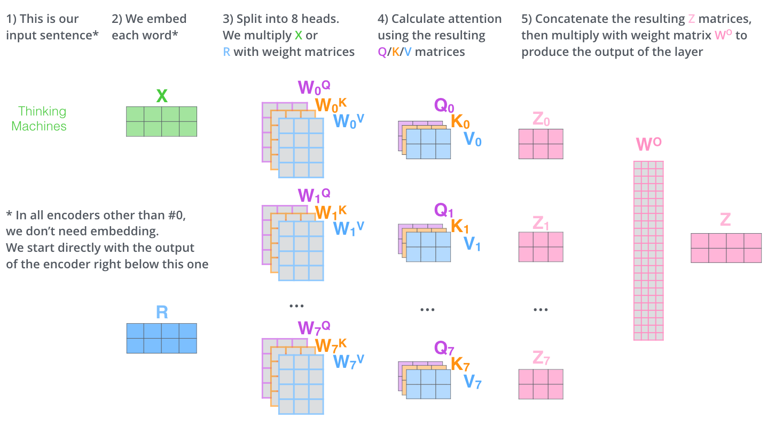
Data Flow in Attention (Multi-Head)
Cited from : https://jalammar.github.io/illustrated-transformer/
Input
Output

Slide 17
Self-Attention in Decoder
In the decoder, the self-attention layer is only allowed to attend to earlier positions in the output sequence. This is done by masking future positions (setting them to -inf) before the softmax step in the self-attention calculation.
For example, if a sentence “I play soccer in the morning.” is given in the decoder, and we want to apply self-attention for “soccer” (let “soccer” be a query), we can only attend “I” and “play” but cannot attend “in”, “the”, and “morning”.

Slide 18
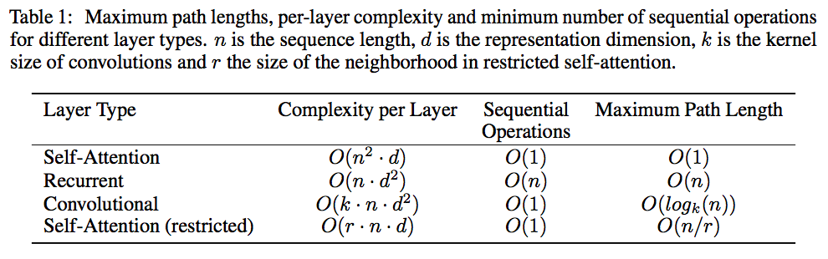
Why Self-Attention?
Total computational complexity per layer
The amount of compotation that can be parallelized
The path length between long-range dependencies
(As side benefit, self-attention could yield more interpretable models.)
Notes:
self-attention layers are faster than recurrent layers when the sequence
length n is smaller than the representation dimensionality d.

Slide 19
2. Feed Forward Layer

Slide 20








Position-wise Feed-Forward Networks
Feed-forward networks are applied to each position separately.
$$FFN\left(x\right)=ReLU\left(xW_{1}+b_{1}\right)W_{2}+b_{2}$$
Embedding dimension (512)
dimension (512)
word1
x1
$$ReLU\left(x_{1}W_{1}+b_{1}\right)W_{2}+b_{2}$$
word2
x2
$$ReLU\left(x_{2}W_{1}+b_{1}\right)W_{2}+b_{2}$$
word3
x3
$$ReLU\left(x_{3}W_{1}+b_{1}\right)W_{2}+b_{2}$$
word4
x4
$$ReLU\left(x_{4}W_{1}+b_{1}\right)W_{2}+b_{2}$$
word5
x5
$$ReLU\left(x_{5}W_{1}+b_{1}\right)W_{2}+b_{2}$$
word6
x6
$$ReLU\left(x_{6}W_{1}+b_{1}\right)W_{2}+b_{2}$$
word7
x7
$$ReLU\left(x_{7}W_{1}+b_{1}\right)W_{2}+b_{2}$$

Slide 21
3. Positional Encoding

Slide 22
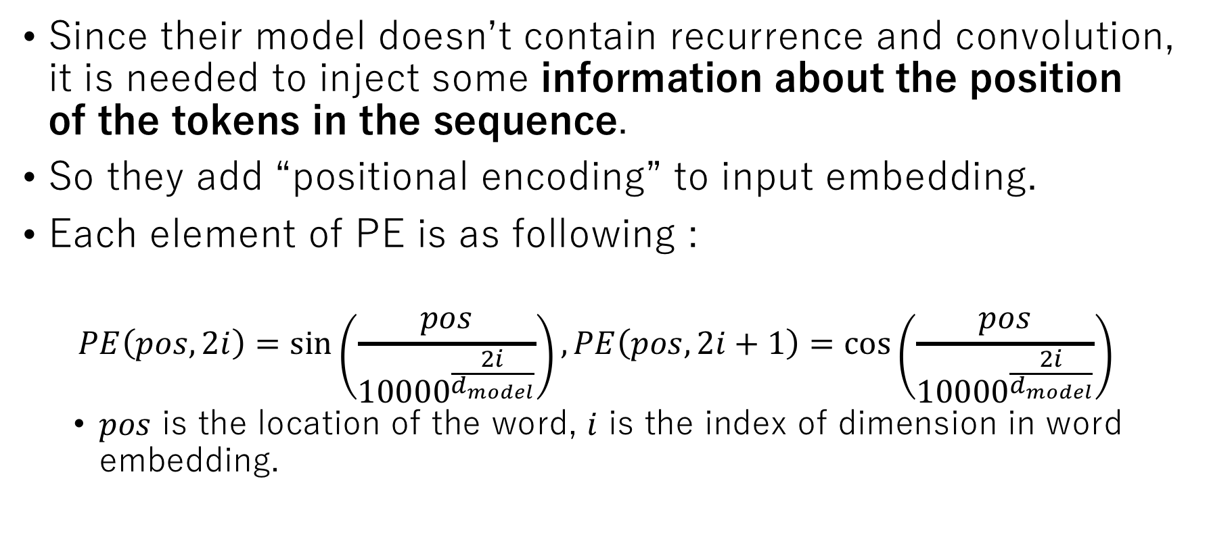
Positional Encoding
Since their model doesn’t contain recurrence and convolution, it is needed to inject some information about the position of the tokens in the sequence.
So they add “positional encoding” to input embedding.
Each element of PE is as following :
$$PE\left(pos, 2i\right)=\sin\left(\frac{pos}{{10000}^{\frac{2i}{d_{model}}}}\right), PE\left(pos, 2i+1\right)=\cos\left(\frac{pos}{{10000}^{\frac{2i}{d_{model}}}}\right)$$
$pos$ is the location of the word, $i$ is the index of dimension in word embedding.

Slide 23
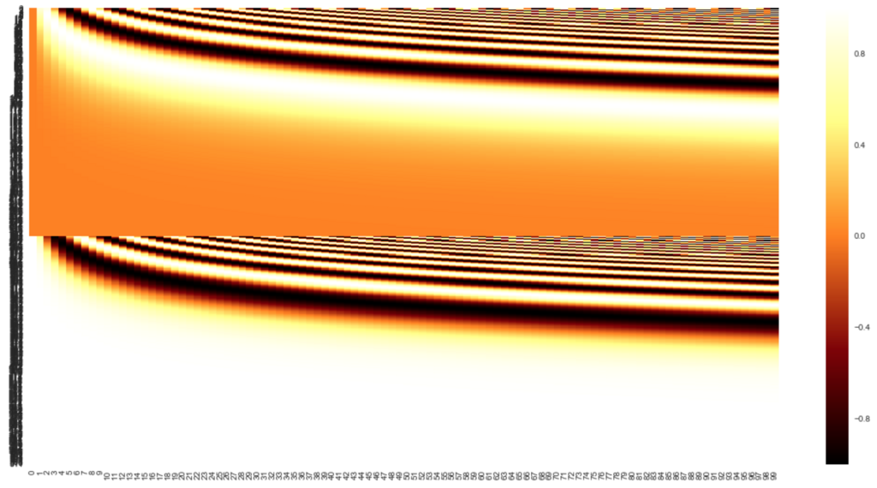
Positional Encoding
Cited from : https://github.com/soskek/attention_is_all_you_need/blob/master/Observe_Position_Encoding.ipynb
Word index in sequence
-1.0 ~ +1.0
Dimension in embedding vector

Slide 24
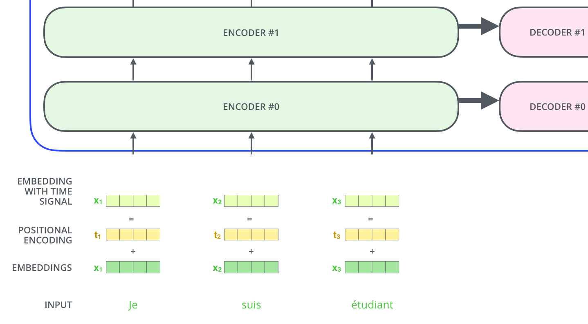
Positional Encoding
Cited from : https://jalammar.github.io/illustrated-transformer/

Slide 25
4. FC and Softmax layer

Slide 26
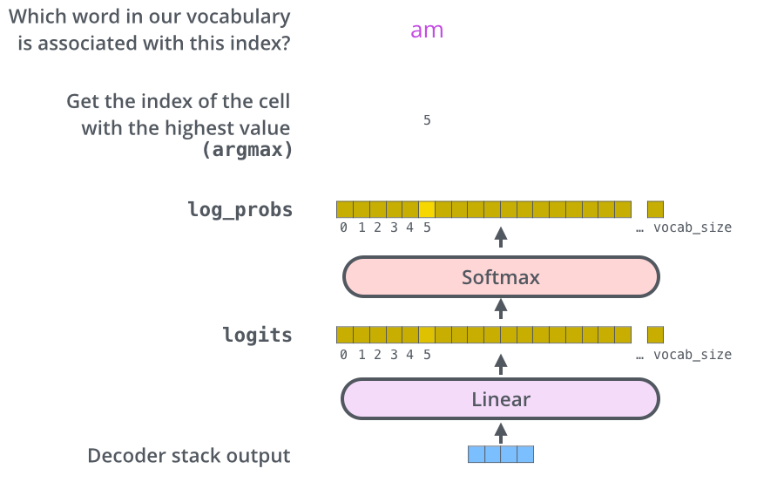
Final FC and softmax layer
Cited from : https://jalammar.github.io/illustrated-transformer/

Slide 27
Using Beam-search in selecting model prediction
When selecting model output, we can take the word with the highest probability and throw away the rest word candidates. : greedy decoding
Another way to select model output is beam-search.
0.1 0.2 0.1 0.6
I you he she

Slide 28
Beam-search
beam-search
Instead of only predicting the token with the best score, we keep track of k hypotheses (for example k=5, we refer to k as the beam size).
At each new time step, for these k hypotheses, we have V new possible tokens. It makes a total of kV new hypotheses. Then, only keep top k hypotheses, … .
The length of words to hold is also a parameter.

Slide 29
Experiment- sequence to sequence task
Data
WMT2014 English-German : 4.5 million sentence pairs
WMT2014 English-French : 36 million sentences
Hardware and Schedule
8 NVIDIA P100 GPUs
Base model : 100,000 steps or 12 hours
Big model : 300,000 steps (3.5 days)
Optimizer : Adam
Warm up, and then decrease learning rate.

Slide 30
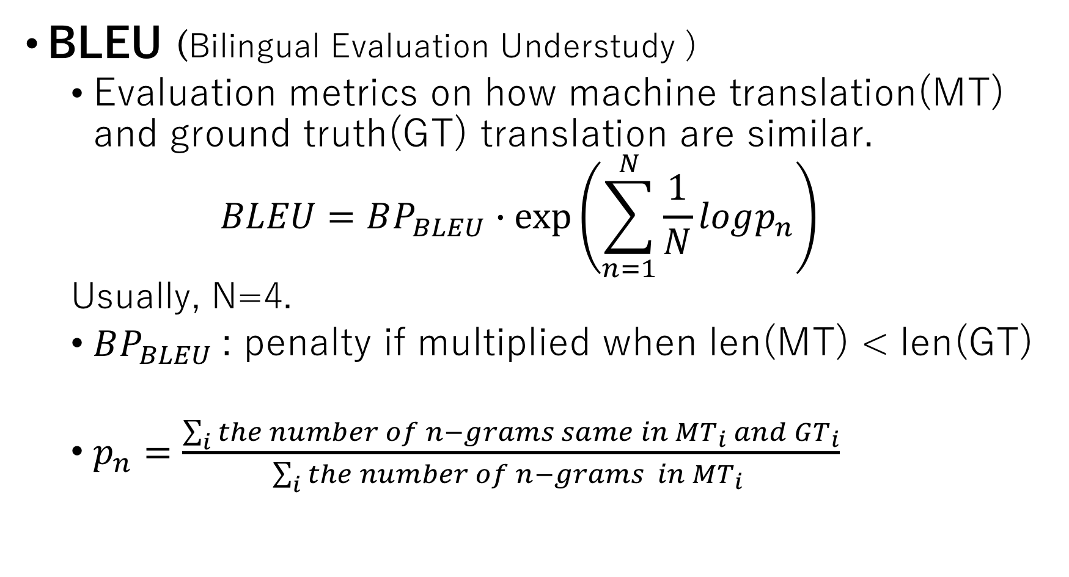
Experiment – evaluation metrics
BLEU (Bilingual Evaluation Understudy )
Evaluation metrics on how machine translation(MT) and ground truth(GT) translation are similar.
$$BLEU=BP_{BLEU}∙\exp\left(\sum_{n=1}^{N}{\frac{1}{N}logp_{n}}\right)$$
Usually, N=4.
$BP_{BLEU}$: penalty if multiplied when len(MT) < len(GT)
$p_{n}=\frac{\sum_{i}{the number of n−grams same in MT_{i} and GT_{i}}}{\sum_{i}{the number of n−grams in MT_{i} }}$

Slide 31
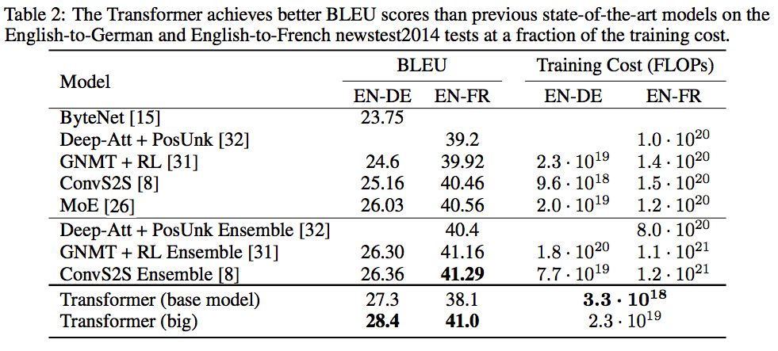
Experiment - Result

Slide 32
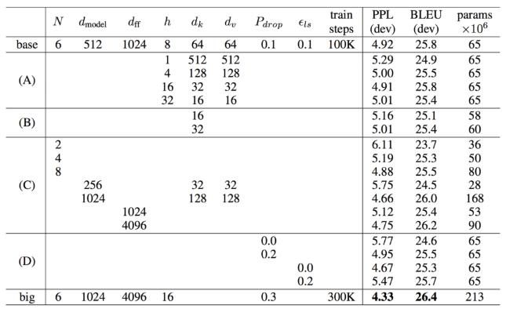
Experiment – Changing the parameters in Transformer
Head number
Base model
Big model

Slide 33
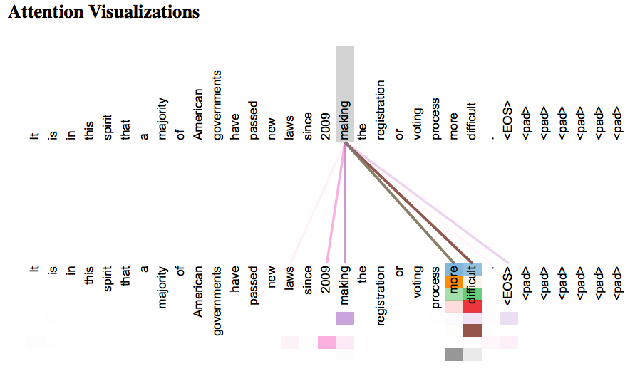
Experiment – Self-attention visualization
Completing the phrase ”making … more difficult”
Notes:
Different colors show different heads..

Slide 34
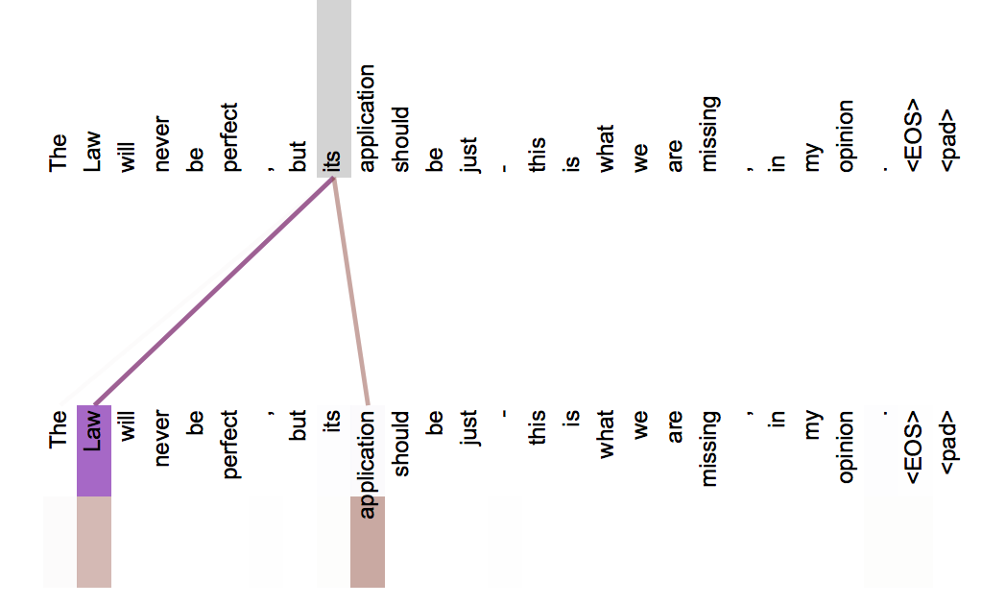
Experiment – Self-attention visualization
Two different heads have different attention weights.
Notes:
Different colors show different heads..

Slide 35
Conclusion
They presented the Transformer, the first sequence transduction model based entirely on attention, replacing the recurrent layers most commonly used in encoder-decoder architectures with multi-headed self-attention.
The Transformer can be trained significantly faster than architectures based on recurrent or convolutional layers.
Notes:
Different colors show different heads..

Slide 36
See detail at:
https://jalammar.github.io/illustrated-transformer/
http://deeplearning.hatenablog.com/entry/transformer

