Slide 1
IT Project
Management
(Introduction to Microsoft Project 1)
Instructor: Tran Vinh Khiem
March 1st, 2020
S³T
Smart Software System Team

Slide 2

“Being a Project Manager is like being an artist, you have the different colored process streams combining into a work of art.”
– Greg Cimmarrusti
IT Project Management

Slide 3
Learning Objectives
Understand the basic structure of Microsoft Project 2019
Know how to create new project, setting project options, create tasks and other necessary features.
Make a basic plan, timeline and grant chart.

Slide 4
Set up
Follow this link: Install Project - Office Support (microsoft.com)
Use Microsoft account of UIT to activate Microsoft Project 2019

Slide 5
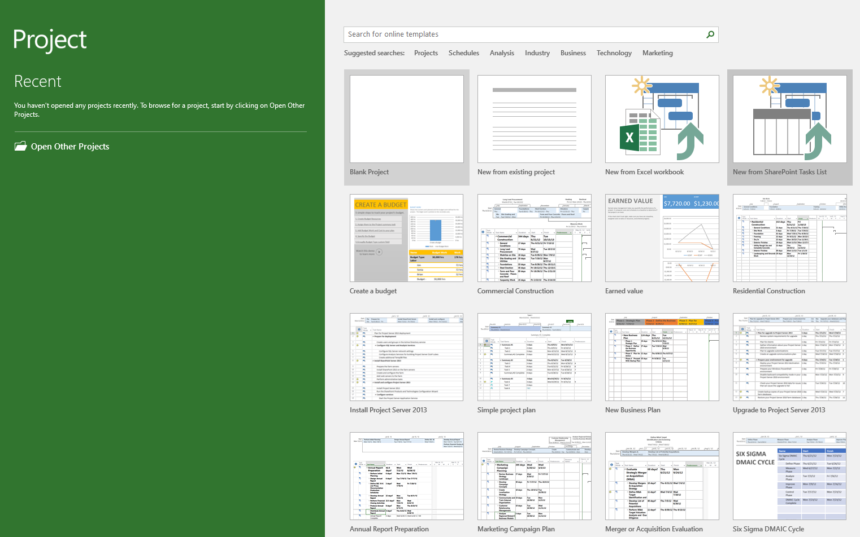
Create MS Project
Open Microsoft Project → select Blank Project.

Slide 6
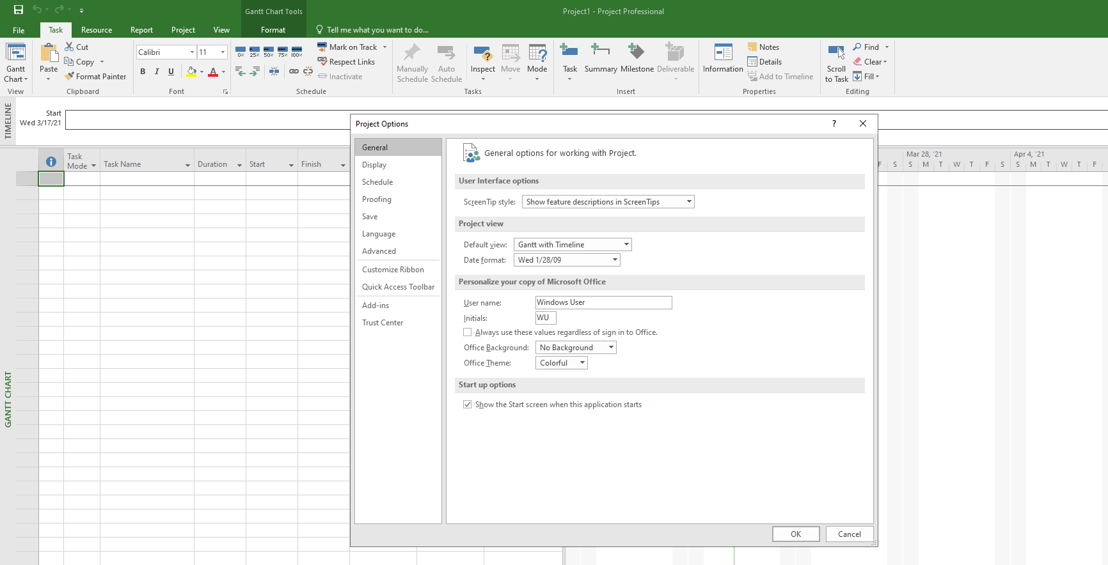
Project Option
Open File → Options → Project Option.

Slide 7
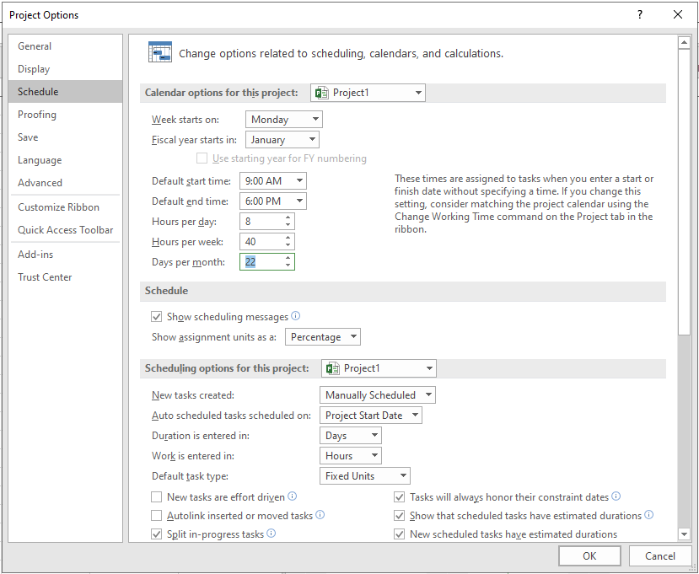
Schedule
Click on Schedule → Week starts on → Choose Monday.
Assign start time to 9:00 AM, end time to 6:00 PM, Days per month to 22.

Slide 8
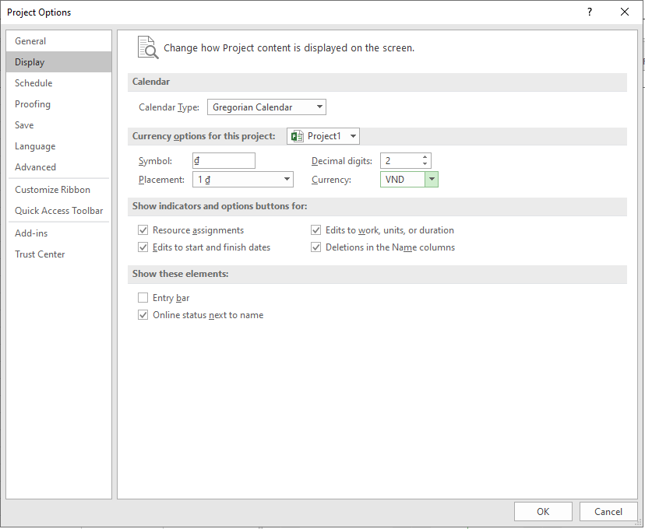
Currency
Click on Display → Currency → Choose VND.

Slide 9
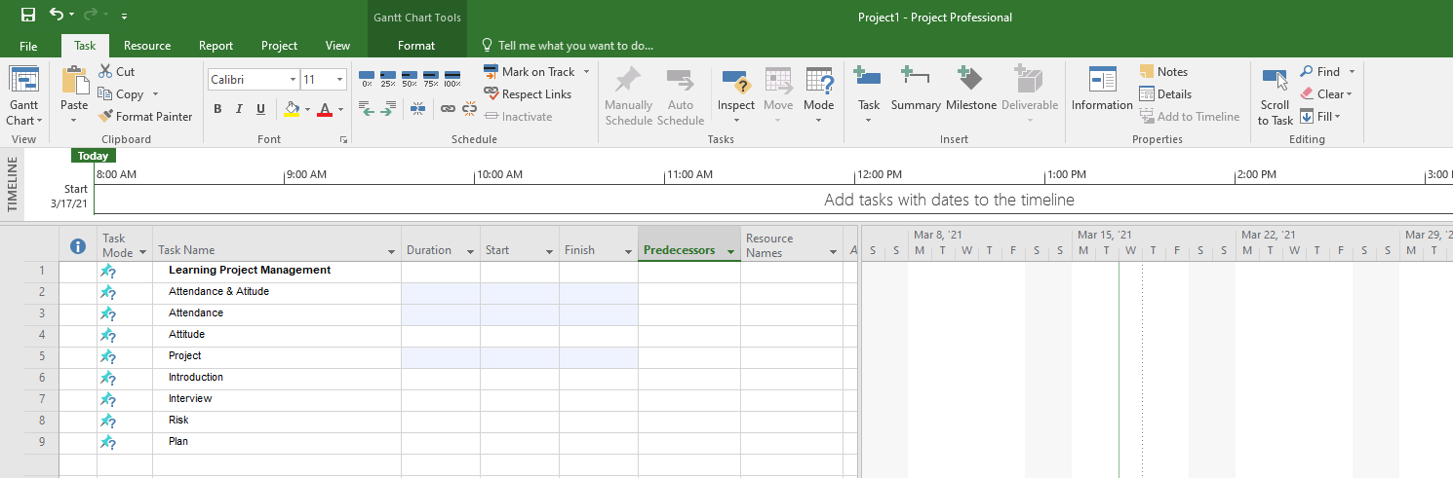
Task
Click on Task → Task Name → Add new tasks

Slide 10
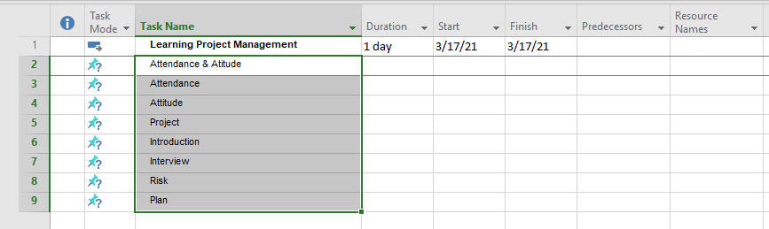
Indent Task
Choose all tasks below Learning Project Management
Task → Schedule → Select Indent task

Slide 11
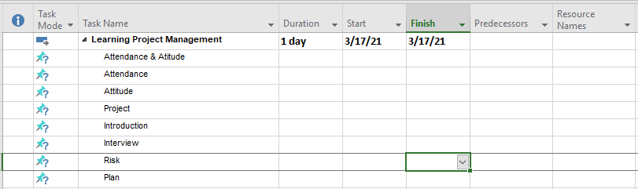
Indent Task

Slide 12
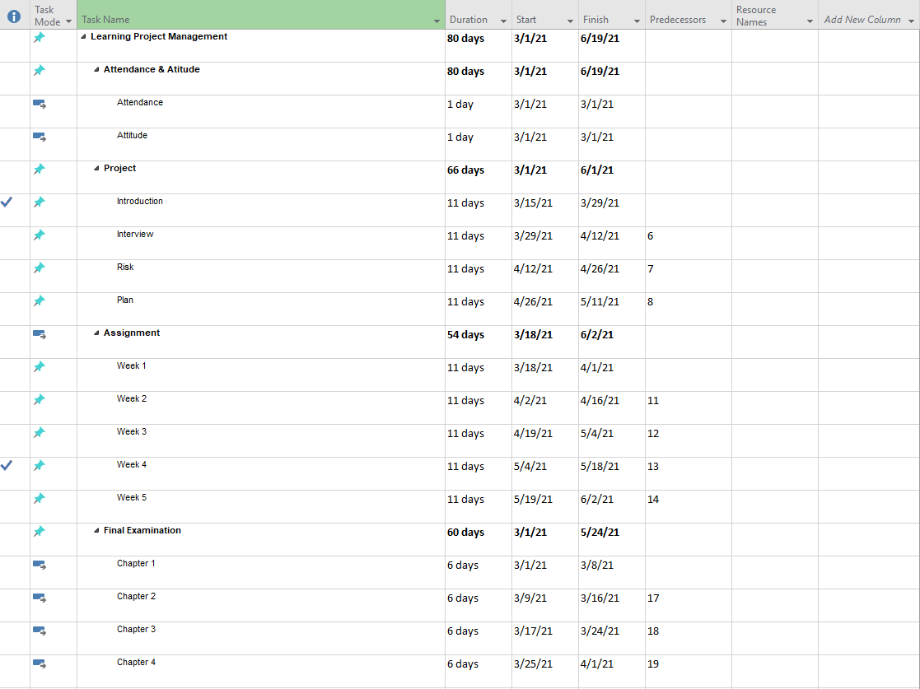
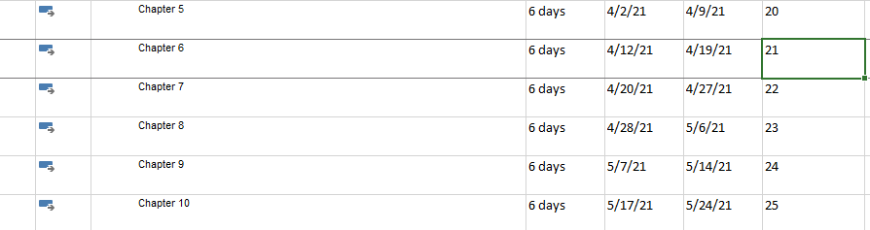
Exercise 1
Make Learning Plan as below:

Slide 13

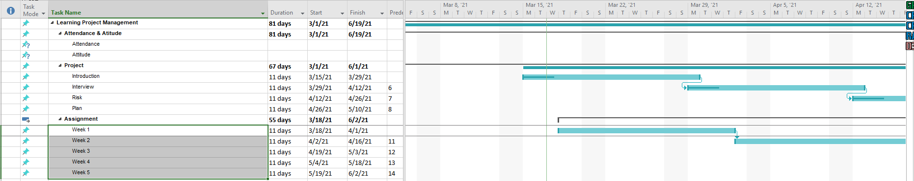
Link the selected task
Task → Schedule → Link selected task (Crt + F2)

Slide 14
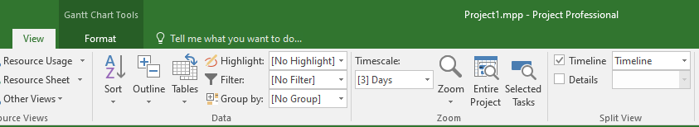
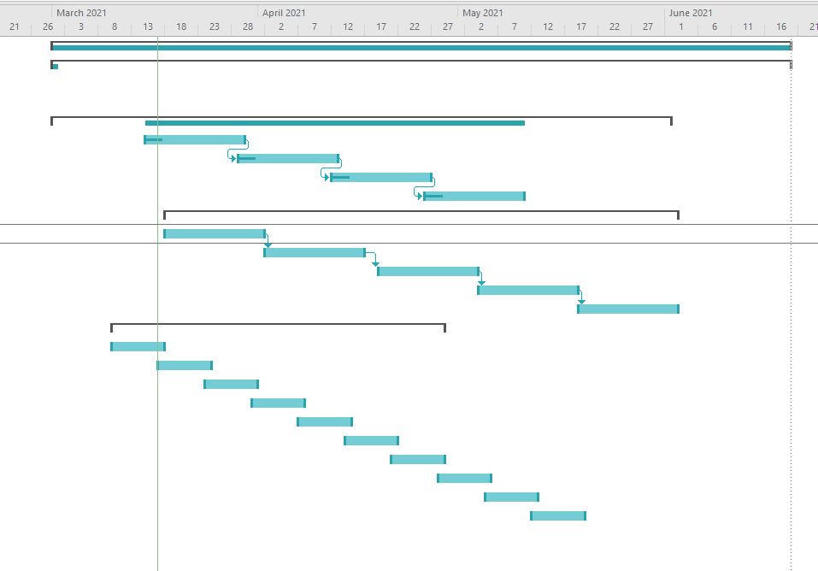
View entire project
View → Zoom → Entire Project

Slide 15
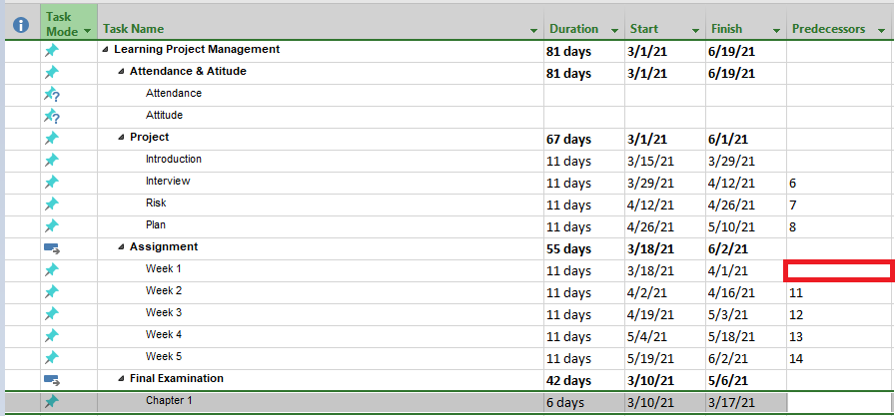
Set predecessors
Click on Predecessors

Slide 16
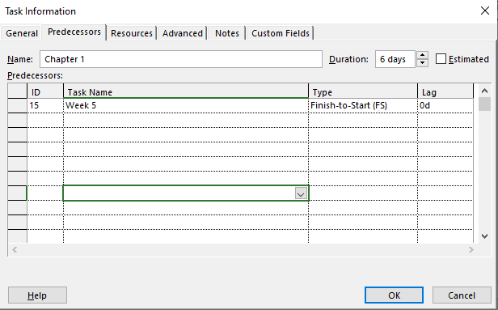
Set predecessors
Task information → Predecessor → ID

Slide 17
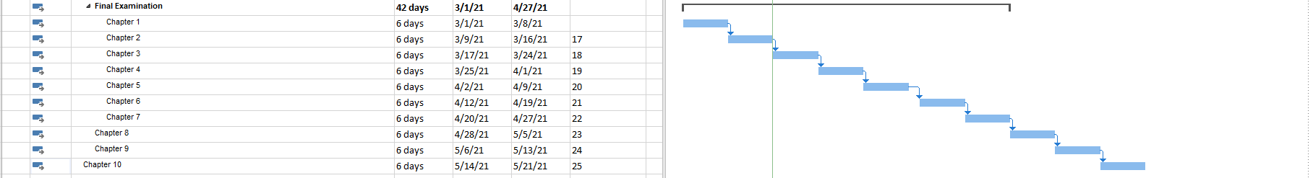
Task mode
Task mode → Manually or Automatic. Try to change as below:

Slide 18
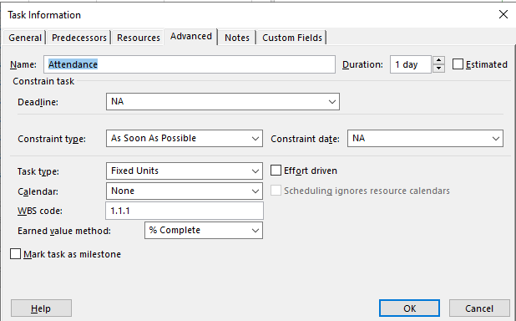
Task type
Double click on Task name → Task information → Advanced → Task Type

Slide 19

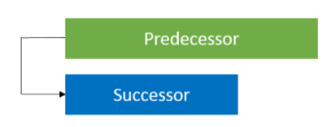
Task dependencies
Finish-to-Start Dependencies (FS) : The predecessor must be finished before the successor start.
Start-to-Start Dependencies (SS): The successor task cannot start until the predecessor task starts

Slide 20
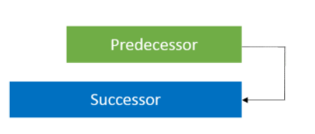
Task dependencies
Finish-to-Finish Dependencies (FF) : The successor cannot finish until the predecessor task finish.
Start-to-Finish Dependencies (SF): The successor task cannot finish until the predecessor task starts
Predecessor
Successor

Slide 21
Task dependencies
Finish-to-Finish Dependencies (FF) : The successor cannot finish until the predecessor task finish.
Start-to-Finish Dependencies (SF): The successor task cannot finish until the predecessor task starts
Predecessor
Successor

Slide 22

Tracking progress
Select Tasks → On Schedule, choose 0, 25, 50, 75 or 100%

Slide 23
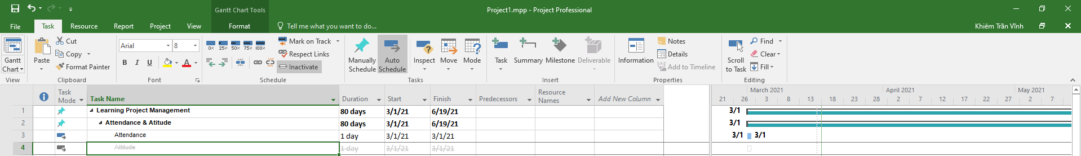
Inactive task
Select Task Name → Task → Schedule → Inactive Task. Note : Task in progress cannot be Inactive.

Slide 24
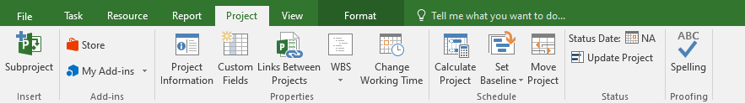
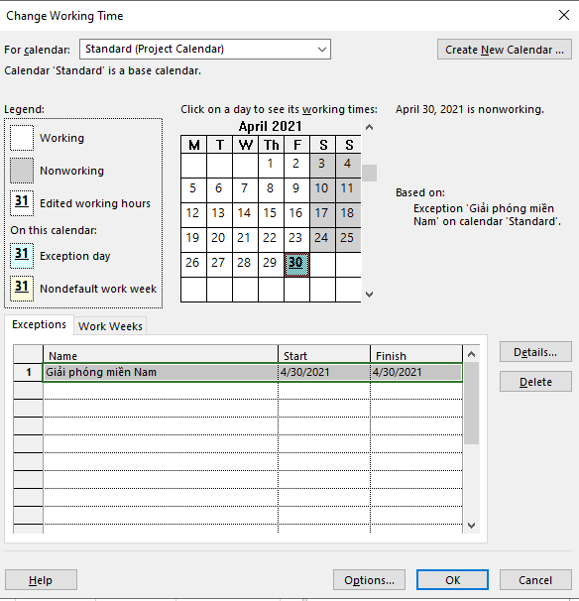
Holiday
Project → Change working time

Slide 25
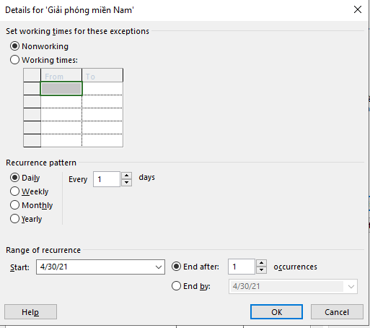
Holiday
Click on Detail → Nonworking or edit Working times, recurrence pattern,…

Slide 26
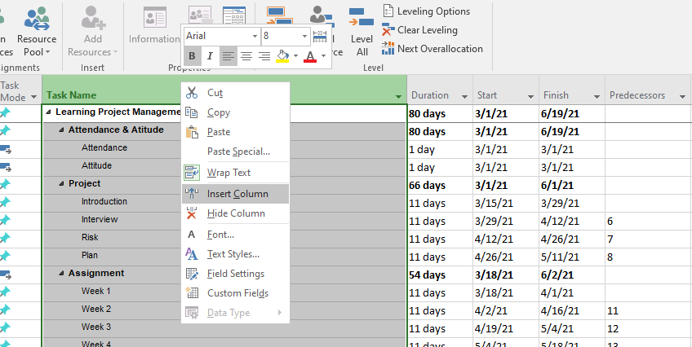
Insert new column
Right click on any column → Select Insert Column

Slide 27
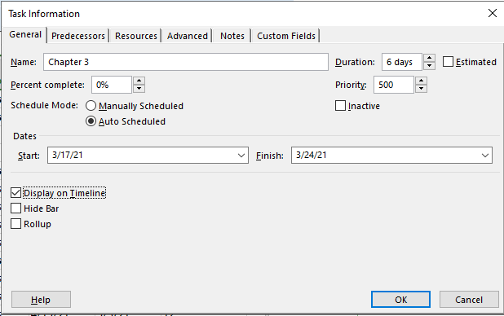
Timeline
Double click on Task Name → Task Information → General → Display on Timeline

Slide 28
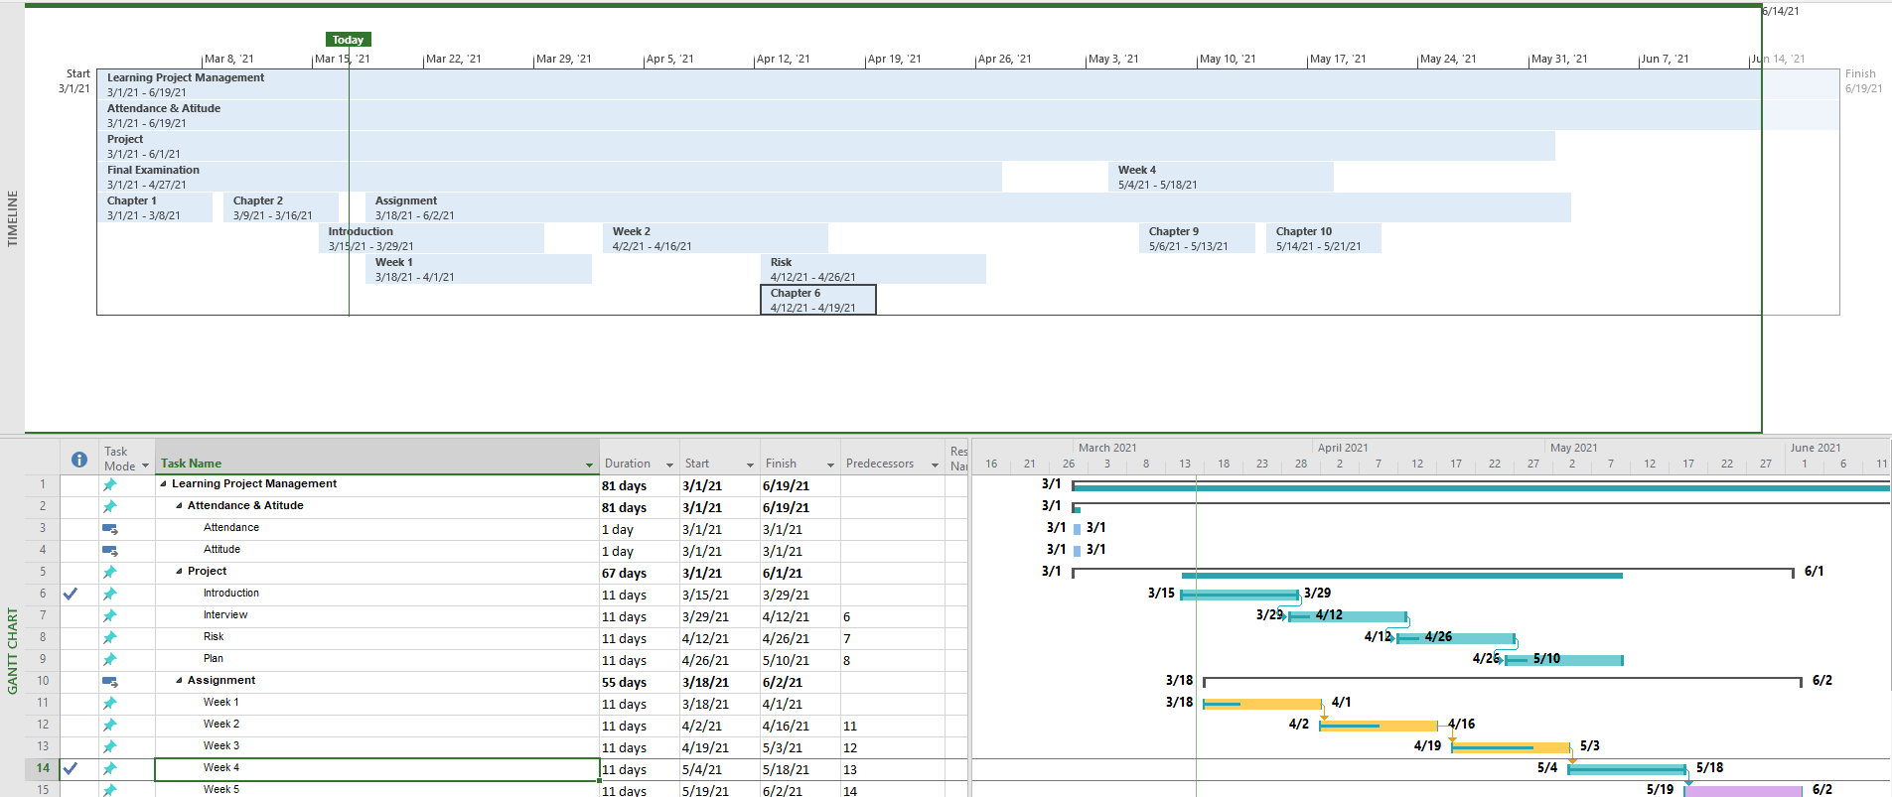
Exercise 2
Create timeline likes this.

Slide 29
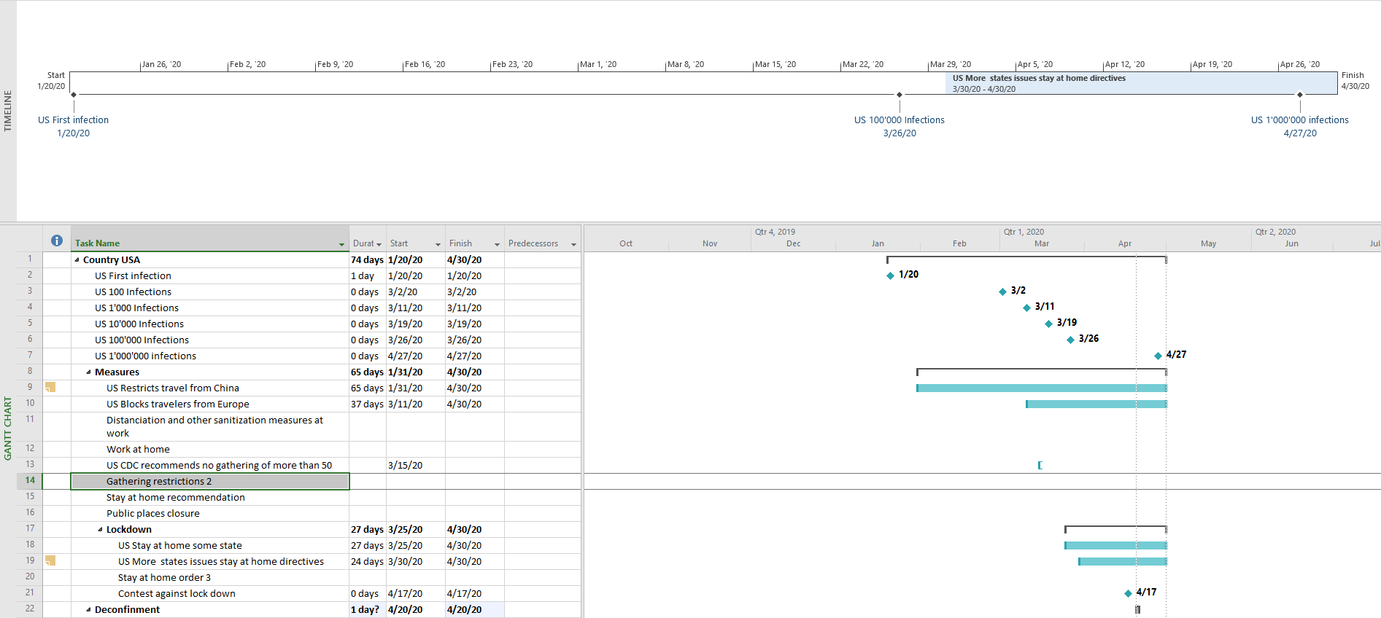
Exercise 3

Slide 30
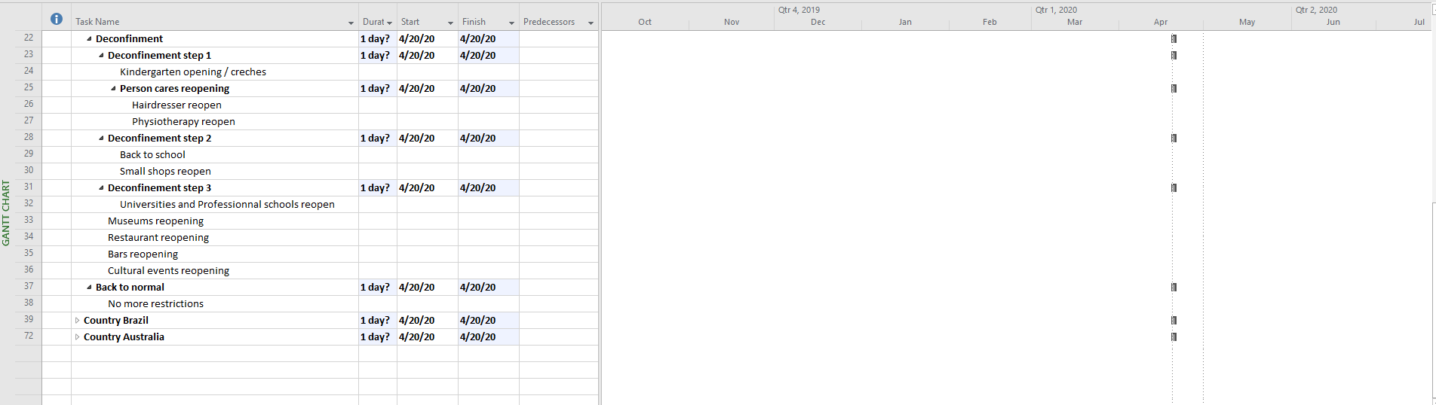
Exercise 4

Slide 31
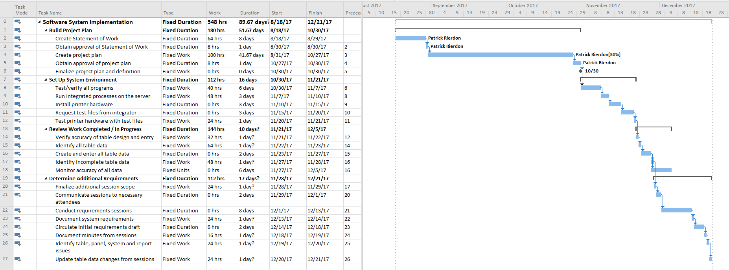
Exercise 5

Slide 32
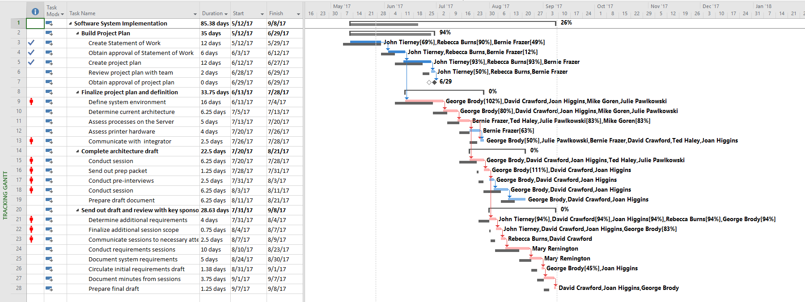
Exercise 6

Slide 33
Q & A
Thank you for attention
“Coming together is a beginning;
Keeping together is progress;
Working together is success.”
- HENRY FORD

