Slide 1
DIOCLETIAN

Slide 2
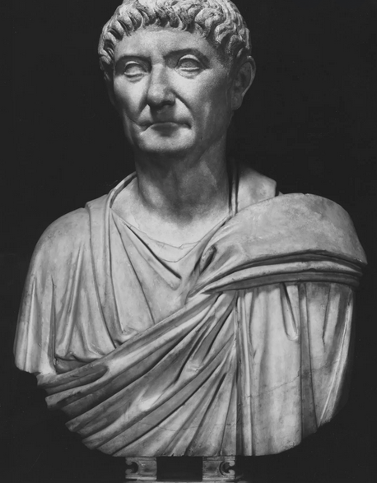
Emporor Diocletian

Slide 3
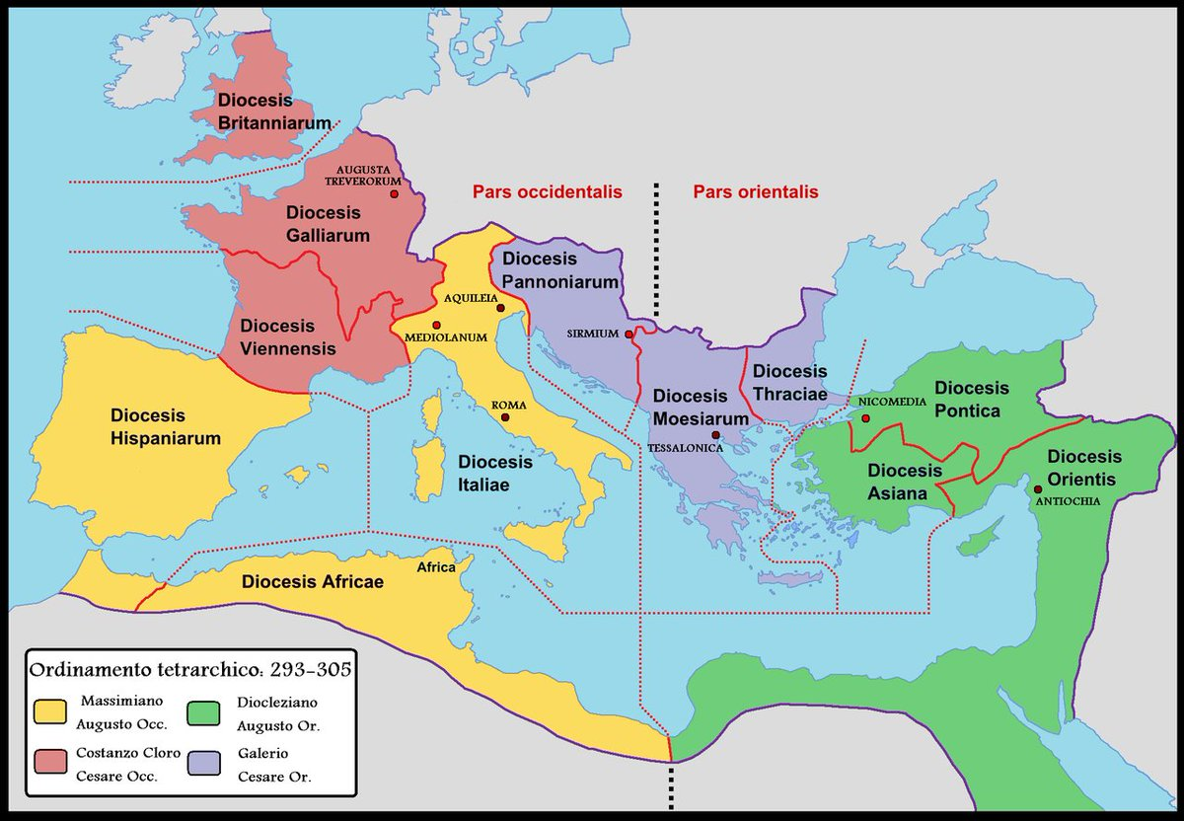
The Tetrarchy

Slide 4
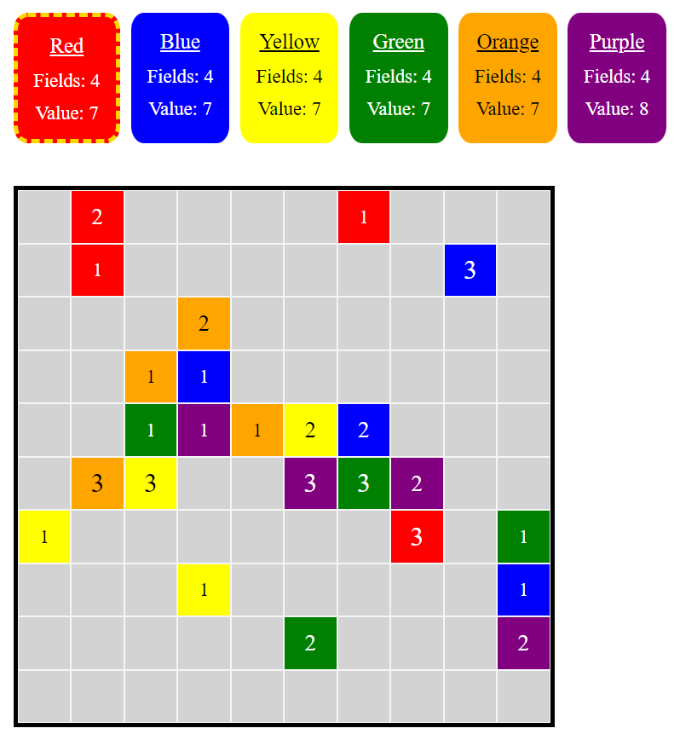
The Game

Slide 5
The Rules
A click on a field of the own color increases the value of the field by 1.
If the value of the field is greater than the number of neighboring fields, the field „overflows“ to the neighbors: The field is set to 1 and the value of the neighbors are increased by 1. They now belong to the player. The neighbors can again overflow.
The last player on the board wins.

Slide 6
Options
The possible size of the board ranges from 4 * 4 to 10 * 10.
Two to six players participate in a game.
The initial density of the board can be set to „sparse“, „medium“, or „dense“.

Slide 7
Biggest Challenge
Ehem, arranging the CSS, especially the grid and flex containers.
THANK YOU!

