Slide 1
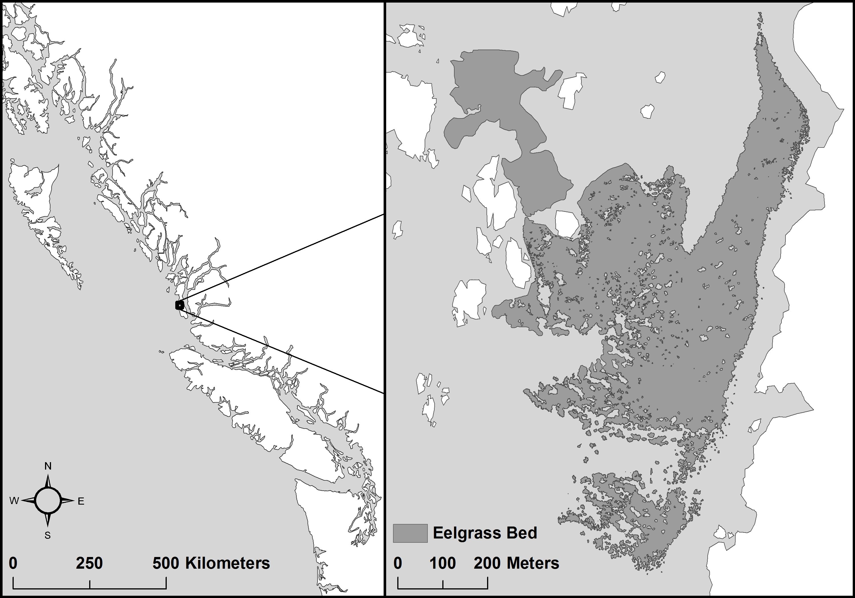
LW
OS
IS
NP
SP
FL
AL
IT
ID
IC
WF
IA

Slide 2
OS
IS
AL
IT
ID
IC
WF
IA

