Slide 1


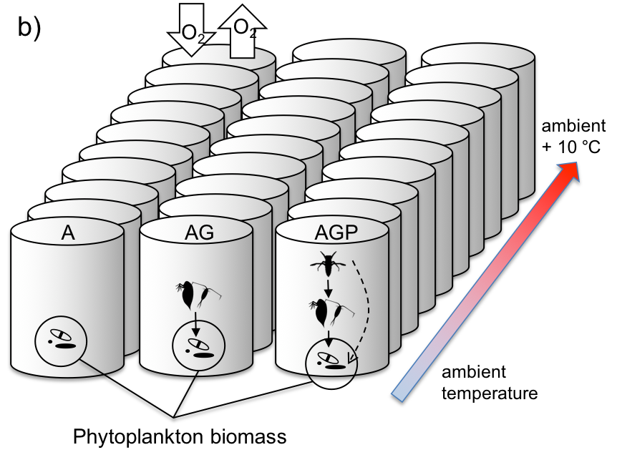
A)
Predator (P)
Temperature
Grazer (G)
Algae (A)
B)
ER (O₂/L/hr)
NEP (O₂/L/hr)
M_{B} (g/L)

