Slide 1
Instana Agent Installer
Faster, safer agent setup and troubleshooting for customers and support engineers
Status report for management
Notes:
Opening. This deck summarises what has been built for installing and configuring the Instana host agent, what has been verified on a real test VM and a real Kubernetes cluster, and what remains.

Slide 2
The problem and the solution
Problem
• Agent setup needs many manual steps: repositories, keys, zone, tags, proxy, sensors
• Small mistakes (wrong region, bad proxy, missing DB grant) cost support time
• Support engineers need to reproduce customer setups quickly
Solution
• One browser tool that generates a correct configuration offline
• One shell installer that applies it, checks it and edits it later
• Built-in connectivity checks and a support bundle with masked keys
• Every setting validated against the IBM Instana documentation
Notes:
The goal is fewer setup errors and faster support. Everything works offline and nothing is sent anywhere by the browser tool.

Slide 3
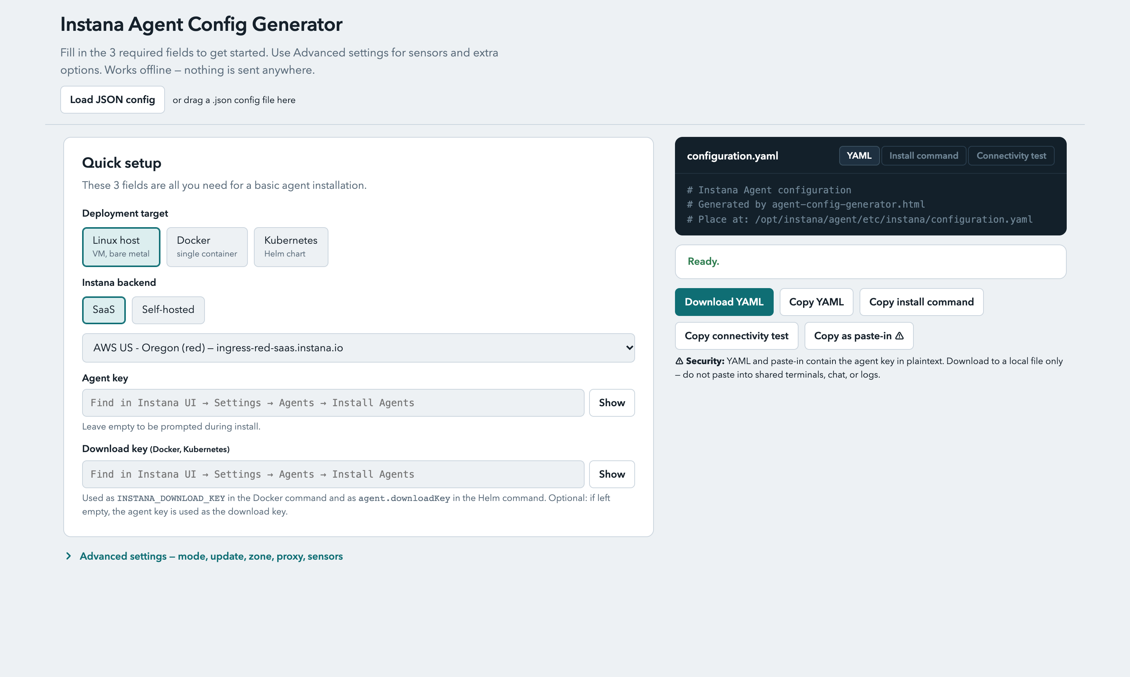
Tool 1: browser configurator
• Single HTML file, works offline
• Targets: Linux host, Docker, Kubernetes (Helm & Operator)
• Tabbed layout: Setup, Sensors, Proxy, Updates & Resources
• Repro Lab Docker script generator & Support Ticket reply template
• Load or export JSON config to share setups
Notes:
The configurator is one HTML file. A customer or engineer fills in three required fields and gets configuration.yaml plus the exact install command. Screenshot shows the empty start screen; no real key is shown.

Slide 4
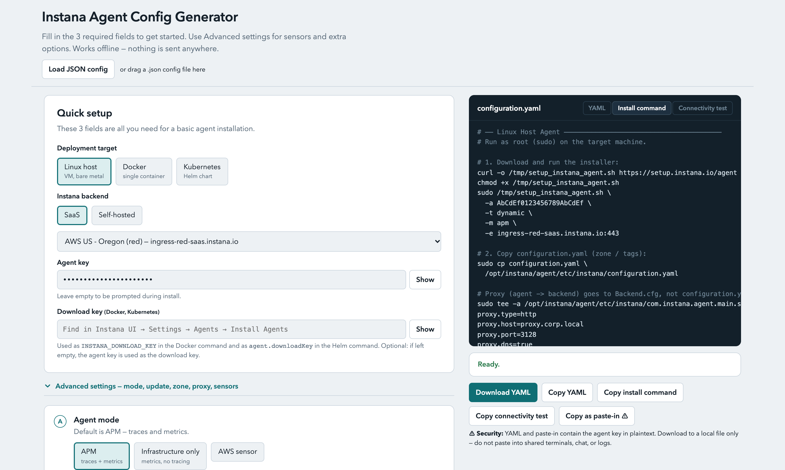
Linux install command, ready to run
• Generated install command with zone, tags and proxy
• Proxy is written to Backend.cfg, not to configuration.yaml
• Key masked in the field, copy buttons for each part
• Key shown here is a fake example
Notes:
Generated Linux command. Note the proxy lines go into the agent main configuration, which is where the documentation requires them. The key in this screenshot is a placeholder.

Slide 5
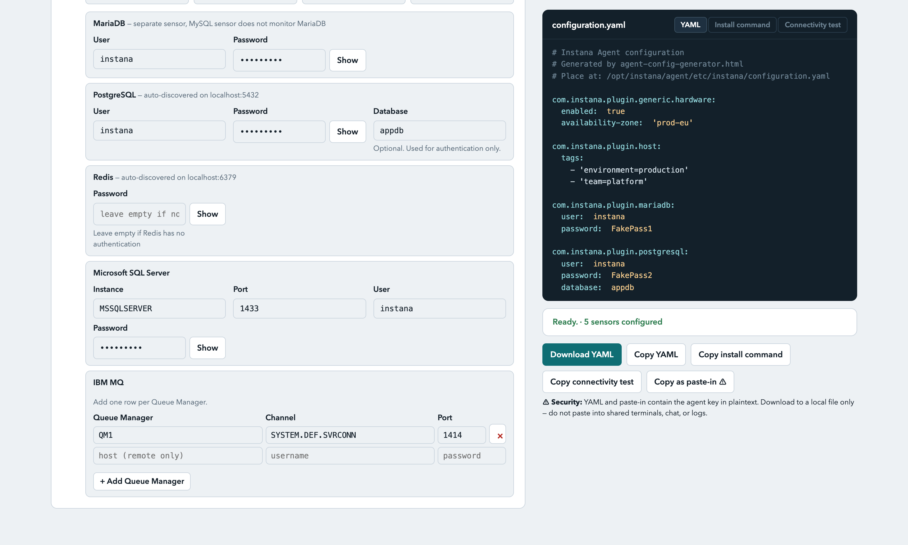
Sensors: databases and messaging
• MariaDB, PostgreSQL, MySQL, MongoDB, Redis, MS SQL, IBM MQ, Elasticsearch
• MariaDB is a separate sensor; the MySQL sensor does not monitor it
• YAML preview updates live as fields change
• All passwords in the screenshot are fake
Notes:
The sensor panel writes the plugin sections into configuration.yaml. We found during testing that MariaDB needs its own sensor and a GRANT on performance_schema, so the tool says so on screen.

Slide 6
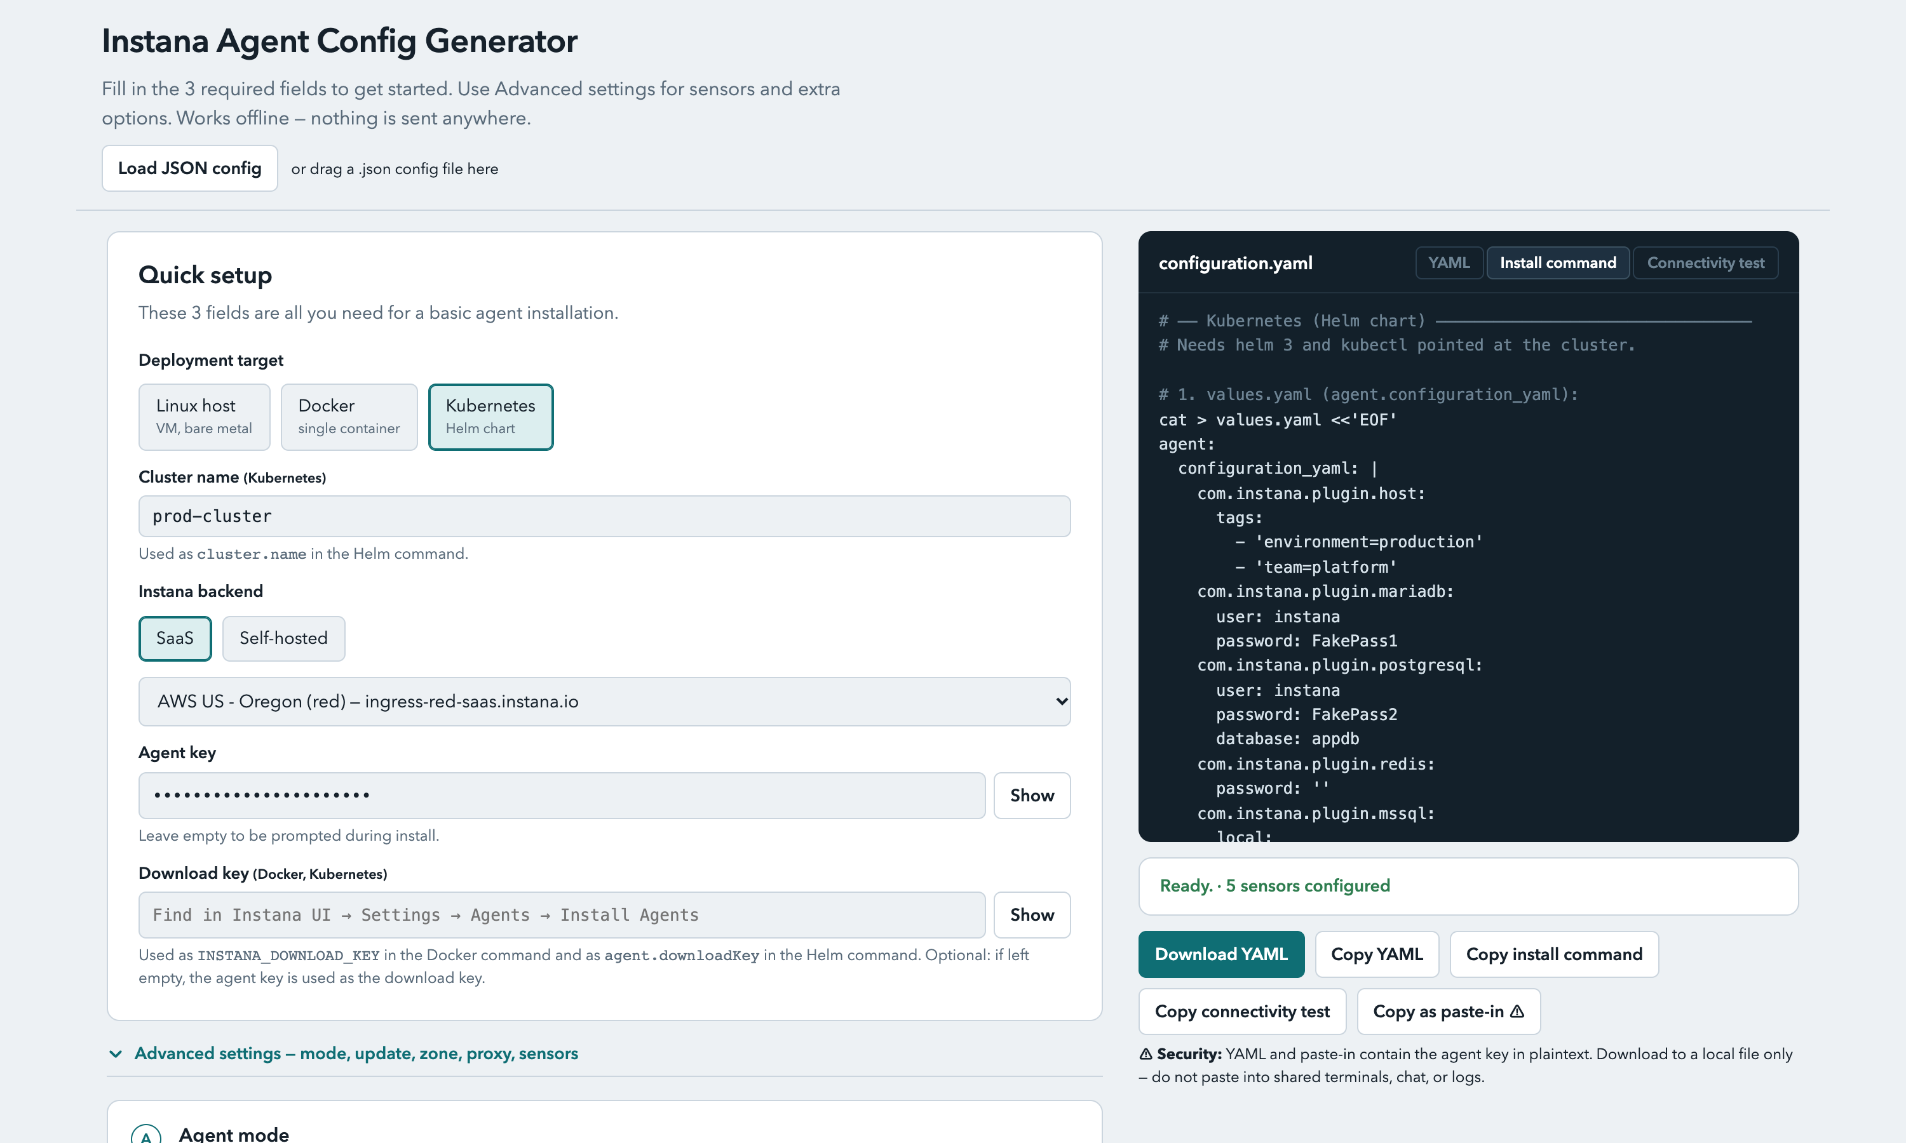
Kubernetes & OpenShift (Helm & Operator)
• Generates values.yaml and helm install command
• Kubernetes Operator & OpenShift InstanaAgent CustomResource
• Cluster name, namespaces, proxy and image repository options
• Verified Helm on GKE: pods Running, backend connected over HTTP/2
Notes:
Helm output was applied to a temporary GKE Standard cluster. All agent pods reached Running and the log showed a connection to the SaaS ingress. The cluster was deleted afterwards.

Slide 7
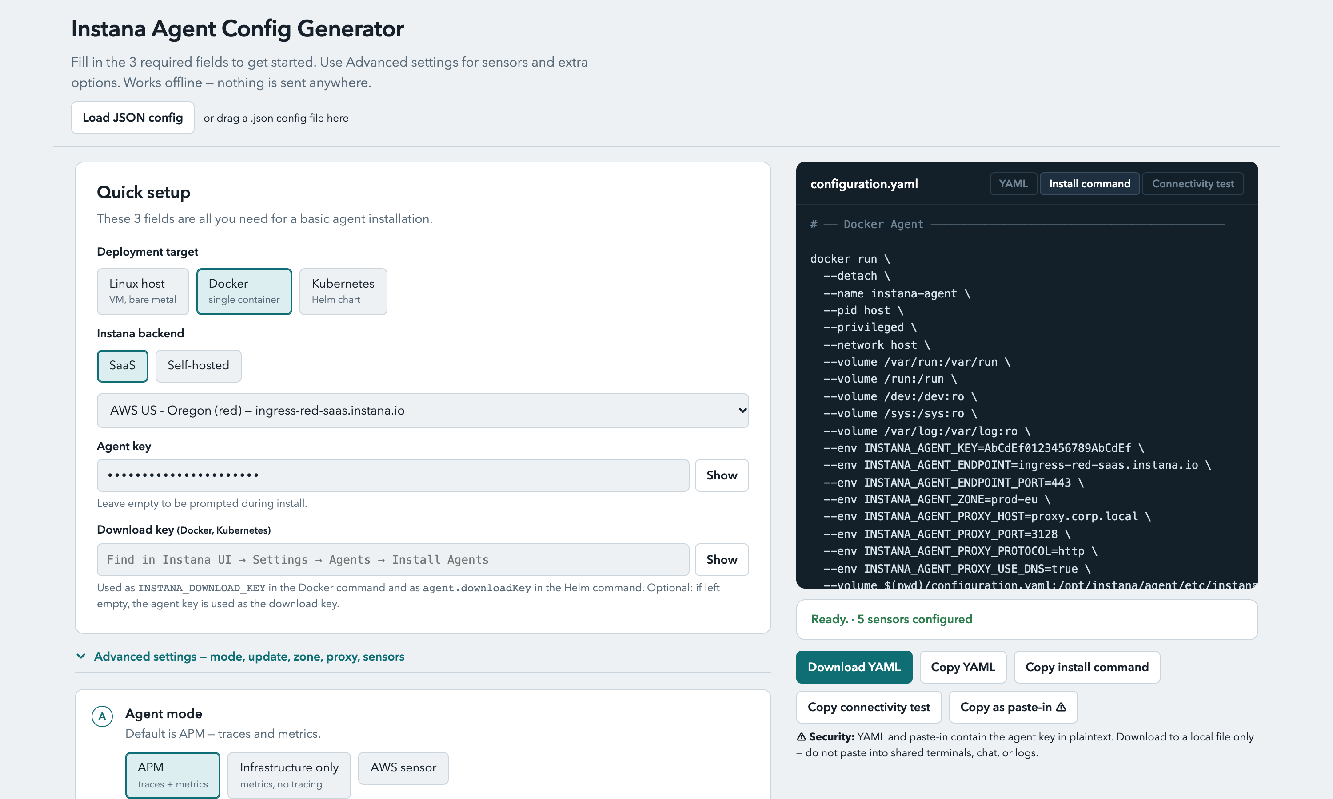
Docker command
• Complete docker run with mounts, key, zone and proxy
• Configuration is mounted as a file
• Verified on the Debian test VM
Notes:
Docker variant generated from the same form. It was run on the test VM and the container connected to the backend.

Slide 8
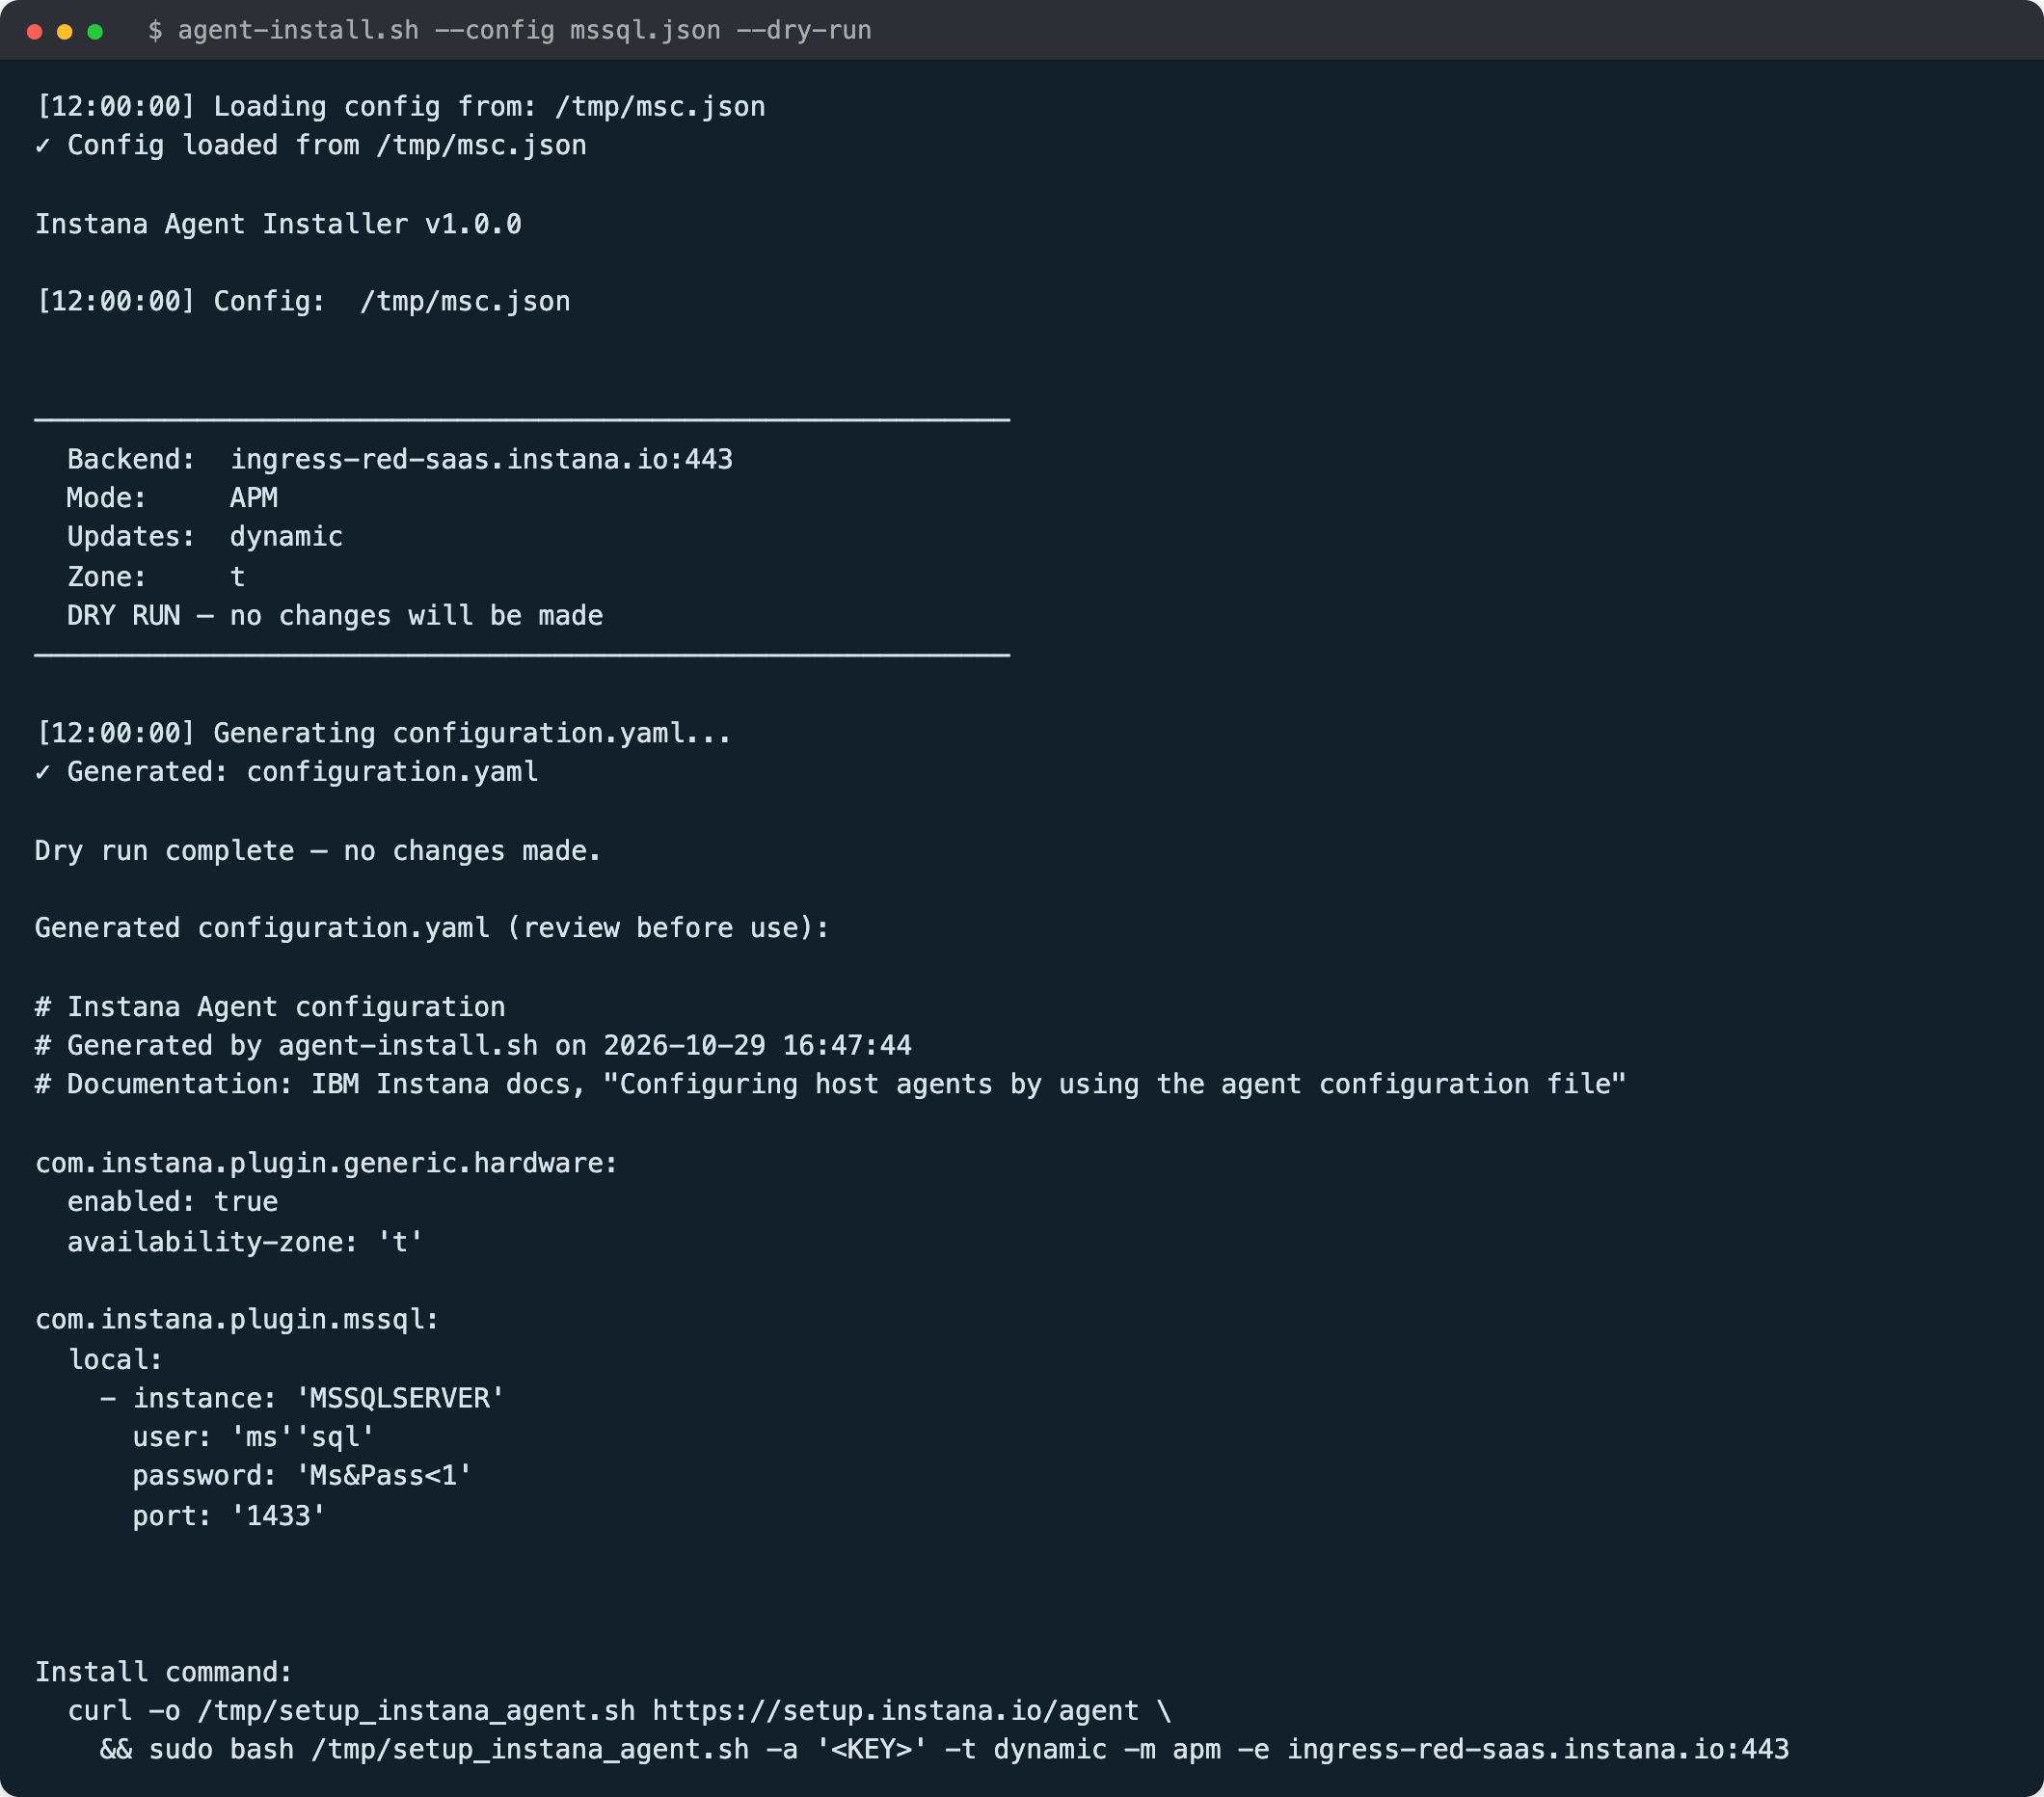
Tool 2: shell installer
• Reads the same JSON as the configurator
• --dry-run shows the plan without changes
• Same YAML as the browser tool
• Menu to edit config, export, restore
• --status and --connectivity for quick checks
• --support-bundle with keys masked
Notes:
The installer reads the JSON produced by the browser tool, or asks questions interactively. Dry run prints the plan and the generated YAML without touching the system. The terminal image is real output; the timestamps were normalised and no key is shown.

Slide 9
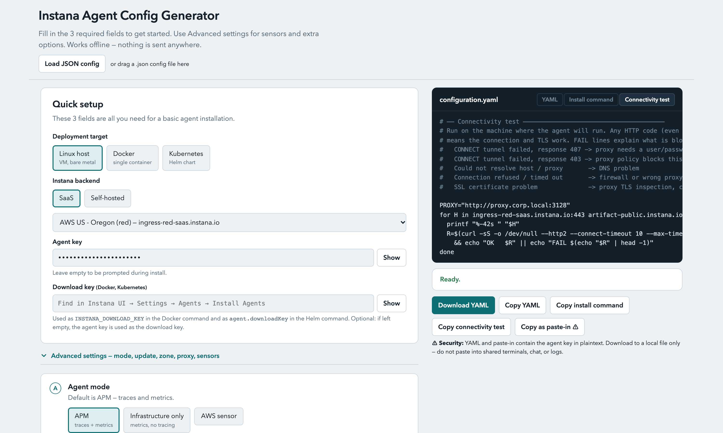
Connectivity test and troubleshooting
• Checks the backend and repositories through the proxy
• Explains errors: 407 proxy login, 403 policy, DNS, firewall, TLS inspection
• Same logic in the installer: exit code 1 on any failure
• Support bundle masks agent and download keys
• Triage scans agent.log for known errors and suggests a fix
Notes:
The connectivity test is the most common support need. It turns raw curl errors into a plain explanation of what to ask the customer network team.

Slide 10
What is verified and what is not
Verified on test VM / cluster
• Real install from profile (Debian 13, GCP)
• Status, edit menu, JSON export and reload
• Support bundle with masked key
• Proxy: Squid with basic auth
• Docker variant verified on host
• Sensors on live agent: Redis, MySQL, MariaDB, PostgreSQL, MongoDB, IBM MQ (connection)
• Kubernetes Helm on GKE
Generated and dry-run only
• MS SQL (local) YAML (dry-run confirmed on VM)
• IBM MQ & MariaDB metrics in Instana UI
• Elasticsearch: only poll_rate documented
• MS SQL remote not implemented
• Reproduction script --apply not fully tested
Notes:
We only claim what was confirmed by real output. IBM MQ: the agent connected to a queue manager in client binding mode and stayed error-free after the OAM authorities were granted. The right column is generated correctly and checked against the documentation, but not yet run against a live product instance.

Slide 11
Next steps
• Verify IBM MQ and database metrics in Instana UI
• Finalize automated reproduction script (--apply)
• Add MS SQL remote monitoring if requested
• Package and hand over to support team
• Test VM cleanup and shutdown completed
Notes:
Priorities in order. The test VM still has an agent installed and should be switched off when no longer needed to avoid cost.

