Slide 1

Pursuing a CS PhD in Europe and Germany
Talk 1: Introduction and Preparation
Dr. Bijun Li
July 2024

Slide 2
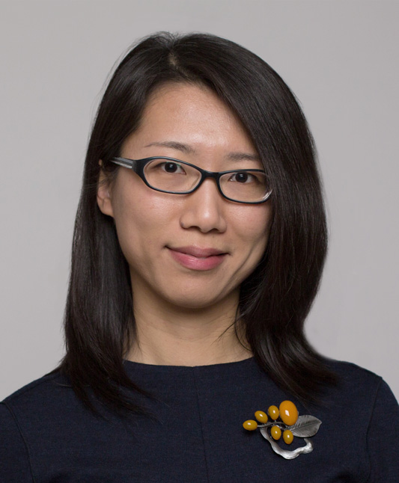
About the speaker
Background
Area of Expertise
Dr.-Ing in Computer Science from TU Braunschweig, Germany
Years of experience in academia and industry, especially in European Startups
Fault-tolerance, consensus in distributed systems, trusted computing
Blockchain, Web3 research and development
Academic career development

Slide 3
Overview
Talk 1: Introduction and Preparation
Introduction to CS PhD programs in Europe
Unique aspects of the German academic system
Preparation for applying
Application process
Talk 2: PhD Life and Beyond
Funding and financial planning
Starting your PhD and research life
Publishing and conferences
Completing your PhD and career prospects

Slide 4
Introduction: CS PhD Programs in Europe
Growing importance of advanced CS research
Europe as a hub for cutting-edge CS PhD programs
Germany’s strengths: strong industry partnerships, excellent funding, world-class research institutions
Comparison with other European countries (e.g., UK, Netherlands, Switzerland)

Slide 5

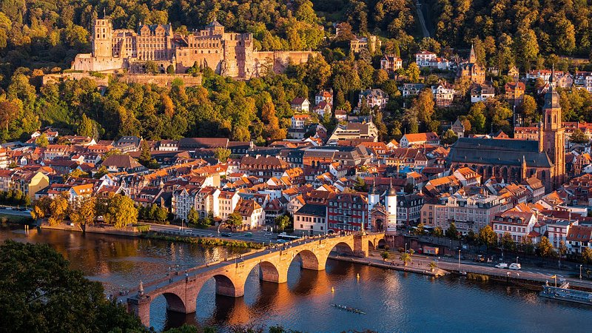
Unique Aspects of the German Academic System
Strong industry partnerships
Excellent funding opportunities
World-class research institutions
Focus on applied research
Structured vs. individual doctorate programs
Munich
Heidelberg

Slide 6
Benefits of Pursuing a PhD in Europe/Germany
High-quality research environment
International collaboration opportunities
Access to cutting-edge technologies and resources
Strong emphasis on work-life balance
Potential for industry connections
Cultural experience and language skills

Slide 7
Preparation: Prerequisites
Academic Qualifications
Master’s degree in CS or related field
Strong academic record (typically 2.0 or better in German grading system, B+/3.3 GPA or better in U.S. grading system)
Language Requirements
English: Usually IELTS 6.5+ or equivalent
German: Often not required, but beneficial
Research Experience
Master’s thesis
Publications or conference presentations
Relevant internships or projects

Slide 8
Choosing Your Research Area
Considerations
Assess your interests and strengths
Explore current trends in CS research
Consider interdisciplinary opportunities
Align with potential career goals
Popular CS Research Areas in Germany
Artificial Intelligence and Machine Learning
Cybersecurity and Cryptography
Human-Computer Interaction
Big Data and Data Science

Slide 9
Identifying Potential Supervisors and Institutions
Top CS Universities and Research Institutions
Technical University of Munich (TUM)
RWTH Aachen University
Max Planck Institute for Informatics
German Research Center for Artificial Intelligence (DFKI)
www.research-in-germany.org
www.gerit.org
www.hochschulkompass.de
Finding the Right Supervisor
Research faculty profiles and publications
Attend CS conferences and workshops
Leverage online platforms (e.g., ResearchGate, GitHub)
Consider reaching out for informal discussions

Slide 10
PhD Structures in Germany
Individual Doctorate
Traditional and most common model
Focus on independent research under a supervisor
Often tied to research assistant (wissenschaftlicher Mitarbeiter) positions
Employed by the university, full employee benefits (öffentliche Dienst)
No formal coursework
Includes teaching and administrative duties
Structured Programs
More formalized, similar to US/UK model
Includes coursework
Often interdisciplinary
May offer more networking opportunities
Receives university fundings or scholarships

Slide 11
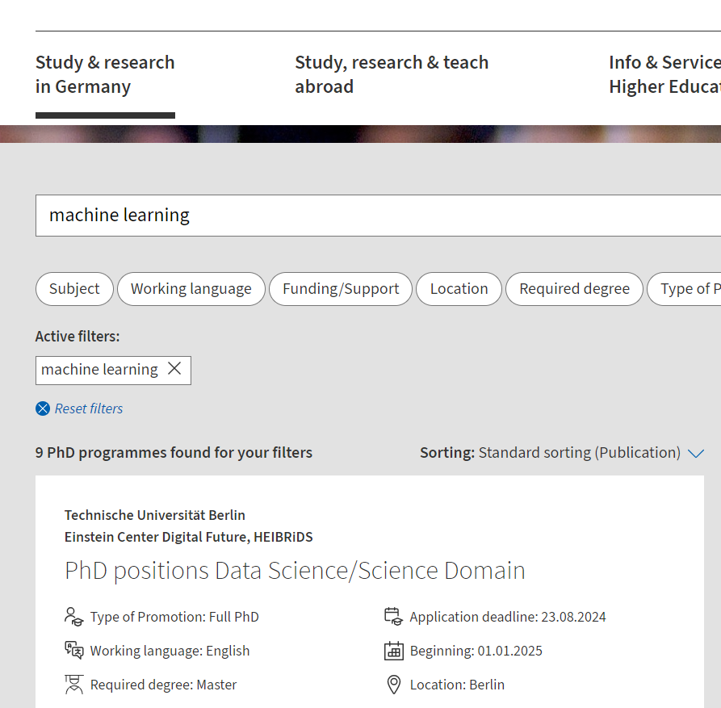
Application Process: Finding PhD Positions
University websites and job boards
Online academic job portals
academics.de
phdgermany.de
daad.de/idp
funding-guide.de
CS conferences and workshops

Slide 12
Preparing Application Materials
CV/Resume
Academic background
Research experience
Technical skills
Publications/presentations
Transcripts and Certificates
Academic records
Degree certificates
Language proficiency proof
Research Proposal
Clear research question
Methodology
Potential impact
Alignment with supervisor/program
Letters of Recommendation (optional)
From academic/research supervisors
Highlighting research potential

Slide 13
Application Timelines and Interview Process
Timelines
Vary by institution and program
Generally, 6-12 months before intended start date
Some programs have fixed annual deadlines
Others review applications on a rolling basis
Interview Process
Often conducted via video call
May include presentation of past research
Questions on technical knowledge and research interests
Discussion of program expectations and your goals
Tip: Prepare a short “elevator pitch” about your research interests

Slide 14
Q&A Session
Time for Your Questions!
Don’t hesitate to ask about any aspect of applying for a CS
PhD in Germany.
Your questions help everyone learn!

Slide 15
Preview of Talk 2
Coming Up in Talk 2
Funding and financial planning
Starting your PhD and research life
Publishing and attending conferences
Completing your PhD and career prospects

