Slide 1
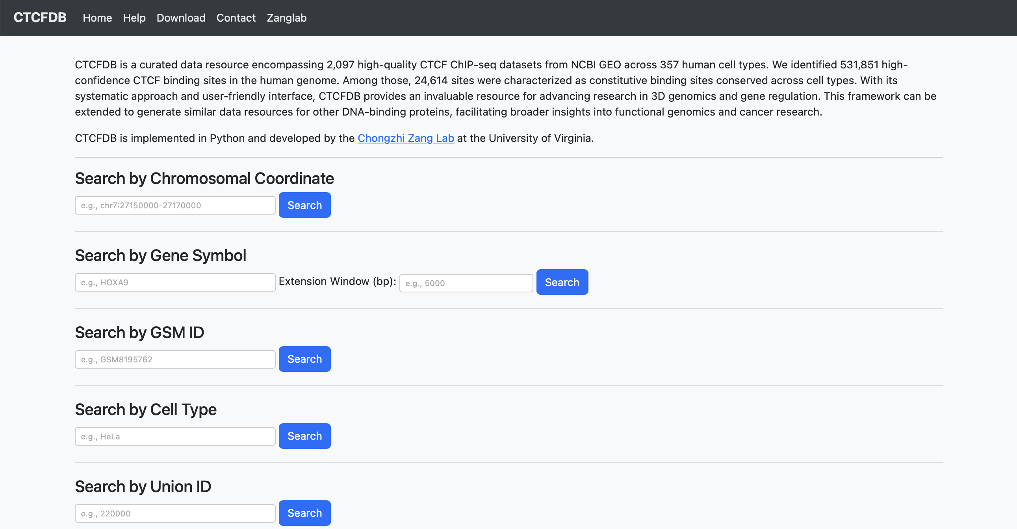
1
2
3
4
5

Slide 2
1
Search by Chromosomal Coordinate allows users to retrieve all CTCF union binding sites located within a specified genomic region. The results include a brief summary of each site. Clicking on a union site provides detailed information
2
Search by Gene Symbol allows users to retrieve all CTCF union binding sites located within the gene body of the specified gene, with a customizable window size upstream and downstream of the gene. The results are the same as those returned by the Search by Chromosomal Coordinate function.
3
Search by GSM ID allows users to visualize the CTCF binding profile (via bigWig) and download the corresponding narrowPeak peak calling results for the specified GSM dataset. Each result includes a brief dataset description along with QC metrics for peak calling.
4
Search by Cell Type allows users to retrieve union site information specific to the selected cell type. The results include three summary tables:
GSM Datasets – All ChIP-seq datasets that use the searched cell type
Gain Sites – Union sites where the cell type shows increased CTCF binding compared to other datasets
Loss Sites – Union sites where the cell type shows decreased CTCF binding compared to other datasets
Cell Type Gain/Loss: We identify cell type-specific union site changes by comparing occupancy frequencies and binding signals between cell type-specific datasets and a reference set of 2,251 datasets.
Loss Sites are defined by:
Occupancy frequency ≤ 0.2 in the cell type datasets
Occupancy frequency ≥ 0.7 in all 2,251 datasets
Lower normalized CTCF signal in the cell type (statistic score < 0)
Average RPKM < 5 in the cell type datasets
Gain Sites are defined by:
Occupancy frequency ≥ 0.5 (with score ≥ 2) in the cell type datasets
Occupancy frequency ≤ 0.2 in all 2,251 datasets
Significantly higher CTCF signal in the cell type (FDR ≤ 0.01)
Average RPKM > 2 in the cell type datasets
5
Search by Union ID allows users to directly access the detailed profile of any of the 531,851 high-confidence CTCF union binding sites. Each result includes three summary tables:
Basic Information – general features of the union site
Cell Type Information – aggregated statistics across cell types
Sample Information – individual ChIP-seq dataset information.
Basic Information
Union ID: Each high-confidence union site is assigned a unique ID ranging from 1 to 531,851.
Loci: Genomic coordinates of the union site.
Motif: A list of all CTCF motifs that overlap with the union site.
Genomic Feature: Annotation of the site’s genomic context — promoter (±2 kb from gene TSS), exon, intron, or intergenic.
Occupancy Score: The number of ChIP-seq datasets in which a peak is found at the union site.
Occupancy Frequency: The ratio of the occupancy score to the total number of datasets (2,097).
Constitutive: Indicates whether the site is highly conserved across cell types, determined by a power-law model.
Cell Type Gain/Loss: We identify cell type-specific union site changes by comparing occupancy frequencies and binding signals between cell type-specific datasets and a reference set of 2,251 datasets.
Cell Type Information
Sample Size: Number of ChIP-seq datasets available for the cell type
Occupancy Frequency: Fraction of cell type datasets with a peak at the site
Average RPKM (Cell Type): Mean RPKM across all cell type datasets at the site
Average RPKM (Others): Mean RPKM across all other datasets
FDR: Statistical significance of RPKM differences, calculated using an unpaired two-tailed Student’s t-test with Benjamini-Hochberg correction
Sample Information
Occupancy: Indicates whether a peak was detected at the union site
RPKM: Normalized binding signal at the site in that dataset

Slide 3
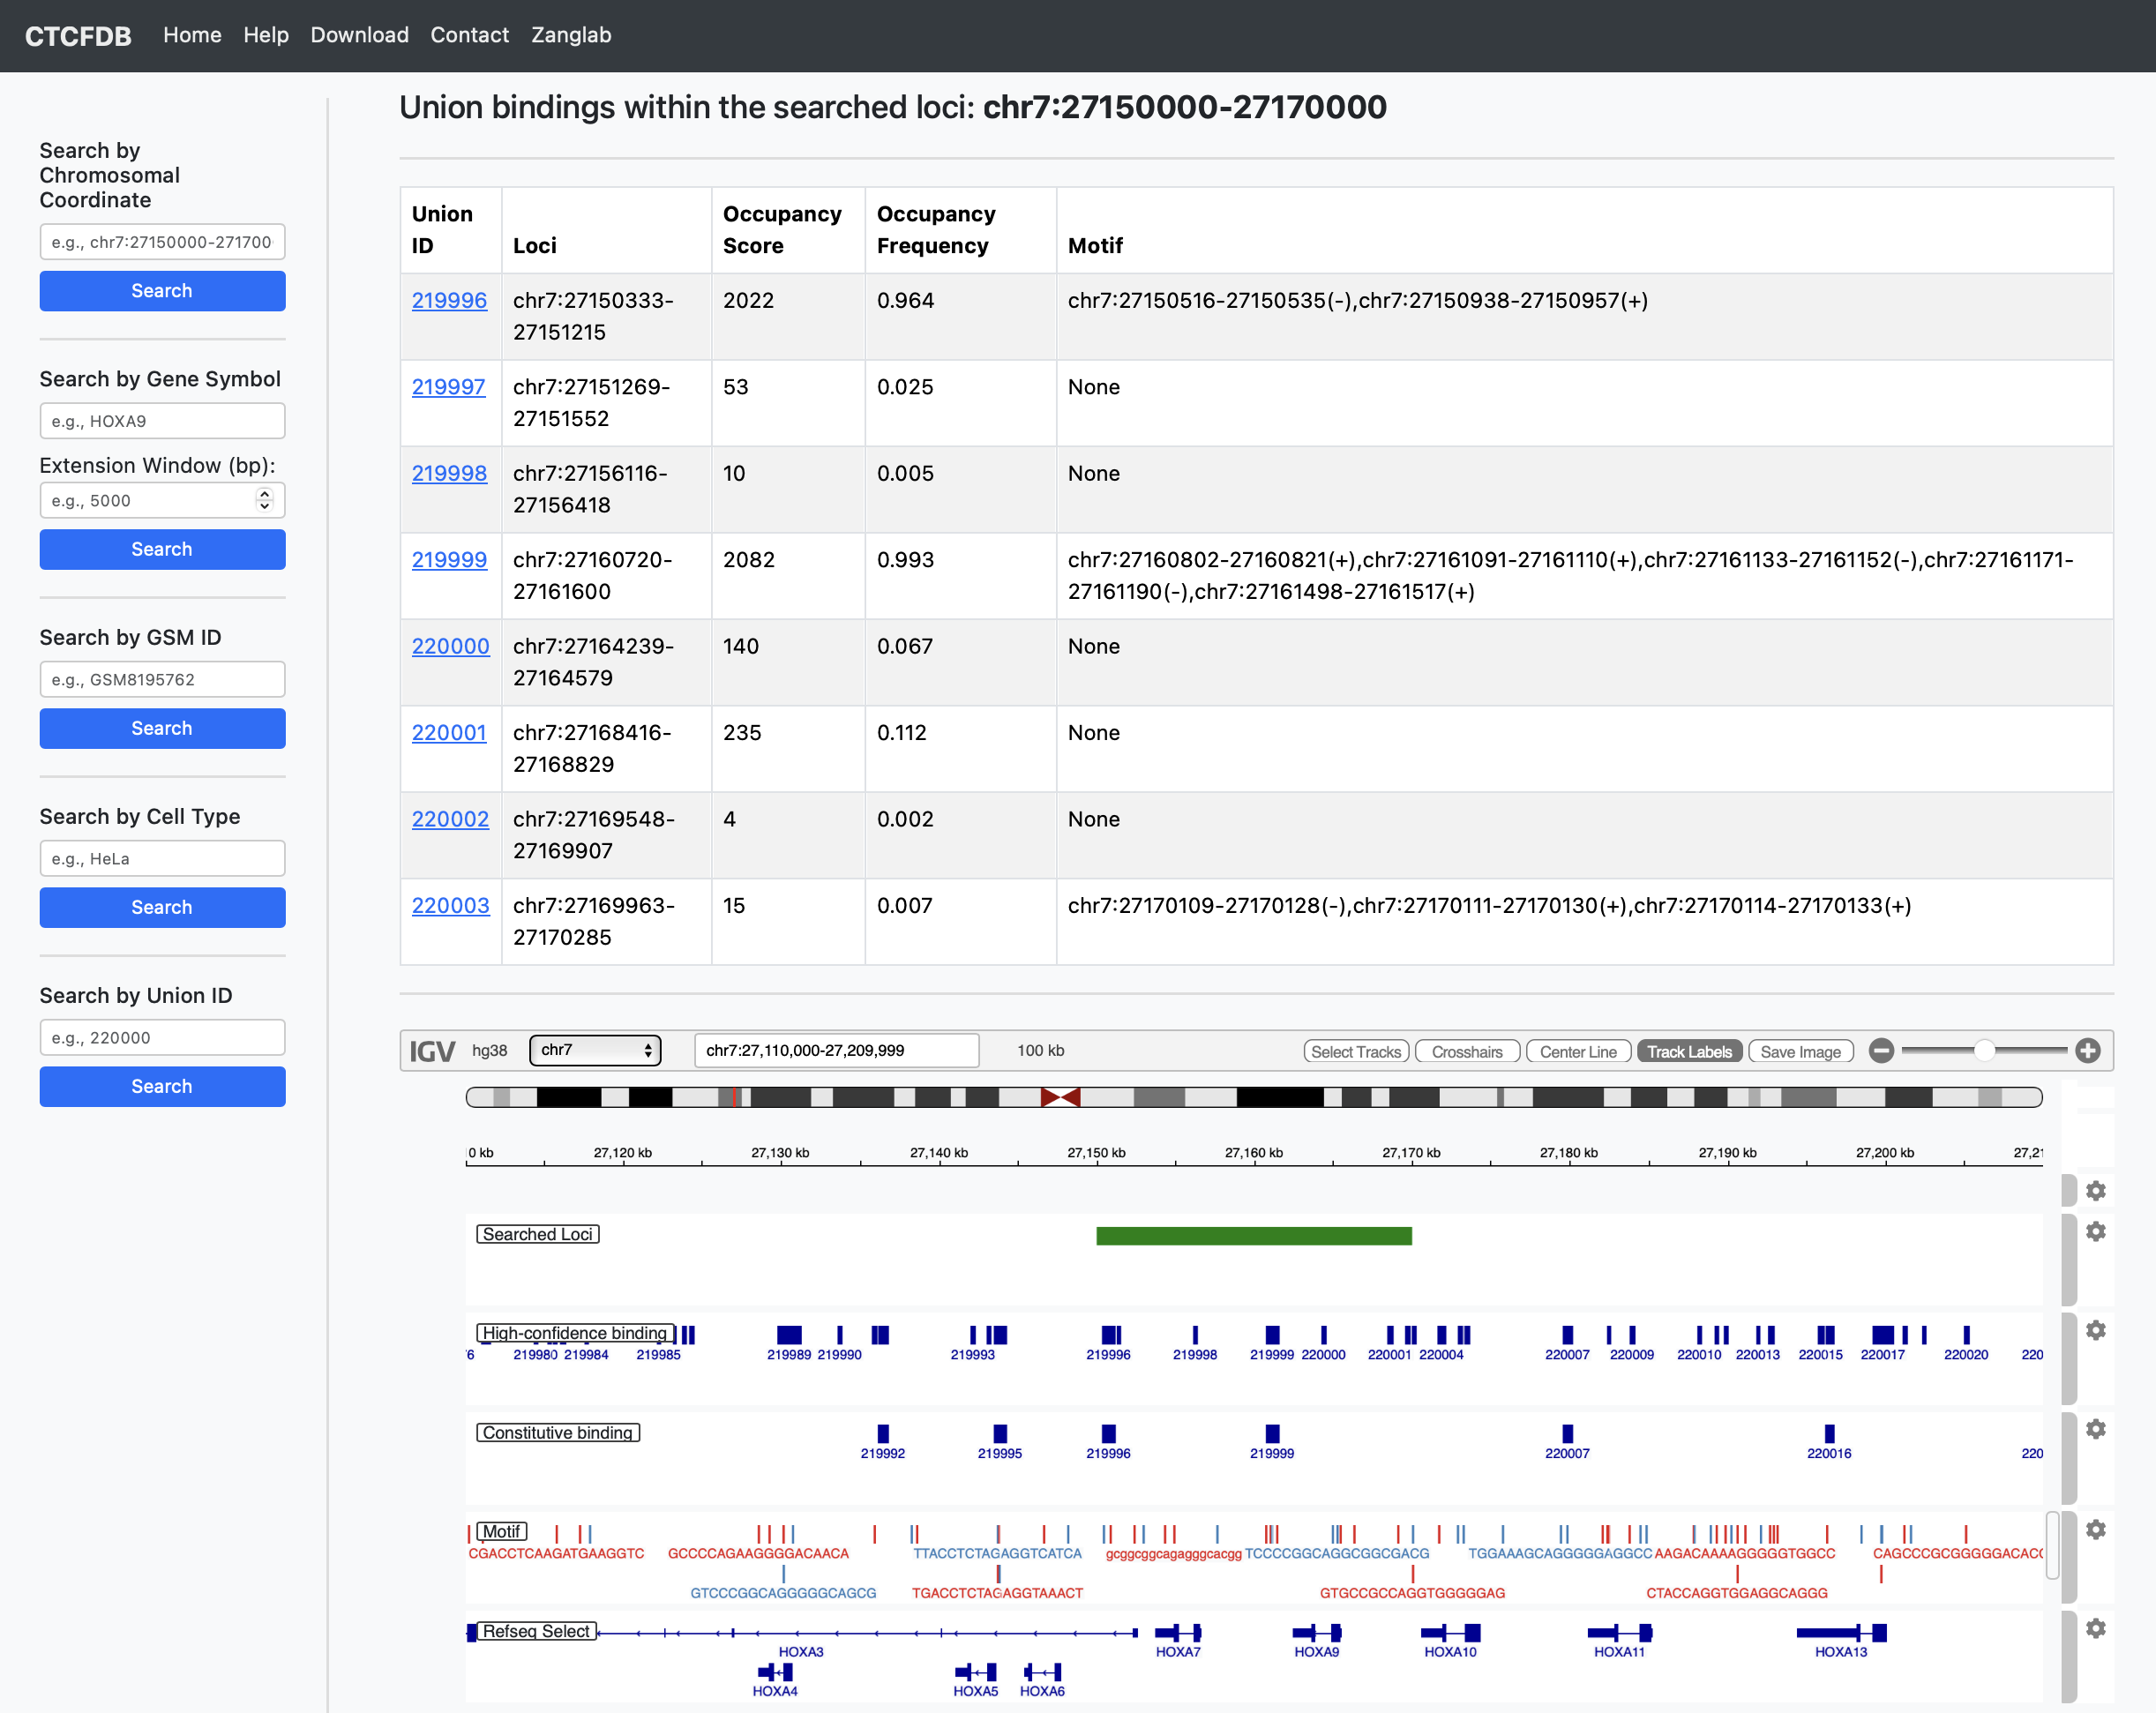
1
Search by Chromosomal Coordinate allows users to retrieve all CTCF union binding sites located within a specified genomic region. The results include a brief summary of each site. Clicking on a union site provides detailed information
2
Search by Gene Symbol allows users to retrieve all CTCF union binding sites located within the gene body of the specified gene, with a customizable window size upstream and downstream of the gene. The results are the same as those returned by the Search by Chromosomal Coordinate function.

Slide 4
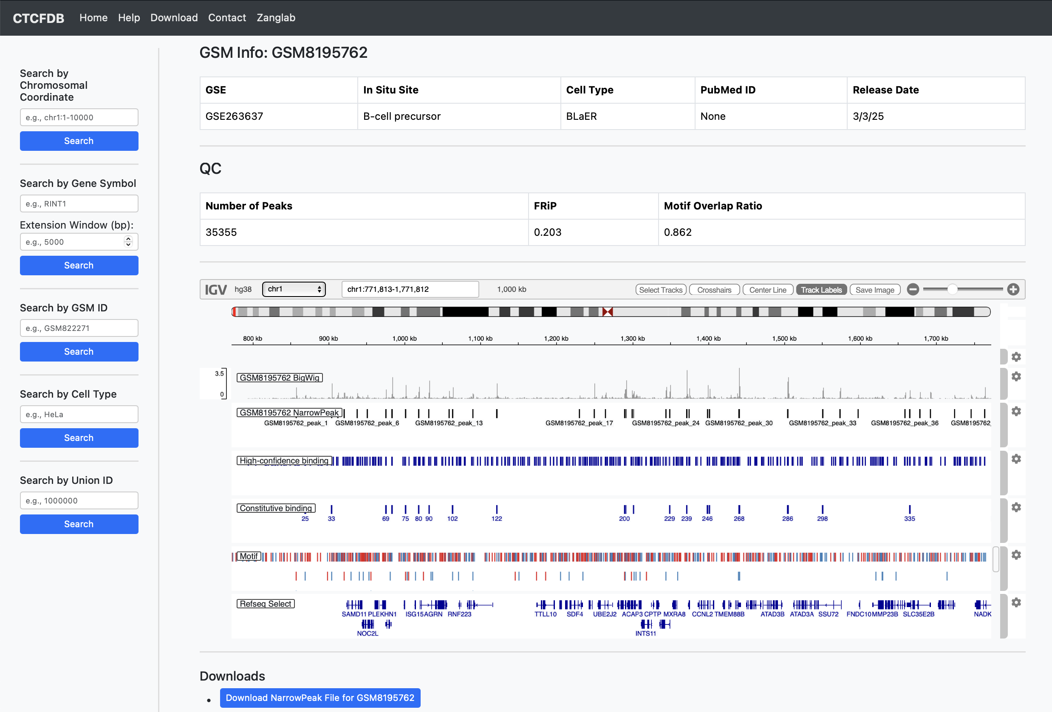
3
Search by GSM ID allows users to visualize the CTCF binding profile (via bigWig) and download the corresponding narrowPeak peak calling results for the specified GSM dataset. Each result includes a brief dataset description along with QC metrics for peak calling.

Slide 5
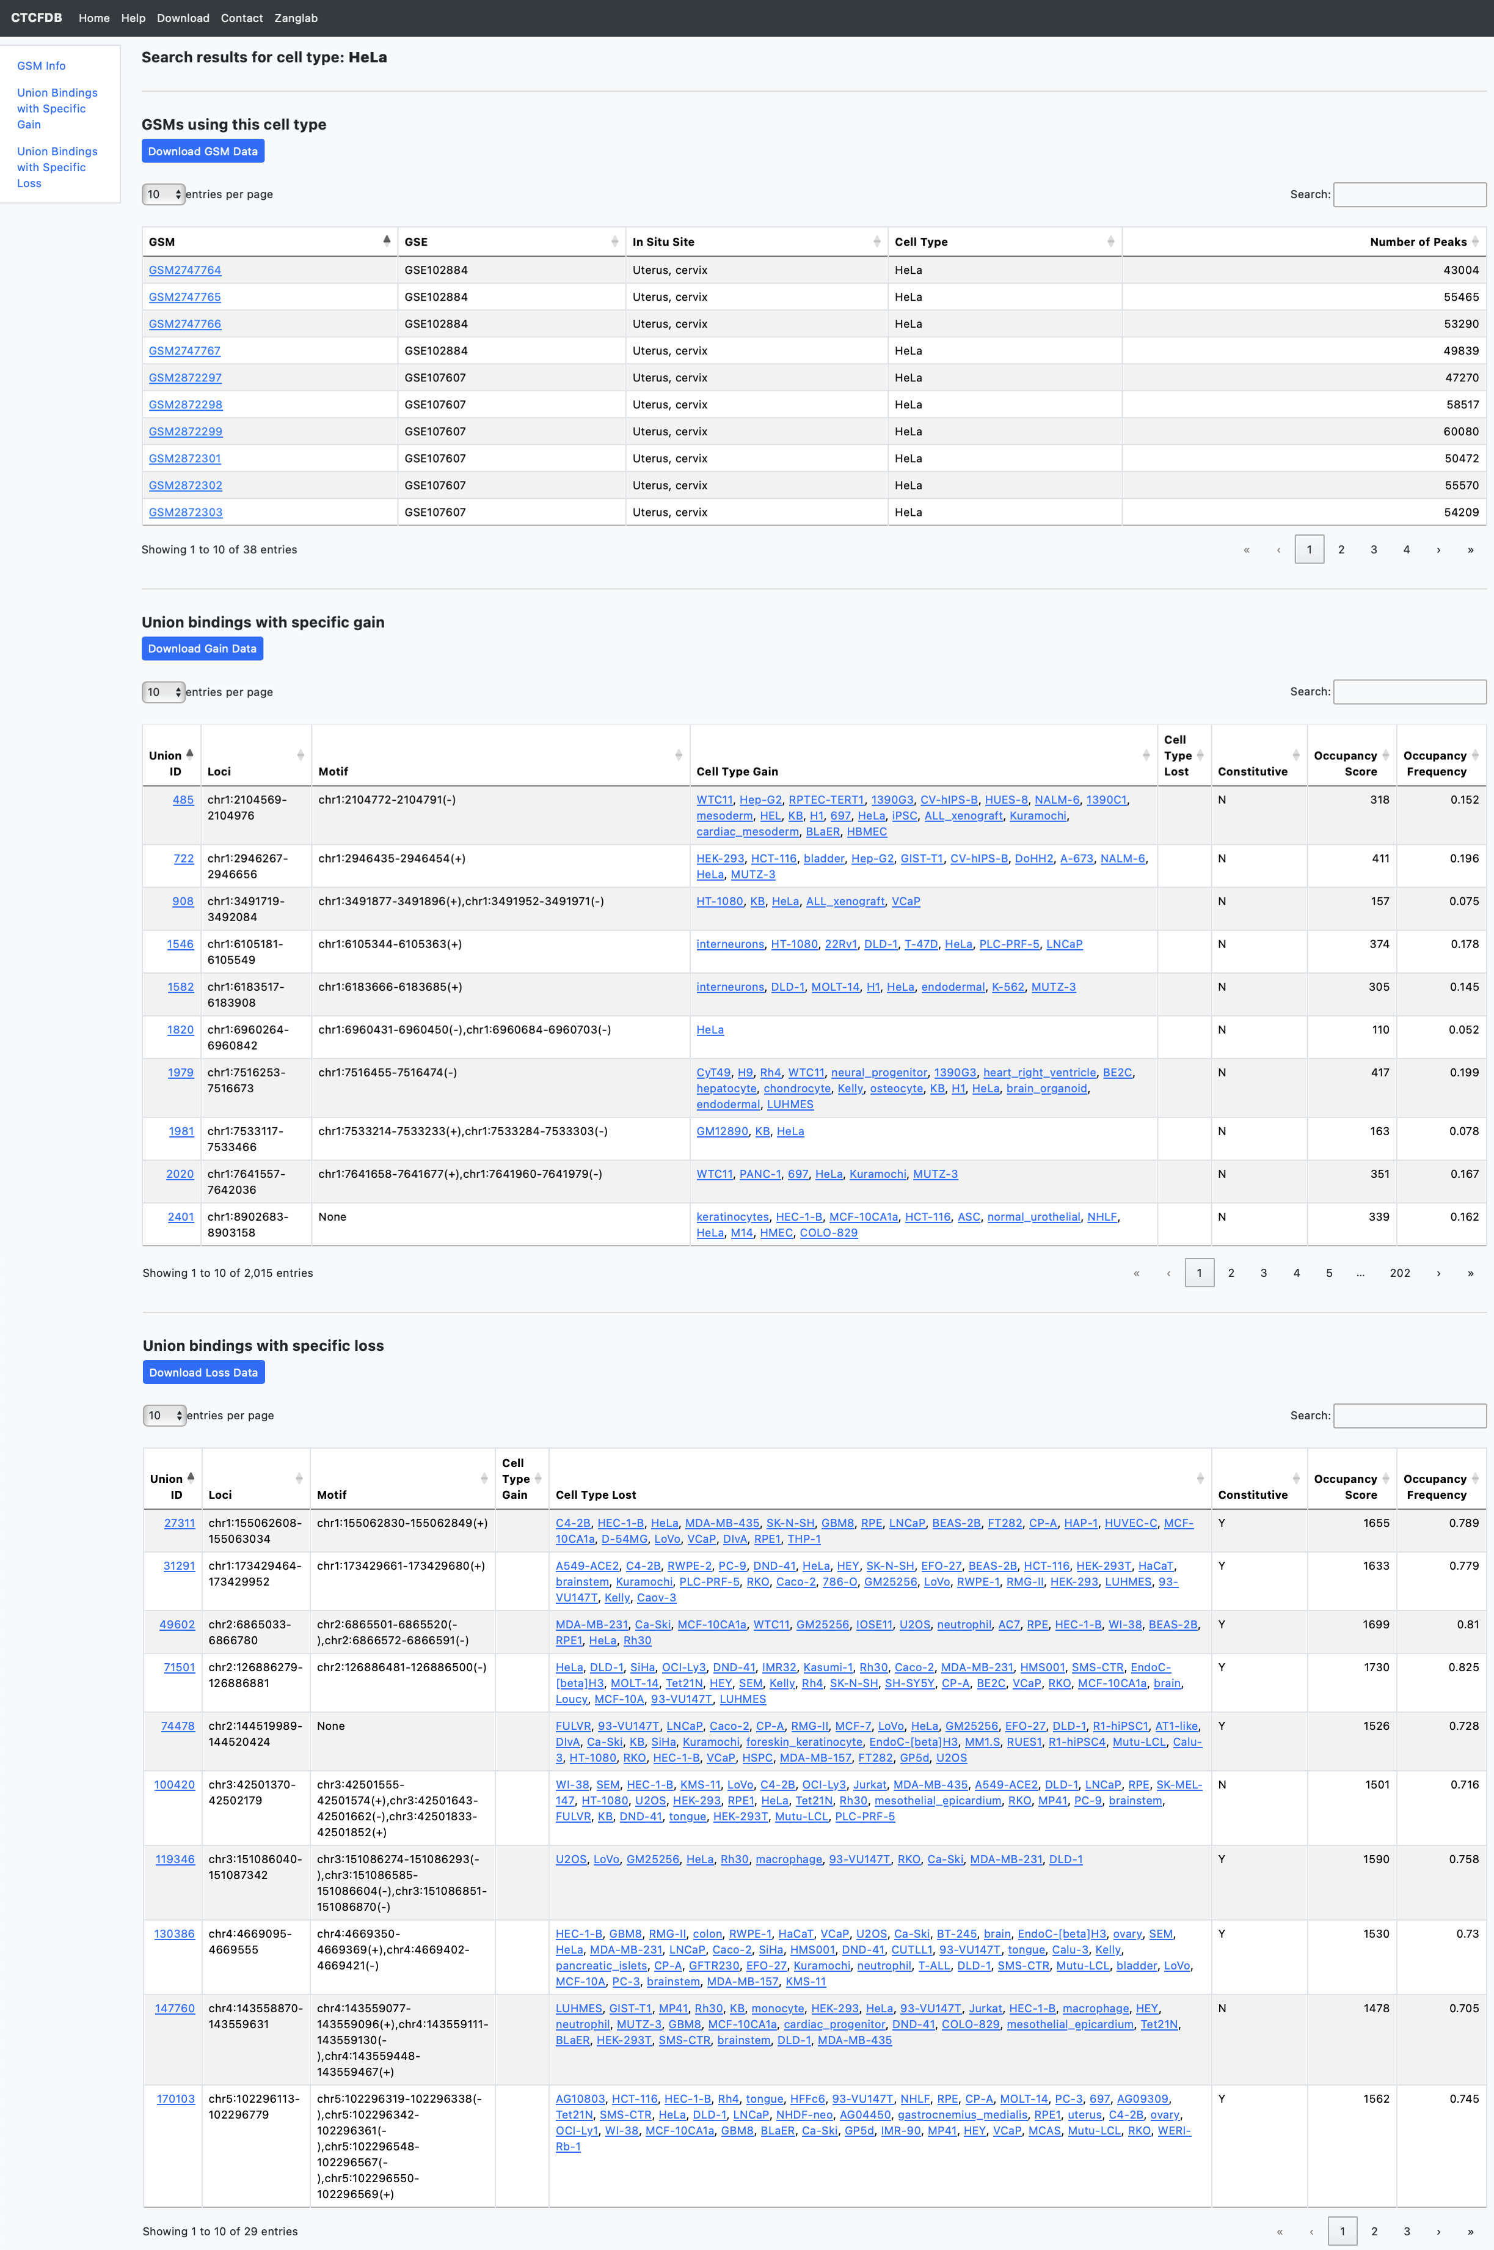

Slide 6
4
Search by Cell Type allows users to retrieve union site information specific to the selected cell type. The results include three summary tables:
GSM Datasets – All ChIP-seq datasets that use the searched cell type
Gain Sites – Union sites where the cell type shows increased CTCF binding compared to other datasets
Loss Sites – Union sites where the cell type shows decreased CTCF binding compared to other datasets
Cell Type Gain/Loss: We identify cell type-specific union site changes by comparing occupancy frequencies and binding signals between cell type-specific datasets and a reference set of 2,251 datasets.
Loss Sites are defined by:
Occupancy frequency ≤ 0.2 in the cell type datasets
Occupancy frequency ≥ 0.7 in all 2,251 datasets
Lower normalized CTCF signal in the cell type (statistic score < 0)
Average RPKM < 5 in the cell type datasets
Gain Sites are defined by:
Occupancy frequency ≥ 0.5 (with score ≥ 2) in the cell type datasets
Occupancy frequency ≤ 0.2 in all 2,251 datasets
Significantly higher CTCF signal in the cell type (FDR ≤ 0.01)
Average RPKM > 2 in the cell type datasets

Slide 7
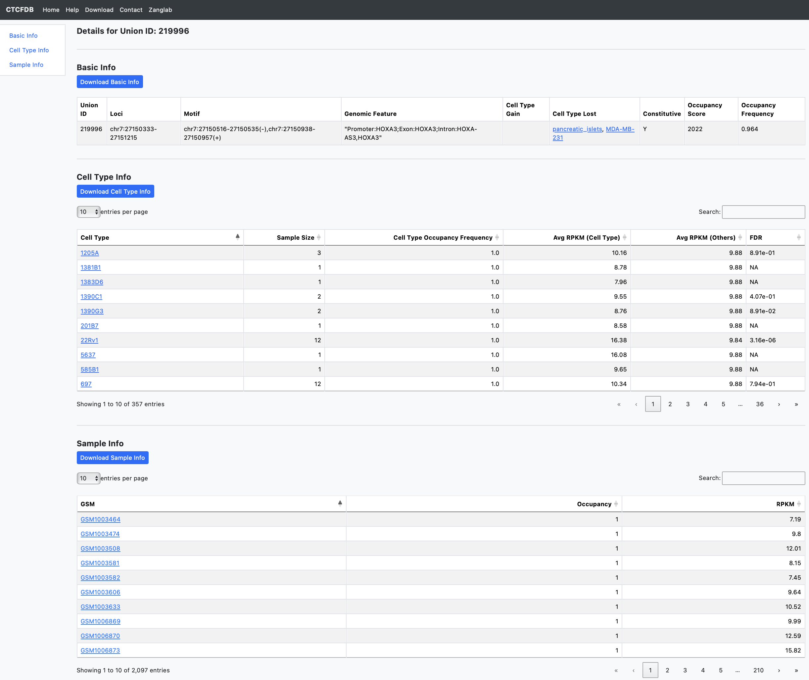
5
Search by Union ID allows users to directly access the detailed profile of any of the 531,851 high-confidence CTCF union binding sites. Each result includes three summary tables:
Basic Information – general features of the union site
Cell Type Information – aggregated statistics across cell types
Sample Information – individual ChIP-seq dataset information.
Basic Information
Union ID: Each high-confidence union site is assigned a unique ID ranging from 1 to 531,851.
Loci: Genomic coordinates of the union site.
Motif: A list of all CTCF motifs that overlap with the union site.
Genomic Feature: Annotation of the site’s genomic context — promoter (±2 kb from gene TSS), exon, intron, or intergenic.
Occupancy Score: The number of ChIP-seq datasets in which a peak is found at the union site.
Occupancy Frequency: The ratio of the occupancy score to the total number of datasets (2,097).
Constitutive: Indicates whether the site is highly conserved across cell types, determined by a power-law model.
Cell Type Gain/Loss: We identify cell type-specific union site changes by comparing occupancy frequencies and binding signals between cell type-specific datasets and a reference set of 2,251 datasets.
Loss Sites are defined by:
Occupancy frequency ≤ 0.2 in the cell type datasets
Occupancy frequency ≥ 0.7 in all 2,251 datasets
Lower normalized CTCF signal in the cell type (statistic score < 0)
Average RPKM < 5 in the cell type datasets
Gain Sites are defined by:
Occupancy frequency ≥ 0.5 (with score ≥ 2) in the cell type datasets
Occupancy frequency ≤ 0.2 in all 2,251 datasets
Significantly higher CTCF signal in the cell type (FDR ≤ 0.01)
Average RPKM > 2 in the cell type datasets
Cell Type Information
Sample Size: Number of ChIP-seq datasets available for the cell type
Occupancy Frequency: Fraction of cell type datasets with a peak at the site
Average RPKM (Cell Type): Mean RPKM across all cell type datasets at the site
Average RPKM (Others): Mean RPKM across all other datasets
FDR: Statistical significance of RPKM differences, calculated using an unpaired two-tailed Student’s t-test with Benjamini-Hochberg correction
Sample Information
Occupancy: Indicates whether a peak was detected at the union site
RPKM: Normalized binding signal at the site in that dataset

