Slide 1
RIPLE: Movie Recommendation and IMDb Score Prediction using Machine Learning
Michail G. Pachilakis Iordanis P. Xanthopoulos
Notes:
Who are we. What we present.

Slide 2
Contents
Description
Implementation
Results
Conclusion
Notes:
Describe the contents

Slide 3
Description
Hundreds of new movies each year
Overwhelmed viewers
Movie production studios want to know if a movie could be a commercial success
Notes:
Each year hundreds new movie release. This makes viewers overwhelmed with information. Also video production studios would like to know if a movie could evolve into a commercial success, so they could invest money on it’s production. But how a movie studio could know if a movie is successful?

Slide 4

Description
Notes:
The commercial success of a movie almost every time reflects on it’s imdb score. The imdb is the biggest movie database, containing every movie ever released with information about it and an overall score. Viewers tend to watch the movies with the best scores, and a movie considered successful if it’s overall score is high. The greatest movies of all time tend to have overall scores above 8.

Slide 5
Description
Movie recommendations interface for the viewers
Movie IMDb Score Prediction for the movie production studios

Slide 6
Implementation
IMDb 5000 Movie Dataset (kaggle)
Machine Learning for the IMDb score prediction
MapReduce for the recommendations
Notes:
For the implementation of the previous we used a dataset provided by kaggle.com. It contains 5000 movies with all their corresponding information. To make recommendations to the users we implemented an interface using Map and Reduce functions. To make imdb score prediction we used machine learning

Slide 7
Implementation (predictions)
Load dataset to Dataframe
Load the csv to the spark and transform it to Dataframe
Create the Machine learning Pipeline
Create all the needed transformers and estimators for the ML pipeline
Get the predictions
Extract the predictions about the scores
Notes:
The machine learning procedure seems very simple. *Describe the figure*. But because of the movies characteristic this procedure is much more complicated than it seems.

Slide 8
Implementation (predictions)
Color | Director_name | Duration | … | Gross | Genre
Color | James Cameron | 178 | … | 760657489 | Action|Sci-Fi
Color | Sam Mendes | 86 | … | 978743949 | Action
Color | Doug Walker | 91 | … | 648738393 | Thriller|Action
Black-White | Sam Riami | 127 | … | 34324544 | Adventure
Color | James Cameron | 112 | … | 92343452 | Sci-Fi|Thriller
Black-White | Nathan Greno | 96 | … | 253435455667 | Action
… | … | … | … | … | …
Color | James Cameron | 123 | … | 7234545464 | Action
Color | Sam Mendes | 118 | … | 20344534 | Adventure
Notes:
Every movie has a release year, budget, gross, social media likes and reviews. These features are numeric which can be used in a machine learning pipeline. Also a movie has a title, actors, producers and directors, gernes and descriptions which are alpharithmetic values. Unfortunately alpharithmetic values cannot be used in a machine learning pipeline

Slide 9
Implementation (predictions)
Color | Director_name | Duration | … | Gross | Gerne
0 | 0 | 178 | … | 760657489 | 2
0 | 1 | 86 | … | 978743949 | 0
0 | 2 | 91 | … | 648738393 | 3
1 | 3 | 127 | … | 34324544 | 1
0 | 0 | 112 | … | 92343452 | 4
1 | 4 | 96 | … | 253435455667 | 0
… | … | … | … | … | …
0 | 0 | 123 | … | 7234545464 | 0
0 | 1 | 118 | … | 20344534 | 1
Notes:
For that we use StringIndexers to transform the String values to integers. Spark.ml provides us with the function StringIndexer. The StringIndexer transforms a String column to a Numeric column so it could be used in a machine learning pipeline.

Slide 10
Implementation (predictions)
Correlation
Correlation is a statistical technique that can show if and how strongly pairs of variables are related.
The default is Pearson correlation coefficient, which measures the linear dependence between two variables.

Slide 11
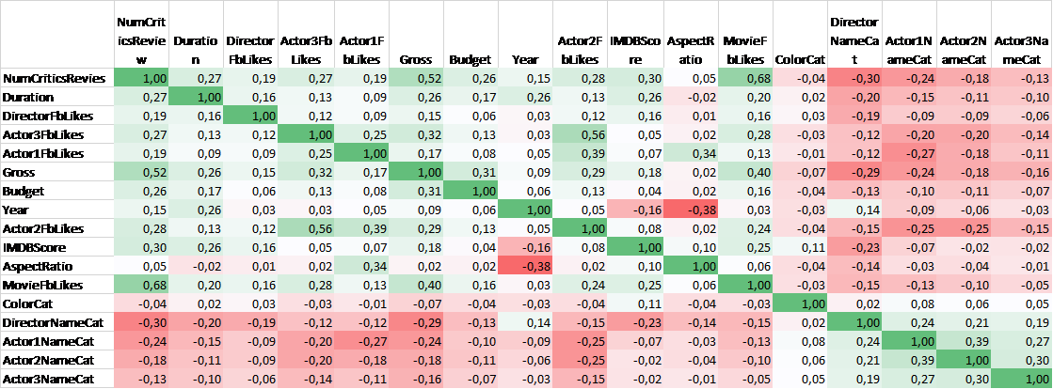
Implementation (predictions)
Notes:
Our initial dataset we had 28 features. We reduced the features to 17 because some features has no meaning in the imdb socre (imdb_link etc.). Then we correlate the remaining features and created a correlation matrix. In our correlation matrix we are interested in the features that correlates good with the imdb score feature.

Slide 12
Implementation (predictions)
Notes:
Our initial dataset we had 28 features. We reduced the features to 17 because some features has no meaning in the imdb socre (imdb_link etc.). Then we correlate the remaining features and created a correlation matrix. In our correlation matrix we are interested in the features that correlates good with the imdb score feature.

Slide 13
Implementation (predictions)
VectorAssembler
Vector from raw feature columns
VectorSlicer
New vector which contains only the features we select.
VectorScaler
Vector whose values are in similar scale
LinearRegression
Predictions
Notes:
We split our Dataframe into training and test dataframes (80%,20%). Now that we have transform all the features to numeric values and have select the features which correlates best with the imdb score feature we can create our pipeline.Scala provides as with the needed functions to transform our dataframe and provide it to the estimator.

Slide 14
Implementation (recommendations)
BestMoviesInCategory : Given a specific category, returns the top ten movies.
findTopTen : Given a specific category, language and protagonist name, returns the top ten movies.
findTitle : Given features such as category, language, protagonist name and directors name, returns the names of the corresponding movies.
Notes:
For the movie recommendations we used Map and Reduce functions in our initial dataset(without the transformations)

Slide 15
Implementation (statistics)
GreatMovieStatistics : Returns the percentage of movies with a score of 8 or more.
DirectorStatistics : Returns the percentage of movies of a specific director.
GerneStatistics : Returns the percentage of movies of a specific genre.

Slide 16
Results
To evaluate our model, we used the “RegressionEvaluator”.
Our RMSE was 1.02.
We compared our model with another one, which uses different features for the movie predictions but the same dataset.
The other model’s RMSE, in our pipeline, was 1.04.

Slide 17
Conclusion
We predict efficiently the IMDb score of a movie.
We provide an interface to the viewers, so that they can find movies similar to their taste.
We provide an interface to extract statistics about the movies of a dataset.

Slide 18
Thank you!

