Slide 1
토익 단어 23개
5분 안에 끝내기
지금 바로 해보세요
미쁨 영단어
토익 파일럿

Slide 2
이 영상은 미쁨 영단어 시리즈를
토익 단어에 적용했을 때 효과가 있는 지
확인하기 위한 파일럿 입니다.
암기를 위한 영상이니
쭉 보시고, 아래 링크로 테스트도 해보세요

Slide 3

First Sentence
I sincerely apologize for the mistake.
실수에 대해 진심으로 사과드립니다.
Keyword
sincerely
진심으로 / 성실하게
(편지 끝맺음 표현으로도 사용)
영영사전 뜻 나오는 중
Notes:
[나레이션]
I sincerely apologize for the mistake.
First Sentence.
I sincerely apologize for the mistake.
(click)
(click)
Keyword
(click)
Sincerely
(click)
(click)
'Sincerely' means in a genuine and honest way, without pretending. Sincerely shows genuine feeling or expression. People notice a true and heartfelt manner. It is an adverb. For example, 'I sincerely hope you feel better soon' means I truly and genuinely hope so. It is also commonly used at the end of formal letters before signing your name.
(click)
(click)
진심으로, 성실하게. Sincerely. 진심으로, 성실하게.
(click)
실수에 대해 진심으로 사과드립니다.
I sincerely apologize for the mistake.
실수에 대해 진심으로 사과드립니다.

Slide 4

Second Sentence
I enclose the document in the letter.
편지에 서류를 동봉했습니다.
Keyword
enclose
영영사전 뜻 나오는 중
둘러싸다 / 동봉하다 / 포함하다
Notes:
[나레이션]
I enclose the document in the letter.
Second Sentence.
I enclose the document in the letter.
(click)
(click)
Keyword
(click)
Enclose
(click)
(click)
'Enclose' means to include something inside a letter or package, or to surround something with a barrier. Enclose shows including inside or surrounding. People notice something included with a document or a surrounded area. It is a verb. For example, 'Please find the document enclosed with this letter' means included inside the envelope along with the letter.
(click)
(click)
둘러싸다 / 동봉하다 / 포함하다 Enclose. 둘러싸다 / 동봉하다 / 포함하다.
(click)
편지에 서류를 동봉했습니다.
I sincerely apologize for the mistake.
편지에 서류를 동봉했습니다.

Slide 5

Third Sentence
Please notify me if the schedule changes.
일정이 변경되면 알려주세요.
Keyword
notify
영영사전 뜻 나오는 중
알리다 / 통지하다
Notes:
[나레이션]
Please notify me if the schedule changes.
Third Sentence.
Please notify me if the schedule changes.
(click)
(click)
Keyword
(click)
Notify
(click)
(click)
'Notify' means to officially inform someone about something. Notify shows official informing. People notice being told something important in a formal way. It is a verb. For example, 'Please notify us if your address changes' means officially inform us of the change so we have the correct information.
(click)
(click)
둘러싸다 / 동봉하다 / 포함하다. Notify. 알리다 / 통지하다
(click)
일정이 변경되면 알려주세요.
Please notify me if the schedule changes.
일정이 변경되면 알려주세요.

Slide 6

Fourth Sentence
I’m excited about the upcoming concert.
나는 다가오는 콘서트가 기대된다.
Keyword
upcoming
영영사전 뜻 나오는 중
다가오는 / 곧 있을
Notes:
[나레이션]
I’m excited about the upcoming concert.
Fourth Sentence.
I’m excited about the upcoming concert.
(click)
(click)
Keyword
(click)
Upcoming
(click)
(click)
'Upcoming' means about to happen or arrive soon. Upcoming shows near future event. People notice something that has not happened yet but will soon. It is an adjective. For example, 'She is preparing for the upcoming exam' means the one that will take place soon.
(click)
(click)
다가오는 / 곧 있을. Upcoming. 다가오는 / 곧 있을.
(click)
나는 다가오는 콘서트가 기대된다.
I’m excited about the upcoming concert.
나는 다가오는 콘서트가 기대된다.

Slide 7

Fifth Sentence
We changed our plan accordingly.
우리는 그에 따라 계획을 변경했다.
Keyword
accordingly
영영사전 뜻 나오는 중
그에 따라 / 따라서
Notes:
[나레이션]
We changed our plan accordingly.
Fifth Sentence.
We changed our plan accordingly.
(click)
(click)
Keyword
(click)
Accordingly
(click)
(click)
'Accordingly' means in a way that is appropriate to the situation, or as a result. Accordingly shows appropriate action or logical consequence. People notice a response that fits the situation. It is an adverb. For example, 'The rules have changed, so please act accordingly' means change your behavior to match the new rules.
(click)
(click)
그에 따라 / 따라서 Accordingly. 그에 따라 / 따라서.
(click)
우리는 그에 따라 계획을 변경했다.
We changed our plan accordingly.
우리는 그에 따라 계획을 변경했다.

Slide 8

Sixth Sentence
The supervisor approved the report.
감독관은 보고서를 승인했다.
Keyword
supervisor
영영사전 뜻 나오는 중
감독관 / 관리자 / 지도교수
Notes:
[나레이션]
The supervisor approved the report.
Sixth Sentence.
The supervisor approved the report.
(click)
(click)
Keyword
(click)
Supervisor
(click)
(click)
'Supervisor' refers to a person who watches over and directs the work of others. Supervisor shows person in charge of others. People notice someone managing a team or workers. It is a noun. For example, 'She reported the problem to her supervisor' means the person responsible for overseeing her work.
(click)
(click)
감독관 / 관리자 / 지도교수. Supervisor. 감독관 / 관리자 / 지도교수
(click)
감독관은 보고서를 승인했다.
The supervisor approved the report.
감독관은 보고서를 승인했다.

Slide 9

Seventh Sentence
Each applicant must submit a resume.
모든 지원자는 이력서를 제출해야 한다.
Keyword
applicant
영영사전 뜻 나오는 중
지원자 / 신청인
Notes:
[나레이션]
Each applicant must submit a resume.
Seventh Sentence.
Each applicant must submit a resume.
(click)
(click)
Keyword
(click)
Applicant
(click)
(click)
'Applicant' refers to a person who formally applies for something such as a job or a place at university. Applicant shows person making a formal request. People notice someone seeking something through an official process. It is a noun. For example, 'All applicants must submit their documents by Friday' means everyone formally applying must do so by then.
(click)
(click)
지원자 / 신청인. Applicant. 지원자 / 신청인
(click)
모든 지원자는 이력서를 제출해야 한다.
Each applicant must submit a resume.
모든 지원자는 이력서를 제출해야 한다.

Slide 10

Eighth Sentence
You are eligible to vote at 18.
18세부터 투표할 수 있습니다.
Keyword
eligible
영영사전 뜻 나오는 중
자격이 있는
Notes:
[나레이션]
You are eligible to vote at 18.
Eighth Sentence.
You are eligible to vote at 18.
(click)
(click)
Keyword
(click)
Eligible
(click)
(click)
'Eligible' means meeting the necessary requirements to qualify for something. Eligible shows meeting the conditions required. People notice whether someone is allowed or qualified. It is an adjective. For example, 'You are eligible to apply if you have two years of experience' means you meet the requirements to do so.
(click)
(click)
자격이 있는. Eligible. 자격이 있는.
(click)
18세부터 투표할 수 있습니다.
I sincerely apologize for the mistake.
18세부터 투표할 수 있습니다.

Slide 11

Ninth Sentence
Please send your resume by email.
이력서를 이메일로 보내주세요.
Keyword
resume
영영사전 뜻 나오는 중
다시 시작하다 / 이력서
Notes:
[나레이션]
Please send your resume by email.
Ninth Sentence.
Please send your resume by email.
(click)
(click)
Keyword
(click)
Resume
(click)
(click)
'Resume' means to start again after stopping, or a document listing work experience and skills. Resume shows restarting or employment document. People notice continuing after a break or a job application document. It is a verb or noun. For example, 'She resumed work after her vacation' means started again after stopping.
(click)
(click)
다시 시작하다 / 이력서. Resume. 다시 시작하다 / 이력서
(click)
이력서를 이메일로 보내주세요.
I sincerely apologize for the mistake.
이력서를 이메일로 보내주세요.

Slide 12
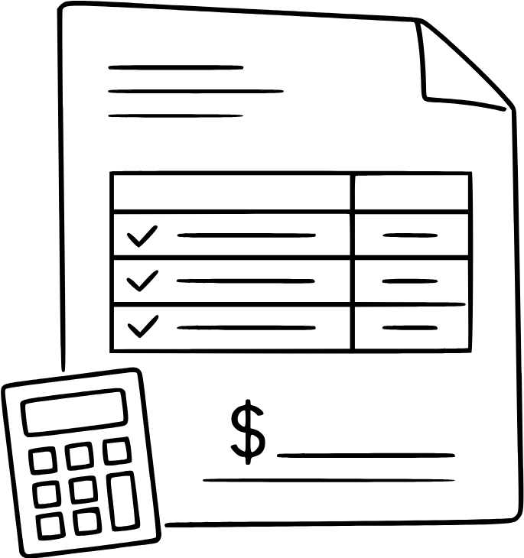
Tenth Sentence
I received an invoice today.
오늘 청구서를 받았습니다.
Keyword
invoice
송장 / 청구서 /
청구서를 발행하다
영영사전 뜻 나오는 중
Notes:
[나레이션]
I received an invoice today.
Tenth Sentence.
I received an invoice today.
(click)
(click)
Keyword
(click)
Invoice
(click)
(click)
'Invoice' refers to an official document listing goods or services provided and the amount owed. Invoice shows official payment request document. People notice a bill showing what must be paid. It is a noun or verb. For example, 'The company sent an invoice for the work completed' means a document requesting payment for the service.
(click)
(click)
송장 / 청구서 / 청구서를 발행하다. Invoice. 송장 / 청구서 / 청구서를 발행하다
(click)
오늘 청구서를 받았습니다.
I received an invoice today.
오늘 청구서를 받았습니다.

Slide 13

Eleventh Sentence
This phone has a warranty.
이 휴대폰은 보증 기간이 남아 있습니다.
Keyword
warranty
영영사전 뜻 나오는 중
품질보증서 / 보장
Notes:
[나레이션]
This phone has a warranty.
Eleventh Sentence.
This phone has a warranty.
(click)
(click)
Keyword
(click)
Warranty
(click)
(click)
'Warranty' refers to a written guarantee that a product will be repaired or replaced if it has problems within a set time. Warranty shows official product guarantee. People notice a promise of repair or replacement. It is a noun. For example, 'The washing machine comes with a two-year warranty' means if it breaks within two years, it will be fixed or replaced at no extra cost.
(click)
(click)
품질보증서 / 보장. Warranty. 품질보증서 / 보장.
(click)
이 휴대폰은 보증 기간이 남아 있습니다.
This phone has a warranty.
이 휴대폰은 보증 기간이 남아 있습니다.

Slide 14
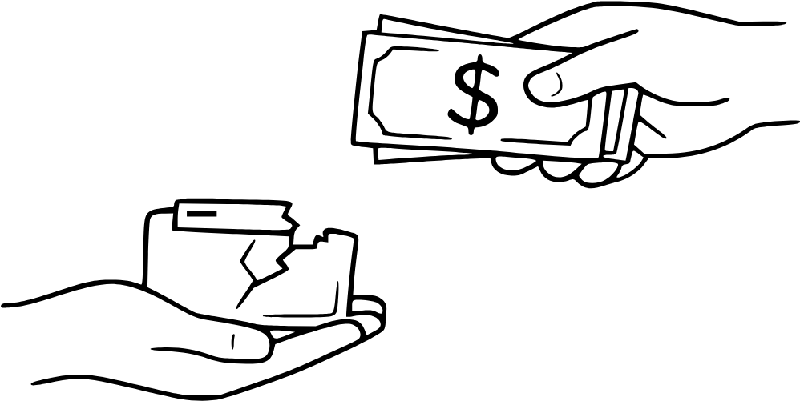
Twelfth Sentence
I want a refund for the broken product.
고장 난 제품에 대한 환불을 원합니다.
Keyword
refund
영영사전 뜻 나오는 중
환불 / 환급하다
Notes:
[나레이션]
I want a refund for the broken product.
Twelfth Sentence.
I want a refund for the broken product.
(click)
(click)
Keyword
(click)
Refund
(click)
(click)
'Refund' refers to a sum of money returned to a customer when goods or services are unsatisfactory. Refund shows returned money. People notice money given back after a complaint or return. It is a noun or verb. For example, 'She requested a refund because the product was damaged' means she asked for her money back.
(click)
(click)
환불 / 환급하다. Refund. 환불 / 환급하다
(click)
고장 난 제품에 대한 환불을 원합니다.
I want a refund for the broken product.
고장 난 제품에 대한 환불을 원합니다.

Slide 15
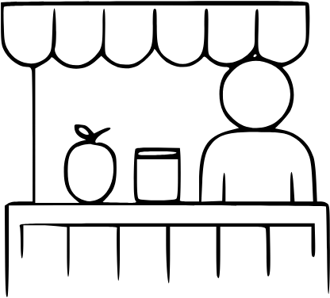
Thirteenth Sentence
The street vendor sells snacks.
노점상이 간식을 팔고 있습니다.
Keyword
vendor
영영사전 뜻 나오는 중
판매자 / 노점상
Notes:
[나레이션]
The street vendor sells snacks.
Thirteenth Sentence.
The street vendor sells snacks.
(click)
(click)
Keyword
(click)
Vendor
(click)
(click)
'Vendor' refers to a person or company that sells goods or services. Vendor shows seller. People notice someone supplying goods. It is a noun. For example, 'The vendor offered a discount on bulk orders' means the seller reduced the price.
(click)
(click)
판매자 / 노점상. Vendor. 판매자 / 노점상.
(click)
노점상이 간식을 팔고 있습니다.
The street vendor sells snacks.
노점상이 간식을 팔고 있습니다.

Slide 16

Fourteenth Sentence
The shipment arrived on time.
배송물이 제때 도착했습니다.
Keyword
shipment
영영사전 뜻 나오는 중
배송 / 선적물
Notes:
[나레이션]
The shipment arrived on time.
Fourteenth Sentence.
The shipment arrived on time.
(click)
(click)
Keyword
(click)
Shipment
(click)
(click)
'Shipment' refers to a quantity of goods transported together. Shipment shows transported goods. People notice a batch of items being moved. It is a noun. For example, 'The shipment arrived at the warehouse on Tuesday' means the batch of goods was delivered that day.
(click)
(click)
배송 / 선적물. Shipment. 배송 / 선적물.
(click)
배송물이 제때 도착했습니다.
The shipment arrived on time.
배송물이 제때 도착했습니다.

Slide 17

Fifteenth Sentence
Don’t forget to get your receipt.
영수증을 받는 것을 잊지 마세요.
Keyword
receipt
영영사전 뜻 나오는 중
영수증 / 수령 / 받음
Notes:
[나레이션]
Don’t forget to get your receipt.
Fifteenth Sentence.
Don’t forget to get your receipt.
(click)
(click)
Keyword
(click)
Receipt
(click)
(click)
'Receipt' refers to a written document confirming that money has been paid or goods have been received. Receipt shows proof of payment or delivery. People notice a document confirming a transaction. It is a noun. For example, 'Keep your receipt in case you need to return the item' means the document proving you paid for it.
(click)
(click)
영수증 / 수령 / 받음. Receipt. 영수증 / 수령 / 받음.
(click)
영수증을 받는 것을 잊지 마세요.
Don’t forget to get your receipt.
영수증을 받는 것을 잊지 마세요.

Slide 18

Sixteenth Sentence
I made an itinerary for the trip.
여행 일정을 짰습니다.
Keyword
itinerary
영영사전 뜻 나오는 중
여행 일정표 / 여정
Notes:
[나레이션]
I made an itinerary for the trip.
Sixteenth Sentence.
I made an itinerary for the trip.
(click)
(click)
Keyword
(click)
Itinerary
(click)
(click)
'Itinerary' refers to a detailed plan or schedule of a journey, listing places to visit and times. Itinerary shows travel plan schedule. People notice an organized list of travel activities. It is a noun. For example, 'The travel agent provided a full itinerary for the trip' means a document listing every stop and activity during the journey.
(click)
(click)
여행 일정표 / 여정. Itinerary. 여행 일정표 / 여정
(click)
여행 일정을 짰습니다.
I made an itinerary for the trip.
여행 일정을 짰습니다.

Slide 19

Seventeenth Sentence
I have a reservation at the hotel.
호텔 예약을 마쳤습니다.
Keyword
reservation
영영사전 뜻 나오는 중
예약 / 보호구역 / 의구심
Notes:
[나레이션]
I have a reservation at the hotel.
Seventeenth Sentence.
I have a reservation at the hotel.
(click)
(click)
Keyword
(click)
Reservation
(click)
(click)
'Reservation' refers to an arrangement to have something kept for your use at a future time, such as a table at a restaurant or a hotel room. Reservation shows advance booking. People notice something set aside for them in advance. It is a noun. For example, 'She made a reservation at the restaurant for seven o'clock' means she arranged in advance to have a table available at that time.
(click)
(click)
예약 / 보호구역 / 의구심. Reservation. 예약 / 보호구역 / 의구심.
(click)
호텔 예약을 마쳤습니다.
I have a reservation at the hotel.
호텔 예약을 마쳤습니다.

Slide 20

Eighteenth Sentence
My luggage is heavy.
제 짐이 무겁습니다.
Keyword
luggage
영영사전 뜻 나오는 중
짐 / 여행 가방
Notes:
[나레이션]
My luggage is heavy.
Eighteenth Sentence.
My luggage is heavy.
(click)
(click)
Keyword
(click)
Luggage
(click)
(click)
'Luggage' refers to bags and suitcases that a traveler carries. Luggage shows travel bags and cases. People notice the bags someone brings on a trip. It is a noun. For example, 'She checked her luggage at the airport before boarding' means her bags were registered and stored in the aircraft.
(click)
(click)
짐 / 여행 가방. Luggage. 짐 / 여행 가방
(click)
제 짐이 무겁습니다.
My luggage is heavy.
제 짐이 무겁습니다.

Slide 21

Nineteenth Sentence
The flight attendant smiled kindly.
승무원이 친절하게 미소 지었어요.
Keyword
attendant
영영사전 뜻 나오는 중
종업원 / 승무원
Notes:
[나레이션]
The flight attendant smiled kindly.
Nineteenth Sentence.
The flight attendant smiled kindly.
(click)
(click)
Keyword
(click)
Attendant
(click)
(click)
'Attendant' refers to a person who assists or serves others in a specific place. Attendant shows serving person. People notice someone whose job is to help. It is a noun. For example, 'The flight attendant served drinks' means the person whose job is to help passengers on the plane.
(click)
(click)
종업원 / 승무원. Attendant. 종업원 / 승무원.
(click)
승무원이 친절하게 미소 지었어요.
The flight attendant smiled kindly.
승무원이 친절하게 미소 지었어요.

Slide 22

Twentieth Sentence
She picked up a travel brochure at the airport.
그녀는 공항에서 여행 안내 책자를 집어 들었습니다.
Keyword
brochure
영영사전 뜻 나오는 중
소책자 / 안내 책자
Notes:
[나레이션]
She picked up a travel brochure at the airport.
Twentieth Sentence.
She picked up a travel brochure at the airport.
(click)
(click)
Keyword
(click)
Brochure
(click)
(click)
'Brochure' refers to a small booklet or folded sheet containing information about a product, service, or place. Brochure shows promotional informational booklet. People notice a printed document used to share information or advertise. It is a noun. For example, 'She picked up a brochure about the hotel at the tourist office' means a small printed booklet describing the hotel.
(click)
(click)
소책자 / 안내 책자. Brochure. 소책자 / 안내 책자.
(click)
그녀는 공항에서 여행 안내 책자를 집어 들었습니다.
She picked up a travel brochure at the airport.
그녀는 공항에서 여행 안내 책자를 집어 들었습니다.

Slide 23

Twenty-first Sentence
The store sells new merchandise every week.
그 가게는 매주 새로운 상품을 판매합니다.
Keyword
merchandise
영영사전 뜻 나오는 중
상품 / 물품
Notes:
[나레이션]
The store sells new merchandise every week.
Twenty-first Sentence.
The store sells new merchandise every week.
(click)
(click)
Keyword
(click)
Merchandise
(click)
(click)
'Merchandise' refers to goods that are bought and sold. Merchandise shows tradeable goods. People notice products available for purchase. It is a noun. For example, 'The store had a wide range of merchandise on display' means many different types of goods available to buy.
(click)
(click)
상품 / 물품. Merchandise. 상품 / 물품.
(click)
그 가게는 매주 새로운 상품을 판매합니다.
The store sells new merchandise every week.
그 가게는 매주 새로운 상품을 판매합니다.

Slide 24

Twenty-second Sentence
My magazine subscription expires next month.
내 잡지 구독은 다음 달에 만료된다.
Keyword
subscription
영영사전 뜻 나오는 중
구독 / 가입 / 기부금
Notes:
[나레이션]
My magazine subscription expires next month.
Twenty-second Sentence.
My magazine subscription expires next month.
(click)
(click)
Keyword
(click)
Subscription
(click)
(click)
'Subscription' refers to an arrangement where you pay regularly to receive a service or publication. Subscription shows regular payment for continued access. People notice a regular payment for ongoing access. It is a noun. For example, 'She has a monthly subscription to a streaming service' means she pays each month to continue using it.
(click)
(click)
구독 / 가입 / 기부금. Subscription. 구독 / 가입 / 기부금.
(click)
내 잡지 구독은 다음 달에 만료된다.
My magazine subscription expires next month.
내 잡지 구독은 다음 달에 만료된다.

Slide 25

Twenty-third Sentence
The old theater is closed for renovation.
옛 극장은 보수 공사로 문을 닫았습니다.
Keyword
renovation
영영사전 뜻 나오는 중
개조 / 수리 / 리노베이션
Notes:
[나레이션]
The old theater is closed for renovation.
Twenty-third Sentence.
The old theater is closed for renovation.
(click)
(click)
Keyword
(click)
Renovation
(click)
(click)
'Renovation' refers to the process of repairing and improving a building or room. Renovation shows repair and improvement work. People notice construction activity to make a place better. It is a noun. For example, 'The kitchen is closed for renovation' means it is being repaired and improved and is temporarily unavailable.
(click)
(click)
개조 / 수리 / 리노베이션. Renovation. 개조 / 수리 / 리노베이션.
(click)
옛 극장은 보수 공사로 문을 닫았습니다.
The old theater is closed for renovation.
옛 극장은 보수 공사로 문을 닫았습니다.

Slide 26
봐주셔서 감사합니다.
아래 댓글을 보시면
무료 복습 링크가 있습니다.
복습도 하시고,
의견도 남겨 주세요
감사합니다

