Slide 1
표지

Slide 3
Introduction
영어

Slide 4
How To Use
소리

Slide 5
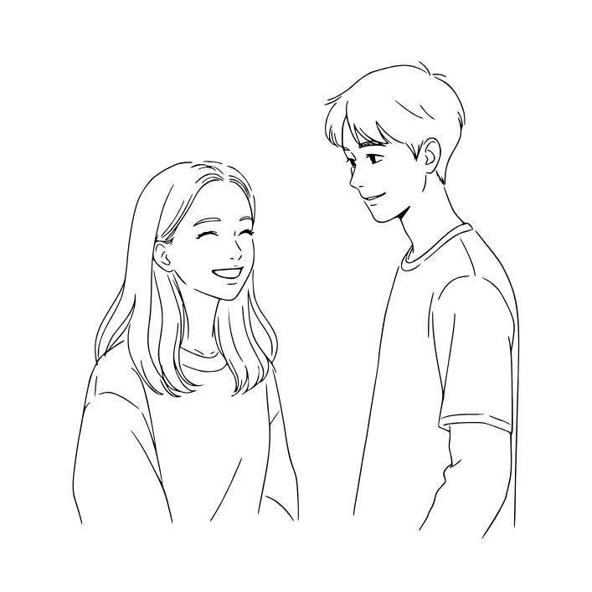

34th sentence
She likes me.
keyword
She

Slide 6
SHE
[ʃiː]
(영영사전) 뜻
She is used to talk about a girl or a woman. It replaces the name to avoid repetition. For example, 'This is Anna. She is kind.'
그녀
She likes me.
그녀는 나를 좋아한다.

Slide 7
끝전

Slide 8
끝

