Slide 1
표지

Slide 3
Introduction
영어

Slide 4
How To Use
소리

Slide 5
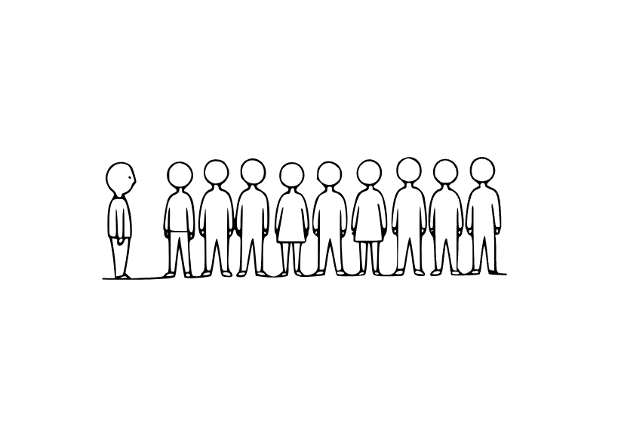
1st sentence
I am first in line.
keyword
first

Slide 6
FIRST
US: [fɜːrst] UK: [fɜːst]
(영영사전) 뜻
First means before all others in order or time. It shows the beginning of something. People say 'first place' in a race or 'first day' at school. Example: 'She was the first to arrive.' It is the opposite of last.
첫 번째
I am first in line.
나는 첫 번째 줄이다.

Slide 7
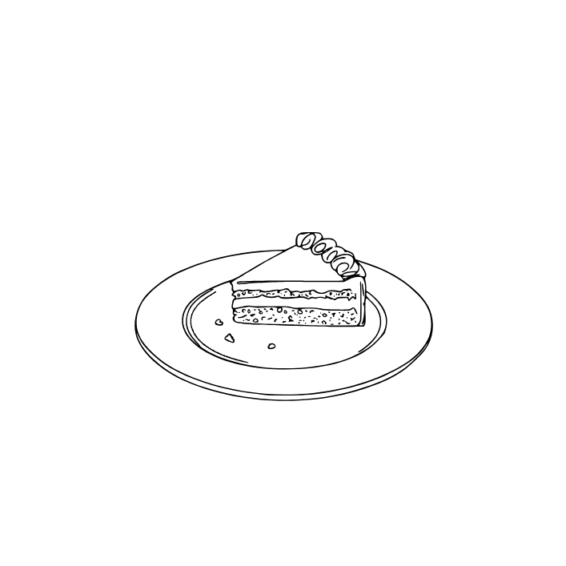

2nd sentence
This is the last piece of cake.
keyword
last

Slide 8
LAST
US: [læst] UK: []
(영영사전) 뜻
Last means coming at the end or most recent. It can describe the final thing in a list or event. People say 'last week' or 'last night' to talk about something that already happened. It can also mean continue, as in 'The show will last two hours.' Example: 'This is the last piece of cake.'
마지막, 지난
This is the last piece of cake.
이것은 마지막 케이크 조각이다.

Slide 9

3rd sentence
I am here.
keyword
here

Slide 10
HERE
US: [hɪr] UK: [][]
(영영사전) 뜻
Here means in this place. It shows that something is close to the speaker. Example: 'Come here, please.' People use it to point to a location or presence.
여기
I am here.
나는 여기 있어.

Slide 11
4th sentence
I am tired, but I will help.
keyword
but

Slide 12
BUT
US: [hɪr] UK: []
(영영사전) 뜻
He
여
I am tired, but I will help.
피곤하지만 도와줄게.

Slide 13
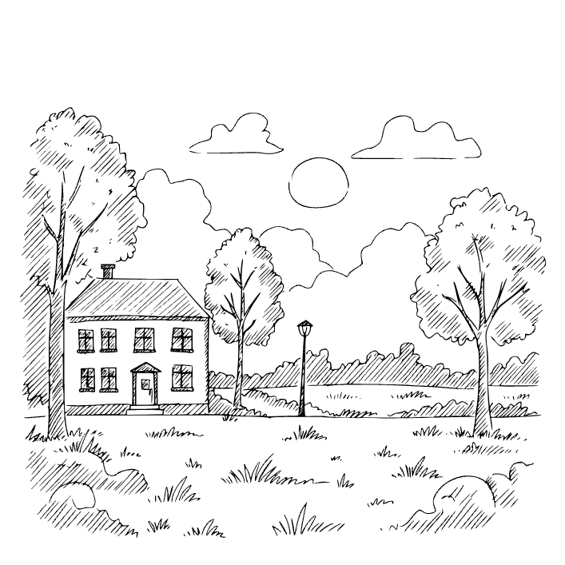
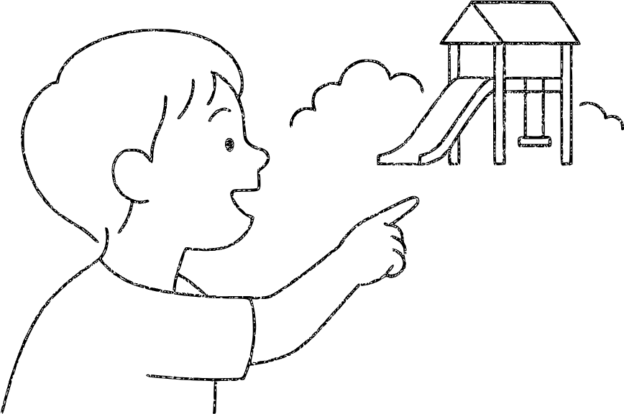
5th sentence
There is a park near my house.
keyword
There

Slide 14
THERE
US: [ðɛr] UK: []
(영영사전) 뜻
There refers to a place that is not here. It can point to something far away or just not close. People also use 'there is' or 'there are' to show that something exists. For example, 'There is a book on the table.' It helps make sentences clear and complete.
거기에, 거기
There is a park near my house.
내 집 근처에 공원이 있다.

Slide 15
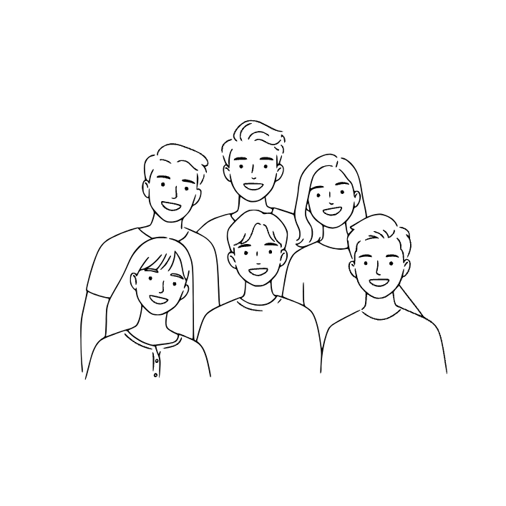
6th sentence
They are my friends.
keyword
They

Slide 16
THEY
US: [ðeɪ] UK: []
(영영사전) 뜻
They is used to talk about more than one person, animal, or thing. For example, 'They are my friends' means several people are friends. It avoids repeating names.
그들, 그 사람들
They are my friends.
그들은 내 친구이다.

Slide 17
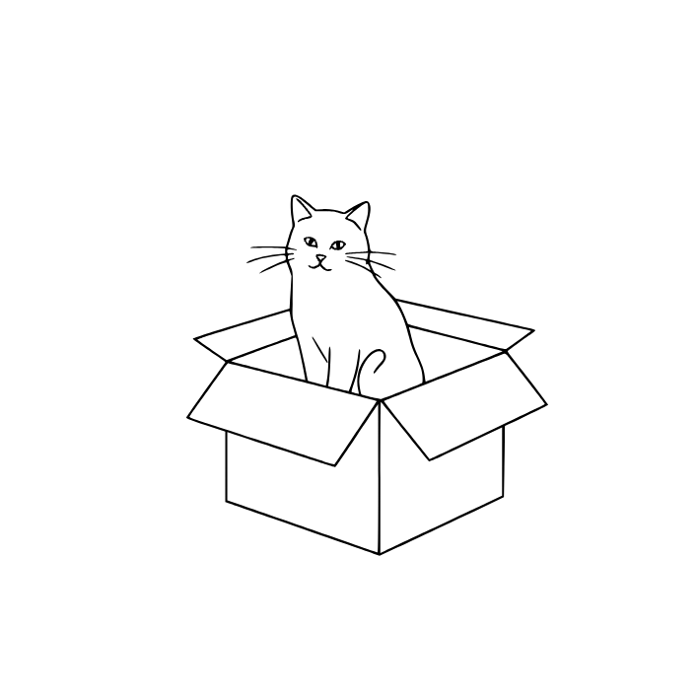
7th sentence
The cat is in the box.
keyword
in

Slide 18
IN
US: [ɪn] UK: []
(영영사전) 뜻
In is a word that shows something is inside a place or time. For example, 'in the box' means inside the box, and 'in the morning' means during that time. It helps explain location or situation.
~안에, ~에서
The cat is in the box.
고양이가 상자 안에 있다.

Slide 19

8th sentence
The book is on the table.
keyword
on

Slide 20
ON
US: [ɑːn] UK: []
(영영사전) 뜻
On shows that something is above and touching a surface, like 'The book is on the table'. It also talks about time and activities, such as 'on Monday' or 'on TV'. It is a very common preposition in English.
~위에, ~에
The book is on the table.
그 책은 탁자 위에 있다.

Slide 21
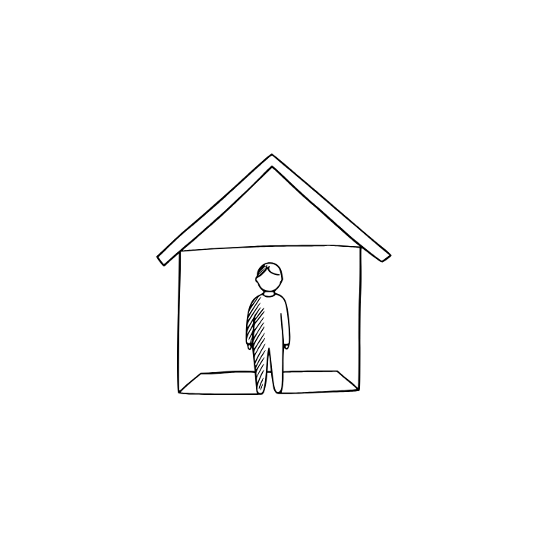

9th sentence
I am at home.
keyword
at

Slide 22
AT
US: [æt] UK: []
(영영사전) 뜻
At shows a specific place or time. For example, 'She is at school' means her location is school. It can also describe time, like 'at 7 o’clock'.
~에, ~에서
I am at home.
나는 집에 있다.

Slide 23
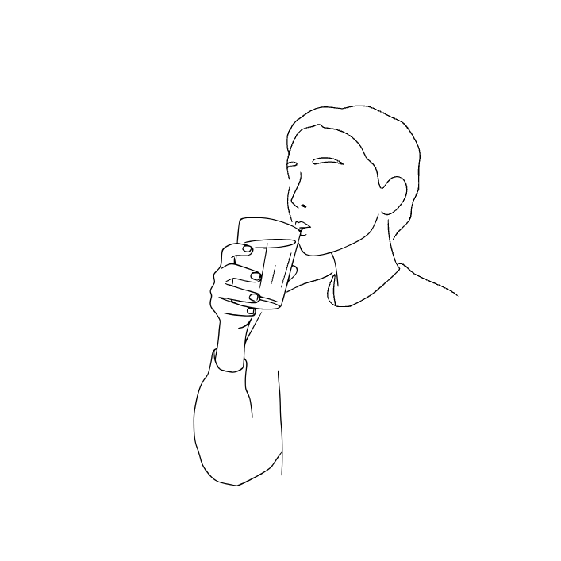
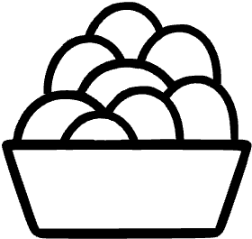
10th sentence
I drink a lot of water every day.
keyword
lot

Slide 24
LOT
US: [lɑːt] UK: []
(영영사전) 뜻
Lot means a large amount or number of something. For example, 'I have a lot of homework.' It shows many or much of something.
많은
I drink a lot of water every day.
나는 매일 물을 많이 마신다.

Slide 25
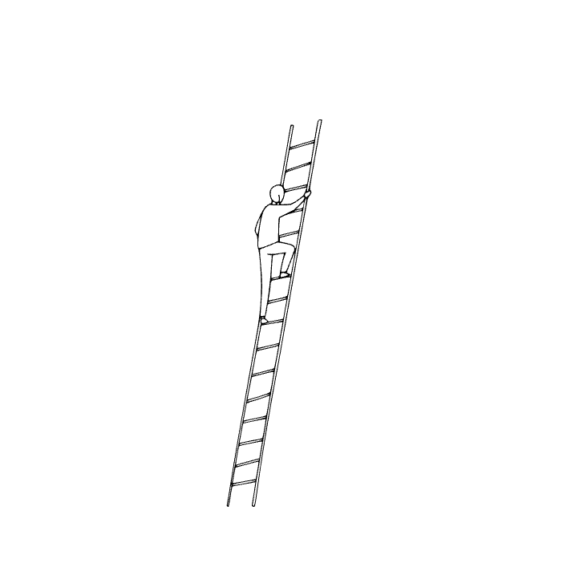
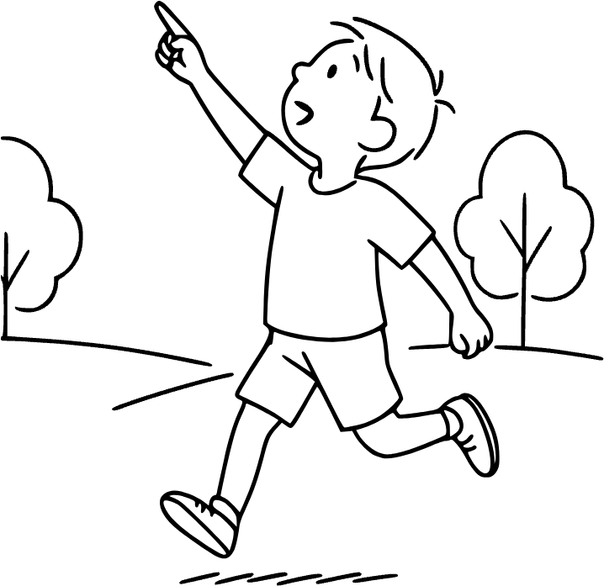
11th sentence
He climbed up the ladder.
keyword
up

Slide 26
UP
US: [ʌp] UK: []
(영영사전) 뜻
Up means moving to a higher place or position. It can show direction, like going from the ground to the sky. People use 'up' in many expressions, such as 'stand up,' 'wake up,' or 'look up.' It can also describe feelings, like being 'cheered up.' Example: 'She climbed up the hill.'
위로, 위쪽에
He climbed up the ladder.
그는 사다리를 올라갔다.

Slide 27
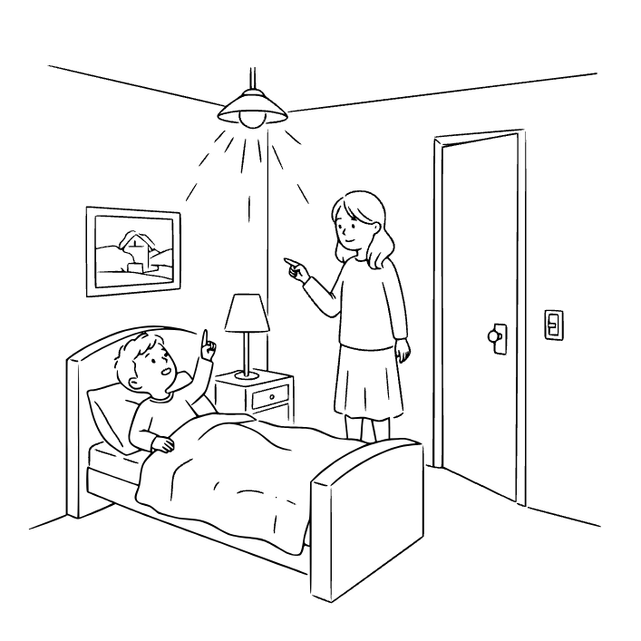
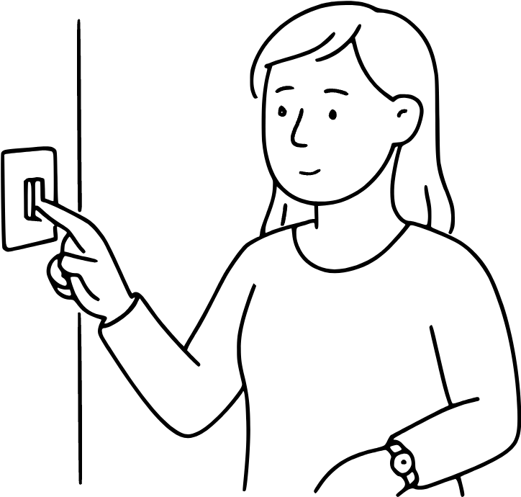
12th sentence
Please turn off the lights.
keyword
off

Slide 28
OFF
US: [ɔːf] UK: []
(영영사전) 뜻
Off means away from or not working. Lights can be off, or someone can take off shoes. It shows separation from something. Example: 'The TV is off.' It is often the opposite of on.
~에서 떨어져, 꺼져
Please turn off the lights.
불 좀 꺼주세요.

Slide 29
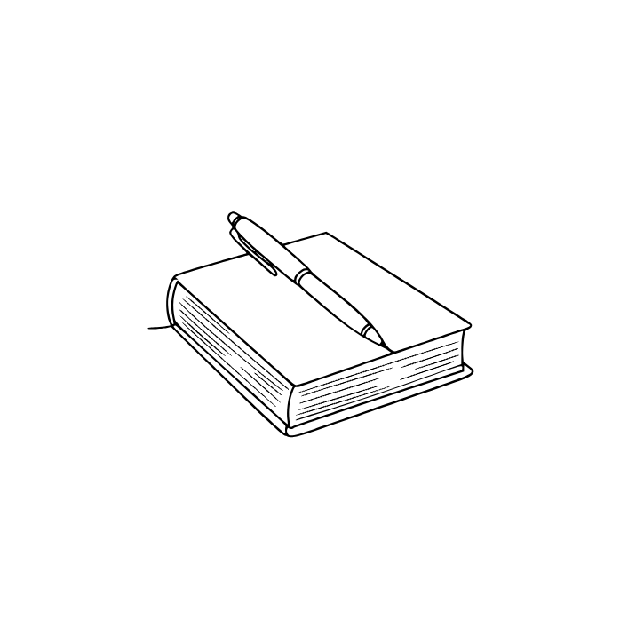

13th sentence
I have a pen and a book.
keyword
and

Slide 30
AND
US: [ænd, ən(d)] UK: []
(영영사전) 뜻
And is a word used to join two or more ideas together. For example, 'I like apples and bananas' means you like both. It makes sentences longer and connects thoughts smoothly.
그리고
I have a pen and a book.
난 펜과 책이 있어.

Slide 31
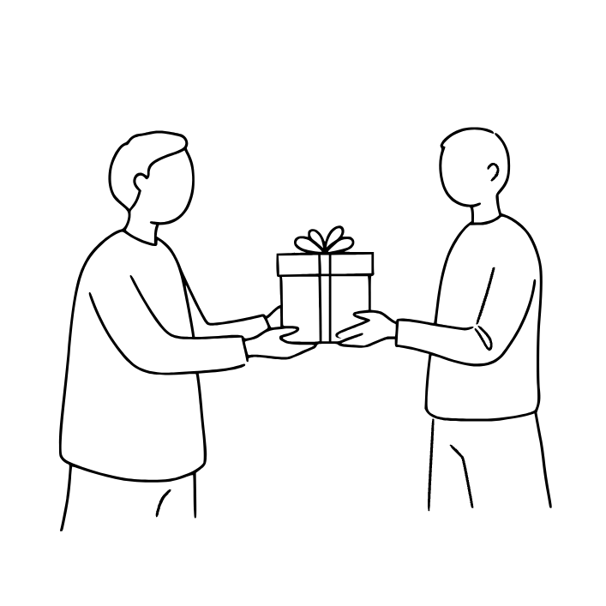
14th sentence
This gift is for you.
keyword
for

Slide 32
FOR
US: [fɔːr] UK: []
(영영사전) 뜻
For is a word that shows purpose, reason, or benefit. For example, 'This gift is for you' means the gift is meant to be yours. It also explains time, like 'for two hours'.
그리
This gift is for you.
이 선물은 당신을 위한 거예요.

Slide 33
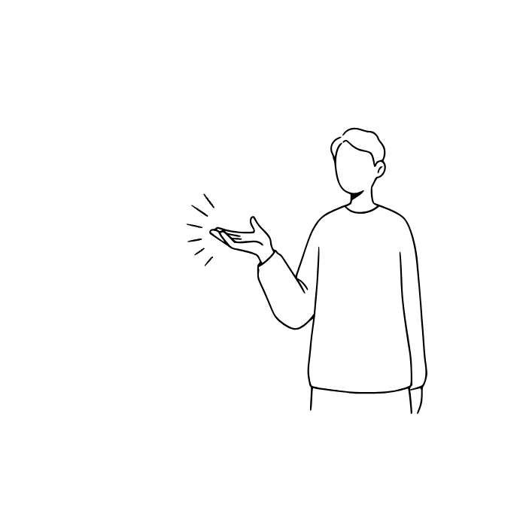
15th sentence
Please come here.
keyword
come

Slide 34
COME
US: [kʌm] UK: []
(영영사전) 뜻
Come means to move closer to the speaker or a place. For example, 'Please come here' means move to where I am. It often shows movement toward someone.
오다
Please come here.
여기로 와 주세요.

Slide 35
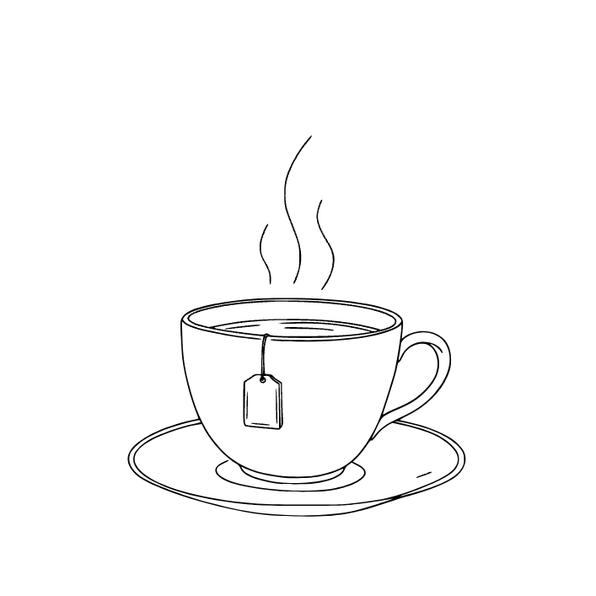

16th sentence
I want a cup of tea.
keyword
want

Slide 36
WANT
US: [wɑːnt] UK: []
(영영사전) 뜻
Want means to wish for something or feel a need. For example, 'I want pizza' means you feel like eating pizza. It shows desire or preference.
원하다
I want a cup of tea.
차 한 잔 마시고 싶어요.

Slide 37
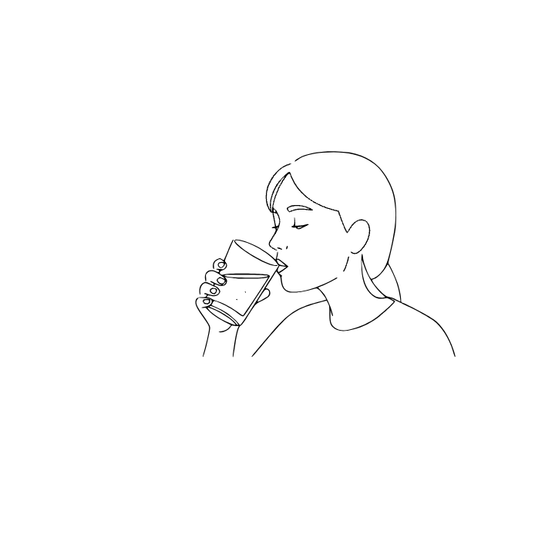
17th sentence
I drink water.
keyword
water

Slide 38
WATER
US: [ˈwɔːtər] UK: []
(영영사전) 뜻
Water is a clear liquid that people, animals, and plants need to survive. We drink it, cook with it, and use it every day. For example, 'I drink water when I am thirsty.'
물
I drink water.
전 물을 마셔요.

Slide 39
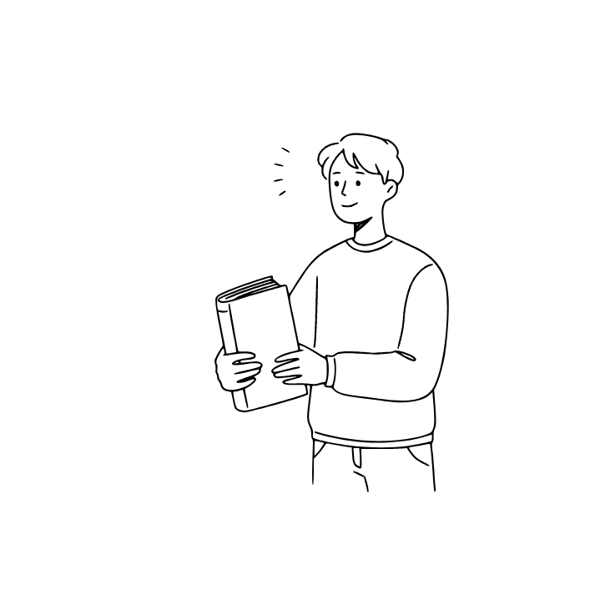
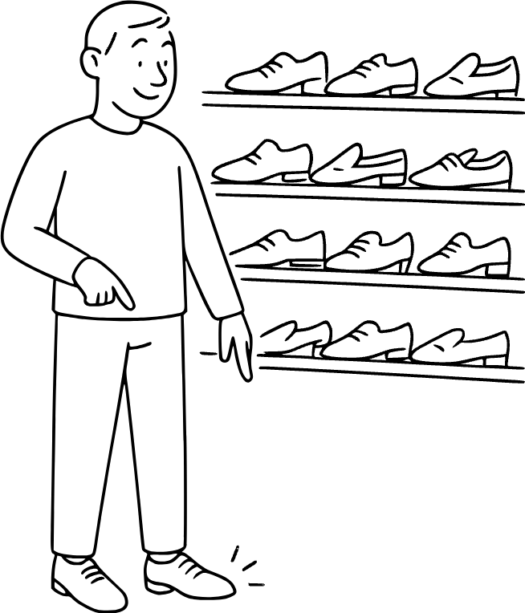
18th sentence
I get a new book.
keyword
new

Slide 40
NEW
US: [nuː] UK: []
(영영사전) 뜻
New means something that has just been made, bought, or discovered. It is the opposite of old. People use it to describe clothes, ideas, or experiences. New things often feel fresh and exciting. Example: 'She bought a new phone yesterday.'
새로운
I get a new book.
나는 새 책을 받았다.

Slide 41

19th sentence
The day is sunny.
keyword
day

Slide 42
DAY
US: [deɪ] UK: []
(영영사전) 뜻
Day is the time from morning until night. It also means a full 24 hours. People talk about special days, like birthdays or holidays. Example: 'It was a sunny day.' Days mark the passing of time.
하루, 날
The day is sunny.
날이 맑다.

Slide 43

20th sentence
The night is quiet.
keyword
night

Slide 44
NIGHT
US: [naɪt] UK: []
(영영사전) 뜻
Night is the time when it is dark outside and people usually sleep. It comes after evening and before morning. For example, 'The stars shine at night.'
밤
The night is quiet.
밤이 고요하다.

Slide 45


21th sentence
Today is a beautiful day.
keyword
today

Slide 46
TODAY
US: [təˈdeɪ] UK: []
(영영사전) 뜻
Today means the day that is happening right now. It is between yesterday and tomorrow. For example, 'Today is my birthday.'
오늘
Today is a beautiful day.
오늘은 날씨가 정말 좋다.

Slide 47
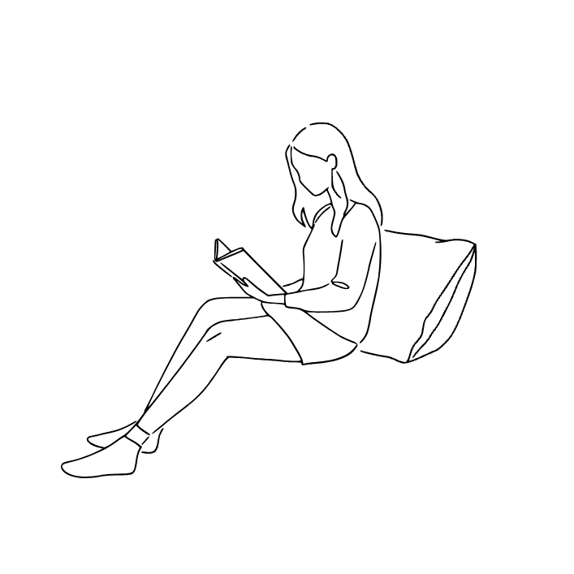
22th sentence
The woman is reading a book.
keyword
woman

Slide 48
WOMAN
US: [ˈwʊmən] UK: []
(영영사전) 뜻
A woman is an adult female human. Women are often daughters, sisters, mothers, or workers in society. For example, 'The woman is a teacher.'
여자
The woman is reading a book.
그녀는 책을 읽고 있었다.

Slide 49
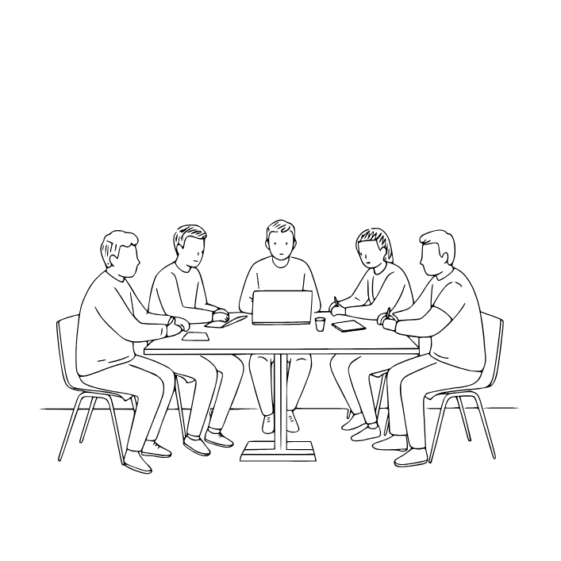
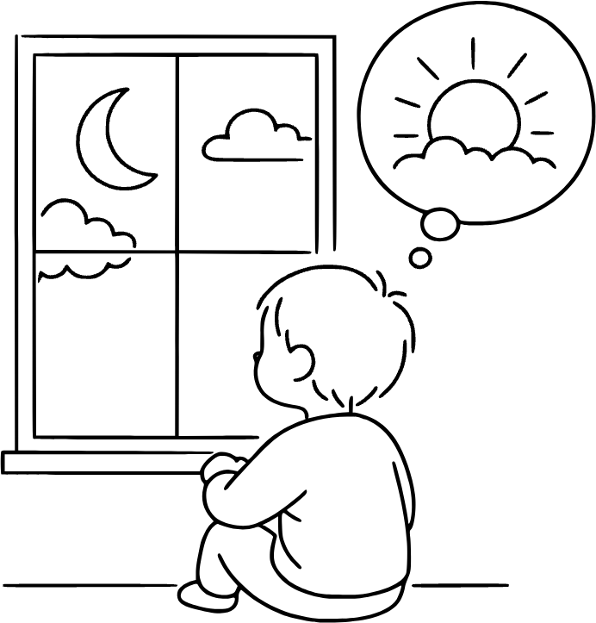
23th sentence
We have a meeting tomorrow.
keyword
tomorrow

Slide 50
TOMORROW
US: [təˈmɑːroʊ] UK: []
(영영사전) 뜻
Tomorrow is the day after today. It has not happened yet. For example, 'Tomorrow we will go to the park.'
내일
We have a meeting tomorrow.
우리는 내일 회의가 있다.

Slide 51

24th sentence
The sun is shining brightly today.
keyword
sun

Slide 52
SUN
US: [sʌn] UK: []
(영영사전) 뜻
The sun is a big star that gives light and heat to Earth. It rises in the morning and sets in the evening. For example, 'The sun is bright today.'
태양
The sun is shining brightly today.
오늘은 해가 밝게 빛나고 있다.

Slide 53

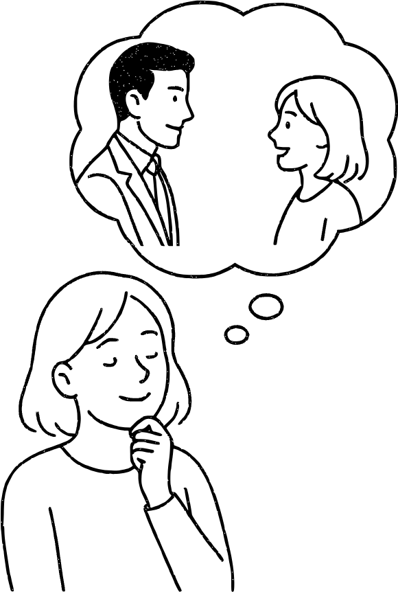
25th sentence
It will rain later.
keyword
later

Slide 54
LATER
US: [ˈleɪtər] UK: []
(영영사전) 뜻
Later means after the present time. For example, 'I will call you later.' It shows something will happen afterward.
나중에
It will rain later.
나중에 비가 올 것이다.

Slide 55
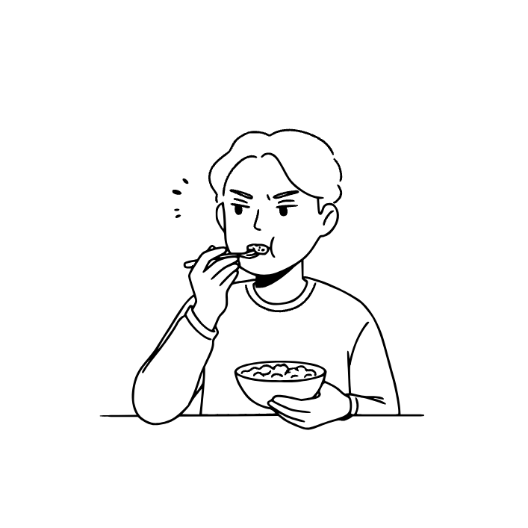

26th sentence
The food tastes bad.
keyword
bad

Slide 56
BAD
US: [bæd] UK: []
(영영사전) 뜻
Bad means not good, unpleasant, or harmful. For example, 'This food tastes bad.' It is the opposite of good.
나쁜
The food tastes bad.
그 음식은 맛이 없다.

Slide 57
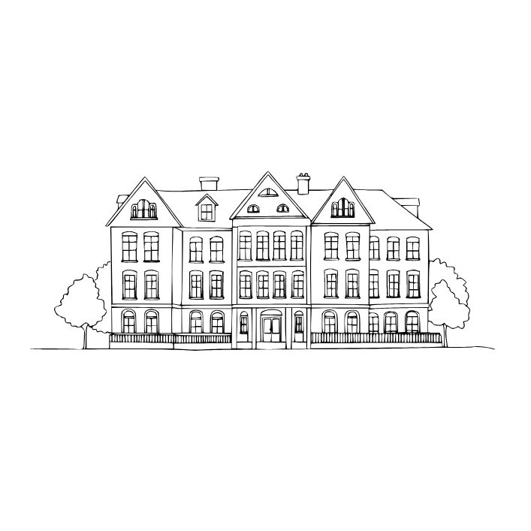
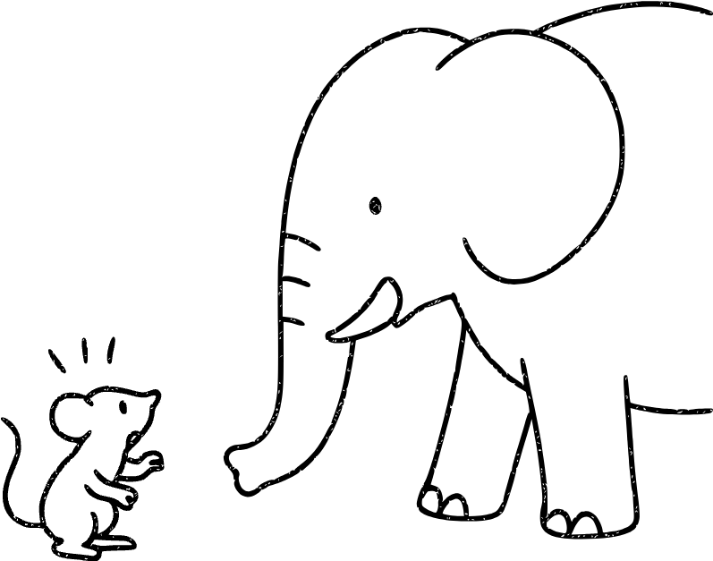
27th sentence
The house is big.
keyword
big

Slide 58
BIG
US: [bɪɡ] UK: []
(영영사전) 뜻
Big means large in size or amount. For example, 'The elephant is big.' It is the opposite of small.
큰
The house is big.
그 집은 크다.

Slide 59
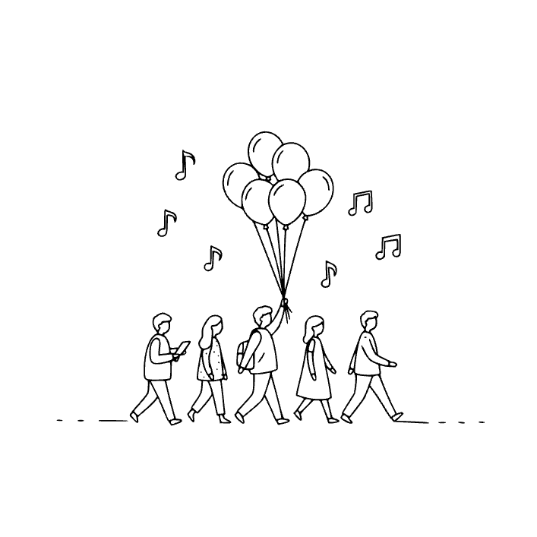

28th sentence
I am going to the party with my friends.
keyword
with

Slide 60
WITH
US: [wɪð, wɪθ] UK: []
(영영사전) 뜻
With shows being together or having something. For example, 'I went to the park with my friend' means your friend was there too. It also shows what tool you use, like 'cut with a knife'.
~와 함께
I am going to the party with my friends.
친구들과 파티에 갈거다.

Slide 61
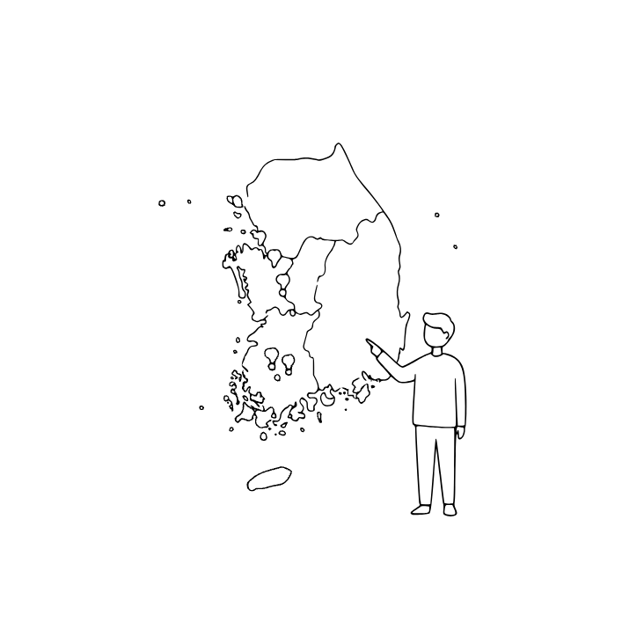
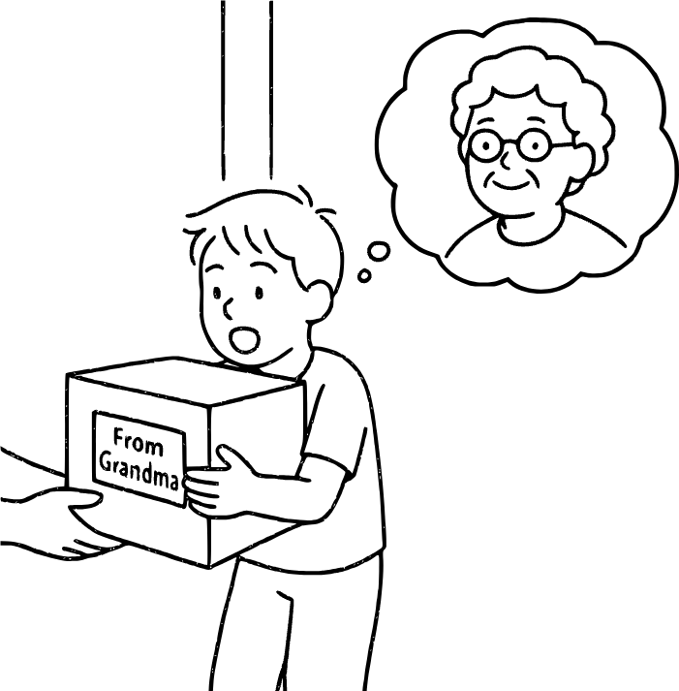
29th sentence
I am from Korea.
keyword
from

Slide 62
FROM
US: [frʌm, frəm] UK: []
(영영사전) 뜻
From shows the starting point of a place, time, or source. For example, 'I am from Korea' means Korea is your origin. It can also show the beginning of time, like 'from morning to night'.
~로부터, ~에서
I am from Korea.
저는 한국에서 왔어요.

Slide 63
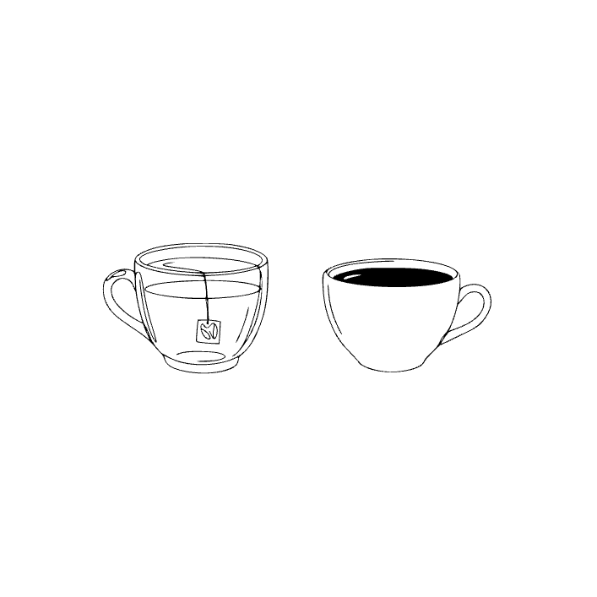
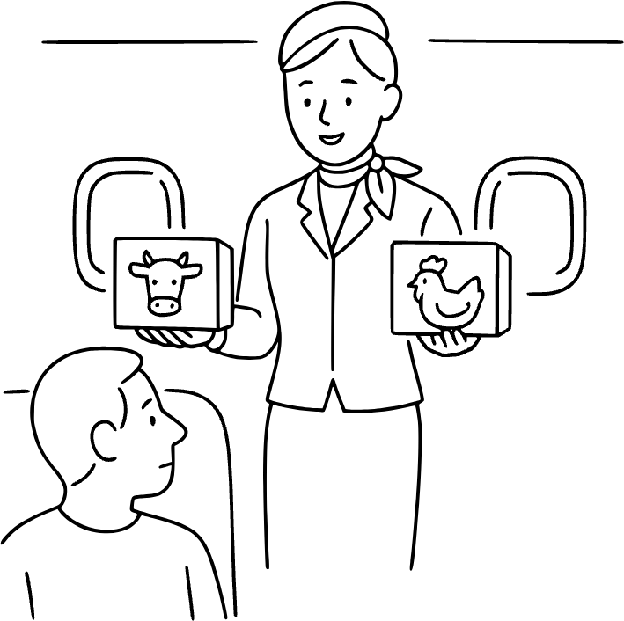
30th sentence
Do you want tea or coffee?
keyword
or

Slide 64
OR
US: [ɔːr] UK: []
(영영사전) 뜻
Or is a word used to show choice between two or more things. For example, 'Do you want tea or coffee?' It helps ask about options or possibilities.
또는, ~이나
Do you want tea or coffee?
차 마실래? 커피 마실래?

Slide 65
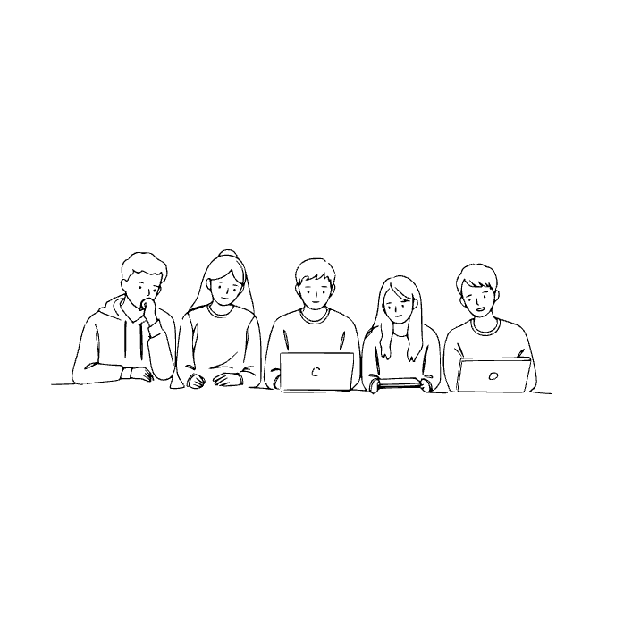
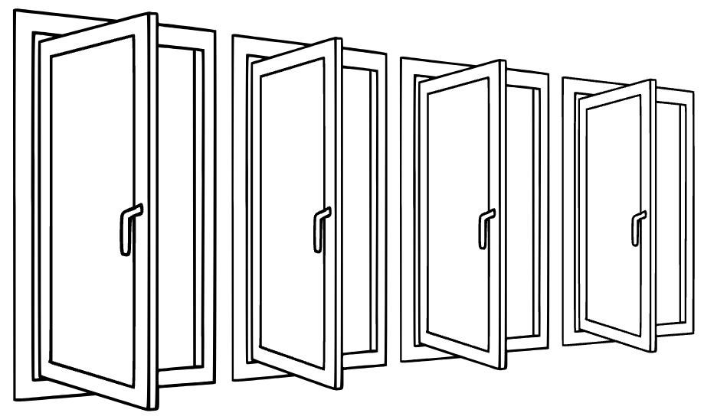
31th sentence
All the students are here.
keyword
All

Slide 66
ALL
US: [ɔːl] UK: []
(영영사전) 뜻
All means every person or thing in a group. For example, 'all the students' means every student without exception. It can describe people, objects, or even time, like 'all day'.
모든, 전부
All the students are here.
모든 학생들이 여기 있어요.

Slide 67
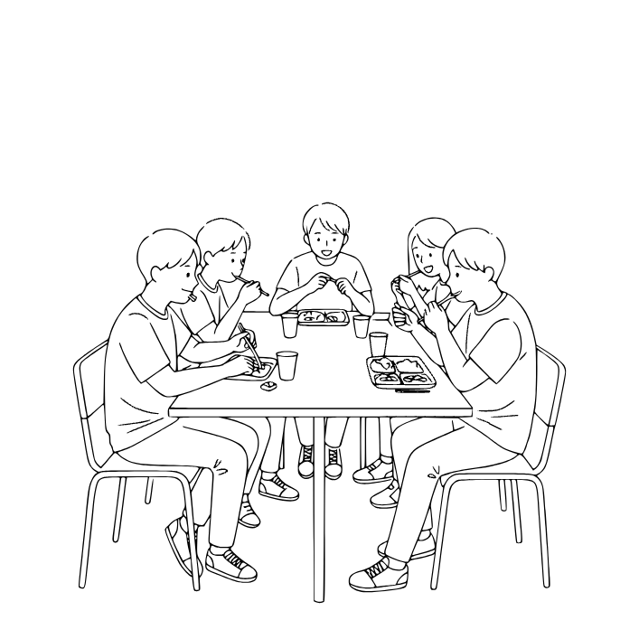
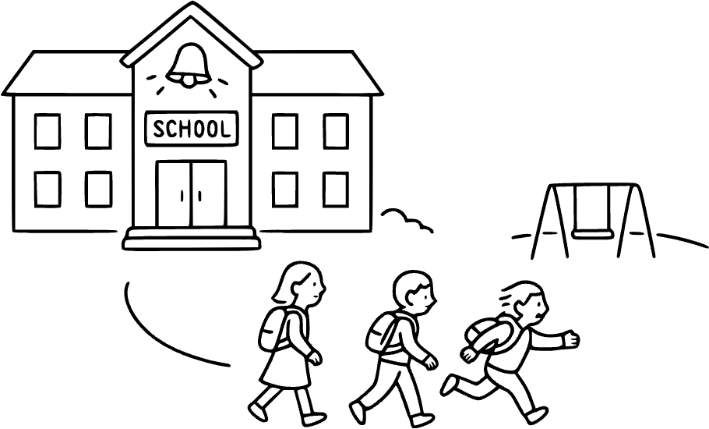
32th sentence
We ate lunch after class.
keyword
after

Slide 68
AFTER
US: [ˈæftər] UK: []
(영영사전) 뜻
After means later in time or following something. If you eat lunch after school, lunch comes second. It can also mean behind in order, like 'B comes after A.' People use it in both time and place. Example: 'We went for ice cream after dinner.'
~후에
We ate lunch after class.
저희는 수업 후에 점심을 먹었어요.

Slide 69
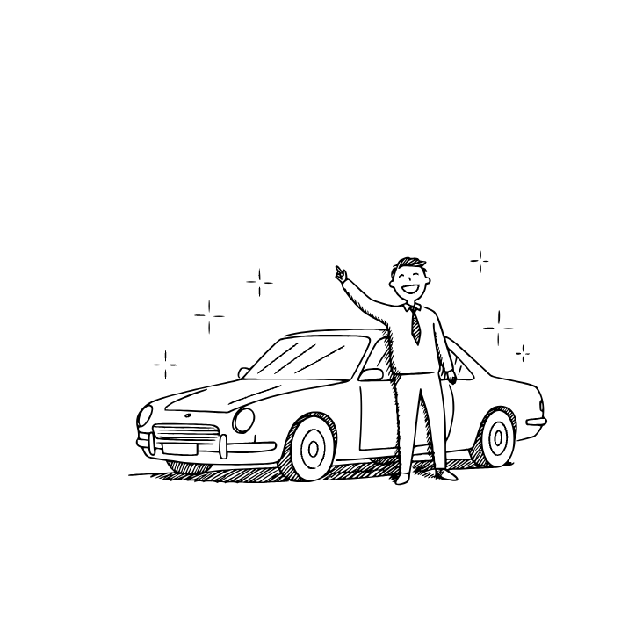
33th sentence
I bought a new car.
keyword
new

Slide 70
NEW
US: [nuː] UK: []
(영영사전) 뜻
New means something that has just been made, bought, or discovered. It is the opposite of old. People use it to describe clothes, ideas, or experiences. New things often feel fresh and exciting. Example: 'She bought a new phone yesterday.'
새로운
I bought a new car.
나는 새 차를 샀다.

Slide 71
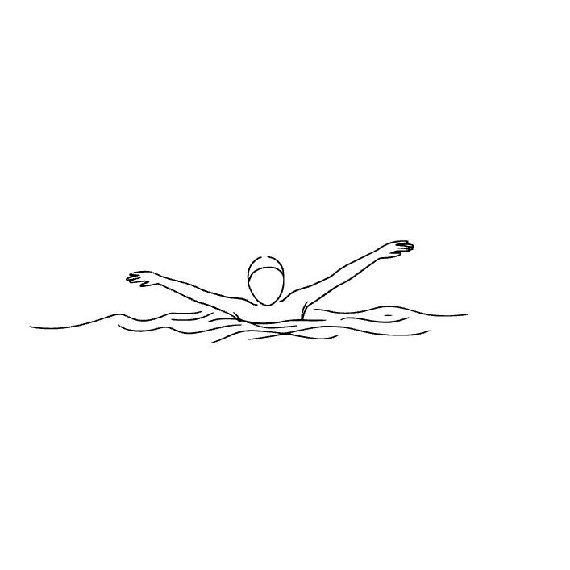
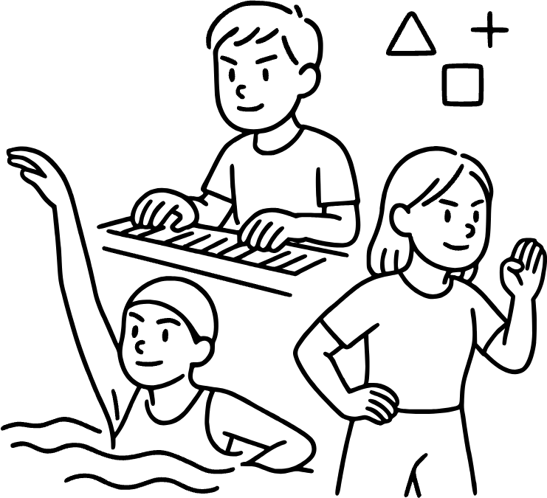
34th sentence
I can swim.
keyword
can

Slide 72
CAN
US: [kæn] UK: []
(영영사전) 뜻
Can is a word that shows ability or possibility. When you say 'I can swim,' it means you know how to do it. It is also used to ask permission, like 'Can I go outside?' Can is very common in everyday speech. Example: 'He can play the guitar very well.'
~할 수 있다
I can swim.
나는 수영을 할 수 있다.

Slide 73
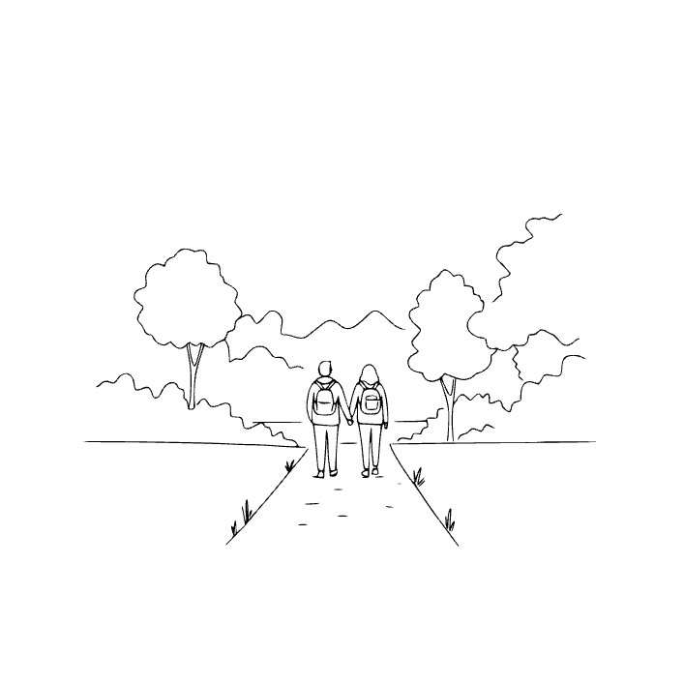
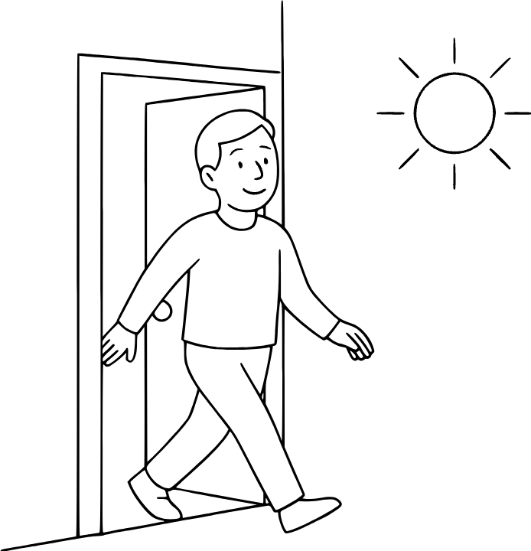
35th sentence
We go out for a walk.
keyword
out

Slide 74
OUT
US: [aʊt] UK: []
(영영사전) 뜻
Out means moving from the inside to the outside. It can describe leaving a house, room, or container. People use it in many phrases, like 'go out,' 'take out,' or 'run out.' It can also mean not available, like 'out of stock.' Example: 'She went out to meet her friends.'
밖에, 밖으로
We go out for a walk.
우리는 산책하러 나갔다.

Slide 75
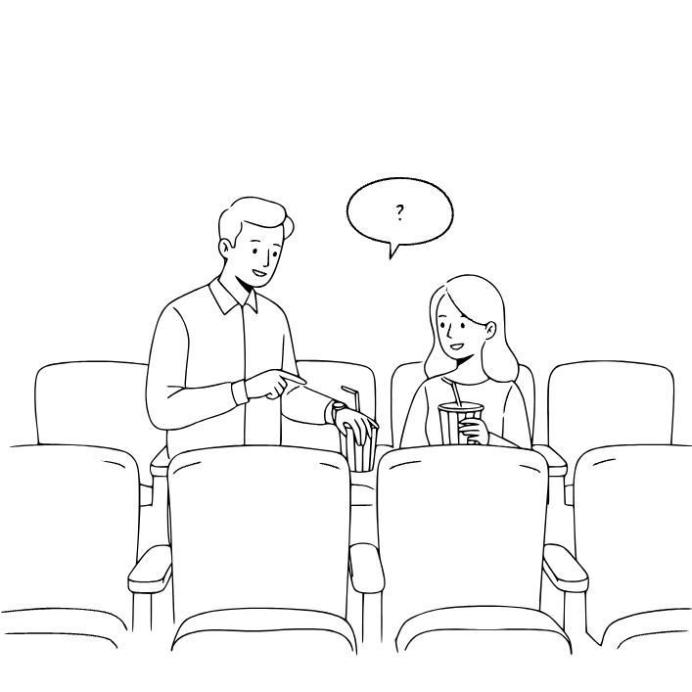

36th sentence
What time does the movie start?
keyword
time

Slide 76
TIME
US: [taɪm] UK: []
(영영사전) 뜻
Time is what we measure with seconds, minutes, and hours. It tells us when things happen and how long they last. People talk about time with clocks, calendars, and seasons. Time can pass quickly or slowly depending on what you do. Example: 'I don’t have much time today.'
시간
What time does the movie start?
영화 몇 시에 시작해?

Slide 77
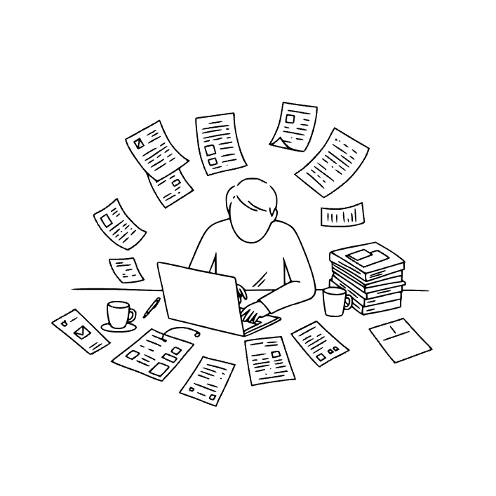

37th sentence
I am busy now.
keyword
now

Slide 78
NOW
US: [naʊ] UK: []
(영영사전) 뜻
Now means the present time. It shows what is happening at this very moment. People use 'now' to talk about something urgent or immediate. Example: 'Please come here now.' It makes the action feel current and important.
지금
I am busy now.
나 지금 바빠.

Slide 79
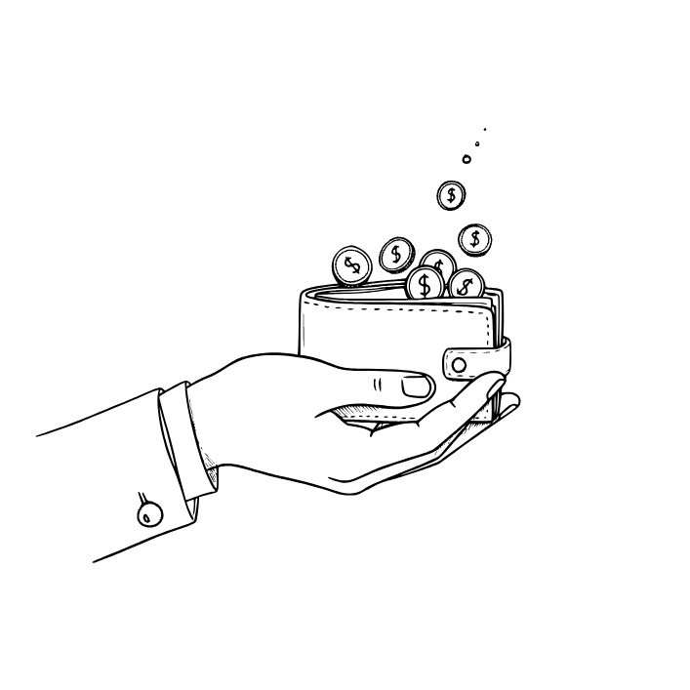
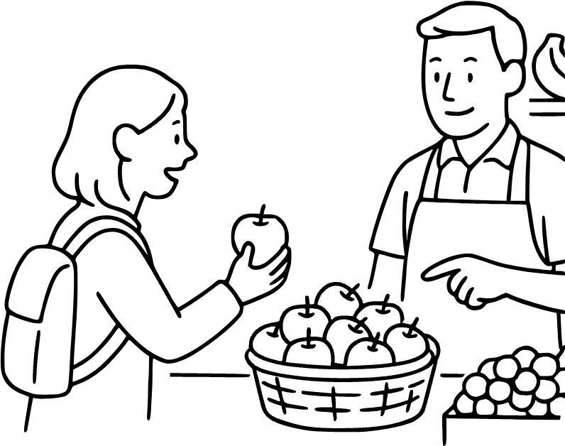
38th sentence
Do you have any money?
keyword
any

Slide 80
ANY
US: [ˈɛni] UK: []
(영영사전) 뜻
Now means the present time. It shows what is happening at this very moment. People use 'now' to talk about something urgent or immediate. Example: 'Please come here now.' It makes the action feel current and important.
어떤, 아무
Do you have any money?
너 돈 좀 있니?

Slide 81
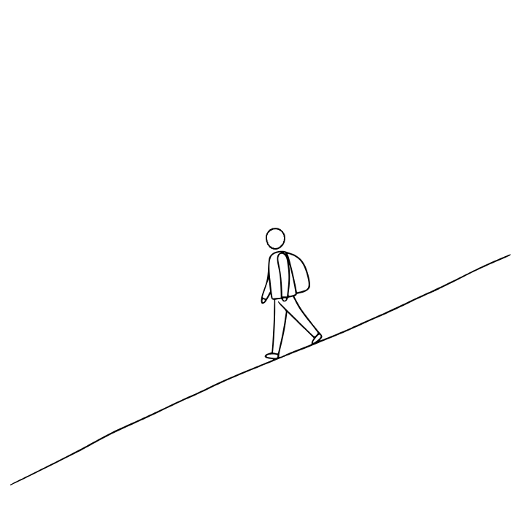
39th sentence
He walks down the hill.
keyword
down

Slide 82
DOWN
US: [daʊn] UK: []
(영영사전) 뜻
Down means moving to a lower place or level. It can describe direction, like going down stairs. People use it to mean sadness, as in 'feeling down.' Example: 'He sat down on the chair.' It is often the opposite of up.
아래로
He walks down the hill.
그가 언덕 아래로 걸어 내려간다.

Slide 83
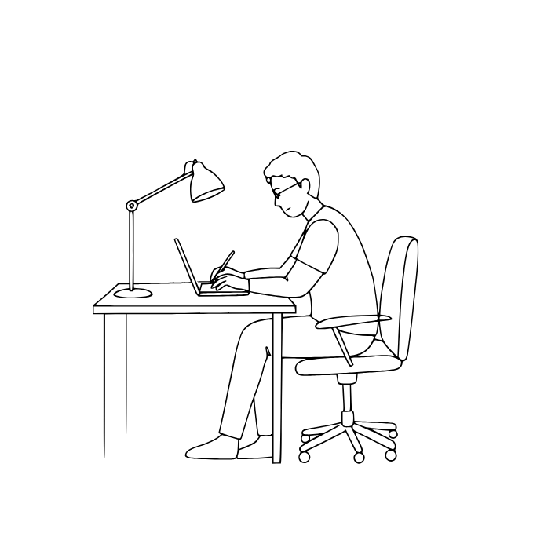
40th sentence
I have to work tomorrow.
keyword
work

Slide 84
WORK
US: [wɜːrk] UK: []
(영영사전) 뜻
Work means activity done to earn money or achieve something. People go to work every day in offices, schools, or shops. It can also mean effort, like 'This plan will work.' Example: 'He is busy with his work.' Work is an important part of life.
일하다
I have to work tomorrow.
나는 내일 출근해야 해.

Slide 85
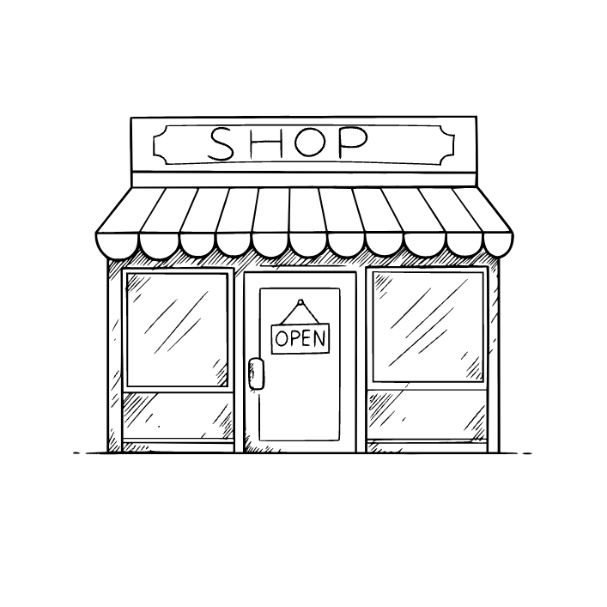

41th sentence
The store is open now.
keyword
open

Slide 86
OPEN
US: [ˈoʊpən] UK: []
(영영사전) 뜻
Open means not closed or shut. Doors, windows, and boxes can be open. It also means ready to accept ideas, like 'open to suggestions.' Example: 'The store is open from 9 to 5.' It gives the idea of freedom and access.
열다, 열린
The store is open now.
가게는 지금 열려 있어.

Slide 87
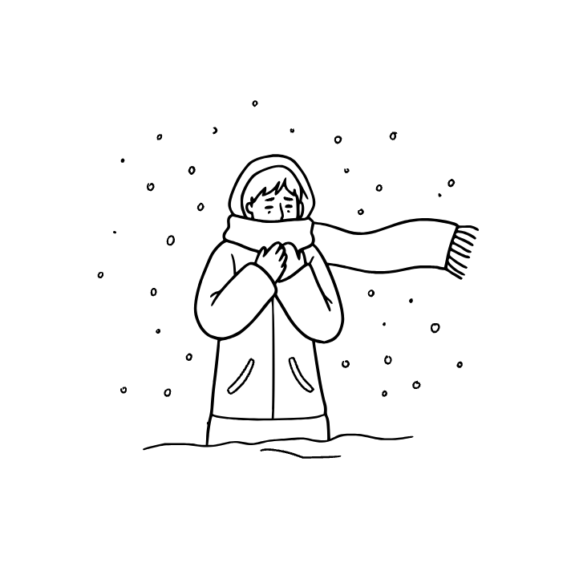
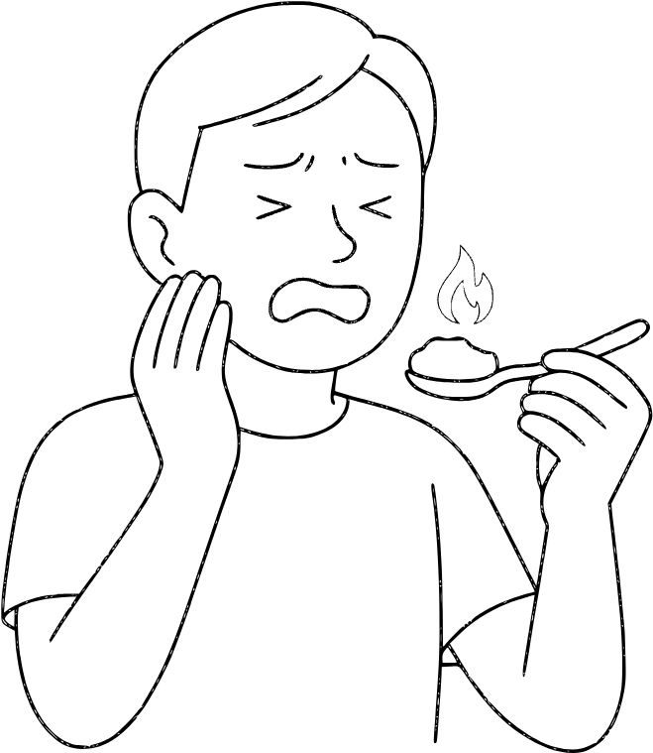
42th sentence
The weather is very cold today.
keyword
very

Slide 88
VERY
US: [ˈvɛri] UK: []
(영영사전) 뜻
Very means to a high degree. It makes words stronger, like 'very big' or 'very happy.' People use it to show strong feelings. Example: 'She is very smart.' It helps make language more expressive.
매우
The weather is very cold today.
오늘 날씨가 매우 춥네.

Slide 89

43th sentence
I think this is a good idea.
keyword
think

Slide 90
THINK
US: [θɪŋk] UK: []
(영영사전) 뜻
Think means to use your mind to form ideas or solve problems. People think about the past, future, or choices they must make. It can also mean having an opinion. Example: 'I think this book is interesting.' Thinking is part of learning.
생각하다
I think this is a good idea.
나는 이게 좋은 생각이라고 생각해.

Slide 91

44th sentence
Open the window for some fresh air.
keyword
window

Slide 92
WINDOW
US: [ˈwɪndoʊ ] UK: []
(영영사전) 뜻
A window is an opening in a wall with glass that lets in light and air. People look through windows to see outside. Windows can open or close for fresh air. Example: 'She opened the window to let in the breeze.' They are found in most buildings and homes.
창문
Open the window for some fresh air.
신선한 공기를 위해 창문을 열어.

Slide 93

45th sentence
You are right about that.
keyword
right

Slide 94
RIGHT
US: [raɪt] UK: []
(영영사전) 뜻
Right can mean correct, like giving the right answer. It can also mean the opposite of left in direction. People use 'right now' to show immediacy. Example: 'Turn right at the corner.' Right is often about correctness or direction.
오른쪽, 옳은
You are right about that.
그건 네가 맞아.

Slide 95


46th sentence
She came back home.
keyword
back

Slide 96
BACK
US: [bæk] UK: []
(영영사전) 뜻
Back means the rear part of something, like the back of a chair. It can also mean returning to a place, like 'go back home.' People use it to talk about support, as in 'I’ve got your back.' Example: 'She looked back and waved.'
뒤, 돌아가다
She came back home.
그녀가 집에 돌아왔다.

Slide 97

47th sentence
There are many people in the room.
keyword
people

Slide 98
PEOPLE
US: [ˈpiːpl] UK: []
(영영사전) 뜻
People are men, women, and children together. The word means more than one person. People live in towns, cities, and countries. They work, play, and share culture. Example: 'Many people came to the party.'
사람들
There are many people in the room.
방에 사람들이 많다.

Slide 99

48th sentence
I make a sandwich.
keyword
make

Slide 100
MAKE
US: [meɪk] UK: []
(영영사전) 뜻
Make means to create or produce something. People make food, art, or plans. It also means causing something to happen, like 'make me happy.' Example: 'She will make a cake for the party.'
만들다
I make a sandwich.
나는 샌드위치를 만든다.

Slide 101


49th sentence
Wash your hands before dinner.
keyword
before

Slide 102
BEFORE
US: [bɪˈfɔːr] UK: []
(영영사전) 뜻
Before means earlier than something in time. Breakfast comes before lunch. It can also mean in front of in space. Example: 'She stood before the class.' It shows both time and position.
~전에
Wash your hands before dinner.
저녁 먹기 전에 너의 손을 씻어라.

Slide 103


50th sentence
I really like this song.
keyword
really

Slide 104
REALLY
US: [ˈriːəli, ˈrɪəli] UK: []
(영영사전) 뜻
Really means truly or in fact. It makes words stronger, like 'really good' or 'really fast.' People use it to show honesty or surprise. Example: 'Do you really mean it?'
정말로, 실제로
I really like this song.
나는 이 노래가 정말 좋아.

Slide 105


51th sentence
What did you say?
keyword
say

Slide 106
SAY
US: [seɪ] UK: []
(영영사전) 뜻
Say means to speak words. People say hello, thank you, or important ideas. It can also mean repeat what someone else said. Example: 'She says she is tired.' It is one of the most common verbs in English.
말하다
What did you say?
뭐라고 했어?

Slide 107


52th sentence
The road is long and winding.
keyword
long

Slide 108
LONG
US: [lɔːŋ] UK: []
(영영사전) 뜻
Long describes something that measures much from end to end. It can also mean lasting a lot of time. People say 'a long road' or 'a long day.' Example: 'The movie was very long.' It is the opposite of short.
긴, 오랫동안
The road is long and winding.
그 길은 길고 구불구불해.

Slide 109
53th sentence
I know the answer.
keyword
he

Slide 110
HE
US: [hɪr] UK: []
(영영사전) 뜻
He
여
re.
나.

Slide 111
54th sentence
This year is good.
keyword
he

Slide 112
HE
US: [hɪr] UK: []
(영영사전) 뜻
He
여
re.
나.

Slide 113
55th sentence
That guy is nice.
keyword
he

Slide 114
HE
US: [hɪr] UK: []
(영영사전) 뜻
He
여
re.
나.

Slide 115
56th sentence
I was hungry, so I ate.
keyword
he

Slide 116
HE
US: [hɪr] UK: []
(영영사전) 뜻
He
여
re.
나.

Slide 117
57th sentence
I like the other book.
keyword
he

Slide 118
HE
US: [hɪr] UK: []
(영영사전) 뜻
He
여
re.
나.

Slide 119
58th sentence
That guy is nice.
keyword
he

Slide 120
HE
US: [hɪr] UK: []
(영영사전) 뜻
He
여
re.
나.

Slide 121
59th sentence
We went to the market.
keyword
he

Slide 122
HE
US: [hɪr] UK: []
(영영사전) 뜻
He
여
re.
나.

Slide 123
60th sentence
My great-grandfather is old.
keyword
he

Slide 124
HE
US: [hɪr] UK: []
(영영사전) 뜻
He
여
re.
나.

Slide 125
61th sentence
The cat is under the table.
keyword
he

Slide 126
HE
US: [hɪr] UK: []
(영영사전) 뜻
He
여
re.
나.

Slide 127
끝전

Slide 128
끝

