Slide 1
표지

Slide 3
Introduction
영어

Slide 4
How To Use
소리

Slide 5
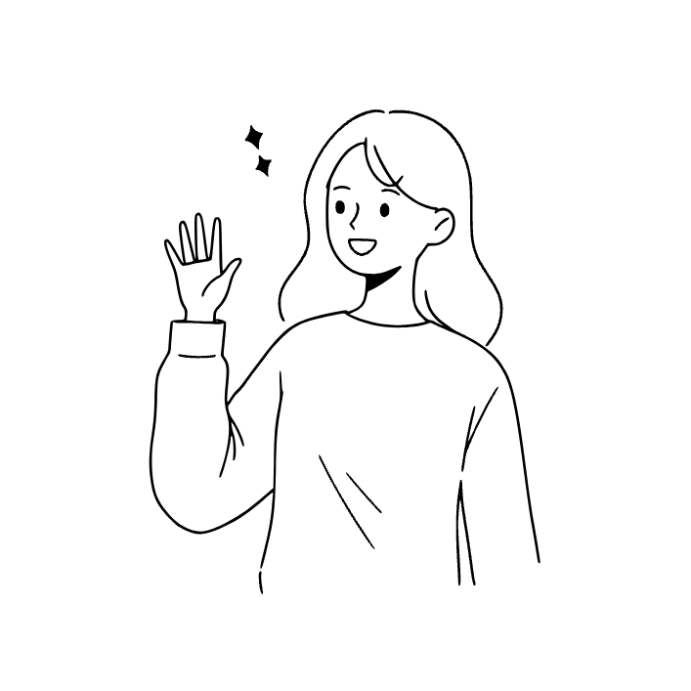
1st sentence
Hello! I am Jina.
keyword
(핵심단어)
Hello

Slide 6
HELLO
[helóu, hə-, hélou]
안녕 / 안녕하세요
I
[ai]
나
AM
[əm, (strong) æm]
~이다 / ~에 있다 / ~하고 있다
be 동사의 원형
(be 동사는 am/are/is 등으로 활용)
Hello! I am Jina.
안녕! 난 지나야.

Slide 7
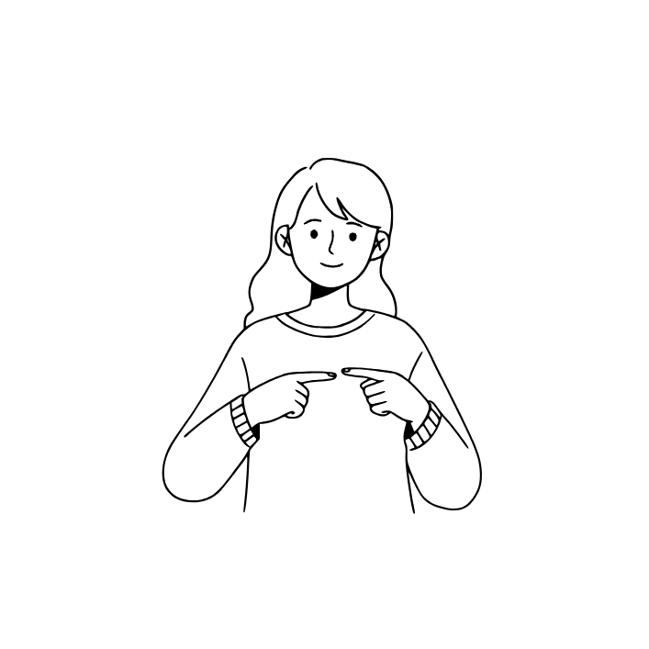
2nd sentence
My name is Jina.
keyword
name

Slide 8
MY
[mai]
나의
NAME
[neim]
이름
My name is Jina.
내 이름은 지나야.

Slide 9
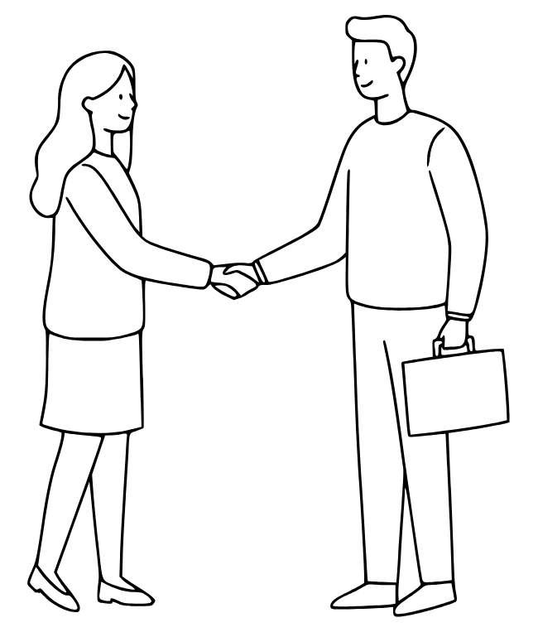
3rd sentence
Nice to meet you.
keyword
meet

Slide 10
NICE
[nais]
좋은, 멋진, 친절한
TO
[to]
~으로, ~에게, ~하기 위해
MEET
[meet]
만나다
YOU
[juː]
너, 당신, 여러분
Nice to meet you.
만나서 반가워.

Slide 11
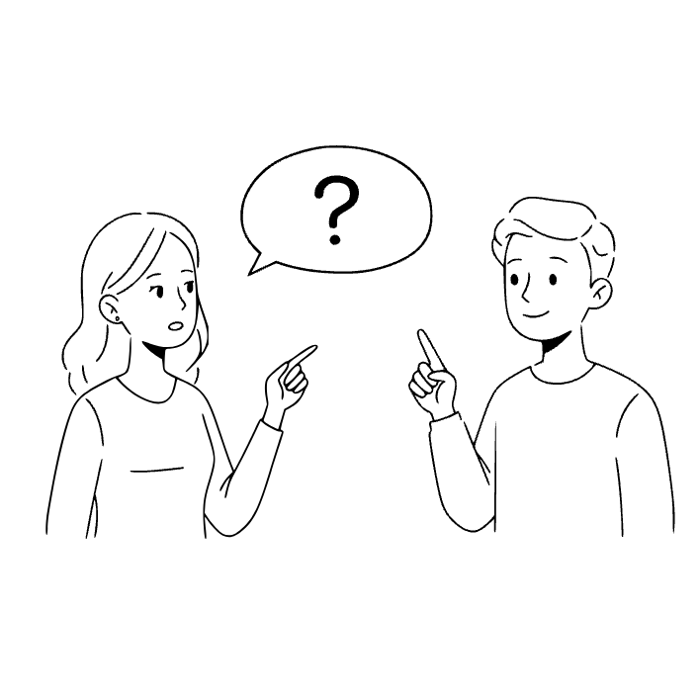
4th sentence
What is your name?
keyword
what

Slide 12
WHAT
[hwʌt, wʌt]
무엇
YOUR
[jɔːr, jər, jʊr]
너의, 당신의
What is your name?
이름이 뭐니?

Slide 13
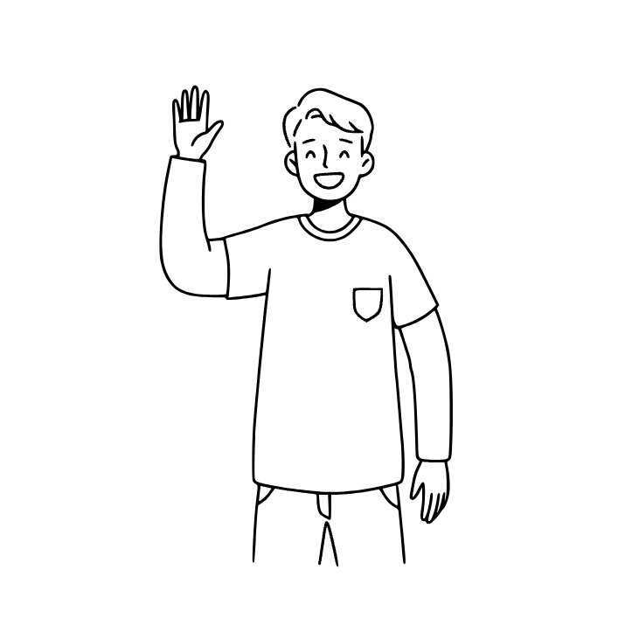
5th sentence
Hi! I'm Tom.
keyword
Hi

Slide 14
HI
[hai]
안녕
(가볍게 인사하는 표현)
MORNING
[mɔːrnɪŋ]
아침
Hi! I'm Tom.
안녕! 난 톰이야.

Slide 15
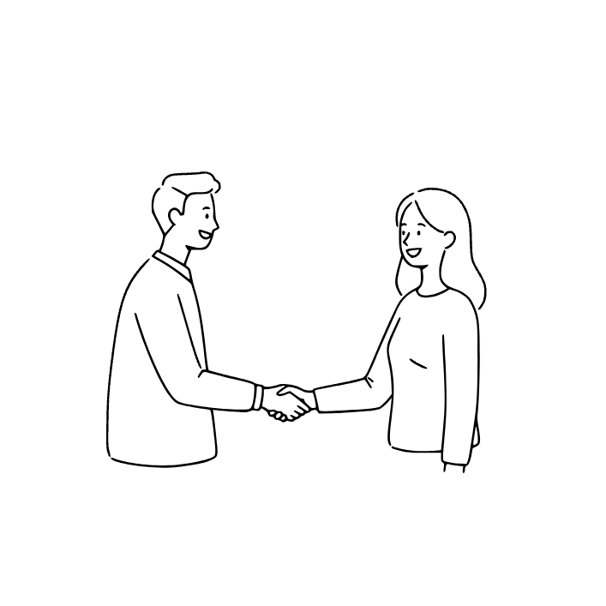
6th sentence
Nice to meet you, too.
keyword
too

Slide 16
too
[tuː]
또한, 너무
Nice to meet you, too.
나도 만나서 반가워.

Slide 17
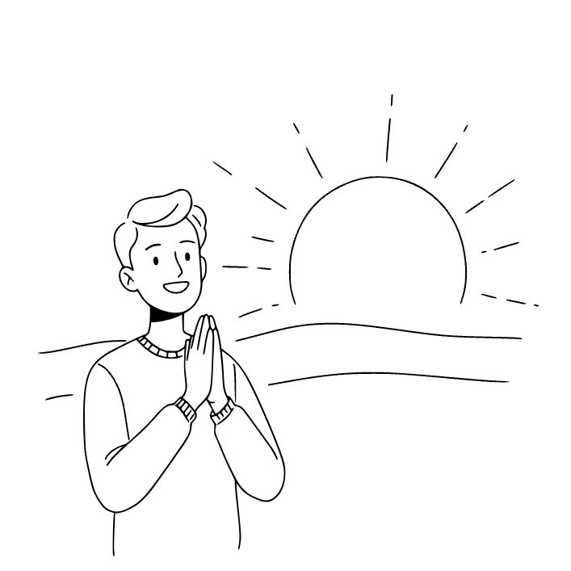
7th sentence
Good morning!
keyword
morning

Slide 18
GOOD
[ɡʊd]
좋은
MORNING
[ˈmɔːrnɪŋ]
아침
Good morning!
좋은 아침이야.

Slide 19
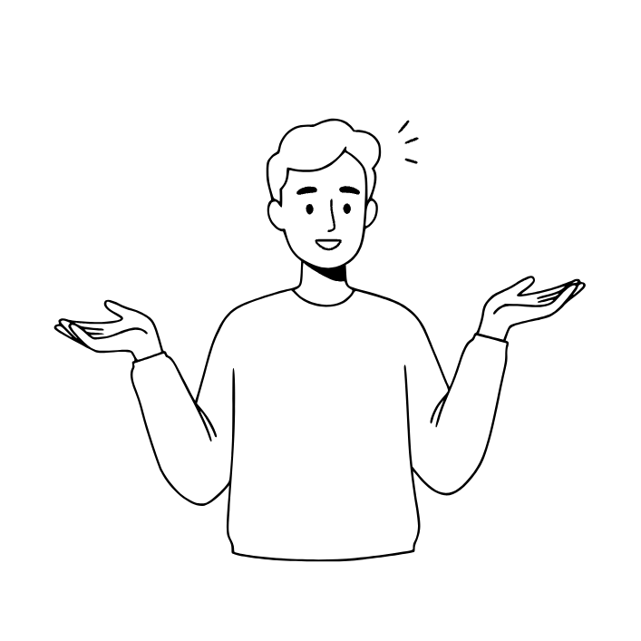
8th sentence
How are you?
keyword
How

Slide 20
HOW
[hau]
어떻게, 얼마나
How are you?
잘 지내?

Slide 21
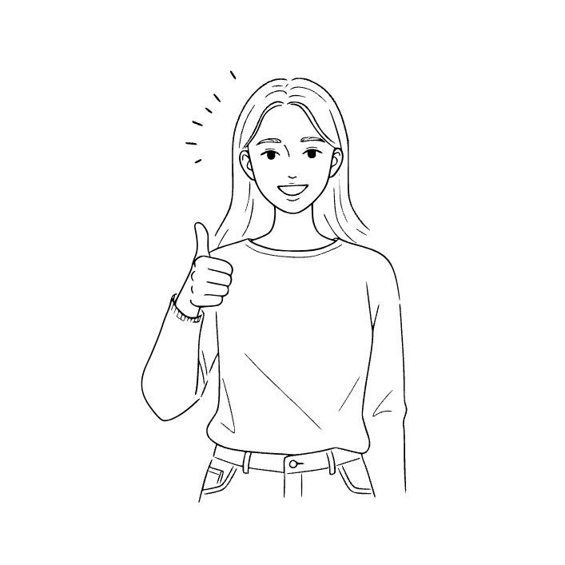
9th sentence
I am fine.
keyword
fine

Slide 22
FINE
[fain]
좋은, 괜찮은
I am fine.
잘 지내고 있어.

Slide 23
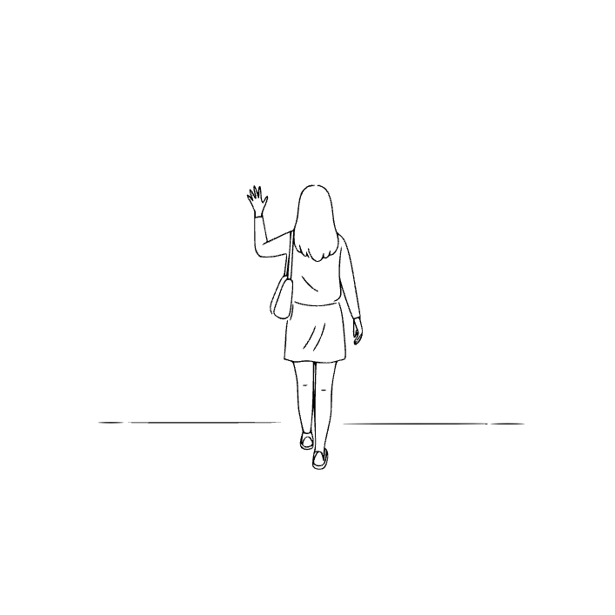
10th sentence
See you later!
keyword
See

Slide 24
SEE
[siː]
보다
LATER
[léitər]
나중에, 이후에
See you later!
다음에 봐!

Slide 25
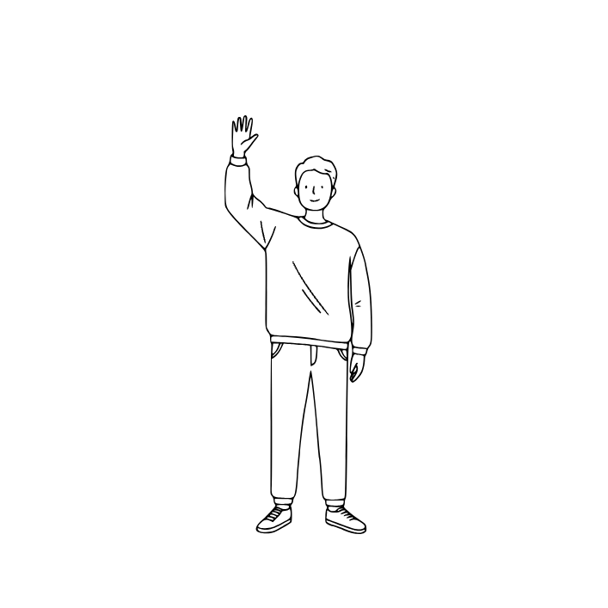
11th sentence
Goodbye!
keyword
Goodbye

Slide 26
GOODBYE
[ˌɡʊdˈbaɪ]
나중에, 이후에
Goodbye!
안녕히 가세요 /
안녕히 계세요

Slide 27
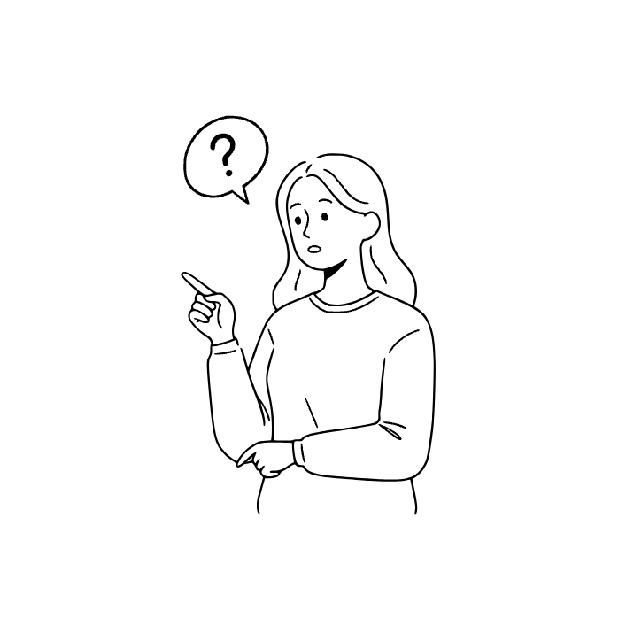
12th sentence
What is this?
keyword
this

Slide 28
THIS
[ðɪs]
이것
What is this?
이게 뭐야?

Slide 29

13th sentence
It is a book.
keyword
book

Slide 30
IT
[ɪt]
그것
It is a book.
그것은 책이야.

Slide 31
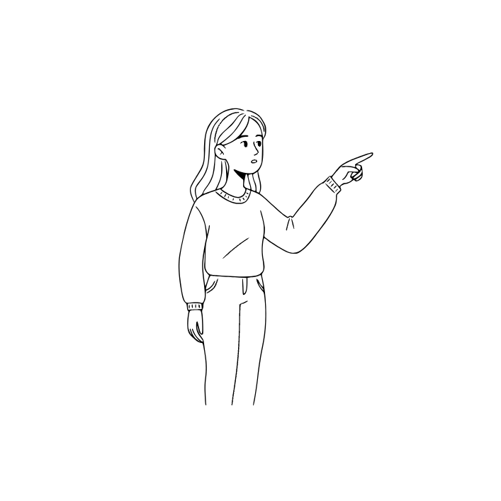
14th sentence
What is that?
keyword
that

Slide 32
THAT
[ðæt, ðət]
저것, 그것
What is that?
저게 뭐야?

Slide 33

15th sentence
It's a pencil.
keyword
pencil

Slide 34
PENCIL
[pénsəl]
연필
It's a pencil.
연필이야.

Slide 35
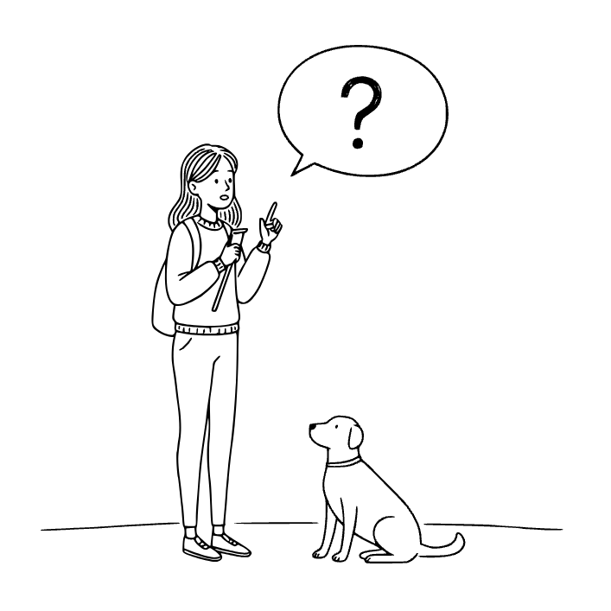
16th sentence
Do you have a dog?
keyword
dog

Slide 36
DO
[duː]
하다
HAVE
[hæv, həv]
가지다
DOG
[duː]
개
Do you have a dog?
개를 키우니?

Slide 37
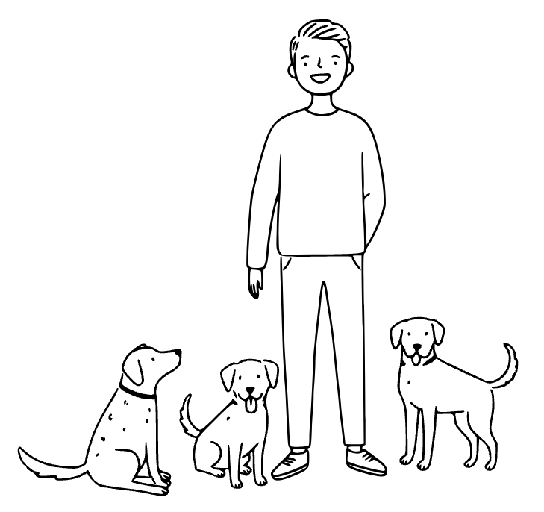
17th sentence
I have a lot of dogs.
keyword
lot

Slide 38
LOT
[lat]
많음, 다수
OF
[əv, ʌv]
~의, ~에 관한
(소유, 부분, 출처 표현)
I have a lot of dogs.
나는 개를 많이 키워.

Slide 39
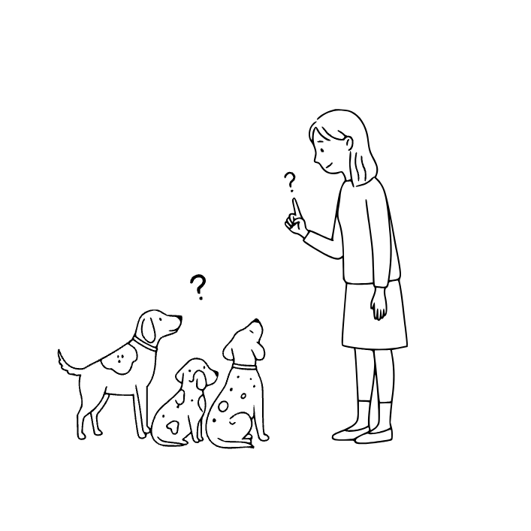
18th sentence
How many do you have?
keyword
many

Slide 40
MANY
[méni]
많은
(셀 수 있는 명사와 함께 사용)
How many do you have?
얼마나 많이 있어?

Slide 41
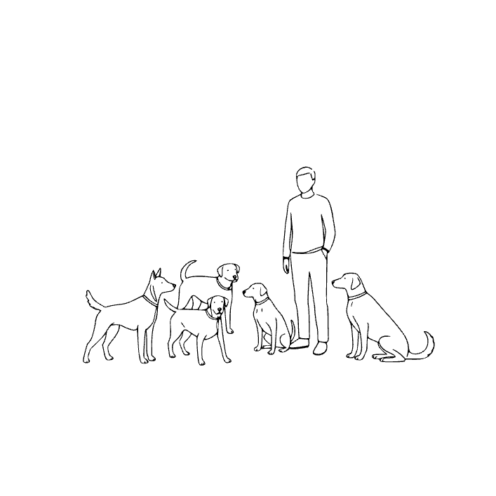
19th sentence
Five dogs.
keyword
five

Slide 42
FIVE
[faiv]
숫자 5
Five dogs.
개 다섯 마리.

Slide 43
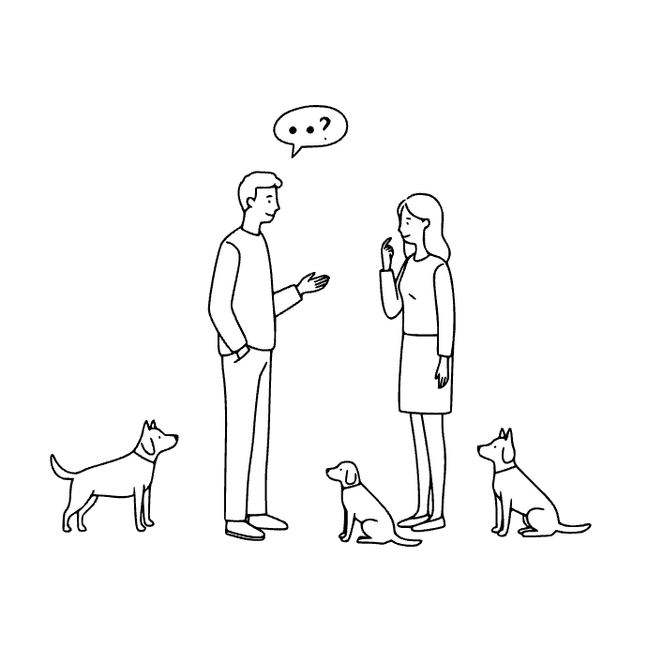
20th sentence
Do you have a dog too?

Slide 44
Do you have a dog too?
너도 개를 키우니?

Slide 45
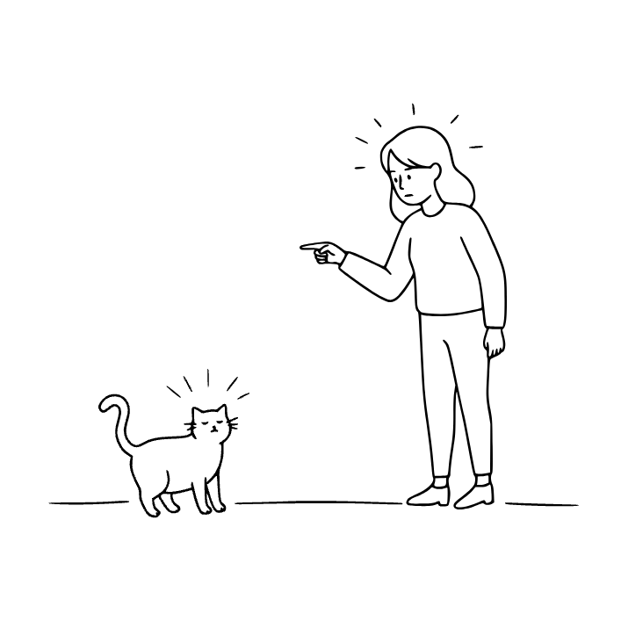

21th sentence
No, I have a cat.
keyword
No

Slide 46
NO
[noʊ]
아니오 / ~이 없는
CAT
[kæt]
고양이
No, I have a cat.
아니, 난 고양이를 키워.

Slide 47
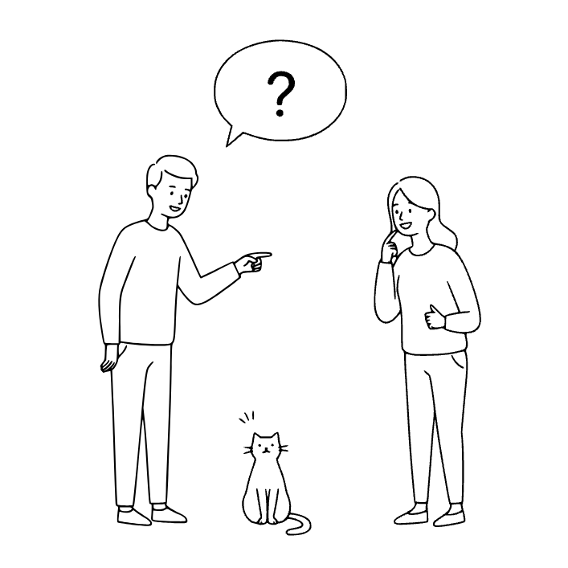

22th sentence
What color is it?
keyword
color

Slide 48
COLOR
[kʌlər]
색, 색깔
What color is it?
무슨 색이야?

Slide 49
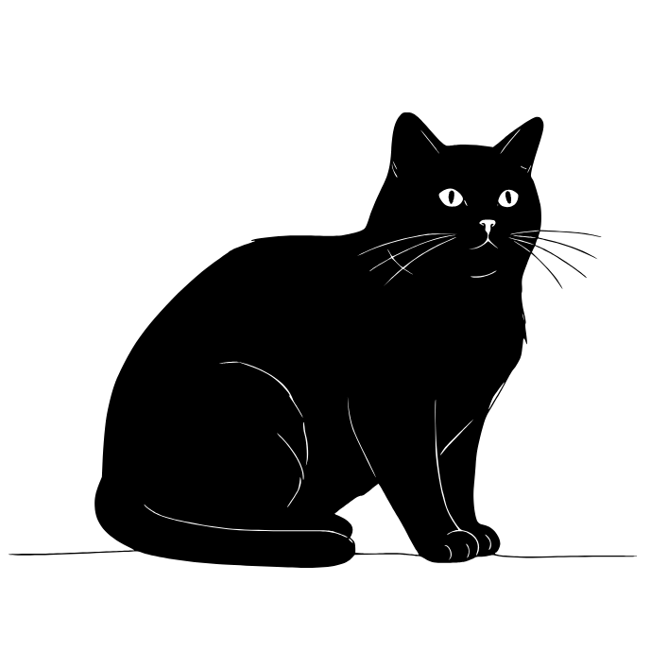
23th sentence
It's black.
keyword
black

Slide 50
BLACK
[blæk]
검은색
It's black.
검은색이야.

Slide 51
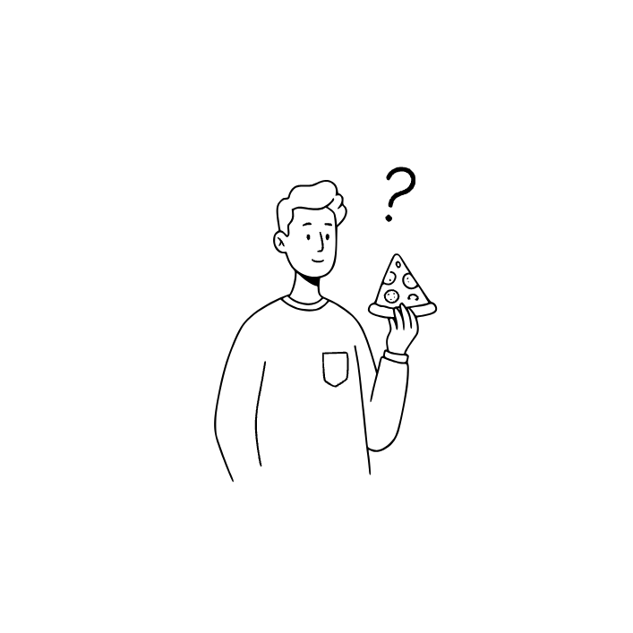
24th sentence
Do you like pizza?
keyword
like

Slide 52
LIKE
[laɪk]
좋아하다 / ~처럼
PIZZA
[píːtsə]
피자
Do you like pizza?
너는 피자를 좋아하니?

Slide 53
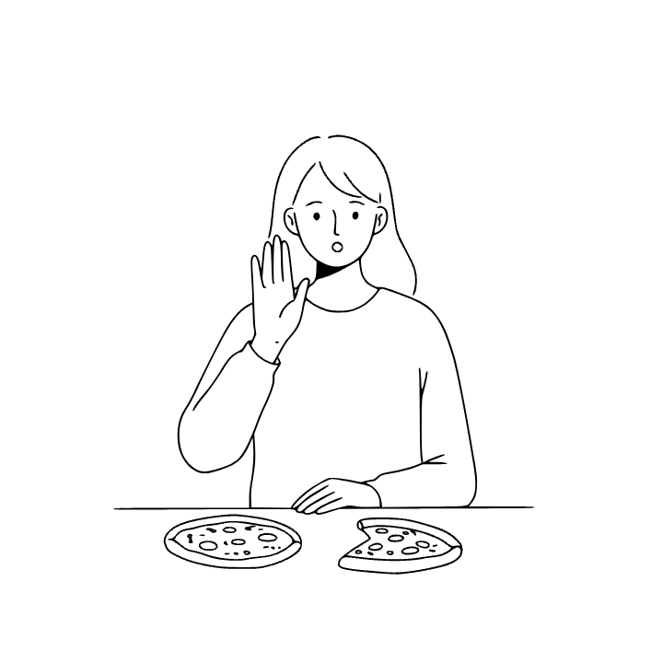
25th sentence
No, I do not like it.

Slide 54
No, I do not like it.
아니, 난 싫어해.

Slide 55
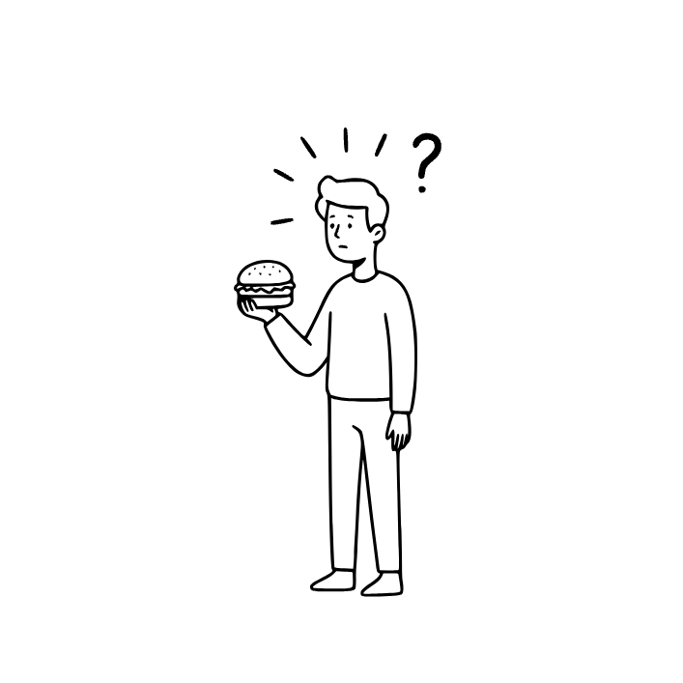
26th sentence
Do you like hamburgers?
keyword
hamburger

Slide 56
HAMBURGER
[hæ̀mbəːrgər]
햄버거
Do you like hamburgers?
햄버거 좋아하니?

Slide 57
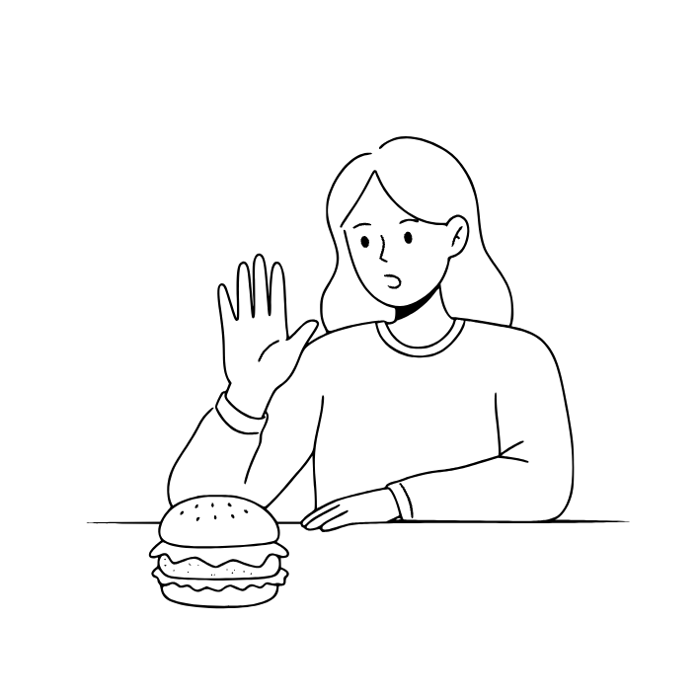
27th sentence
No, I don't like it.

Slide 58
No, I don't like it.
아니, 난 싫어해.

Slide 59
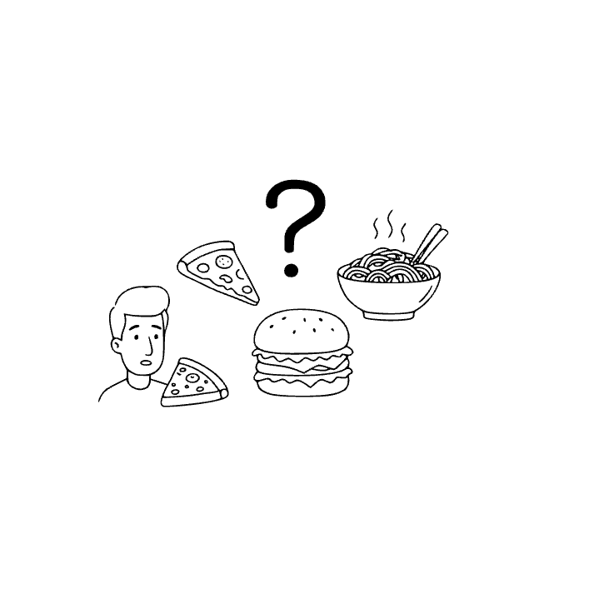

28th sentence
What's your favorite food?
keyword
favorite

Slide 60
FAVORITE
[féivərit]
가장 좋아하는, 마음에 드는
Do you like sports?
가장 좋아하는 음식이 뭐야?

Slide 61
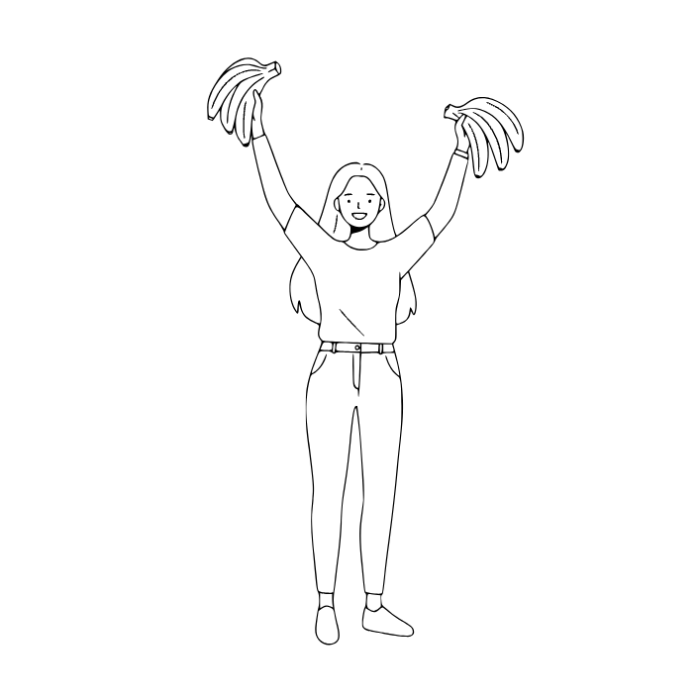
29th sentence
I like bananas.
keyword
banana

Slide 62
BANANA
[bənǽnə]
바나나
I like bananas.
난 바나나를 좋아해.

Slide 63
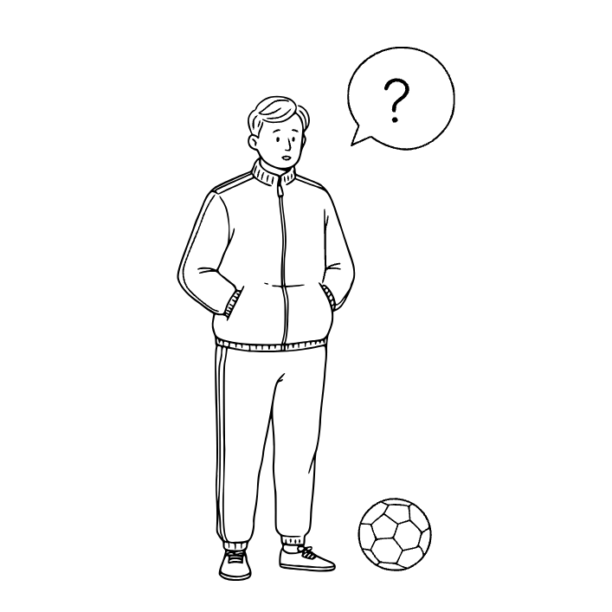
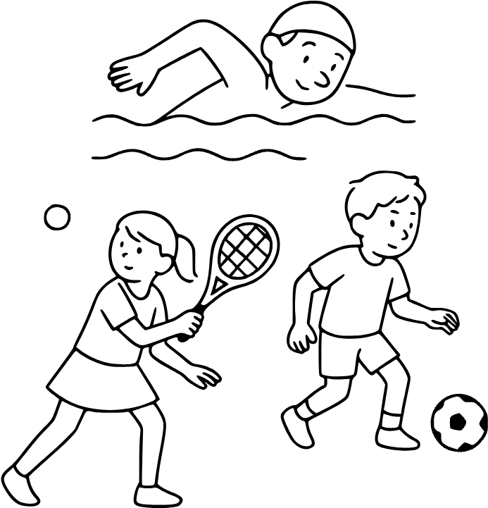
30th sentence
Do you like sports?
keyword
sport

Slide 64
SPORT
[spɔːrt]
스포츠, 운동
Do you like sports?
스포츠를 좋아하니?

Slide 65
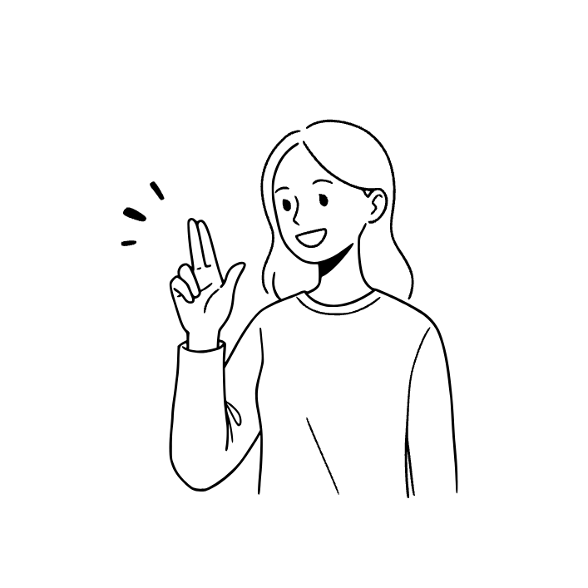
31th sentence
Yes, I do.

Slide 66
Yes, I do.
난 펜

Slide 67
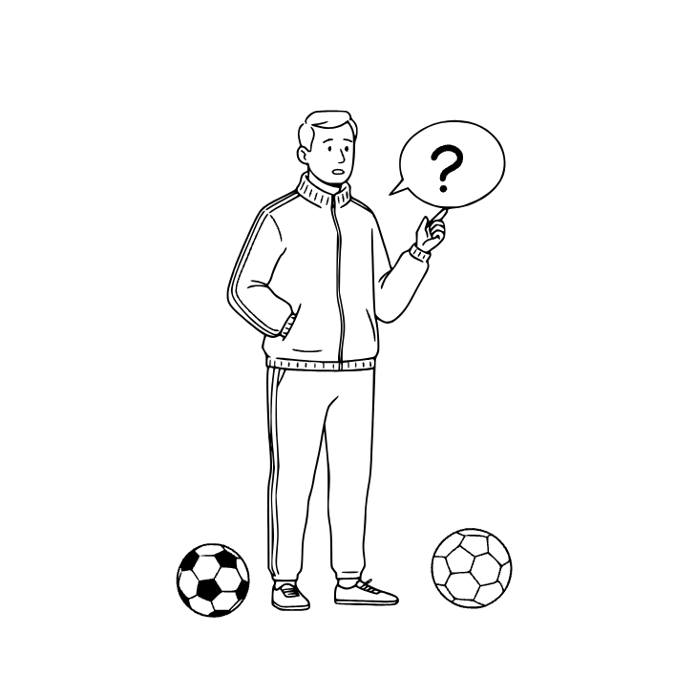
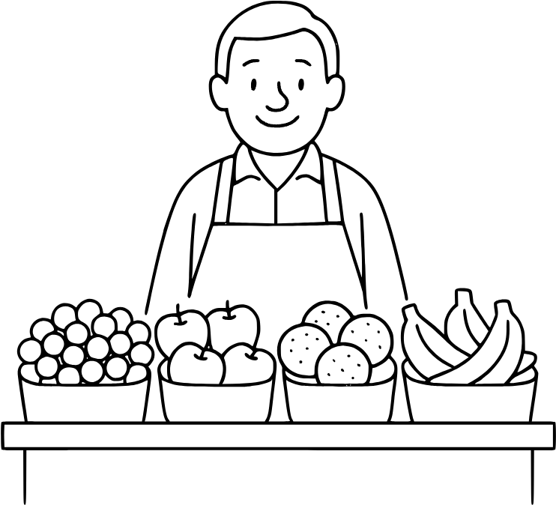
32th sentence
What kind of sport do you like?
keyword
kind

Slide 68
KIND
[kaind]
종류 / 친절한
(문맥에 따라 다르게 쓰임)
What kind of sport do you like?
어떤 종류의 스포츠를 좋아하니?

Slide 69
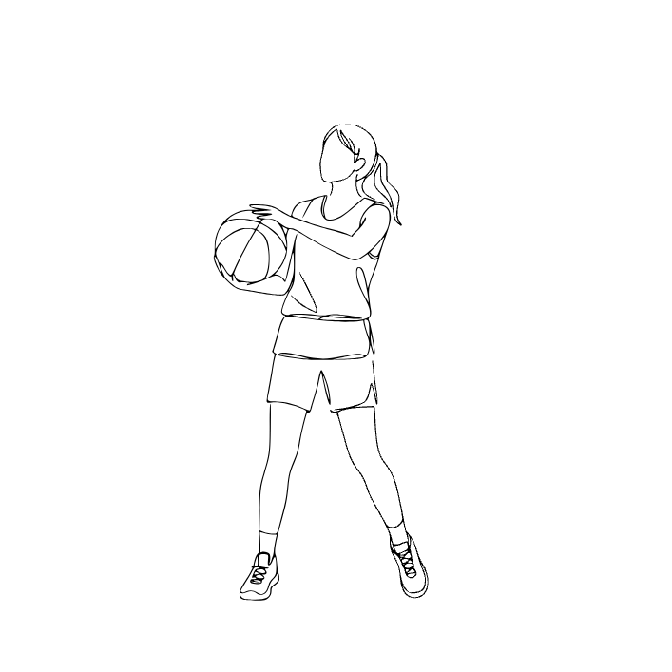
33th sentence
I like basketball.
keyword
basketball

Slide 70
BASKETBALL
[bǽskitbɔːl]
농구
I like basketball.
난 농구가 좋아.

Slide 71
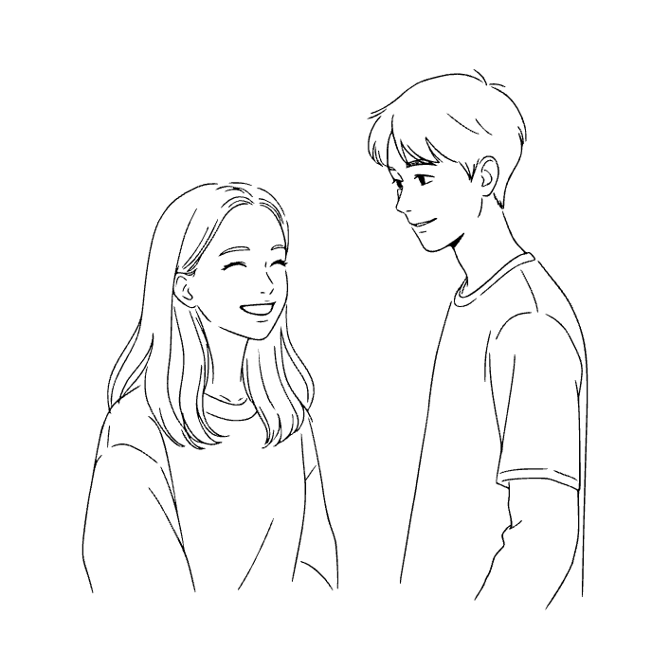
34th sentence
She likes me.
keyword
She

Slide 72
SHE
[ʃiː]
(영영사전) 뜻
She is used to talk about a girl or a woman. It replaces the name to avoid repetition. For example, 'This is Anna. She is kind.'
그녀
She likes me.
그녀는 나를 좋아한다.

Slide 73
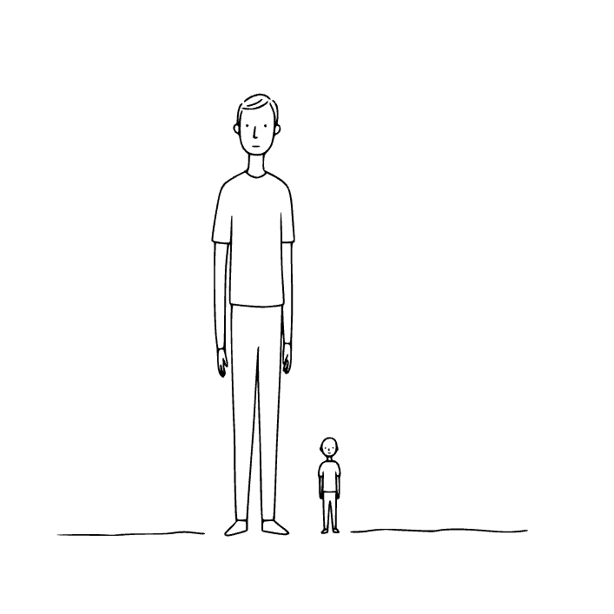
35th sentence
He is tall.
keyword
He

Slide 74
HE
[hiː]
(영영사전) 뜻
He is a word used instead of a man or boy’s name. For example, 'This is John. He is my friend.' It is a subject pronoun that helps avoid repeating names.
그 / 그 남자
He is tall.
그는 키가 크다.

Slide 75
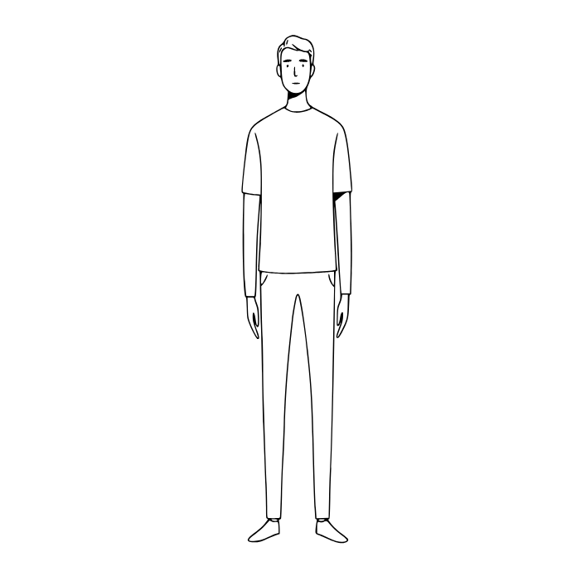
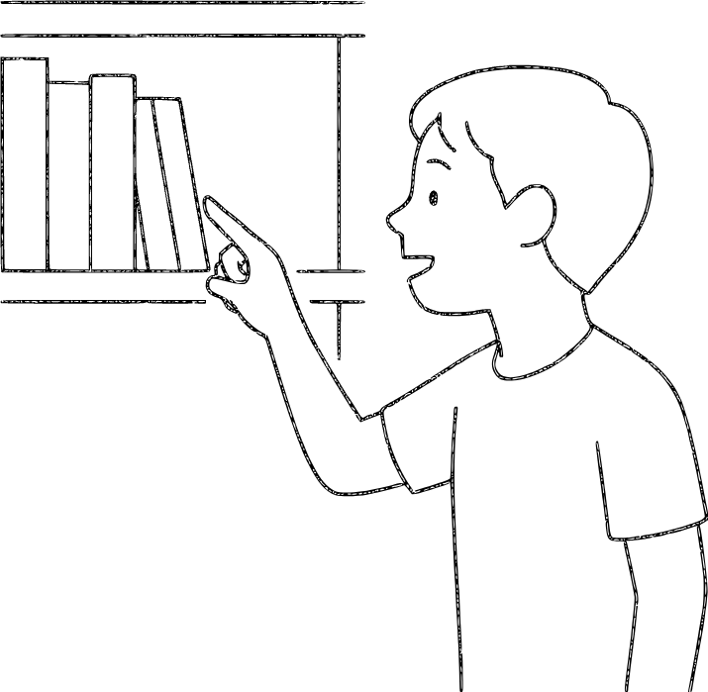
36th sentence
The man is tall.
keyword
The

Slide 76
THE
[ðə, ðiː]
(영영사전) 뜻
The is a word used before nouns to talk about something specific. For example, 'the dog' means one particular dog, not any dog. It helps make sentences more clear and exact.
그, 저
(정관사. 특정한 것을 가리킬 때 사용)
The man is tall.
그 남자는 키가 크다.

Slide 77
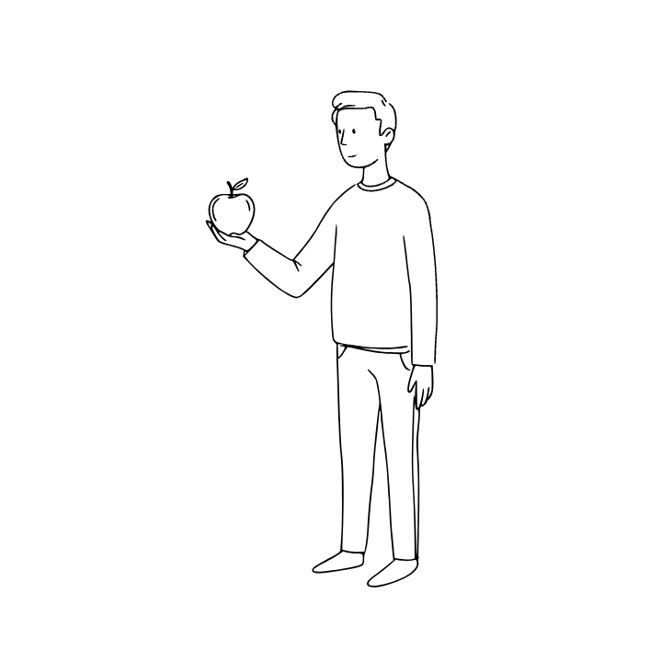
37th sentence
I have one apple.
keyword
one

Slide 78
ONE
[wʌn]
(영영사전) 뜻
One is the number 1. It can also mean a single person or thing, like 'one apple'. Sometimes it is used to replace a noun, as in 'This is a good one'.
하나, 1
I have one apple.
나는 사과 하나를 가지고 있다.

Slide 79
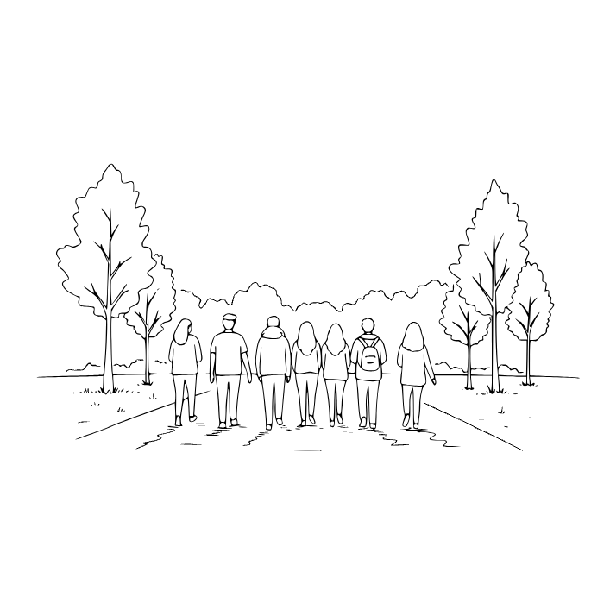
38th sentence
We are going to the park.
keyword
We

Slide 80
WE
[wiː]
(영영사전) 뜻
We means the speaker together with other people. It shows more than one person including yourself. For example, 'We are going to school' means you and others are going.
우리
We are going to the park.
우리는 공원에 간다.

Slide 81
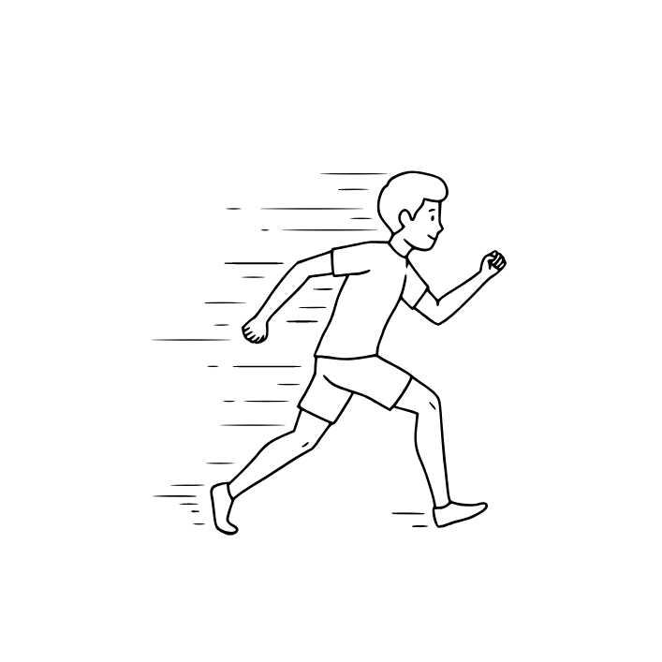
39th sentence
The boy runs fast.
keyword
boy

Slide 82
BOY
[bɔɪ]
(영영사전) 뜻
A boy is a male child. Boys can be sons, brothers, or classmates. They grow up to become men. Example: 'The boy is playing football.' The word is the opposite of girl.
소년, 남자아이
The boy runs fast.
그 소년은 빨리 달린다.

Slide 83
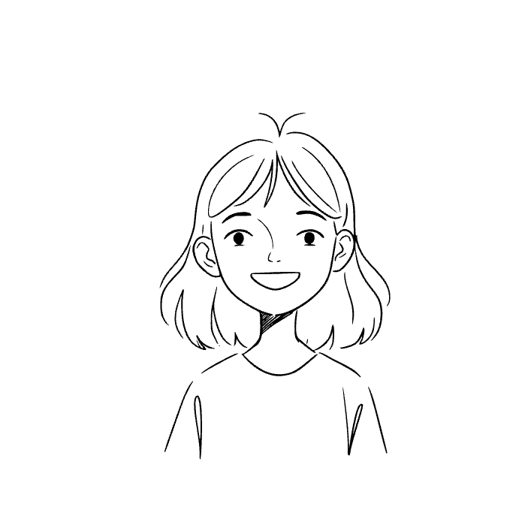
40th sentence
The girl is happy.
keyword
girl

Slide 84
GIRL
[ɡɜːrl]
(영영사전) 뜻
A girl is a female child or young woman. Girls can be daughters, sisters, or friends. They go to school, play, and learn just like boys. The word 'girl' is often used to talk about age before someone becomes a woman. Example: 'The girl is reading a storybook.'
소녀, 여자아이
The girl is happy.
그 소녀는 행복하다.

Slide 85
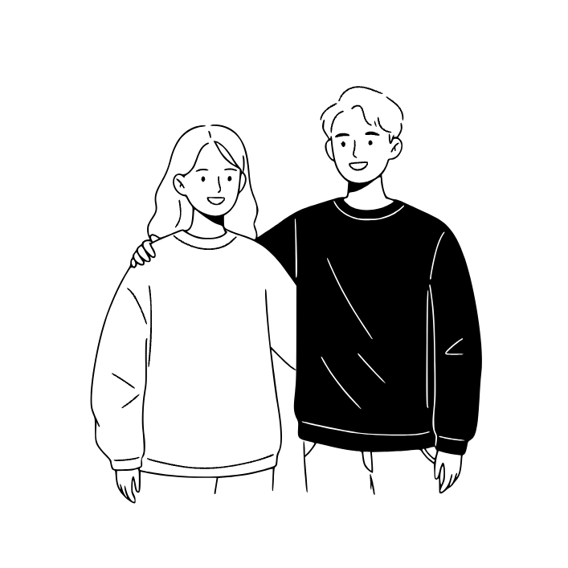
41th sentence
She is my friend.
keyword
friend

Slide 86
FRIEND
[frɛnd]
(영영사전) 뜻
A friend is a person you like and spend time with. Friends support and help each other. For example, 'My friend plays with me.'
친구
She is my friend.
그녀는 내 친구이다.

Slide 87
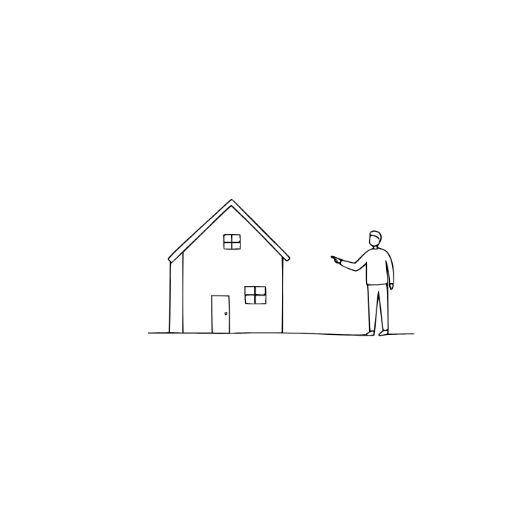
42th sentence
This is my house.
keyword
house

Slide 88
HOUSE
[haʊs]
(영영사전) 뜻
A house is a building where people live. It usually has rooms like a kitchen, bedroom, and bathroom. For example, 'My family lives in a house.'
집
This is my house.
여기는 내 집이다.

Slide 89
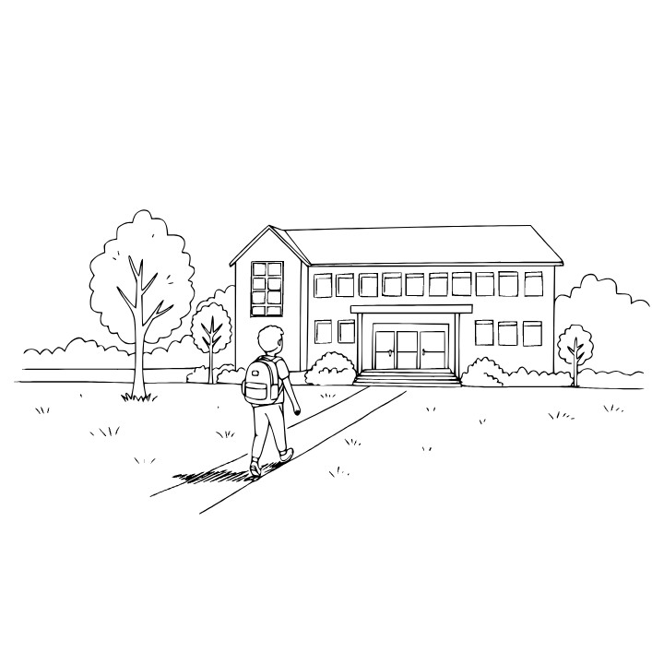
43th sentence
I go to school every day.
keyword
school

Slide 90
SCHOOL
[skuːl]
(영영사전) 뜻
A school is a place where children and students learn. Teachers help them study subjects like math, reading, and science. For example, 'I go to school every day.'
학교
I go to school every day.
나는 매일 학교에 간다.

Slide 91
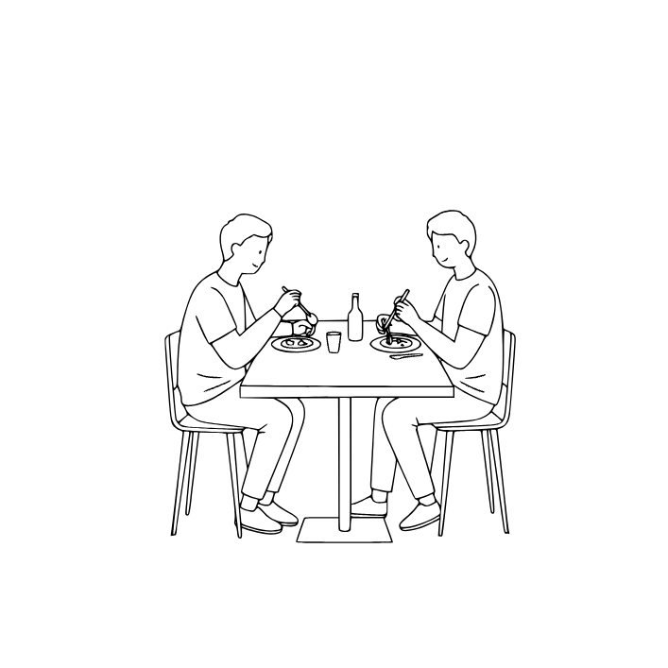
44th sentence
We eat lunch together.
keyword
eat

Slide 92
EAT
[iːt]
(영영사전) 뜻
Eat means to take food into your mouth and chew or swallow it. For example, 'I eat rice every day.' Eating gives your body energy to live and grow.
먹다
We eat lunch together.
우리는 함께 점심을 먹는다.

Slide 93
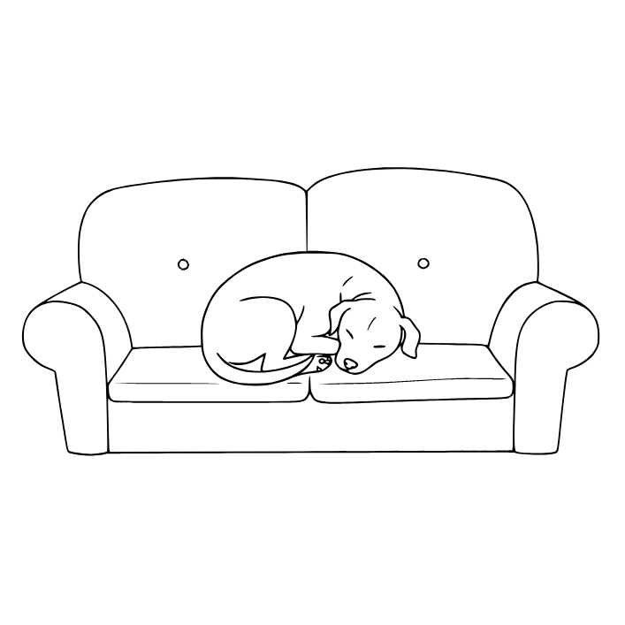
45th sentence
The dog is sleeping on the couch.
keyword
sleep

Slide 94
SLEEP
[sliːp]
(영영사전) 뜻
Sleep is the natural rest your body needs every night. During sleep, you close your eyes and your body recovers energy. Without enough sleep, people feel tired and cannot think or work well.
잠자다
The dog is sleeping on the couch.
그 개는 소파에서 자고 있다.

Slide 95
끝전

Slide 96
끝

