Slide 1
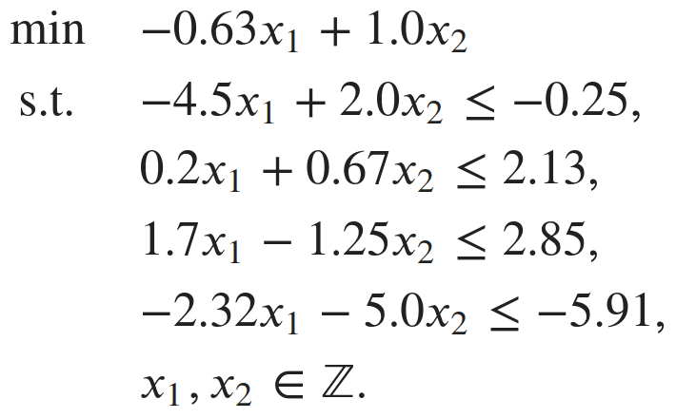
Algebraic and Graphical Representations of a MIP
x2
0.10
-0.26
-0.57
-0.89
x1
Legend
LP relaxation
Objective function
Relaxation solution
Feasible solution
Mip Wise - 2022

Slide 2
The goal is to close the MIP Gap
How do we solve a MIP?
x2
x1
Legend
LP relaxation
Objective function
Relaxation solution
Feasible solution
Mip Wise - 2022

Slide 3
The goal is to close the MIP Gap
How do we solve a MIP?
x2
Upper Bound (Primal bound)
MIP Gap
Lower Bound (Dual bound)
(x1, x2) = (2.0, 1.0)
(x1, x2) = (1.9, 0.3)
x1
Legend
LP relaxation
Objective function
Relaxation solution
Feasible solution
Mip Wise - 2022

Slide 4
Cutting planes
How do we solve a MIP?
x2
MIP Gap
(x1, x2) = (2.0, 1.0)
(x1, x2) = (1.9, 0.3)
x1
Legend
LP relaxation
Objective function
Relaxation solution
Feasible solution
Mip Wise - 2022

Slide 5
Cutting planes
How do we solve a MIP?
x2
Upper Bound (Primal bound)
MIP Gap
Lower Bound (Dual bound)
(x1, x2) = (2.0, 1.0)
(x1, x2) = (2.4, 1.0)
x1
Legend
LP relaxation
Objective function
Relaxation solution
Feasible solution
Mip Wise - 2022

Slide 6
Cutting planes
How do we solve a MIP?
x2
Upper Bound (Primal bound)
MIP Gap
Lower Bound (Dual bound)
(x1, x2) = (2.0, 1.0)
(x1, x2) = (2.4, 1.0)
x1
Legend
LP relaxation
Objective function
Relaxation solution
Feasible solution
Mip Wise - 2022

Slide 7
Cutting planes
How do we solve a MIP?
x2
Upper Bound = Lower Bound
(x1, x2) = (2.0, 1.0)
x1
Legend
LP relaxation
Objective function
Relaxation solution
Feasible solution
Mip Wise - 2022

Slide 8
Perfect formulation
How do we solve a MIP?
x2
Upper Bound = Lower Bound
(x1, x2) = (2.0, 1.0)
x1
Legend
LP relaxation
Objective function
Relaxation solution
Feasible solution
Mip Wise - 2022

Slide 9
Branch & Bound
How do we close the MIP gap?
Node 0
z = -0.89
(x1, x2) = (1.9, 0.3)
x2
x1 ≤ 1
x1 ≥ 2
Node 1
Node 2
-0.89
(x1, x2) = (1.9, 0.3)
x1
Legend
LP relaxation
Objective function
Relaxation solution
Feasible solution
Mip Wise - 2022

Slide 10
Branch & Bound
How do we close the MIP gap?
Node 0
z = -0.89
(x1, x2) = (1.9, 0.3)
x2
x1 ≤ 1
x1 ≥ 2
Node 1
Node 2
z = -0.81
(x1, x2) = (2.0, 0.45)
x2 ≤ 0
x2 ≥ 1
Node 3
Node 4
Infeasible
-0.81
(x1, x2) = (2.0, 0.45)
x1
Legend
LP relaxation
Objective function
Relaxation solution
Feasible solution
Mip Wise - 2022

Slide 11
Branch & Bound
How do we close the MIP gap?
Node 0
z = -0.89
(x1, x2) = (1.9, 0.3)
x2
x1 ≤ 1
x1 ≥ 2
Node 1
Node 2
z = -0.81
(x1, x2) = (2.0, 0.45)
x2 ≤ 0
x2 ≥ 1
Node 3
Node 4
z = -0.51
-0.51
Infeasible
(x1, x2) = (2.4, 1.0)
x1 ≤ 2
x1 ≥ 3
Node 5
Node 6
(x1, x2) = (2.4, 1.0)
x1
Legend
LP relaxation
Objective function
Relaxation solution
Feasible solution
Mip Wise - 2022

Slide 12
Branch & Bound
How do we close the MIP gap?
Node 0
z = -0.89
(x1, x2) = (1.9, 0.3)
x2
x1 ≤ 1
x1 ≥ 2
Node 1
Node 2
z = -0.81
(x1, x2) = (2.0, 0.45)
x2 ≤ 0
x2 ≥ 1
Node 3
Node 4
-0.26
Infeasible
z = -0.51
-0.30
(x1, x2) = (2.4, 1.0)
x1 ≤ 2
x1 ≥ 3
Node 5
z = -0.26
Node 6
(x1, x2) = (2.0, 1.0)
(x1, x2) = (2.0, 1.0)
x1
Legend
LP relaxation
Objective function
Relaxation solution
Feasible solution
Mip Wise - 2022

