Slide 1


Bulletproof Data Validation
Workshop – Mar 2023
Copyright 2022 Mip Wise LTDA

Slide 2
Sources of Decision Making
Traditional
Consulting
Applications
Off-the-shelf
Software
Copyright 2022 Mip Wise LTDA

Slide 3
Components and Features of an App
Input Data
Engines
Output Data
Reliability
Performance
Usability
Reusability
Adaptability
Accuracy
Copyright 2022 Mip Wise LTDA

Slide 4

Reliability is Mandatory
Client Skepticism
Developer Responsibility
“Clients would rather stay with a problem than using a solution they don’t trust.”
Copyright 2022 Mip Wise LTDA

Slide 5





ProJeans Use Case*
Procurement Cost: Jeans Pants
Cost ($)
USA
Mexico
Egypt
Bangladesh
41,690
28,400
20,405
$3,350/container
$7,950/container
$4,650/
container
Order
Size
3,500
5,000
8,000
Procurement Cost: Jeans Jackets
Cost ($)
Container Capacity: 2,400 units.
29,350
21,745
Demand
Minimum Order Quantity
13,000
Jeans Pants | 12,000
Jeans Jacket | 6,000
 | Bangladesh | Egypt | Mexico
Jeans Pants | 1000 | 1500 | 1000
Jeans Jacket | 1500 | 1000 | 500
Order
Size
2,000
3,500
5,000
* https://www.mipwise.com/use-cases/projeans
Copyright 2022 Mip Wise LTDA

Slide 6


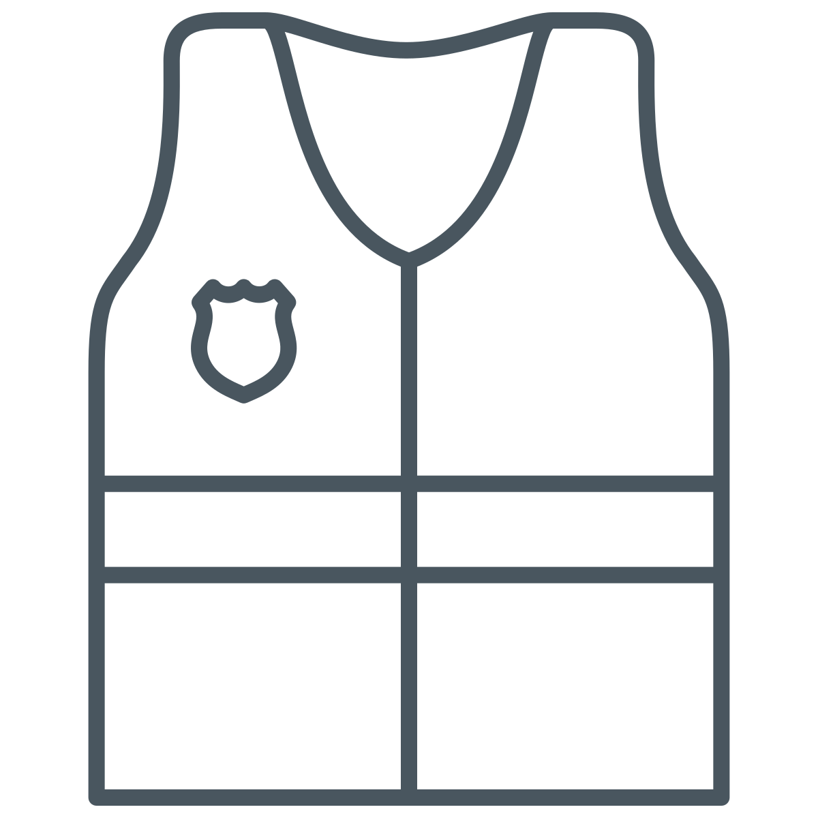
Apply TTS* to Build Reliable Solutions
Tidy
What: Code
Responsibility: Developer
Tested
Safe
What: Data
Responsibility: Developer & User
https://ttspython.org/
Copyright 2022 Mip Wise LTDA

Slide 7

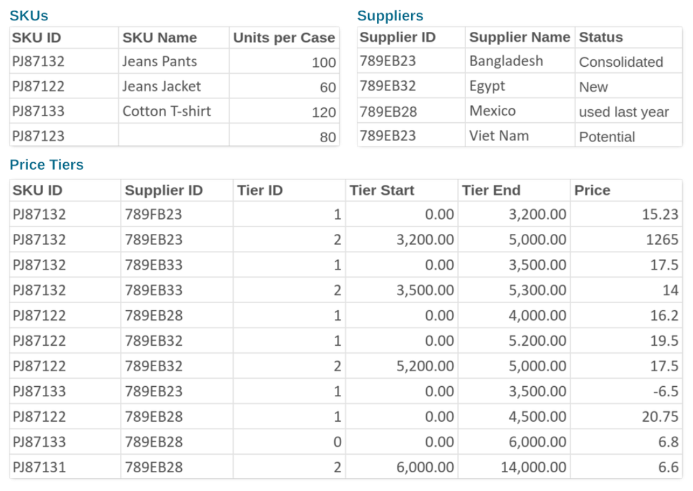
Bulletproof Data Validation
Ineffective:
Predict and Catch
Effective:
Set the rules
(for user AND developers)
Copyright 2022 Mip Wise LTDA

Slide 8

The ticdat Python Package
Makes it easy to set the rules
Standardizes data reading, writing, and converting
Streamlines usage of data inside applications
Offers an elegant way to define and use user parameters
Provides automated data checking and failure reports
Peter Cacioppi
20+ years of industry experience
Alternatives:
- SQLAlchemy
- Django
- Cerberus
- Schema
Copyright 2022 Mip Wise LTDA

Slide 9
Keep it Going!
Summary
Resources
Reliable decision making support starts with safe data
Safe data obeys well-defined rules, agreed by developers and users
Developers must provide ways to identify and help fixing bad data
The ticdat package makes it easy to adopt best practices
Mip Go
  https://github.com/mipwise/mip-go
  https://github.com/mipwise/mip-go/tree/main/5_develop/4_data_schema
Mip Template
  https://github.com/mipwise/mip_template
  https://github.com/mipwise/mip_template/blob/master/mip_template/schemas.py
Copyright 2022 Mip Wise LTDA

Slide 10



THANK
YOU.
Supporting optimal enterprise
decision-making.
Florianópolis – SC - Brazil

