Slide 1


GAME PROGRAM
Nguyễn Minh Quan – ITITIU18271
Bành Quang Long – ITITIU18199

Slide 2

TOOLS

Slide 3
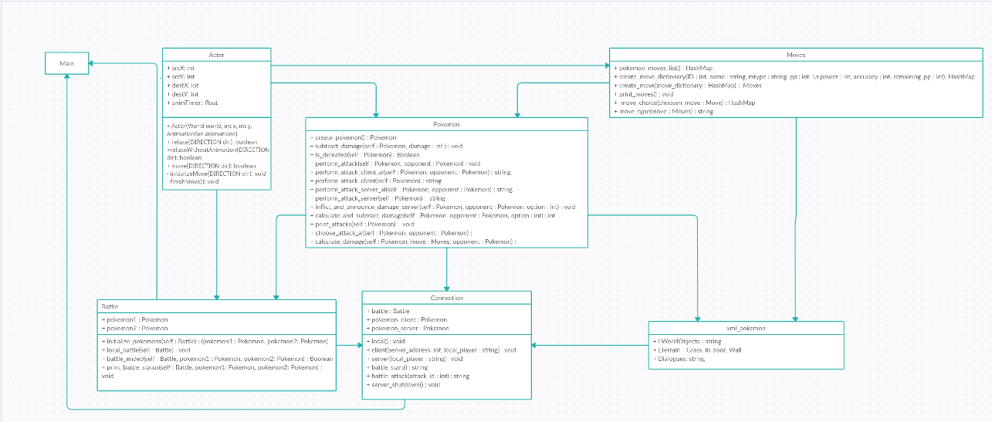
CLASS DIAGRAM

Slide 4
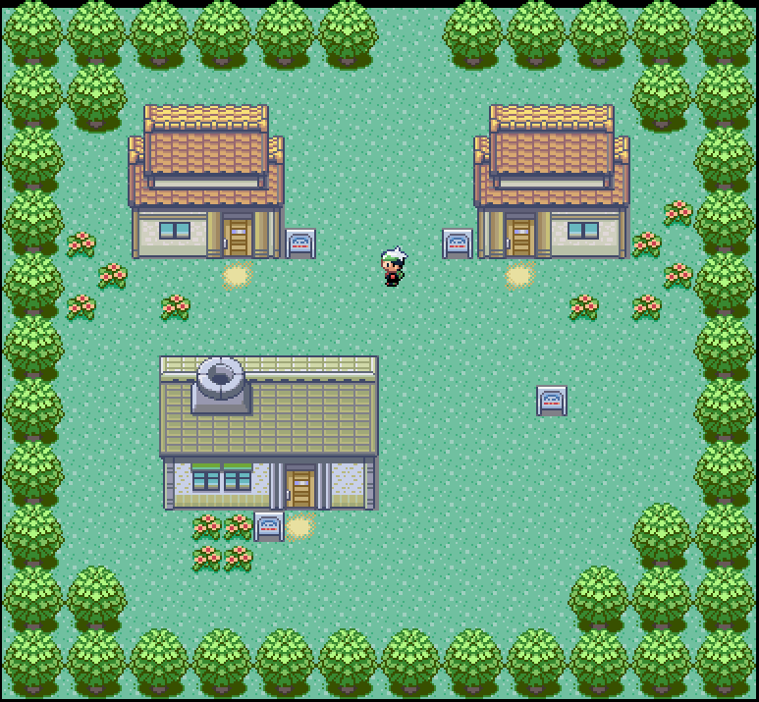
PROJECT TASKS
Map design
Player: information, movement
Game character:
Animation
Information: name, age, health,…
Battle technique:
Name of attack, damage, …
Battle 2v2, team-up,…

Slide 5
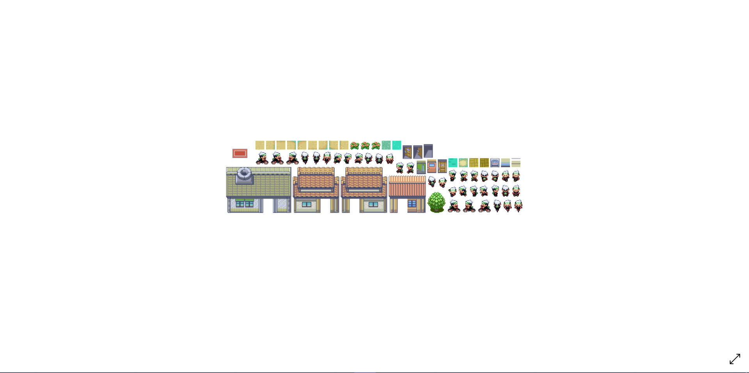
MAP DESIGN
Create Box2D
Add image (houses, trees, flowers,...)

Slide 6
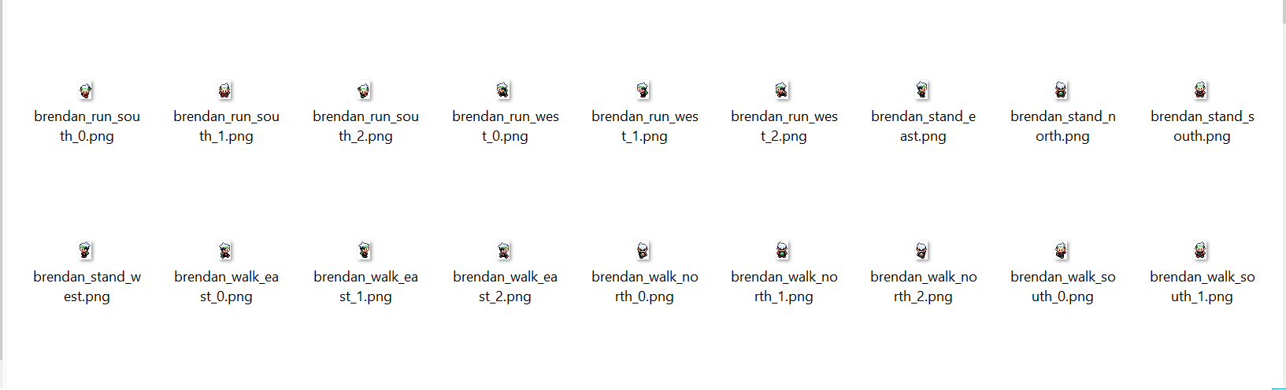
CHARACTER
Movement: left, right, up , down

Slide 7
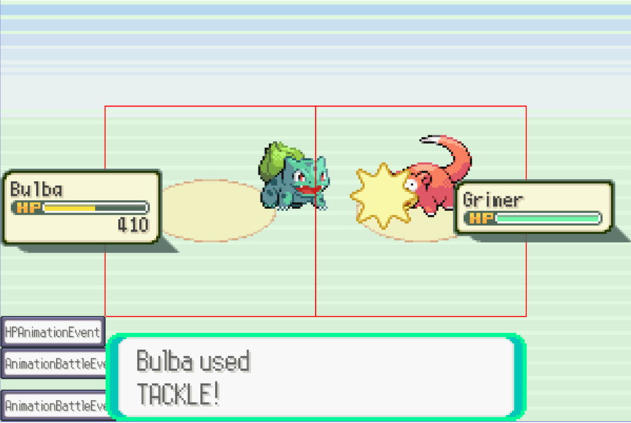
Future
Add more NPCs, pokemon fight
Add menu Play/Pause
Add more maps, house,...

Slide 8
THE END.

