Slide 1

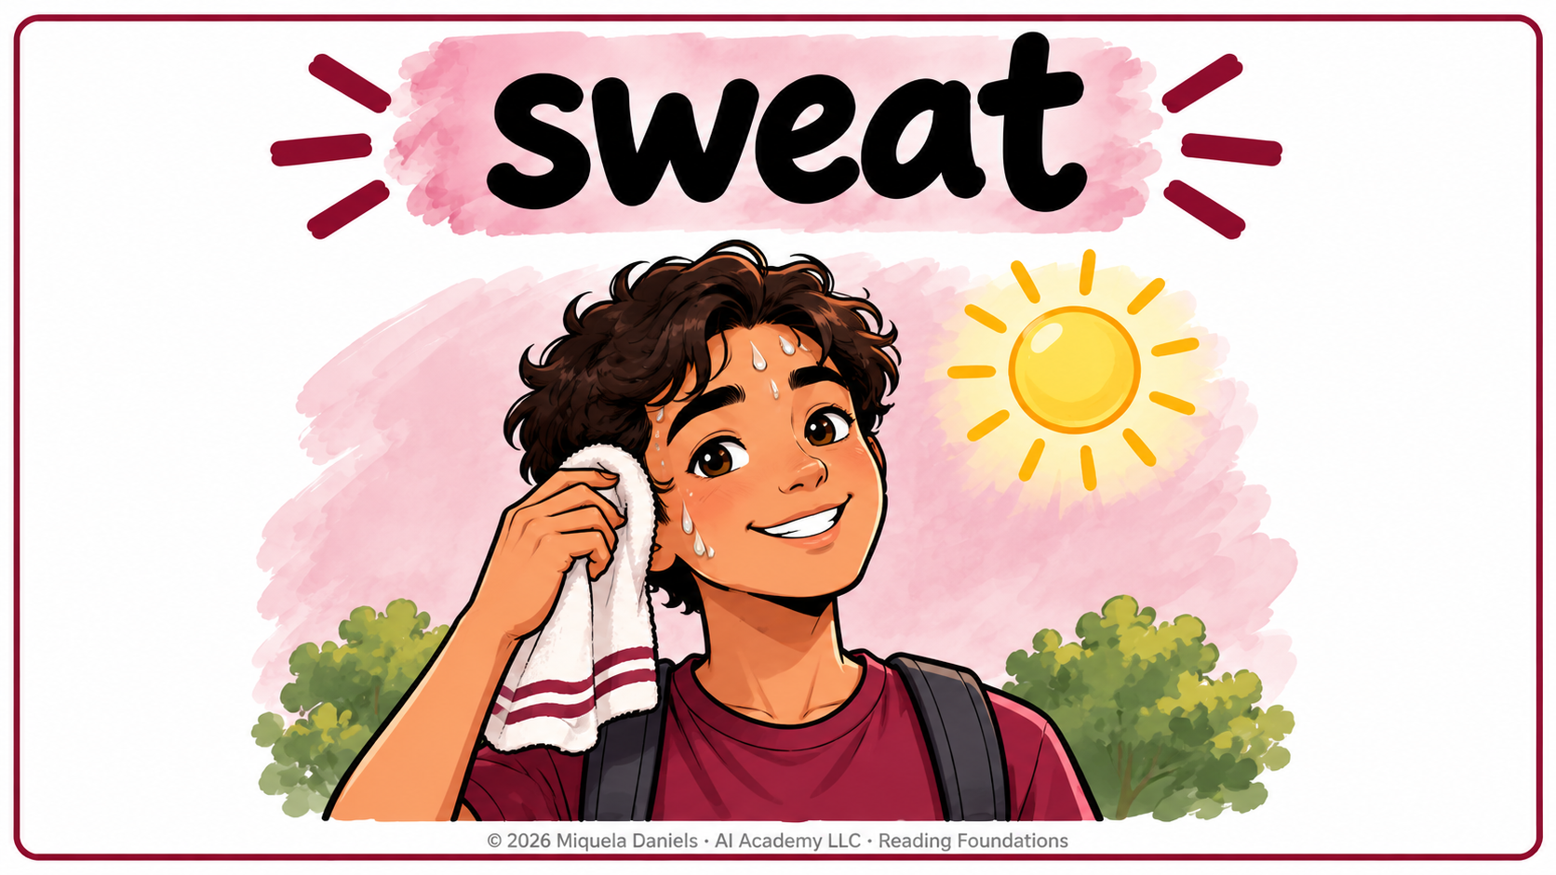




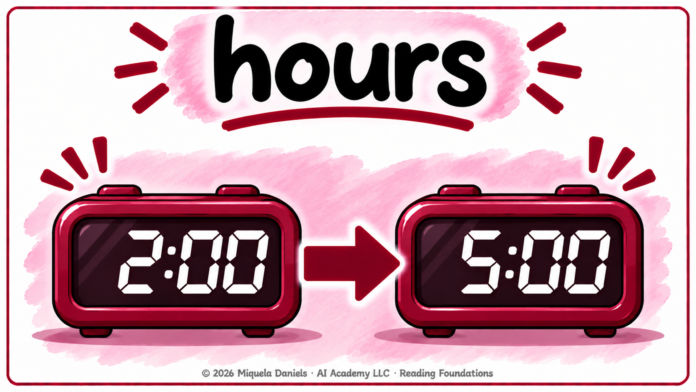

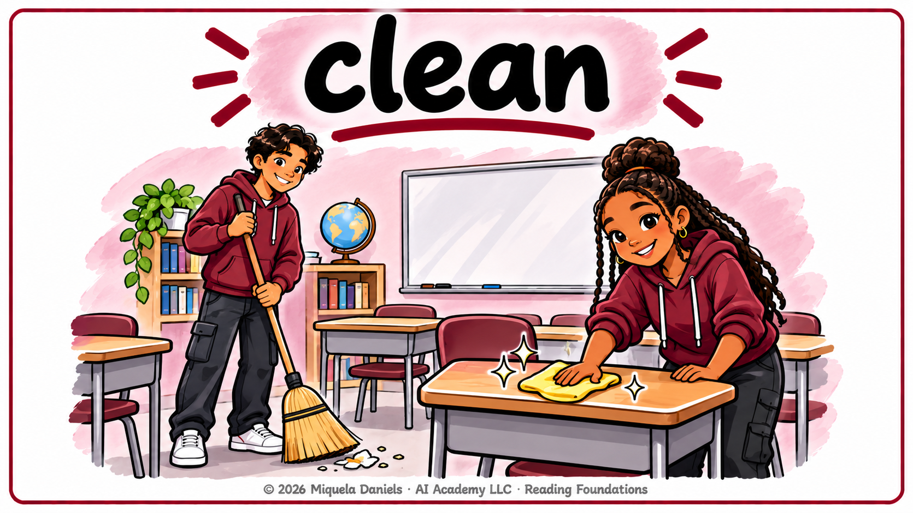



© 2026 Miquela Daniels · AI Academy LLC · Reading Foundations · Proprietary — do not copy or distribute
Notes:
Teacher: Extra vocabulary for Grade 1 Passages 1.1 Water, 1.2 Your Phone, and 1.3 Schools Are Not All the Same. Teach the 3 words for a passage right before students read it. Live option: click through and teach each word out loud (script is in each slide's notes). Student option: use Record > From Beginning, read each slide's script, then Export > Export to Video and post it in Canvas.

Slide 2
Notes:
Passage 1.1 · Water
SAY: "sweat." (pause)
SAY: "Sweat is water that comes out of your skin when you are hot." (point to the picture)
SAY: "When it is hot, you sweat and lose water."
SAY: "Your turn. Say: sweat." (wait 3 seconds, then go to the next slide)

Slide 3
Notes:
Passage 1.1 · Water
SAY: "body." (pause)
SAY: "Your body is all of you, from your head to your feet." (point to the picture)
SAY: "Your body is more than half water."
SAY: "Your turn. Say: body." (wait 3 seconds, then go to the next slide)

Slide 4
Notes:
Passage 1.1 · Water
SAY: "bottle." (pause)
SAY: "A bottle holds water or other drinks." (point to the picture)
SAY: "Look at your water bottle."
OPTIONAL: "En español: botella."
SAY: "Your turn. Say: bottle." (wait 3 seconds, then go to the next slide)

Slide 5
Notes:
Passage 1.2 · Your Phone
SAY: "text." (pause)
SAY: "A text is a short message you send on a phone." (point to the picture)
SAY: "You can use it to call, text, and look up words."
OPTIONAL: "En español: texto."
SAY: "Your turn. Say: text." (wait 3 seconds, then go to the next slide)

Slide 6
Notes:
Passage 1.2 · Your Phone
SAY: "pictures." (pause)
SAY: "A picture shows what someone or something looks like." (point to the picture)
SAY: "You can also use it to take pictures."
SAY: "Your turn. Say: pictures." (wait 3 seconds, then go to the next slide)

Slide 7
Notes:
Passage 1.2 · Your Phone
SAY: "hours." (pause)
SAY: "An hour is 60 minutes." (point to the picture)
SAY: "Some people look at their phone for more than five hours a day."
OPTIONAL: "En español: horas."
SAY: "Your turn. Say: hours." (wait 3 seconds, then go to the next slide)

Slide 8
© 2026 Miquela Daniels · AI Academy LLC · Reading Foundations · Proprietary — do not copy or distribute
Notes:
Passage 1.3 · Schools Are Not All the Same
SAY: "uniform." (pause)
SAY: "A uniform is the same clothes that everyone at a school or job wears." (point to the picture)
SAY: "In Mexico, many kids wear a uniform."
OPTIONAL: "En español: uniforme."
SAY: "Your turn. Say: uniform." (wait 3 seconds, then go to the next slide)

Slide 9
Notes:
Passage 1.3 · Schools Are Not All the Same
SAY: "clean." (pause)
SAY: "To clean means to make a place neat, with no dirt or trash." (point to the picture)
SAY: "In Japan, kids help clean their school each day."
SAY: "Your turn. Say: clean." (wait 3 seconds, then go to the next slide)

Slide 10
© 2026 Miquela Daniels · AI Academy LLC · Reading Foundations · Proprietary — do not copy or distribute
Notes:
Passage 1.3 · Schools Are Not All the Same
SAY: "bell." (pause)
SAY: "A bell rings to tell you it is time." (point to the picture)
SAY: "Here, kids go from class to class when the bell rings."
SAY: "Your turn. Say: bell." (wait 3 seconds, then go to the next slide)

